Slide 1
Web Programming 2
2 – Advanced features

Slide 2
Using multiple backgrounds
Why have a boring single background when you can have multiple ones!
To do so, simply use the background attributes as usual, but put the items one after the other, separated by commas
e.g.
background-image: url(./st.jpg), url(./bg.jpg);
background-size:4em auto, 100% 100%;
background-position: bottom right, 0 0;
background-repeat: no-repeat, no-repeat;

Slide 3
Changing the display style
We already have seen the display property with values
none (hides the item)
inline (default, which places items in a line, useful on lists)
There are other interesting display options
Block
Allows you to treat the item as an individual block, will automatically break around it
Inline-block
Puts item as a block but on the same line as previous item
table
Displays the element as a table

Slide 4
Using Flexible Boxes (or Flexbox)
This is one of those cool things that is not fully implemented, has endured countless changes since first proposed in 2009
There are about 3 different types of syntax:
Pre-2009
Mid-2011
Mid-2012 (→We’ll study this one)
OK, that’s good and all, but what is flexbox?
It is a way to organize items in a container in a more “flexible” way than using float, tables, grids, or other things you may have seen
First things first: make the container be a flexbox container
display: flex; // you may need to pre-pend –ms- or –webkit-
Can also use inline-flex

Slide 5
Flex Properties
Pick the direction of the box
flex-direction: column; // or row, row-reverse, column-reverse
Should the flow be fixed or break when needed?
flex-wrap: wrap; // or nowrap, wrap-reverse
Shorthand version:
flex-flow: row wrap; // combines direction & wrap

Slide 6
Understanding Flex Terminology
Flex container
Container that holds the items to be positioned
Flex item
Item placed inside the container
Main axis/dimension
Main axis along which items are positioned, extends to main dimension
Main start/end
Items are placed starting on main start and heading to main end
start could be at the bottom or the right
Main size / size property
Flex item’s size (height/width) in the direction of the dimension is the main size. Size property height/width is the same direction as the dimension (vertical/horizontal)
Cross axis/dimension/start/end/size/size property
It is the perpendicular to the main
A “cross” start/end defines a flex line or column

Slide 7
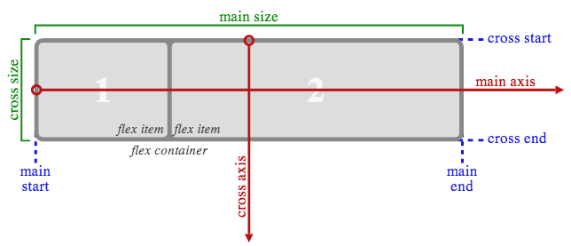
Example on a “row” flex

Slide 8
Behavior
A flex container will act as a block that maintains its flex items as you decide to
Float items will not enter the flex container
You can set the overflow attribute as with block containers
Since it is NOT a block, some attributes will not work in it
All multi-column support
float/clear (though your flex container could be float)
vertical-align
::first-line ::first-letter
Don’t go around fixing the position of the flex items, they’ll be placed by the flex container
You can use order to change the position
If you want to have the set of items centered in the container, give them auto margins
The flow will always adjust based on the natural text order
e.g. In Japanese, with writing-mode: vertical-rl; a flex-flow: row wrap will make columns from right to left. The same flex-flow with writing-mode: horizontal-tb; will do rows from left to right.

Slide 9
Hiding/Moving Flex Items
Rather than using display:none which essentially removes the item, or visibility: none which keeps a blank block, use visibility: collapse
This ensures that the cross-size remains stable regardless of which item is hidden
The default value of order will always be 0.
A negative order will be shown first
A higher number will be shown last
If orders are equal they are in code-order
Be aware that using collapse or reordering the items will only affect the visual output, and will not alter the logical code order. You can use this to ensure that the site functions correctly for the blind
On the down side, if you use tab to navigate, your focus will be flying all over the place

Slide 10
Taking advantage of Flex
With the attribute flex you can make a flex item take up the entire unused space
Simply do flex: 1; to make the item “flexible”
A flex of auto will make all items share all the space available on the line
Combining this with “order” should allow you to reorganize your code in a much cleaner way!
Content first!
Then navigation
Banners and other unimportant things last

Slide 11
Other flex attributes
flex-basis
Sets the “initial” main size of the flex item before free space is distributed
flex-shrink
Takes a number (default being 1) with the shrink factor of a flex item
The number represents a ratio compared to other items
0 means no shrink
2 means shrink twice as much as those with 1
flex-grow
Takes a number (default being 1) with the grow factor
Like shrink but when growing
Can be set up with shorthand form
flex: <grow> <shrink> <basis>

Slide 12
Typical Flex values
flex: 0 auto; or flex: initial;
Makes the item shrinkable but not growable
flex: auto;
Seen earlier, shares the extra free space, which is absorbed evenly by “auto” flex items
flex: none;
Same as 0 0 auto. Items become inflexible
flex: <positive number>;
Same as flex: <number> 1 0px;

Slide 13
Aligning your flex items
You can play around with your margin
You could have items sharing the space with an auto margin (which is assumes 0 if your items take up the free space)
Could be used to position items right or left of a flexbox
Check the example shown in class
You can also justify-content
flex-start
Items packed towards the start of the line
flex-end
Items packed towards the end of the line
center
Items packed towards the center
space-between
Any empty space is split up between items, but not before first or after last
space-around
Any empty space is split around all items.

Slide 14
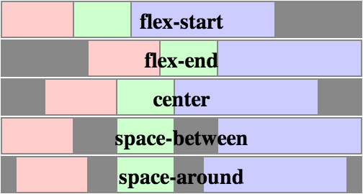
Illustration of justify-content

Slide 15
Using align-items and align-self
Instead of relying on margins for alignment, use these 2 attributes
The previous attributes helps the alignment in the cross axis, but to align in the perpendicular direction (main axis) use align-self or align-items
flex-start / flex-end / center / baseline / stretch
Use align-items to set the default for all items
Use align-self to overwrite the default behavior
See picture on next slide

Slide 16
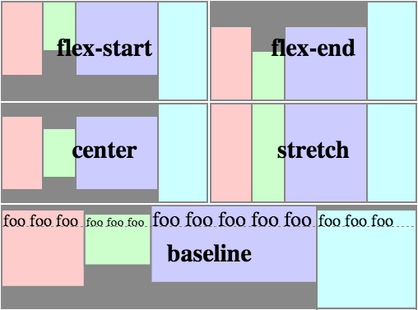
Illustration of align-self

Slide 17
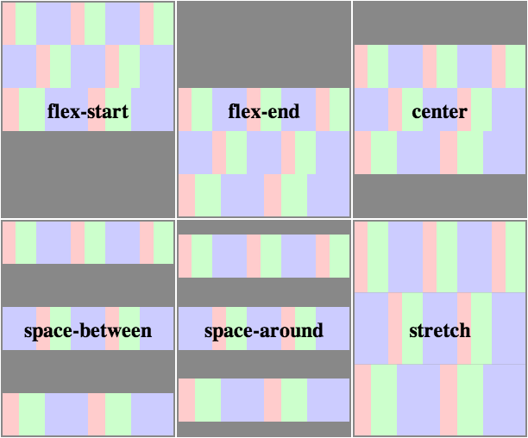
Using align-content
Similar to justify-content but using the cross axis if there are more than a single line of content
Takes the same attributes as justify-content

Slide 18
Using the grid
Another new approach of layouts is the use of grids
This is another one of those properties that has been completely revamped in the past few months (or should I say weeks)
Background:
The regular floating items, tables (yuk), or other classic layout technique tends to be too volatile when sizes change, and doing proper media queries for all scenarios can be a burden
Once solution is the flexboxes we just saw
You can also use grids, which make repositioning of items much easier than traditional techniques
Idea
Break up your site into a set of columns and rows, and decide on grid areas that fit those lines. Then simply assign content to specific grid areas

Slide 19
To be continued…
Turns out it is not yet supported in many browsers, so we’ll delay this a bit. (Current draft is from Jan 24 2014)
Currently 10.6% of browser versions out there support it… And by that I mean, only MSIE 10, 11 and mobile…
Flexboxes are however fully supported! though require the prefix -webkit- or -ms- in some browsers (even MSIE 11 supports it without -ms-)

Slide 20
Using Transitions
Transitions are a nice way to create animations without needing complex JS or JQ to do it
Simply change 2 attributes and decide how quickly you want to transition from one to the other
Use 4 properties to decide on how it will behave
transition-property
Decides which attribute(s) will be affected by the transition
transition-duration
How long will it take to transition?
transition-timing-function
Should it accelerate? Slow down? Be steady?
transition-delay
How long before it starts?
Or use transition: property duration timing delay

Slide 21
Transition Property
That attribute could be any of the following
none (if you want to stop transitioning)
all (to transition all changes)
type1, type2, type3 (to enumerate a list of attributes to transition)
The list of animatable properties is huge, so just assume that anything you may want to change can be animated
http://www.w3.org/TR/css3-transitions/#animatable-properties-
(For the full list)

Slide 22
Transition Timing Function
You can use the simple ones
ease, linear, ease-in, ease-out, ease-in-out, step-start, step-end
Or go crazy with your Math hats on
steps(number, [start | end])
cubic-bezier(num, num, num, num)
etc etc
You should probably find enough to play around with the basic ones
The delay and duration are set in seconds (with a default value of 0s) or milliseconds (s or ms behind your number)
Negative delays are also accepted
In those cases it will start when normally triggered, but “catch up” in the animation as if it had started that amount of time earlier
e.g. A duration of 5s with delay of -3 will have the animation last 2 seconds and start on the 3rd second of the normal animation

Slide 23
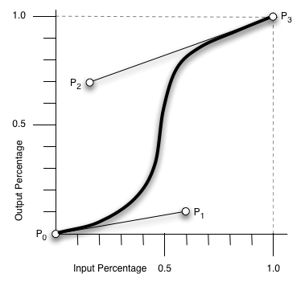
Understanding Cubic Bezier
Basically, your P0 and P3 points are always fixed at 0,0 and 1,1 respectively
Now pick where p1 and p2 are, and voila!
Set the attributes as p1.x, p1.y, p2.x, p2.y

Slide 24
More fun in motion: Transforms!
Transforms allow you to move, rotate, scale, skew, etc etc any item on your page
Combine this with transitions for really cool effects!
You can put multiple transforms at once, but don’t go to crazy
We don’t want transforms to become the “animated gifs” of the 2010s
transform: function()
As usual, you may have to do –moz- -webkit- -o- or –ms-
Webkit is currently the only one supporting 3D transforms

Slide 25
The functions
none
Useful to stop transforms
matrix(n,n,n,n,n,n) matrix3d(n,n,n,n,n,n,n,n,n,n,n,n,n,n,n,n)
2d and 3d matrix transformations with 6 or 16 (4x4) values
translate(x,y) translate3d(x,y,z)
Moves the item through 2 or 3 dimensions
translateX(x) translateY(y) translateZ(z)
Same as translate(x, 0), translate(0, y), translate(0,0,z) respectively
scale(x,y) scale(x,y,z) scaleX(x) scaleY(y) scaleZ(z)
Grow/shrink an item. 1 means 100%, 0.5 means 50%, etc etc
rotate(angle)
Angle written as x deg (e.g. 90deg). Calculated as a counter-clockwise rotation when using positive numbers
rotate(x,y,z,angle) rotateX(angle) rotateY(angle) rotateZ(angle)
3D rotation
skew(x-angle, y-angle) skewX(angle) skewY(angle)
Skews your item
perspective(n)
Defines the perspective view for a 3D transformed item

Slide 26
Useful reference/help sites
Want to make nice gradient background? No problem!
Learn to do it manually, or use this site
http://gradients.glrzad.com/
Other useful sites to use as reference
http://leaverou.github.com/animatable/ (for animations)
http://www.canisue.com (to check the current state of new features and possible need of prefixes)

