Slide 1
Simple Parallel Calibration and 3D Reconstruction
in Real-Timefor RGB-D Cameras
Dr. Lau, advisor
Dr. Hastings, committee member
Dr. Cheung, committee member
Presented By: Sen Li

Slide 2
Outline
Introduction
Academic Background:
Pinhole Camera Model (Camera calibration / 3D reconstruction)
Kai’s per-pixel 3D reconstruction on GPU
Inspiration
Natural GPU Calibration and Reconstruction Method:
Calibration system
Calibration procedures
Undistorted 3D Reconstruction
Conclusion

Slide 3
Introduction
Goal: given a RGB-D camera, show undistorted 3D
reconstruction with color (RGB) on GPU
Camera: KinectV2
Streams:
Depth, NearIR: 424 * 512 ; RGB : 1080 * 1920
Plan:
determine best-fit calibration system
choose corresponding parallel (on GPU) calibration method
build models in demand
calibrate and reconstruct

Slide 4
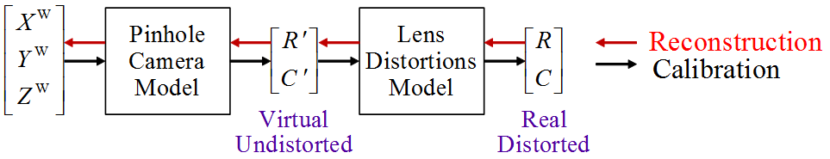
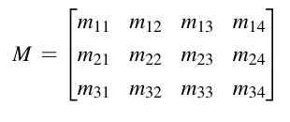

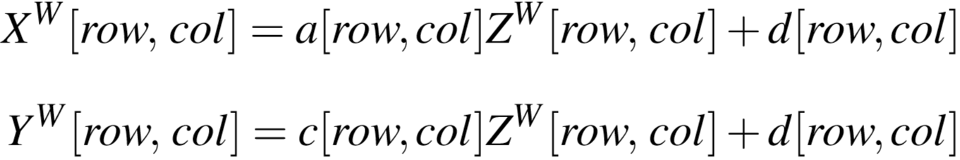

Academic Background
Pinhole-Camera Model
(Reconstruction and Calibration)
Kai’s [1] : A Natural Parallel Reconstruction
Inspiration: find a way to get per-pixel
Notes:
Note that, in Kai’s work only offers an inspiration for parallel processing, did not offer a complete calibration method, because he did not offer the method to get Zw.

Slide 5
Pinhole-Camera Model
based calibration and reconstruction
Pinhole Camera Model
Derive Pinhole Camera Matrix
Solve Pinhole Camera Matrix
Lens Distortion
Solve Lens Distortion
Notes:
Note that, in Kai’s work only offers an inspiration for parallel processing, did not offer a complete calibration method, because he did not offer the method to get Zw.

Slide 6
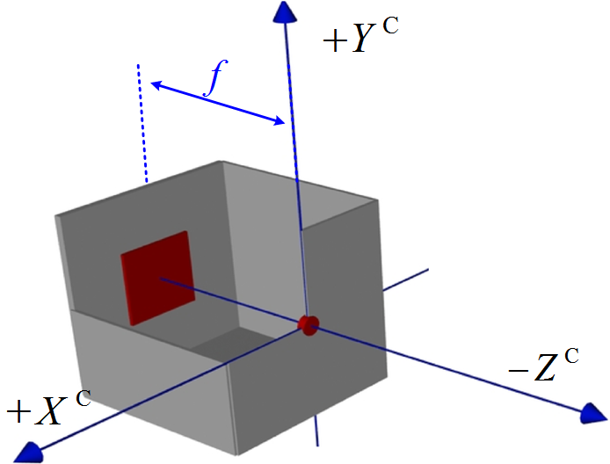
Pinhole-Camera Model
Pinhole Camera

Slide 7
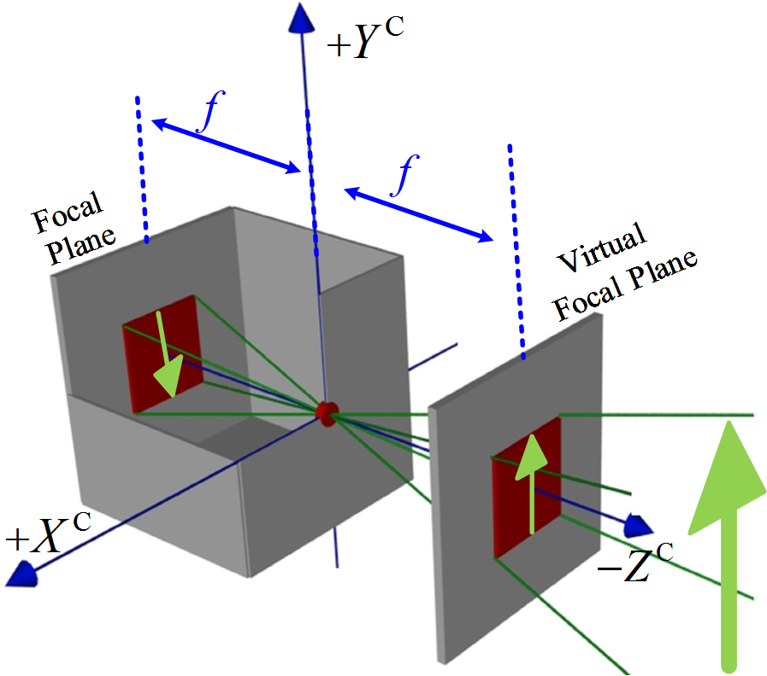
Pinhole-Camera Model
Virtual Focal Plane
of a Pinhole Camera

Slide 8
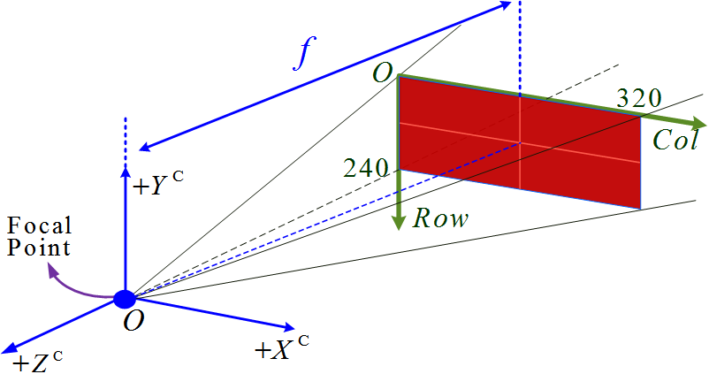
Pinhole-Camera Model
Common Pinhole Camera Model

Slide 9
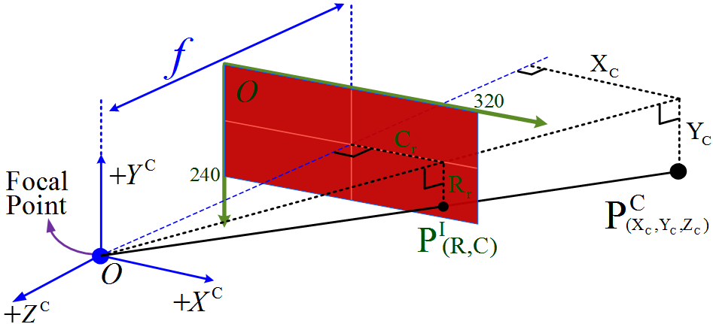

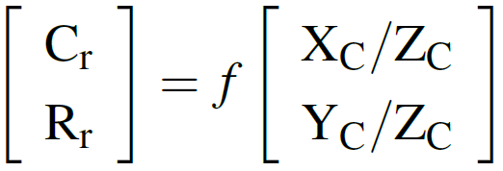
Pinhole-Camera Model
from Camera Space to Image Space

Slide 10

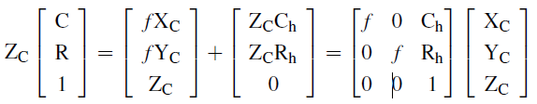
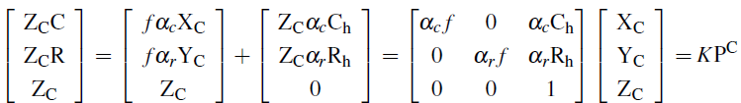
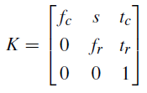
Pinhole-Camera Model
from Camera Space to Image Space
Intrinsic Matrix

Slide 11
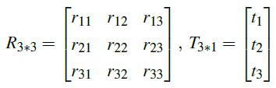
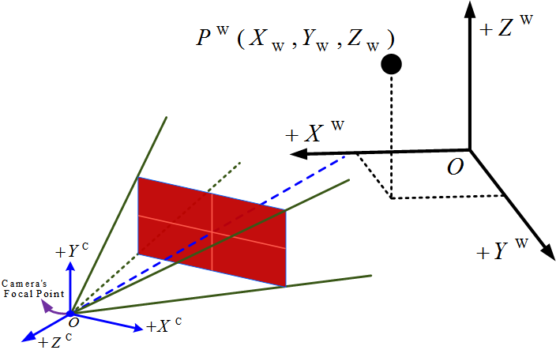
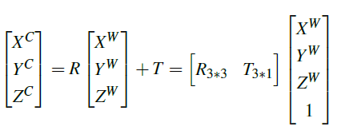

Pinhole-Camera Model
from World Space to Camera Space
Extrinsic Matrix

Slide 12
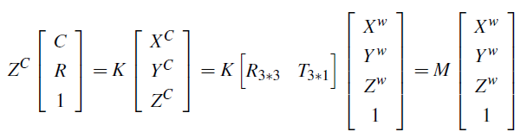
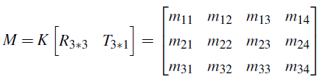
Pinhole-Camera Model
Pinhole Camera Matrix M
Intrinsic Matrix
Extrinsic Matrix
Pinhole Camera Matrix :

Slide 13

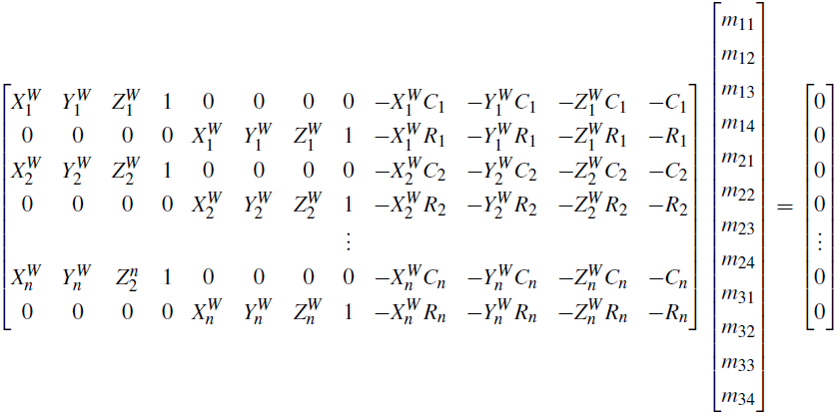
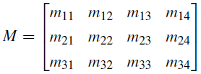
Pinhole-Camera Model
based calibration and reconstruction
with 1 point:
Solve
Pinhole
Camera
Matrix
with n points:
Homogeneous system, always has all zeros solution
Select

Slide 14
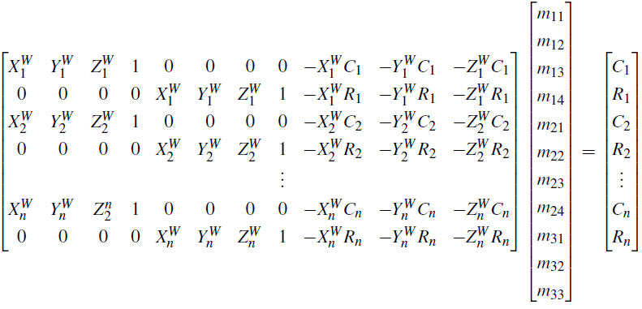
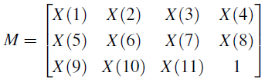
Pinhole-Camera Model
based calibration and reconstruction
Solve
Pinhole
Camera
Matrix
with n points:
pseudo inverse
to determine a best-fit

Slide 15
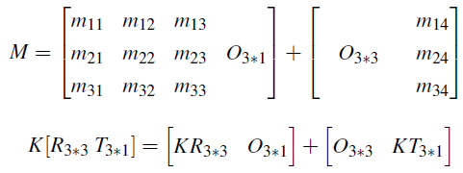
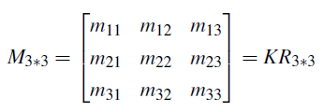




Pinhole-Camera Model
based calibration and reconstruction
Recover Intrinsic and Extrinsic Camera Matrix
Intrinsic Matrix
Extrinsic Matrix
K: upper triangular matrix
: orthogonal
RQ decomposition

Slide 16
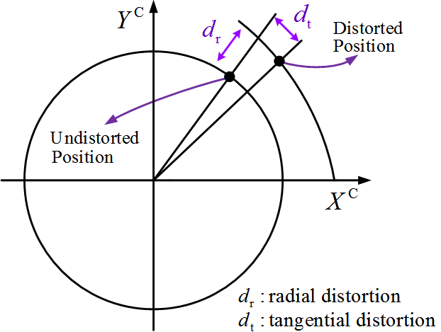
Pinhole-Camera Model
based calibration and reconstruction
Lens Distortion

Slide 17
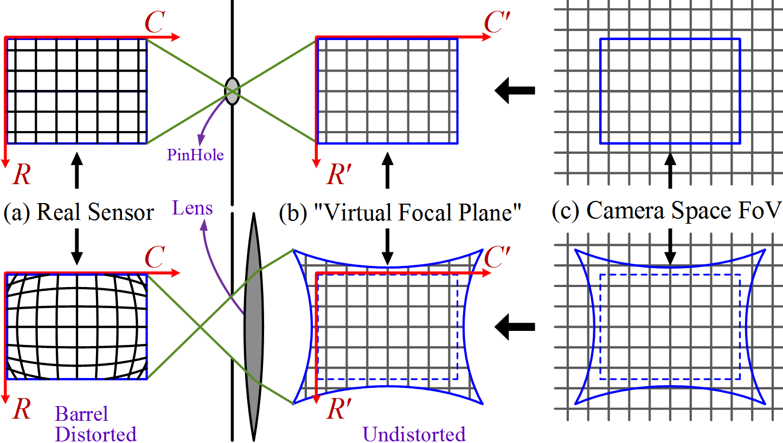
From Camera Space to Image Space with Lens Distortions

Slide 18
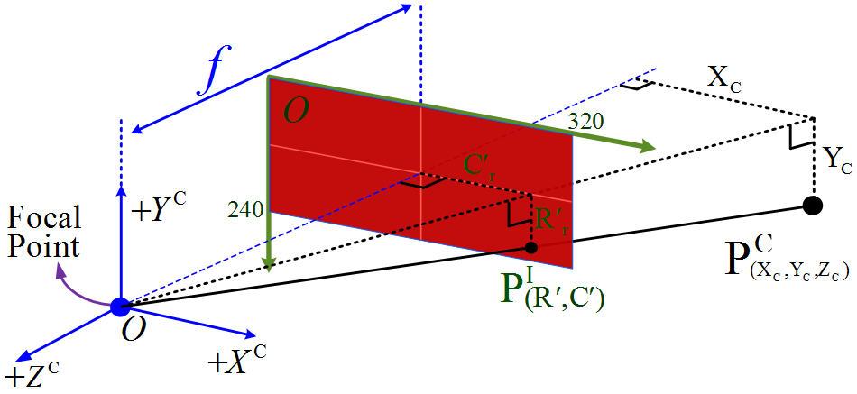



from Camera Space to Image Space Considering Lens Distortions
Solve Lens Distortions
Distortion Parameters:

Slide 19
Academic Background
Pinhole-Camera Model
(Reconstruction and Calibration)
Kai’s [1] : A Natural Parallel Reconstruction
Inspiration: Per-pixel 3D reconstruction
Notes:
Note that, in Kai’s work only offers an inspiration for parallel processing, did not offer a complete calibration method, because he did not offer the method to get Zw.

Slide 20
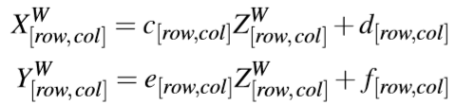
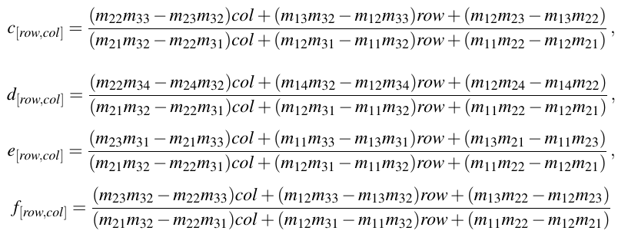
Academic Background
Kai’s [1] inspiration: Natural Parallel Reconstruction
Inspiration: get per-pixel $D$-$Z^{W}$ mapping, such that do per-pixel 3D reconstruction
Notes:
Note that, in Kai’s work only offers an inspiration for parallel processing, did not offer a complete calibration method, because he did not offer the method to get Zw.

Slide 21
Outline
Introduction
Academic Background:
Pinhole Camera Model (Camera calibration / 3D reconstruction)
Kai’s per-pixel 3D reconstruction on GPU
Inspiration
Natural GPU Calibration and Reconstruction Method:
Calibration system
Calibration procedures
Undistorted 3D Reconstruction
Conclusion

Slide 22
Natural GPU Calibration and Reconstruction
Calibration System
Calibration Procedures
Undistorted 3D Reconstruction
Calibration system
Calibration procedures
Undistorted 3D reconstruction
Notes:
Note that, in Kai’s work only offers an inspiration for parallel processing, did not offer a complete calibration method, because he did not offer the method to get Zw.

Slide 23
Questions?

