Slide 1
Ahmed Ayman Ahmed Okka.
Advanced maker diploma.
American embassy.

Slide 2
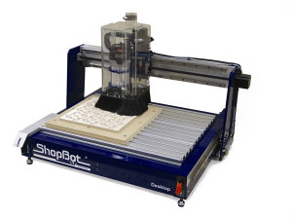
Identification of our project
I intend to make a CNC machine to be as my startup.

Slide 3
Identification of our project
First of all I try to know what is the market need around me.
During my conversation with some one who has a mirrors workshop I knew that he is in need to a machine that replaces his hand made work so when we reach that point I started thinking why not to do it my self as a first CNC machine in my life then moving to other ones that also in the market need.

Slide 4
Identification of our project
So our project will be a CNC machine that plates transparent glass to make it a silver plated mirrors.
The first thing I did it is to know every single detail in the hand made process for this mirrors manufactures and by that way I got the first paper of the processes needed to manufacture those mirrors.

Slide 5
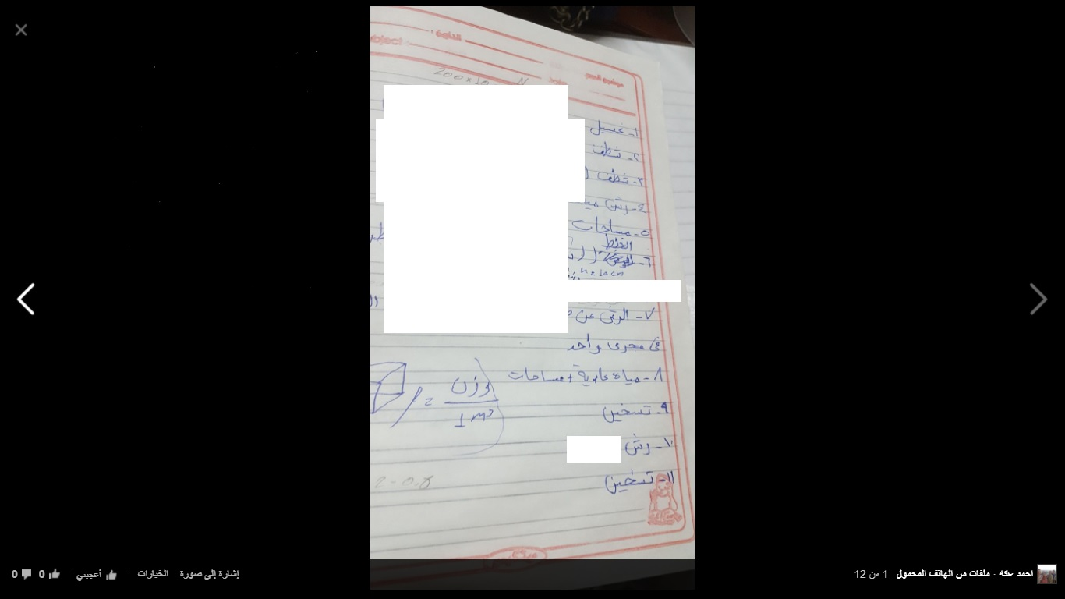
Identification of our project

Slide 6
Identification of our project
After that paper I could know what is the operations I can make in this manufacture process so I started to think of some machine that can do this operation while I still was a blank in that field.

Slide 7
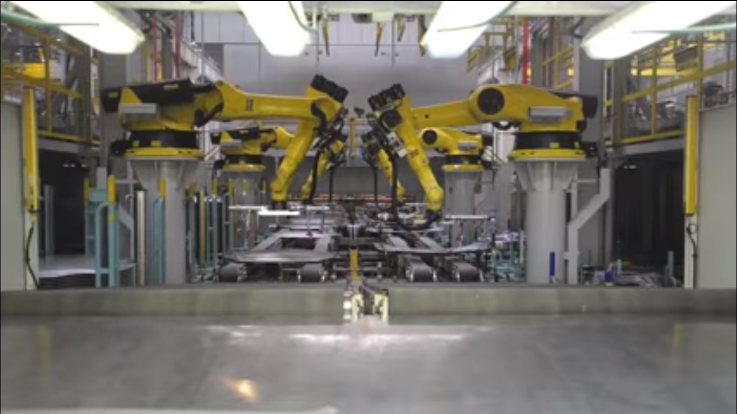
Design stages and development
First of all I stated thinking of a robotic arm factory something bigger than my abilities which I couldn’t recognize at that time, I started thinking of some thing like that in the picture.

Slide 8
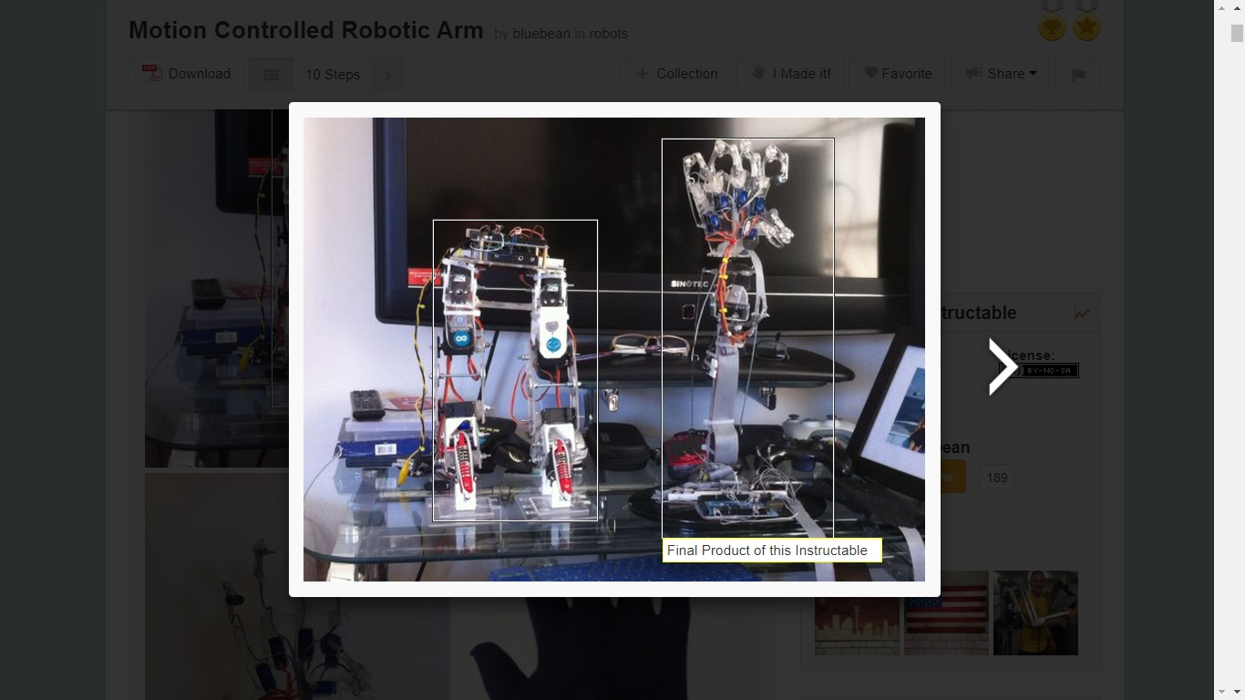
Design stages and development
So I started thinking of a robotic arm as a prototype to learn first how to make a robotic arm then somehow I can make that machine.
So this is the first project I start studying it to make it.

Slide 9
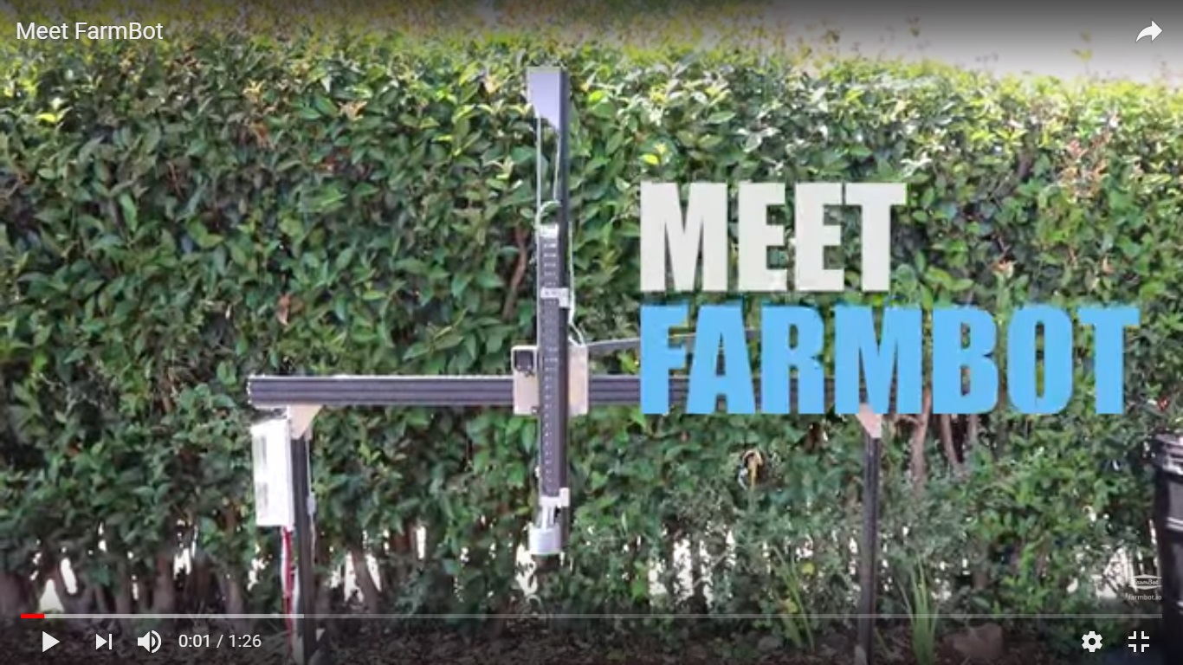
Design stages and development
After that I meet farmbot in the fourth session in the diploma during our discussion about projects for me it was somehow exactly what I need.

Slide 10
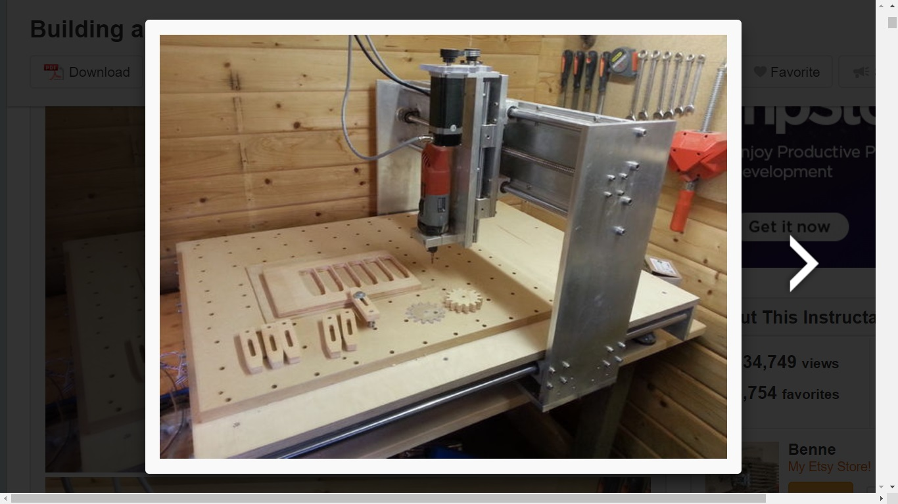
Design stages and development
So for the first time I started to know CNC.
First I searched instructables for a CNC project to know some ideas about that topic and I choosed that project.

Slide 11
Design stages and development
When I started to do that project no one comment on my idea somehow they were thinking that I know every thing about it but when I start to talk everyone get astonished that someone who didn’t know anything about the topic try to make a CNC.
First of all I knew that I must start designing my project prototype on solidworks so I started learning solidworks that I wasn’t able to do anything in it before except extrusion.

Slide 12
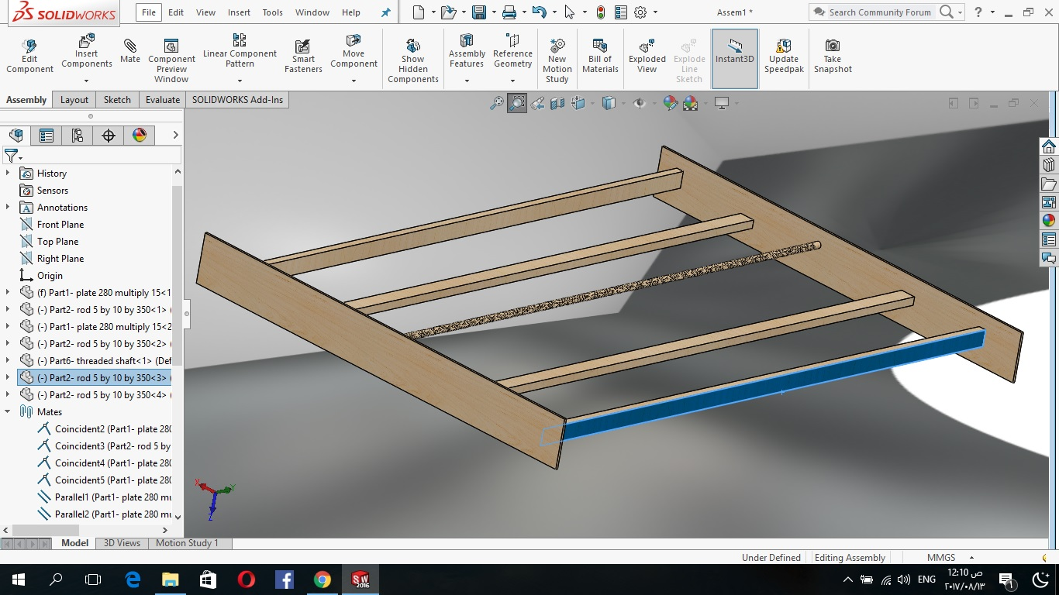
Design stages and development
I coordinated with the lab that I will do that project in wood so I choose a design based on screws and rods as the x-axis section here view.

Slide 13
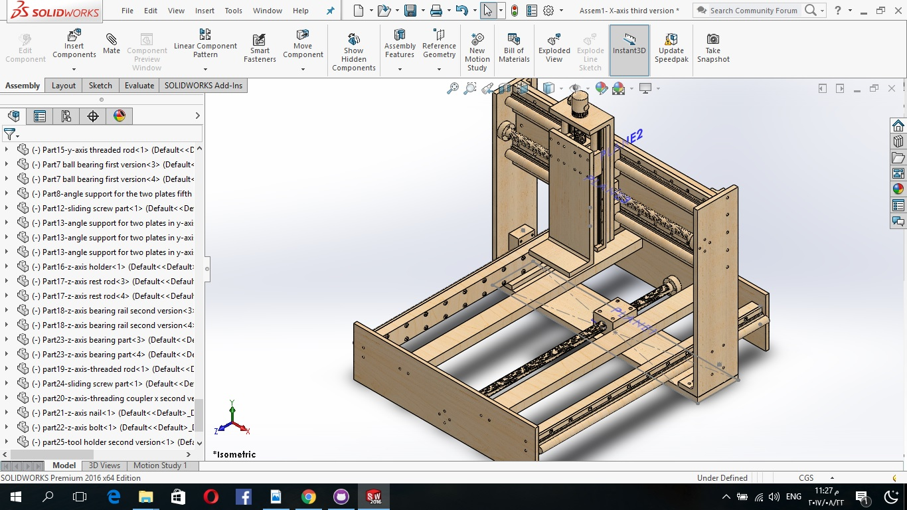
Design stages and development
And after two weeks of designing the project reach it’s final stage it was a much time but until that instant I wasn’t able to recognize that.

Slide 14
Design stages and development
This design faced three basic problems:
1-first it was from wood so it isn’t compatible with the processes I need some how sprinkling must not reach wood.
2-my design was 140 cm which may make wood undergo buckling.
3-it wasn’t able to undergo the manufacturing processes I need such as threading.

Slide 15
Design stages and development
So I started to change the design to have the following properties:
1-provide me with a working area 350*250 cm.
2-the machine’s material must be able to resist chemicals and water.
3-it must be able to resist buckling.
4-has a high stability, low vibration and high strength.
5-can undergo the manufacturing processes as shown in the difference between wood and teflon in the following picture.

Slide 16
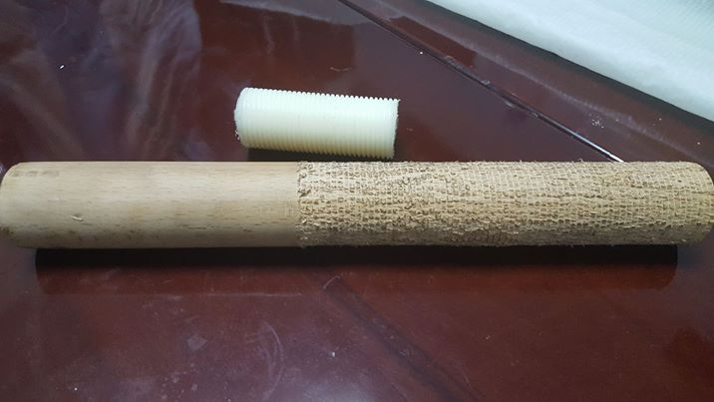
Design stages and development

Slide 17
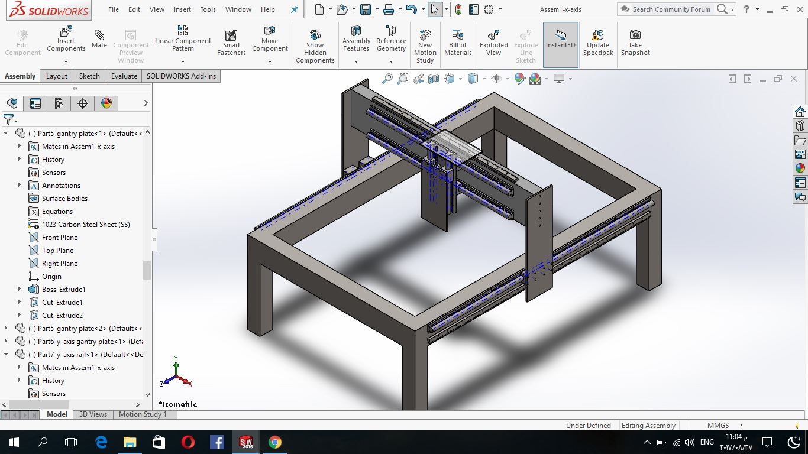
Design stages and development
By studying that teflon I found that the design only will cost 80000 pounds for me it was inappropriate.
So I tested steel and aluminium also it’s cost will be 30000 pounds it was a lot.

Slide 18
Design stages and development
To be able to make that design I went to 2 workshops to see some CNCs to be able to get another way to escape from screws so I used in that design rack and pinion mechanism with screws and rods with belt and gears in that design but it’s cost won’t be appropriate to me at that time.

Slide 19
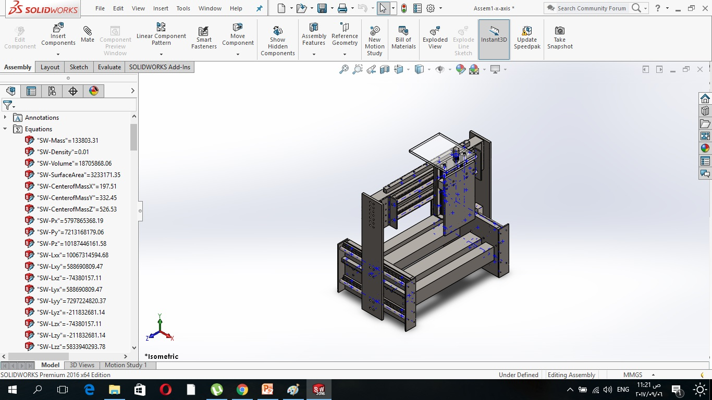
Design stages and development
Then I decide to reduce the dimensions to be appropriate to the amount of cash I have so with the prices I know now I designed my third design to be 50*40*30 cm it is suitable to a cash of 25000 pounds in total with electricity and motors

Slide 20
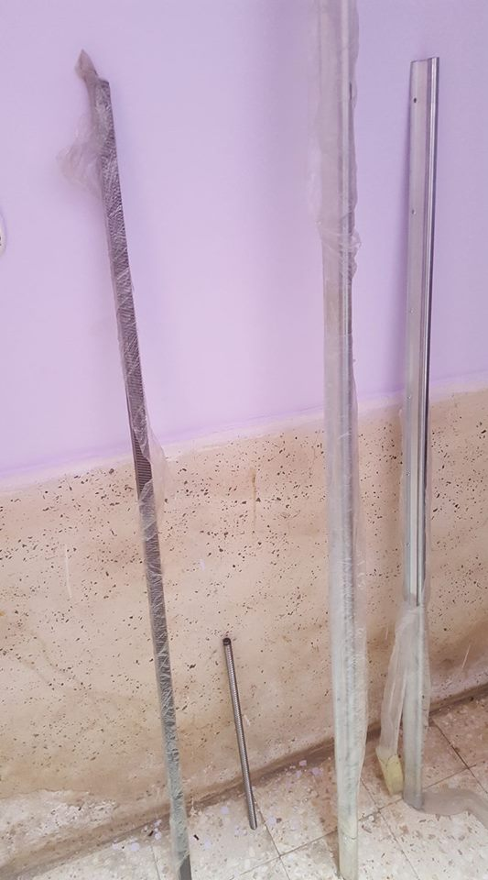
Design stages and development
This machine is 60 kilogram with 34 kilograms gantry so it is appropriate.
So I started execution and buy the rack,screw,rail and ballscrew.

Slide 21
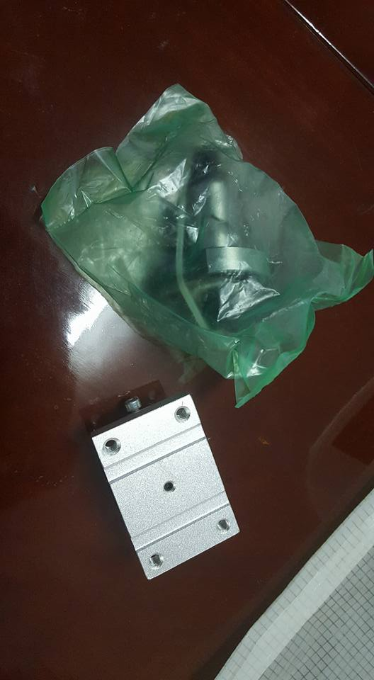
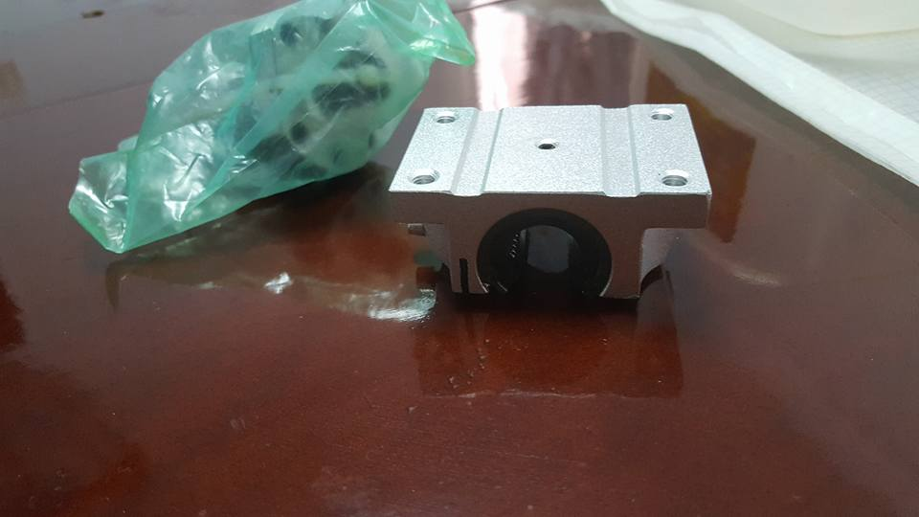
Design stages and development
Ball screws.

Slide 22
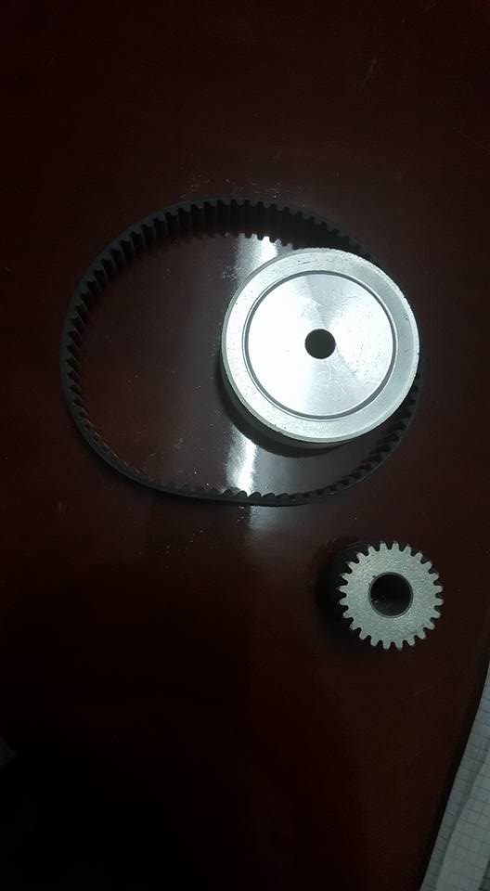
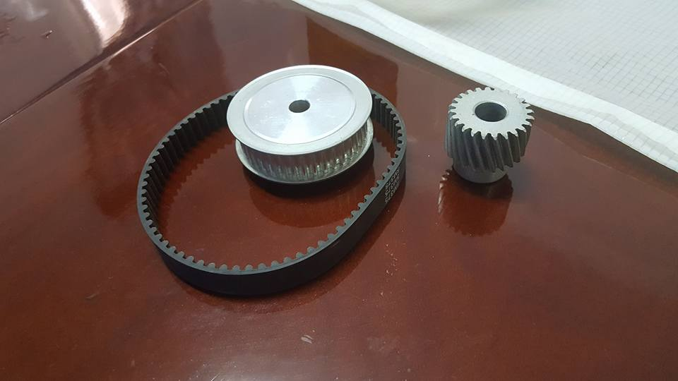
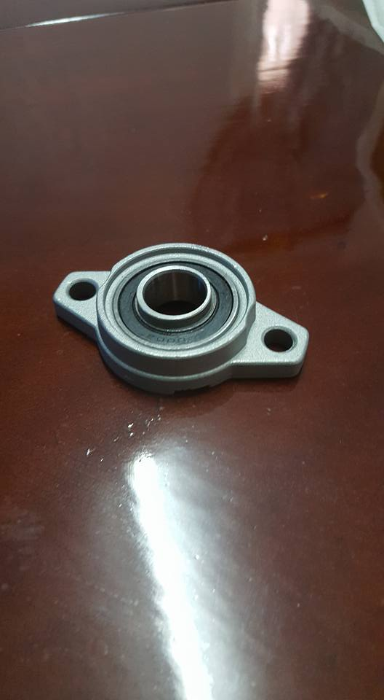
Design stages and development

Slide 23
Design stages and development
Now i still didn’t complete the design execution as I will buy extrusions today and stands after that the only thing will remain is the plates cutting and this depends on the workshop until now the minimum workshop till me to wait three weeks so I still search.

Slide 24
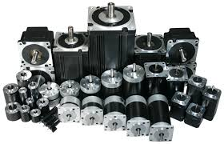
Electricity, motors and controling
Any cnc to move it needs 2 things:
1-motors kit.
2-control unit.

Slide 25
Electricity, motors and controling
There are two types of motors with 2 ways of connection:
1-stepper motor which needs a driver connected to an interface board.
2-servo motors with an encoder.
In my design I intend to use stepper motors.

Slide 26
Electricity, motors and controling
For controlling you have two choices:
1-to use a microcontroller unit like arduino.
2-to use a complete computer.
But I intend to use a complete computer for now.

Slide 27
Electricity, motors and controling
So now how to connect our stepper motor to the computer and controlling it:
1-first way if our computer is windows xp or 2000 and 32 bit so we need to connect the computer to a breakout board via parallel port and provide that board with a power supply then connect that board to the 4 drivers then every driver to a motor to control it using mach3 software.

Slide 28
Electricity, motors and controling
2-second if your computer uses operating system more advanced than xp or 2000 with 64 bit so I will connect my computer to a motion card then I will connect it with a power supply then connecting it also to the drivers to motors and controlling them using mach3.
After that you make a driver test

Slide 29
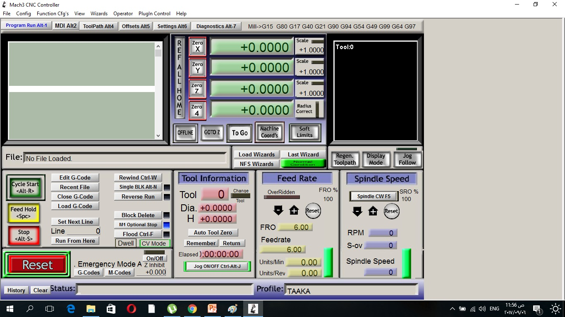
Electricity, motors and controling

Slide 30
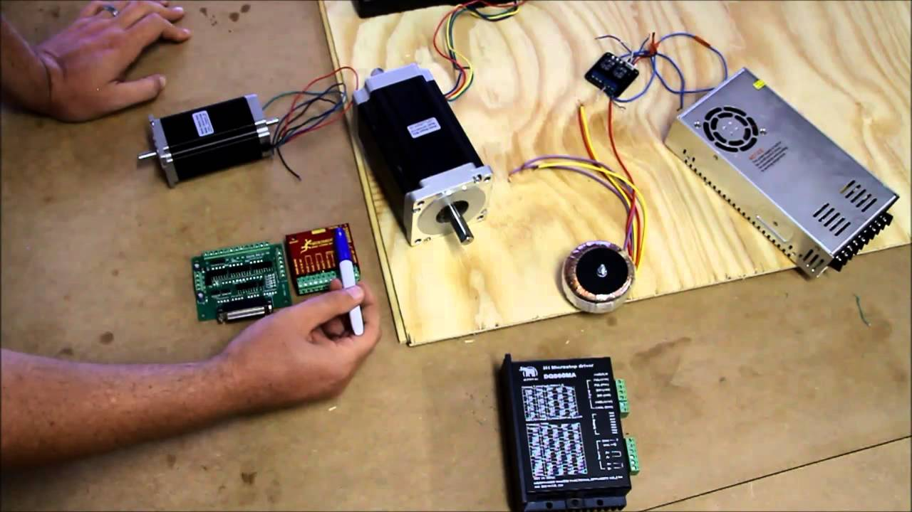
Electricity, motors and controling
I will go through this stage today with the permission of allah.

Slide 31
Electricity, motors and controling
In my design also I will use limit switches but until now I didn’t need home switches.
Target until the end of diploma is to get a CNC machine move and sprinkling water.
Also after the diploma I intend to use a tool changer in my machine.
Hoping for my colleagues the best thanks for fablab Egypt and American embassy for that experiment.

