Slide 1
USER EXPERIENCE

Slide 2


ADMIN LOGIN
User name : _______________
Password : _______________

Slide 3



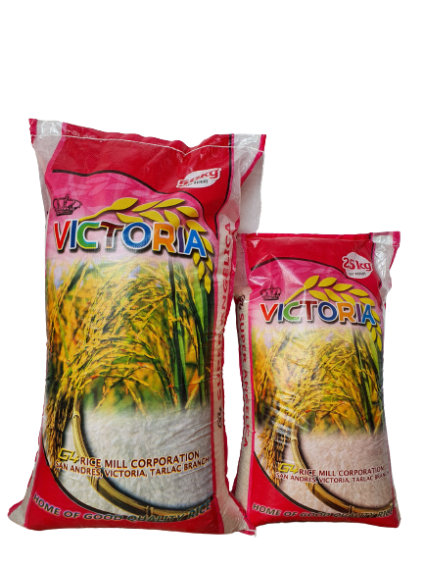
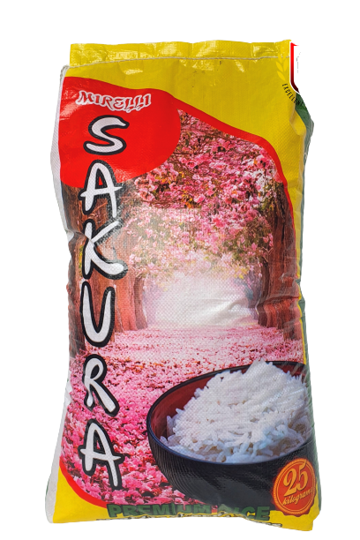

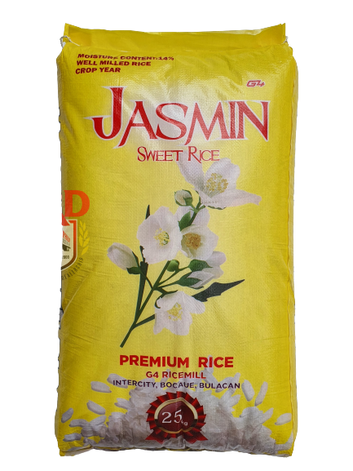
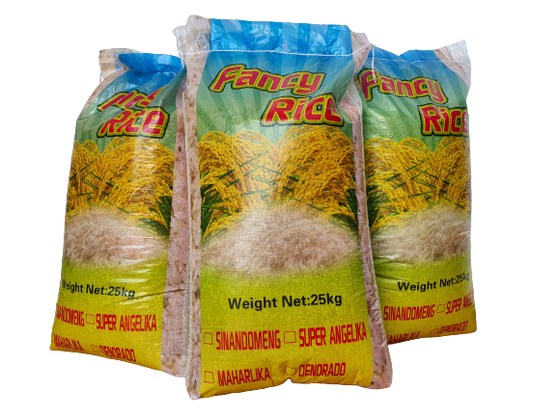
DASHBOARD
ORDERS
DAILY SALES
INVENTORY
SALES FORECASTING

Slide 4
D A S H B O A R D
DASHBOARD
ORDERS
DAILY SALES
INVENTORY
SALES FORECASTING

Slide 5
O R D E R S
NAME | ADDRESS | ARTICLE | PRICE | QTY | QLTY | TOTAL PRICE | TO PAY
MYLENE | MALIGAYA C.C | BUKO PANDAN COCO PANDAN SWEET JASMINE VICTORIA | 980 1000 1,050 940 | 10 15 10 30 | 25kg 50kg 25kg 25kg | 9800 15000 10500 28200 | 63,500
DASHBOARD
ORDERS
DAILY SALES
INVENTORY
SALES FORECASTING

Slide 6
DAILY SALES REPORT
DASHBOARD
JANUARY
ORDERS
DAILY SALES
INVENTORY
SALES FORECASTING

Slide 7
INVENTORY
DATE | ARTICLE CODE | ARTICLE NAME | PURCHASED | SOLD | STOCK
DASHBOARD
ORDERS
DAILY SALES
INVENTORY
SALES FORECASTING

Slide 8
SALES FORECASTING REPORT
DASHBOARD
ORDERS
DAILY SALES
INVENTORY
SALES FORECASTING

Slide 9
CUSTOMER END

Slide 10
CUSTOMER LOGIN
User name : _______________
Password : _______________
LOGIN
CREATE ACCOUNT

Slide 11
CREATE AN ACCOUNT
Name : _________________________
Contact Number : ________________
Address : _______________________
User name : ___________________
Password : ___________________
Retype Password : ________________
CREATE ACCOUNT

Slide 12
About
Contacts
PRODUCTS
MY ORDERS
ORDER DETAIL

Slide 13
JIMANO “PHILIP” RICE DEALER
ABOUT
(THIS PAGE WILL TELL ABOUT THE BUSINESS)
CONTACTS
PRODUCTS
MY CART
ORDER DETAILS

Slide 14
CONTACTS
ABOUT
(THIS PAGE WILL TELL ABOUT THE HOW CUSTOMER CAN CONTACT PRD)
CONTACTS
PRODUCTS
MY CART
ORDER DETAILS

Slide 15

PRODUCTS
ABOUT
CONTACTS
PRODUCTS
QTY: ____ + | -
QLY: 25kg | 50kg
QTY: ____ + | -
QLY: 25kg | 50kg
QTY: ____ + | -
QLY: 25kg | 50kg
QTY: ____ + | -
QLY: 25kg | 50kg
MY CART
ORDER DETAILS
ADD TO CART
BUY NOW

Slide 16
My Cart
 | PRODUCT CODE | PRODUCT NAME | PRICE | QUALITY | QUANTITY | TOTAL PRICE
ABOUT
CONTACTS
PRODUCTS
MY CART
ORDER DETAILS
BUY NOW

Slide 17
USER INTERFACE

Slide 18
ADMIN LOGIN
User name : _______________
Password : _______________

Slide 19
CUSTOMER LOGIN
User name : _______________
Password : _______________
LOGIN
CREATE ACCOUNT

Slide 20
ORDERS
DAILY SALES
INVENTORY
SALES FORECASTING

Slide 21
About
Contacts
PRODUCTS
MY ORDERS

