Slide 1


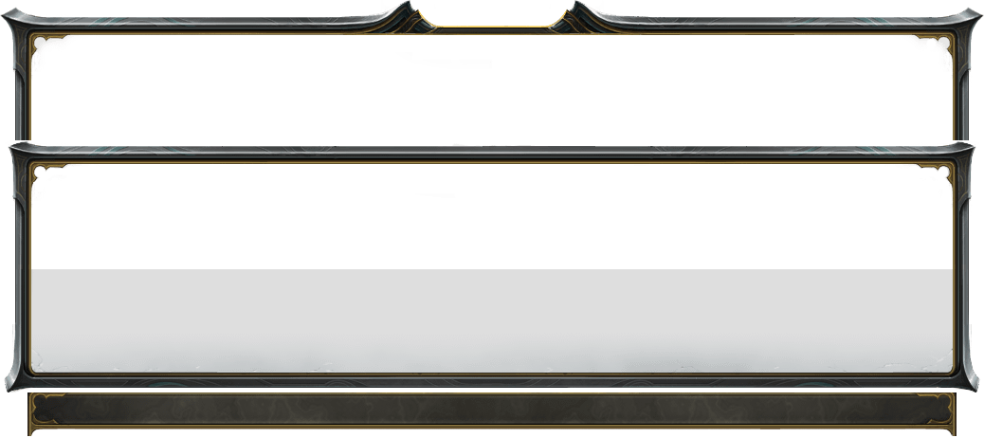




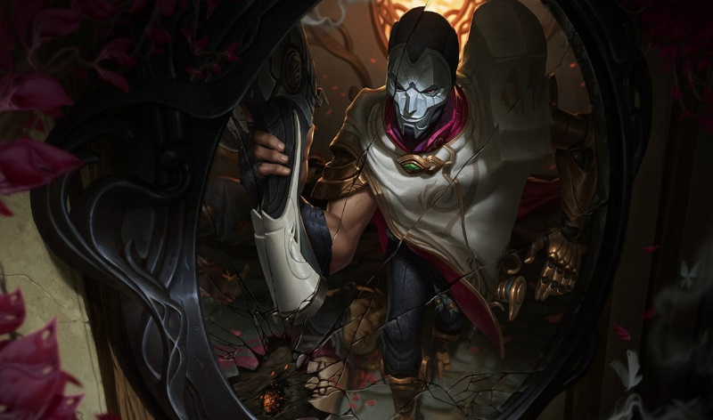








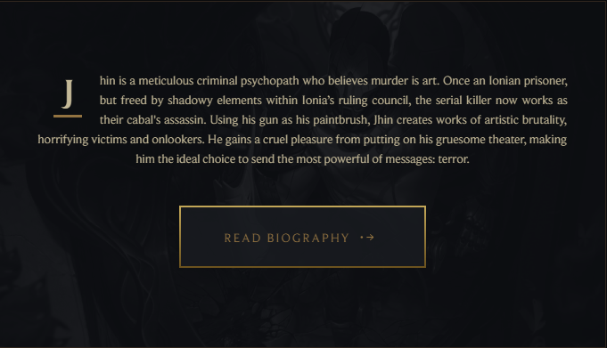
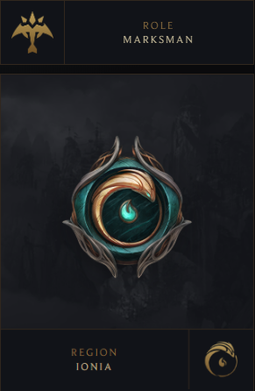








Search
Search
Select Champion
Jhin
Welcome to
PICK & GUIDE
Your Champion
Our Guide
THE VIRTUOSO
Start

Slide 2
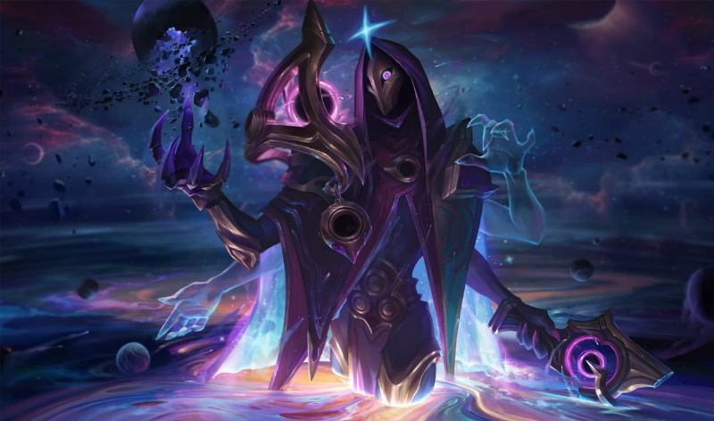
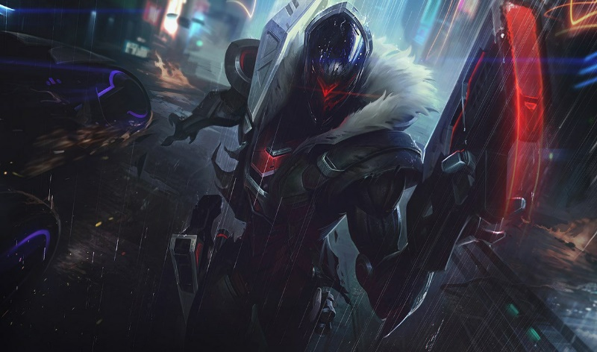
Search
Search
Biography
Jhin
Jhin
JHIN
THE VIRTUOSO
Jhin is a meticulous criminal psychopath who believes murder is art. Once an Ionian prisoner, but freed by shadowy elements within Ionia’s ruling council, the serial killer now works as their cabal's assassin. Using his gun as his paintbrush, Jhin creates works of artistic brutality, horrifying victims and onlookers. He gains a cruel pleasure from putting on his gruesome theater, making him the ideal choice to send the most powerful of messages: terror.
For years, Ionia’s southern mountains were plagued by the infamous “Golden Demon.” Throughout the province of Zhyun, a monster slaughtered scores of travelers and sometimes whole farmsteads, leaving behind twisted displays of corpses. Armed militias searched the forests, towns hired demon hunters, Wuju masters patrolled the roads - but nothing slowed the beast’s grisly work.
In desperation, the Council of Zhyun sent an envoy to beg Great Master Kusho for help. Upon hearing of the region’s plight, Kusho feigned an excuse for why he couldn’t help. But a week later, the master, his son Shen, and star apprentice Zed, disguised themselves merchants and moved to the province. In secret, they visited the countless families emotionally shattered by the killings, dissected the horrific crime scenes, and looked for possible connections or patterns to the murders.
Their investigation took four long years, and left
Dark Cosmic
Project

Slide 3

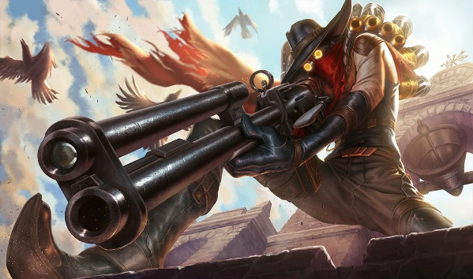
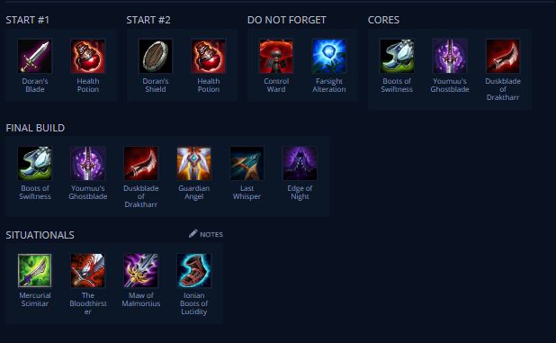

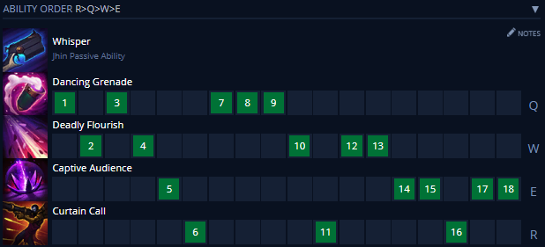



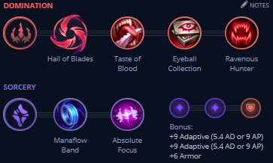
Search
Outside the prison, Ionia fell into turmoil as the Noxian empire’s invasion led to political instability. War awoke the tranquil nation’s appetite for bloodshed. The peace and balance Kusho had famously fought to protect was shattered from within as dark hearts rose in power and secret alliances competed for influence. Desperate to counter the power of the ninja and Wuju swordsmen, a cabal within the ruling council conspired to secretly free Jhin and turn him into a weapon of terror.
Now with access to the Kashuri armories’ new weapons, and nearly unlimited funds, the scale of Khada Jhin’s “performances” has grown. His work has brought fear to many foreign dignitaries and to Ionia’s secret political underground, but how long will a serial killer, craving attention, be satisfied working in the shadows?
Item Build

Slide 4
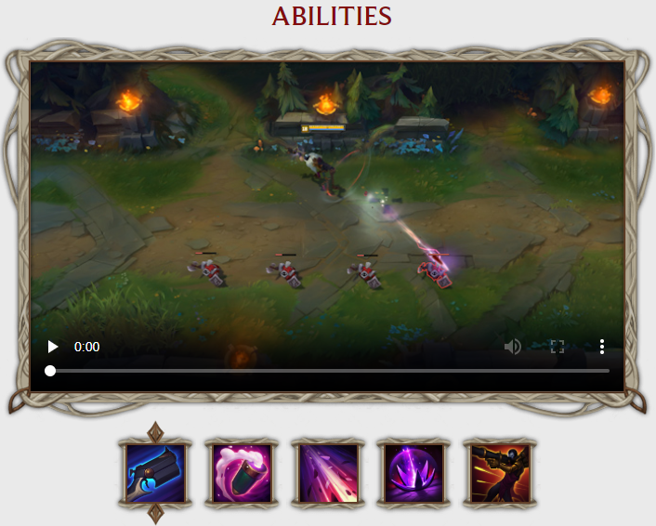
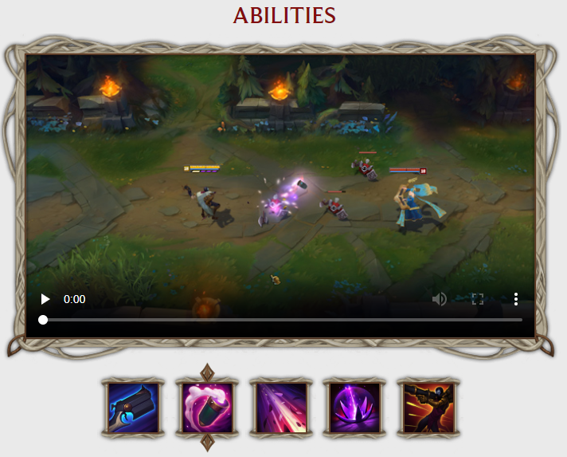
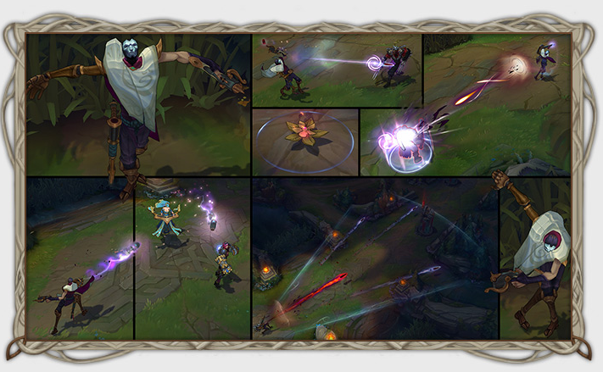
Search
Search
Search
Q: DANCING GRENADE
Jhin throws a cannister at a nearby targeted enemy. After landing, the cannister bounces up to four times on other nearby enemies. Killing an enemy with Dancing Grenade causes the following bounces to deal extra damage.
PASSIVE: WHISPER
Jhin’s gun - Whisper - chambers four shots, the last of which always crits and applies extra damage based on a portion of his target’s missing health. After firing all four shots, Jhin takes a moment to reload.
Jhin’s crits deal less damage than normal, and his attack speed doesn’t actually scale with attack speed. Instead, Jhin gains attack damage from any attack speed and crit chance he earns through itemization and runes, while crits give him a burst of movement based on his attack speed.
Q: DANCING GRENADE
Jhin throws a cannister at a nearby targeted enemy. After landing, the cannister bounces up to four times on other nearby enemies. Killing an enemy with Dancing Grenade causes the following bounces to deal extra damage.

