Slide 1
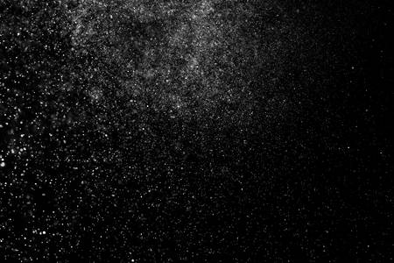


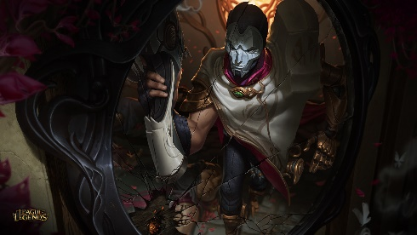
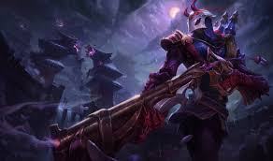





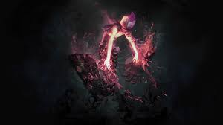
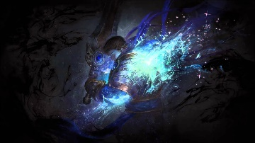
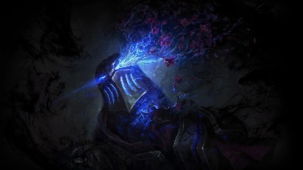
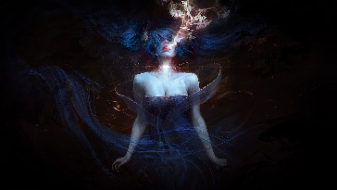
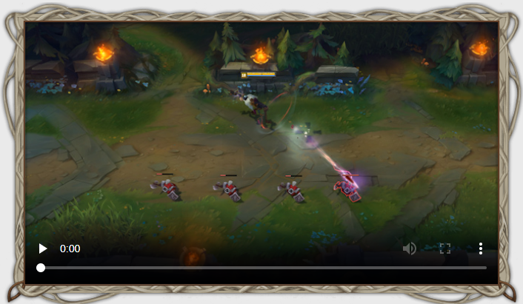
Search
Search
Jhin
Jhin
Day and Night mode
Passive
Q
W
E
R
Passive
Q
W
E
R
Art
Art
PASSIVE: WHISPER
Jhin’s gun - Whisper - chambers four shots, the last of which always crits and applies extra damage based on a portion of his target’s missing health. After firing all four shots, Jhin takes a moment to reload.
Jhin’s crits deal less damage than normal, and his attack speed doesn’t actually scale with attack speed. Instead, Jhin gains attack damage from any attack speed and crit chance he earns through itemization and runes, while crits give him a burst of movement based on his attack speed.

Slide 2
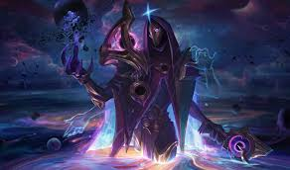





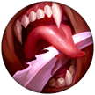





Search
Search
Jhin Builds
Jhin
Runes
DOMINATION
Hail of Blades
Taste of Blood
Eyeball Collection
Ravenous Hunter
SORCERY
Manaflow Band
Absolute Focus
Bonus:
+9 Adaptive (5.4 AD or 9 AP) +9 Adaptive (5.4 AD or 9 AP) +6 Armor
Passive
Q
W
E
R
Art

Slide 3




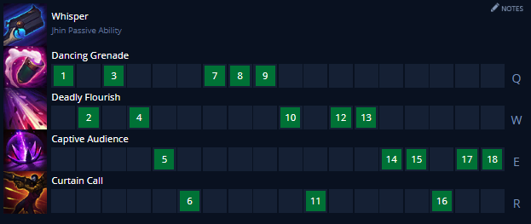
Search
Jhin Builds
Items

