Slide 1
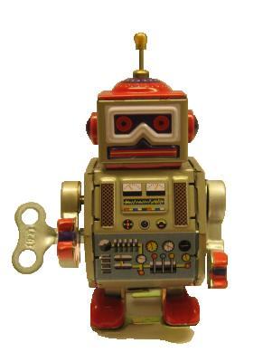
An introduction to
Robot Framework

Slide 2
Short introduction
Robot Framework is a Python-based keyword-driven test automation framework for acceptance level testing and acceptance test-driven development (ATDD). It has an easy-to-use tabular syntax for creating test cases and its testing capabilities can be extended by test libraries implemented either with Python or Java.
Robot Framework is open source software released under Apache License 2.0. Its copyrights are owned and development supported by Nokia Siemens Networks.

Slide 3
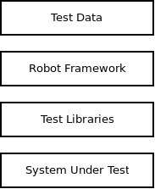
Test automation framework
Robot Framework itself is generic and it doesn't know anything about the system under test or tested interfaces.
It controls other, interface specific, test tools (a.k.a. drivers) via test libraries.
Test libraries and drivers don't need to care about how to represent the test data, how/where to create reports, how to start the test execution, etc.
The modular architecture supports creating tests even for applications with several diverse interfaces.

Slide 4
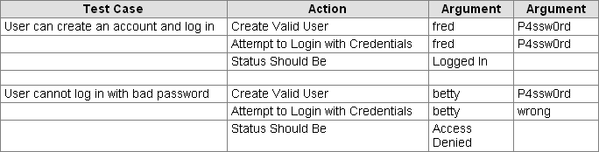
Keyword-driven approach
Test cases are created from keywords and their possible arguments
The test data is in HTML or TSV (tab-separated values) tables with simple syntactical rules.
Tabular format is easy to parse by computers yet still simple to write and understand by humans.

Slide 5
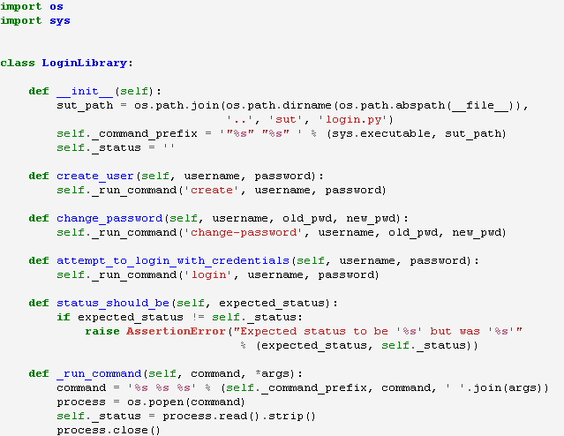
Low level keywords
Implemented in test libraries and normally map directly to methods.

Slide 6
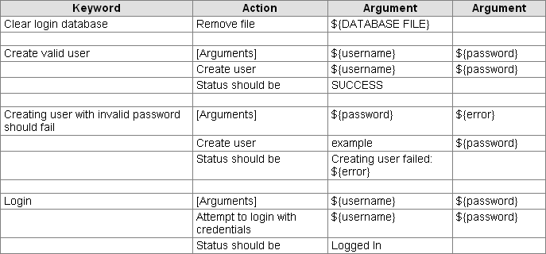
Higher level keywords
Can be created from other keywords.
Same simple syntax that is used for creating test cases.

Slide 7
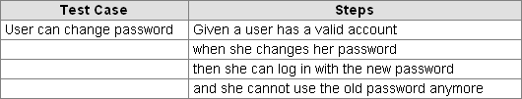
Keyword-driven testing and ATTD
Higher level keywords are very well suited for Acceptance Test-Driven Development (ATTD)
In ATTD test cases are created before implementation and they act also as requirements
The example belows uses the Behavior-Driven Development (BDD) style

Slide 8
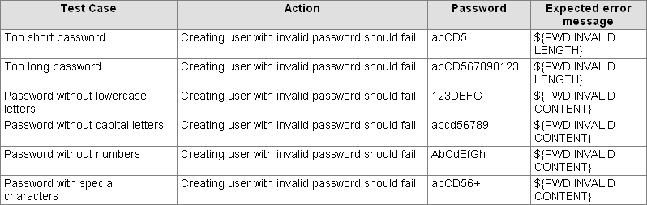
Data-driven testing
Keyword-driven testing also supports data-driven testing.
Just need to have a suitable keyword that takes all the needed input and output values as arguments.

Slide 9
Test library API
Test libraries can be natively implemented with Python and Java.
In the static library API keywords map directly to methods in classes or modules.
  See the earlier test library example
“Natural” and direct interface
  Exceptions are used to report failures
  Logging is done via the standard output
  Return statement used for returning information
In general very simple to understand and get started.

Slide 10
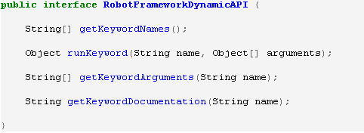
Dynamic library API
Easies creating very large libraries (especially with Java)
Easy to create wrappers or proxies to other tools or libraries.
Has special methods for interacting with the framework.
  No need to implement any formal interface.
  Communication status, logging, and returning information similarly as with the static API

Slide 11
Remote library API
Libraries can be on different machines than the core framework.
Makes it possible to create test libraries using any programming language supporting XML-RPC protocol (Python, Ruby, Perl, Java, ...).
Will be officially released soon.
  Remote library will be a new standard library
  Remote server implementations for different languages (Python and Ruby in the beginning) distributed as supporting tools

Slide 12
Tagging
Free metadata to categorize test cases
Statistics by tags collected automatically
Select test cases to be executed
  --include and --exclude options
Specify which test cases are considered critical

Slide 13
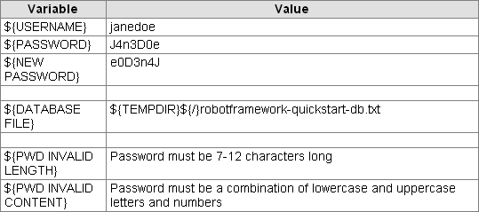
Variables
Can be used pretty much anywhere in the test data using syntax ${VARIABLE NAME}
Simple to create in the test data using tabular syntax
Possible to create them using Python in Variable files
Easy to override from the command line

Slide 14
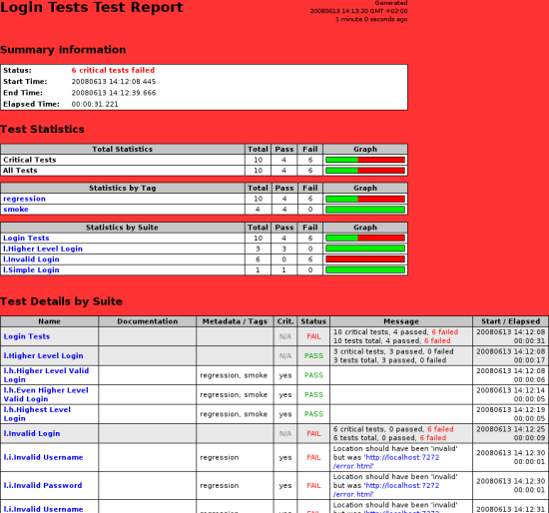
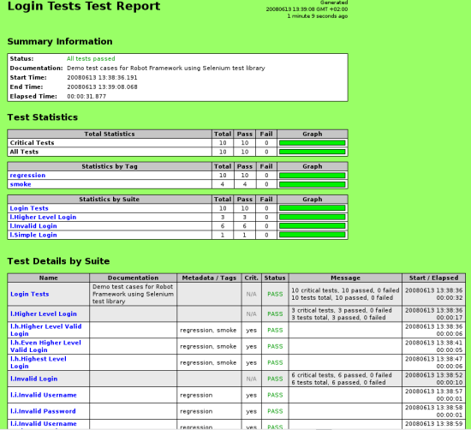
Clear reports

Slide 15
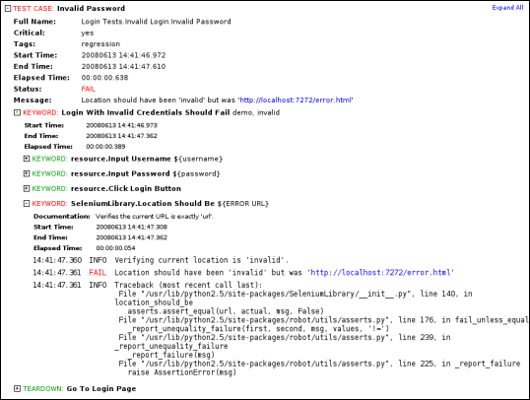
Detailed logs

Slide 16
Easy integration
Test suites are created as files and directories
  Trivial to store into any version control system
Simple command line interface
  Easy to start test execution by continuous integration systems or other tools
XML based outputs
  All the information about test execution available in format suitable for machines.
Listener interface
  Possible to get notifications when test suites, test cases and keywords start and end

Slide 17
Available test libraries
So called standard libraries are part of the normal Robot Framework installation.
External libraries, and their possible dependencies, must be installed separately.
External libraries developed both by the core development team and other parties.

Slide 18
Standard libraries
BuiltIn
  Is in use automatically
  Should Be Equal, Log, Convert To Integer, Sleep...
OperatingSystem
  Run, File Should Exist, Create Directory, ...
Telnet
  Open Connection, Login, Write, Read Until, ...
Collections
  List Should Be Empty, Dictionary Should Contain Value, ...
Screenshot
  Available only when running tests on Jython
  Take Screenshot, Log Screenshot, ...

Slide 19
External libraries
SeleniumLibrary
  A web testing library
  Uses popular Selenium tool internally
SwingLibrary
  For testing Java Swing GUIs
  Uses Jemmy
SSHLibrary
  Supports SSH and SFTP
  User Paramiko (Python) or Trilead SSH (Jython)
RestLibrary
  For testing HTTP, web services and REST
  First publicly available library not created by the core team.

Slide 20
Other supporting tools
Some tools distributed with Robot Framework
  Included in source distributions
  Can be downloaded from the project pages
Others available as separate projects similarly as external test libraries

Slide 21
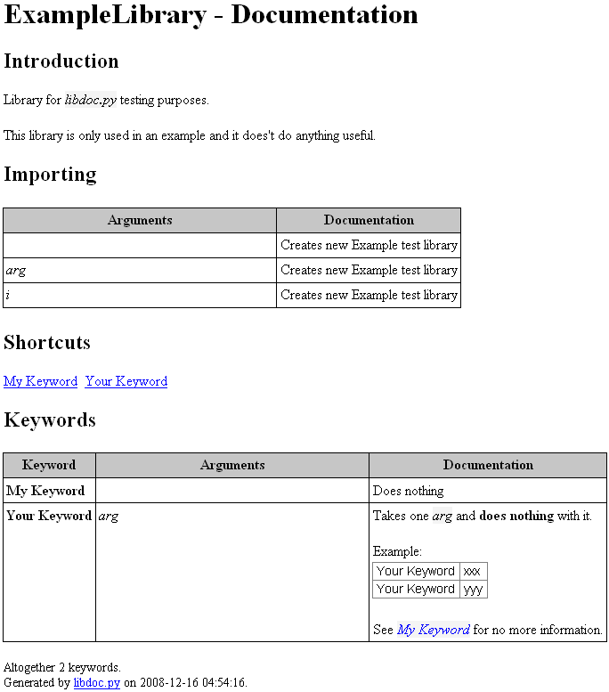
libdoc.py
Tool for generating keyword documentation for a test library or a resource file.
HTML format for humans and XML for machines

Slide 22
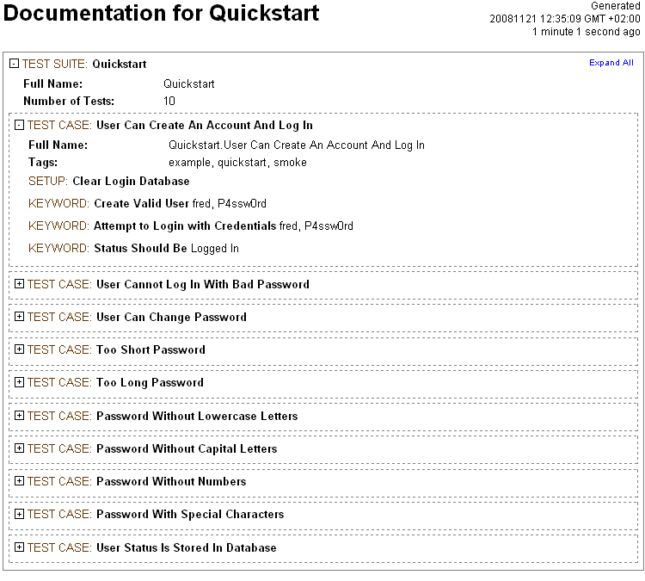
testdoc.py
A tool for generating high level test documentation for a given test suite.
The generated documentation includes names, documentations and other metadata of test suites and test cases, as well as names and arguments of the top-level keywords.

Slide 23
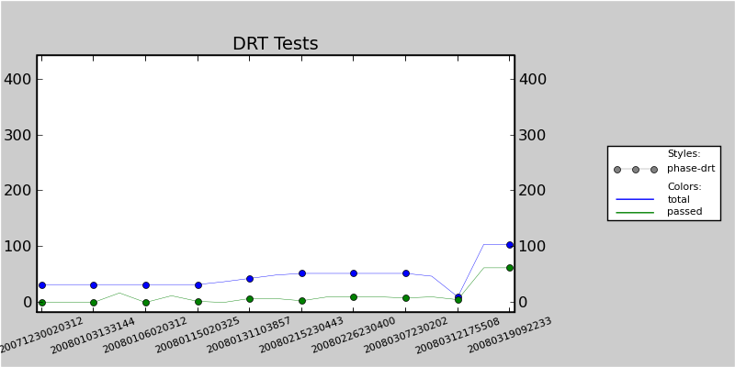
risto.py
A tool for generating graphs about historical statistics of test executions.

Slide 24
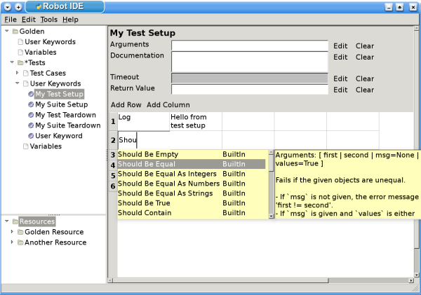
RIDE
Robot Framework Test Data Editor
Has an intuitive GUI with handy features like keyword-completion.
A separate project
Still pre-1.0 but under active development

Slide 25
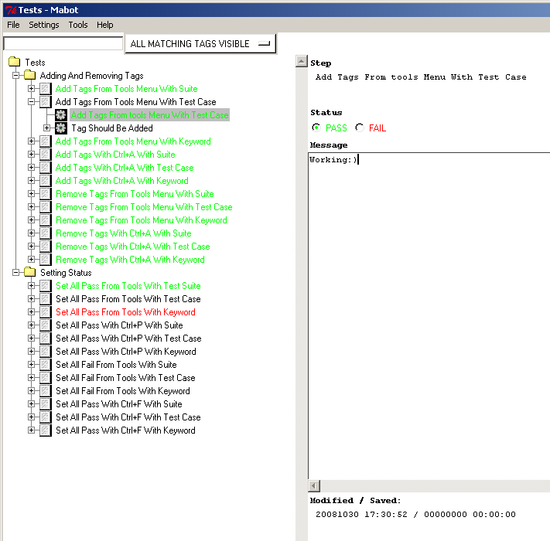
Mabot
A tool for reporting manual test result in Robot Framework compatible format
Makes it possible to combine all tests results together even when some tests haven't been automated
A separate project

Slide 26
Java Tools
A collection of utilities which help creating test libraries and other tools using Java
Heavily used by SwingLibrary
A separate project

Slide 27
History
Initial concept and prototype developed in Pekka Klärck's (born Laukkanen) Master's Thesis
Development at Nokia Siemens Networks started in August 2005
Open sourced in June 2008 under Apache License 2.0
NSN owns copyrights of the core framework and supports the development.

