Slide 1
Rolling Ball X
Sinisa Stevanovic
Notes:
Change layout (colors, etc.) of this document to your liking :D

Slide 2
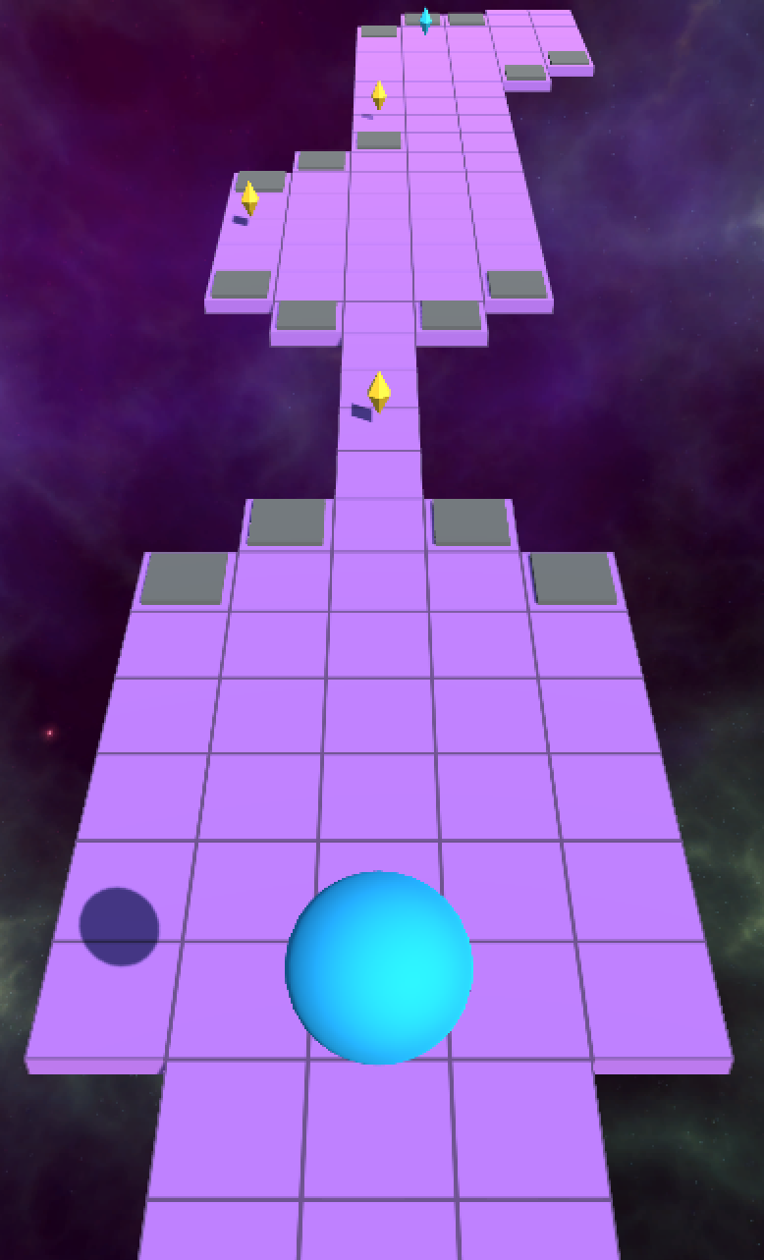
Game Pitch
Sinisa Stevanovic
Notes:
Team Name and Logo (optional)

Slide 3
High Concept
It’s a ‘Roll A Ball’ game where you have to dodge obstacles to get to the goal.
The game is quite challenging so if the player gets to the goal, he can show his skills!
Notes:
Game Pitch
High Concept describes the game goal:
What is the goal of the game? What is the player expected to achieve? What does the player do in-game to advance? Describe all aspects of advancement achievable during the game.

Slide 4
Key Features
Hard level, Jump Tiles, obstacles, obstacles, obstacles…
Custom Physics, custom collision detection
Notes:
Game Pitch

Slide 5
Comparative Products
The gameplay of ‘Rolling Ball X’ is based on the android app ‘Rolling Sky’, which is a really hard roll-a-ball-game.
Notes:
Game Pitch

Slide 6
Gameplay Pattern and Genre
The Player tries to move the ball to the goal. On his way he faces many obstacles that he has to dodge.
Notes:
Game Pitch

Slide 7
Target Platform
The target platform is Android. A minimum Android version isn’t required.
The game will also work on Windows PC
I want to get a good grade
Notes:
Game Pitch

Slide 8
Basic Controls
You control the ball by swiping left and right on the touchscreen
The game has a main menu where the player can choose to start a new game or to quit. In the HUD there will be a point counter as well as a image where the current Power Up is shown
On Windows you control the ball with the Keys ‘A’ and ‘D’
Notes:
Game Pitch

Slide 9
The end.
Thank you.
Notes:
Closing Remarks

