Slide 1
Data Mining for Business Analytics Final Project
Emily Fox & Daniel Lynch
November 9, 2018

Slide 2
The research topic: Using data mining to understand Uber’s business from the point of view of various stakeholders
Can we use data mining to:
Replicate Uber’s ride pricing algorithm?
Understand the drivers of wait time?
Identify strategies for preventing ride cancellation?
From the P.O.V of:
Competitors (e.g. Lyft)
Customers
Uber
Key questions:
What factors determine the fare for a ride?
Can a competitor accurately model Uber’s pricing in order to offer competitive fares?
Why does wait time vary so significantly from one ride to the next?
Are there things to avoid (e.g. rides at certain times of day) that can help a rider minimize wait time?
What are time main factors driving rider cancellations?
Is there an opportunity for Uber to prevent these cancellations?

Slide 3

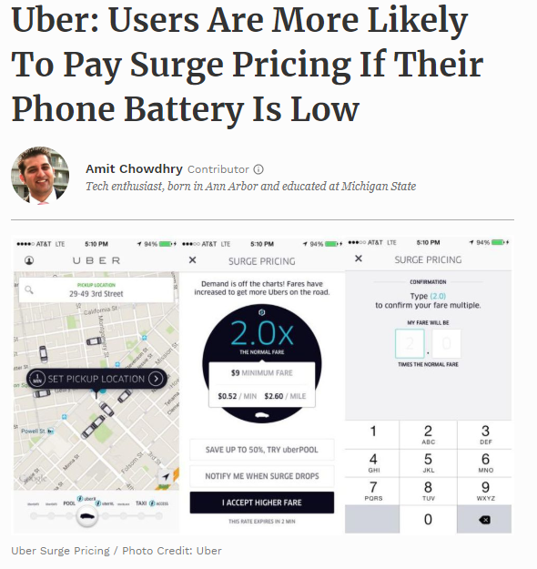
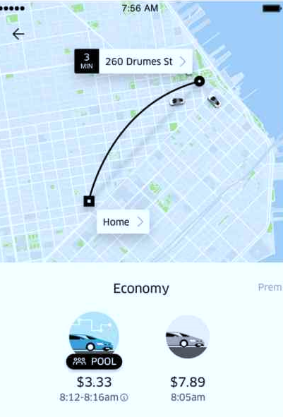
Data that is available vs. data behind the scenes

Slide 4
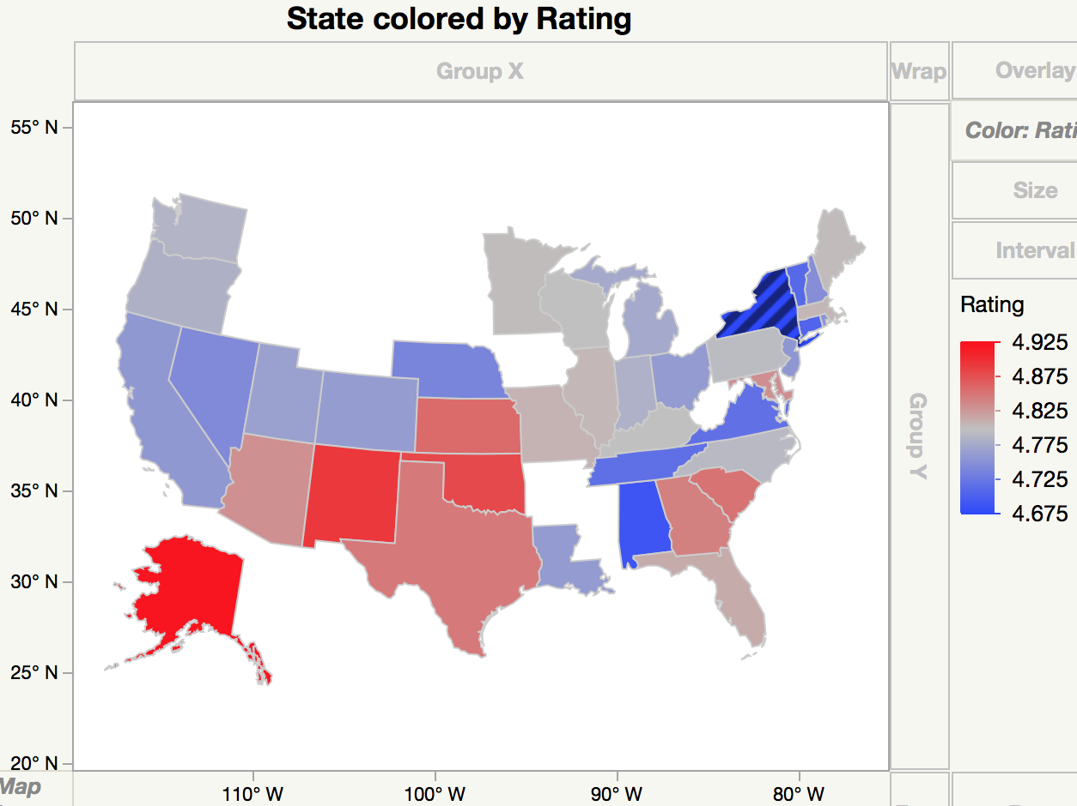
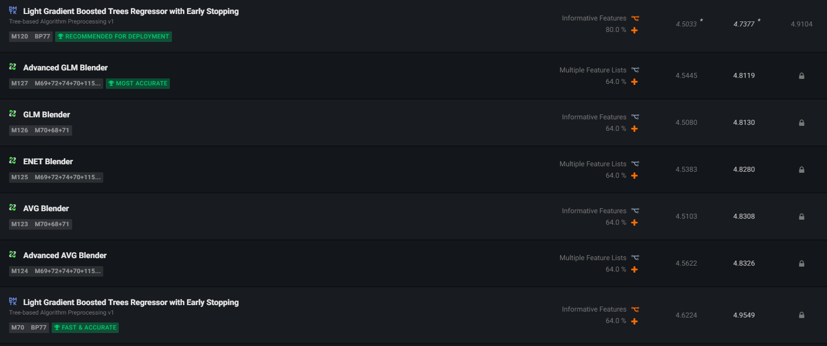
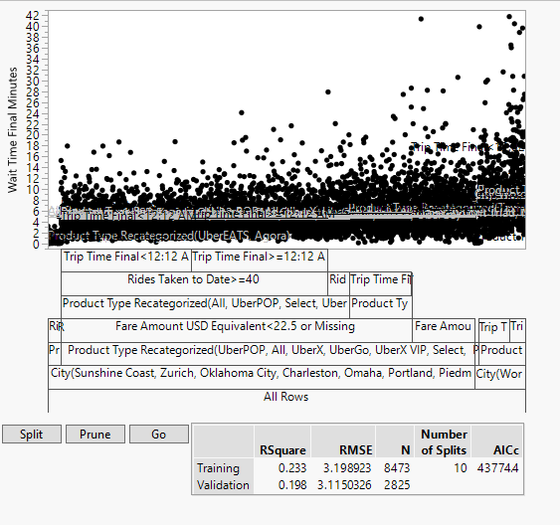
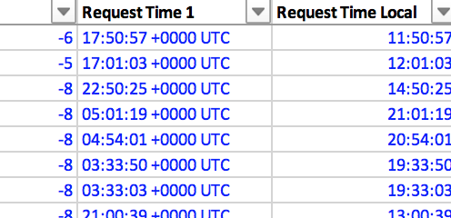
Our data mining journey
Collection
Exploration
Variable Transformation
Algorithm Testing
New variables introduced included:
Rider’s Uber rating and gender
# rides taken to-date
Fare in USD
Country, state
Local times
Year, month, day of week

Slide 5
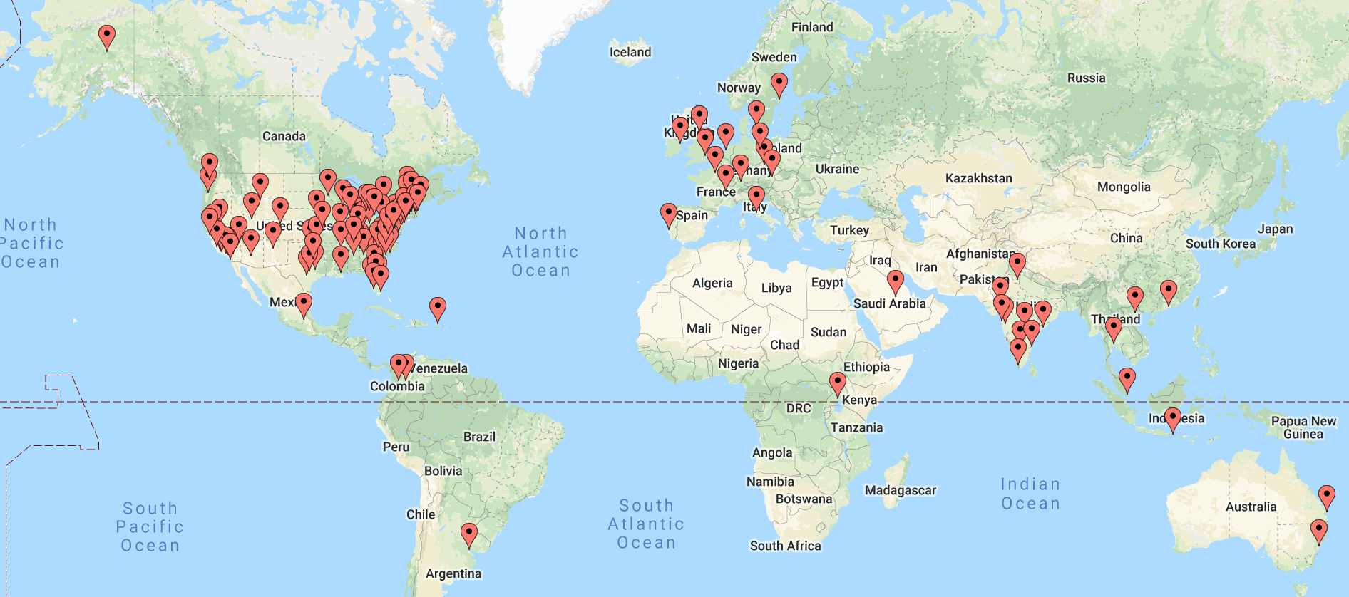
Summary of data
Dataset comprised of ~14k Uber rides taken between 2012 and 2018 from 36 customers across 26 countries and 120 localities

Slide 6
Algorithms Tested
Pricing
Wait Time
Cancellation
 | Boosted Tree | Boostrap Forest | Linear Regression | Decision Tree | Neural Nets
RMSE - Training | 5.9809 | 5.0688 | 6.0517 | 5.8354 | 4.2363
RMSE - Validation | 6.1692 | 5.8947 | 5.6837 | 6.9873 | 5.0672
R^2 - Training | 0.7670 | 0.8330 | 0.7628 | 0.7790 | 0.8838
R^2 - Validation | 0.7340 | 0.7570 | 0.7555 | 0.6590 | 0.8057
Top Column Contributions (from largest to smallest contributions) | Distance | Distance | Product Type | Distance
 | Product Type | Product Type | Distance | Producty Type
 | City | Trip Time | Trip Time | City
 | Trip Time | Speed | State | Trip Time
 | Dropoff Lat | State | Sign-up City | Fare Currency
 | Speed of Trip (mi per min) | City | Speed of Trip (mi per min) | Year
 |  | Country | Month Requested | Speed
 |  | Signup City | Wait Time | Dropoff Longitude
 |  | Rating | Rides Taken to Date | Signup City
 |  |  |  | Rating

Slide 7
Most Important Drivers
Pricing
Wait Time
Cancellation
Price
Distance
Traveling farther is more costly
Product Type
Black Car vs. UberX vs. Pool
Trip Time
In addition to the distance you’re traveling, congestion on the roadways contributes to higher prices
City
Uber is more expensive in certain geographies

Slide 8
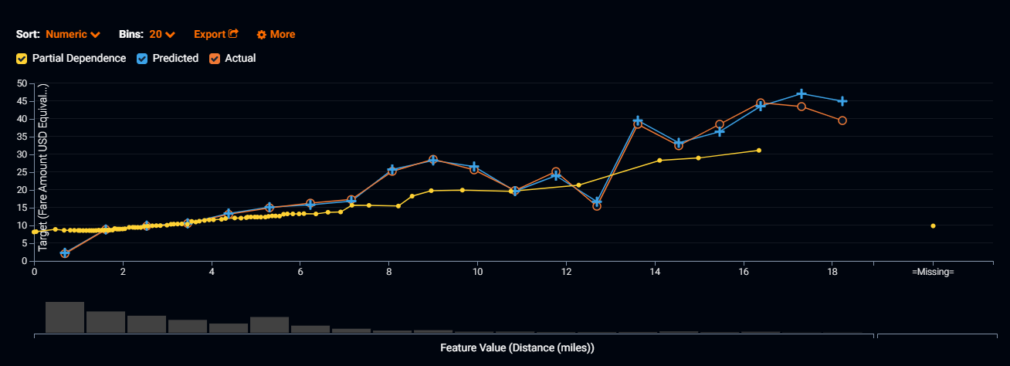
The number 1 predictor of fare price is distance
Pricing
Wait Time
Cancellation

Slide 9
Baseline fare rates by city are an important component of the pricing algorithm
Pricing
Wait Time
Cancellation

Slide 10
Algorithms Tested
Pricing
Wait Time
Cancellation
 | Boosted Tree | Bootstrap Forest | Linear Regression | Decision Tree | Neural Nets
RMSE - Training | 3.1032 | 2.4938 | 3.7750 | 3.1486 | 3.1442
RMSE - Validation | 3.0523 | 2.9745 | 3.3904 | 3.0996 | 3.1103
R^2 - Training | 0.2780 | 0.5340 | 0.1699 | 0.2570 | 0.2628
R^2 - Validation | 0.2300 | 0.2680 | 0.0548 | 0.2060 | 0.2045
Top Column Contributions (from largest to smallest contributions) | Product Type | City | Product Type | City
 | City | Product Type | Trip Time Final | Product Type
 | Distance | Speed | Day of Week | Trip Time Final
 | Dropoff Lng | Month | User Type | Fare Amount
 | Fare Amount | Distance | Country | Dropoff Lat
 | Trip Time Final | Trip Time Final | Language | Rides Taken to Date
 | Speed | Fare Amount | Speed | Begin Trip Lng
 | Begin Trip Lat | Begin Trip Longitude | Rides Taken to Date
 | Begin Trip Lng | Begin Trip Latitude
 | Rides Taken to Date

Slide 11
Most Important Drivers
Pricing
Wait Time
Cancellation
Price
Wait Time
Distance
Product Type
Traveling farther is more costly
Different products are designed to minimize consumer surplus based on wait time tolerance
Product Type
City
Black Car vs. UberX vs. Pool
Like price, certain cities have greater wait times
Trip Time
Trip Time
In addition to the distance you’re traveling, congestion on the roadways contributes to higher prices
Higher demand for Uber is linked to higher congestion on roadways
City
Fare Amount
Uber is more expensive in certain geographies
Due to the design of surge pricing, more demand for Uber rides will both raise fares and increase wait time

Slide 12
Wait time is linked to Product, which is directly communicated to the customer
Pricing
Wait Time
Cancellation

Slide 13
Demand for rides / congestion impacts both wait time and trip time
Pricing
Wait Time
Cancellation
Correlation: 0.16

Slide 14
Algorithms Tested
Pricing
Wait Time
Cancellation
 | Boosted Tree | Boostrap Forest | Logistic Regression | Decision Tree | Neural Net | Naïve Bayes
RMSE - Training | 0.1256 | 0.1182 | 0.0787 | 0.1170 | 0.1022 | 0.2019
RMSE - Validation | 0.1278 | 0.1298 | 0.1672 | 0.1285 | 0.1427 | 0.2074
R^2 - Training | 0.9032 | 0.9118 | 0.9650 | 0.9235 | 0.9390 | 0.3486
R^2 - Validation | 0.9079 | 0.9031 | 0.6950 | 0.9129 | 0.8848 | 0.4759
Misclassification Rate - Training | 0.0199 | 0.0175 | 0.0069 | 0.0169 | 0.0129 | 0.0431
Misclassification Rate - Validation | 0.0191 | 0.0191 | 0.0364 | 0.1940 | 0.0258 | 0.0460
Top Column Contributions (from largest to smallest contributions) | Pin Used for Start | Distance | City | Distance
 | Distance | Fare Amount | Distance | Product Type
 | City | Product Type | Rating | Fare Amount
 | Rider Gender | Pin Used for Start | Signup App Version | Year
 | Fare Amount | Pin Used for End | Product Type | Month
 | Weekend? | Year Requested | Rides Taken to Date | Pin Used for Start
 | Year | Rides Taken to Date | Day of Week Requested | Rides Taken to Date
 | Rides Taken to Date | State | Month Requested | Signup App Version
 | Pin Used for End | City | Request Time Local | State
 | Product Type |  | Fare Amount USD | Rating

Slide 15
Most Important Drivers
Pricing
Wait Time
Cancellation
Price
Wait Time
Cancellation
Distance
Product Type
Distance
Traveling farther is more costly
Different products are designed to minimize consumer surplus based on wait time tolerance
Riders are more likely to cancel shorter trips
Product Type
City
Pin Used for Start
Black Car vs. UberX vs. Pool
Like price, certain cities have greater wait times
When a rider is unfamiliar with their location, they are more likely to cancel
Trip Time
Trip Time
Fare Amount
In addition to the distance you’re traveling, congestion on the roadways contributes to higher prices
Higher demand for Uber is linked to higher congestion on roadways
Riders are more likely to cancel cheaper trips
City
Fare Amount
Product Type
Uber is more expensive in certain geographies
Due to the design of surge pricing, more demand for Uber rides will both raise fares and increase wait time
Riders are less likely to cancel on premium products like Black Car and are more likely to cancel on Pools, etc.

Slide 16
The use of a pin for setting pick-up and drop-off locations is a key indicator of cancellation risk
Pricing
Wait Time
Cancellation
Pin Used for Start | Pin Used for End | Rider Cancellation Rate (Actual) | Rider Cancellation Rate (Predicted) - Boosted Tree | Rider Cancellation Rate (Predicted) - Bootstrap Forest
N | N | 5% | 6% | 6%
Y | Y | 14% | 17% | 15%
N | Y | 18% | 20% | 20%
Y | N | 80% | 85% | 85%

Slide 17
Most Important Drivers
Price
Wait Time
Cancellation
Distance
Product Type
Distance
Traveling farther is more costly
Different products are designed to minimize consumer surplus based on wait time tolerance
Riders are more likely to cancel shorter trips
Product Type
City
Pin Used for Start
Black Car vs. UberX vs. Pool
Like price, certain cities have greater wait times
When a rider is unfamiliar with their location, they are more likely to cancel
Trip Time
Trip Time
Fare Amount
In addition to the distance you’re traveling, congestion on the roadways contributes to higher prices
Higher demand for Uber is linked to higher congestion on roadways
Riders are more likely to cancel cheaper trips
City
Fare Amount
Product Type
Uber is more expensive in certain geographies
Due to the design of surge pricing, more demand for Uber rides will both raise fares and increase wait time
Riders are less likely to cancel on premium products like Black Car and are more likely to cancel on Pools, etc.

Slide 18
Most Important Findings
Can we use data mining to:
Replicate Uber’s ride pricing algorithm?
Understand the drivers of wait time?
Identify strategies for preventing ride cancellation?
From the P.O.V of:
Competitors (e.g. Lyft)
Customers
Uber
Key questions:
What factors determine the fare for a ride?
Can a competitor accurately model Uber’s pricing in order to offer competitive fares?
Why does wait time vary so significantly from one ride to the next?
Are there things to avoid (e.g. rides at certain times of day) that can help a rider minimize wait time?
What are time main factors driving rider cancellations?
Is there an opportunity for Uber to prevent these cancellations?
Most important findings:
Location (e.g. city) is an important factor driving ride fares. We suspect a base rate exists for each location within Uber’s algorithm.
Beyond the product type, price of a ride is the top indicator of wait time, explaining why we experience longer wait times when prices are surging.
Rider cancellation can be accurately modeled with data mining algorithms, however, the key predictors suggest that there is little Uber could do to improve upon these potential causes of cancellation to prevent.

Slide 19
Appendix of Algorithms Tested

Slide 20
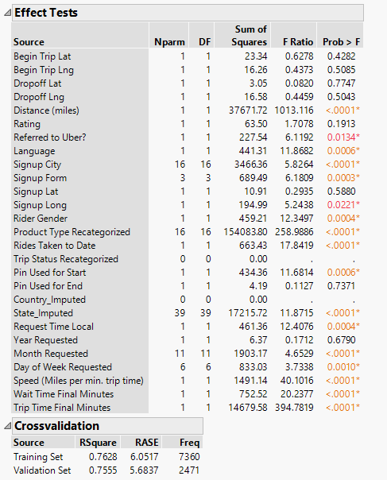
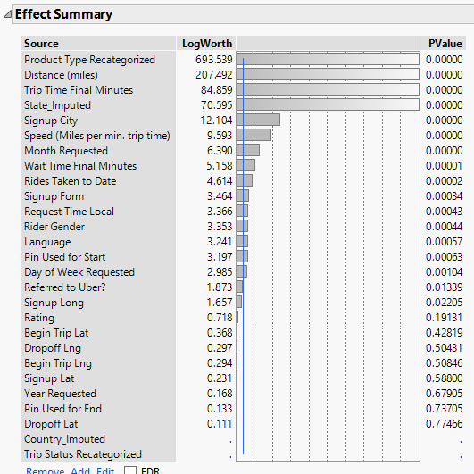
Least Squares Regression
Pricing
Wait Time
Cancellation

Slide 21
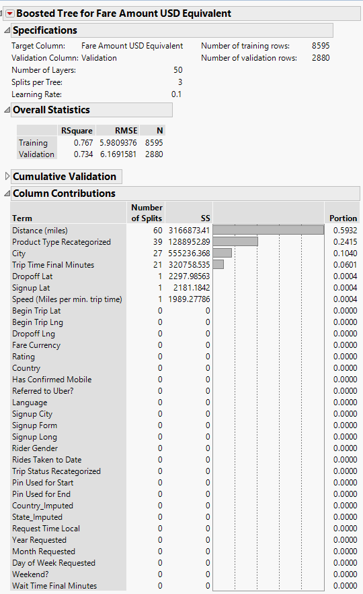
Boosted Tree
Pricing
Wait Time
Cancellation

Slide 22
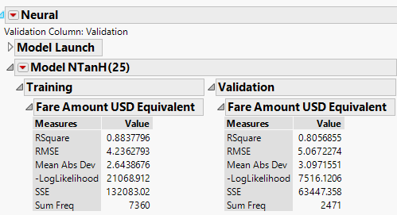
Neural Nets
Pricing
Wait Time
Cancellation

Slide 23
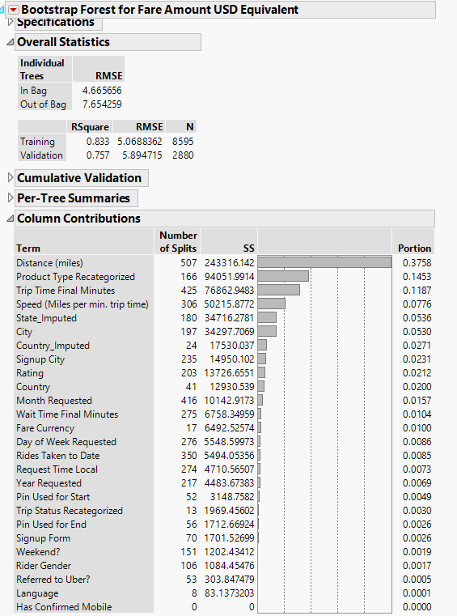
Bootstrap Forest
Pricing
Wait Time
Cancellation

Slide 24
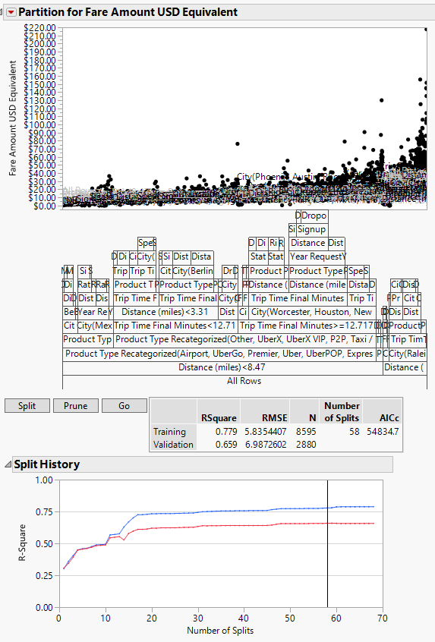
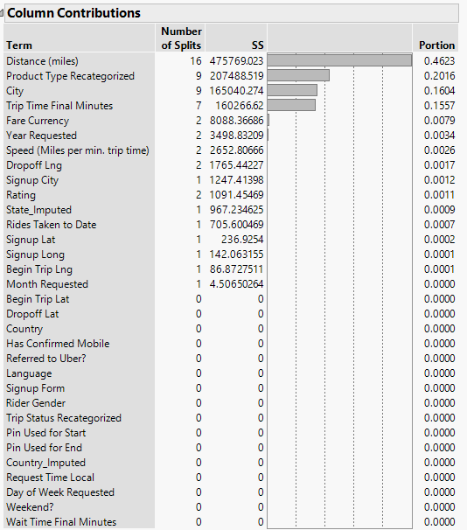
Decision Tree
Pricing
Wait Time
Cancellation

Slide 25
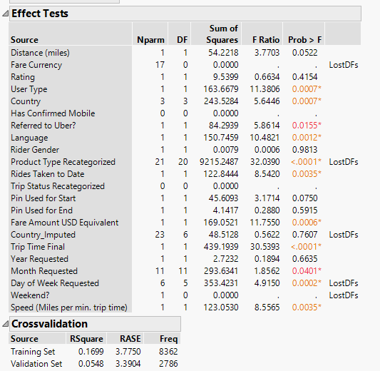
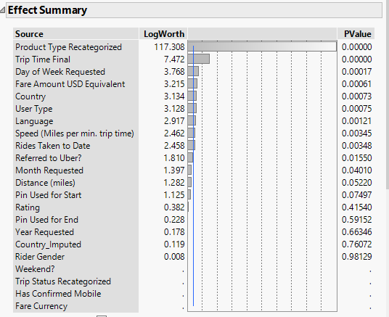
Linear Regression
Pricing
Wait Time
Cancellation

Slide 26
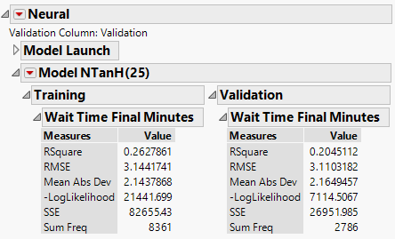
Neural Network
Pricing
Wait Time
Cancellation

Slide 27
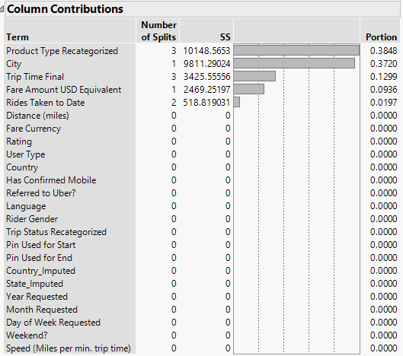
Decision Tree
Pricing
Wait Time
Cancellation

Slide 28
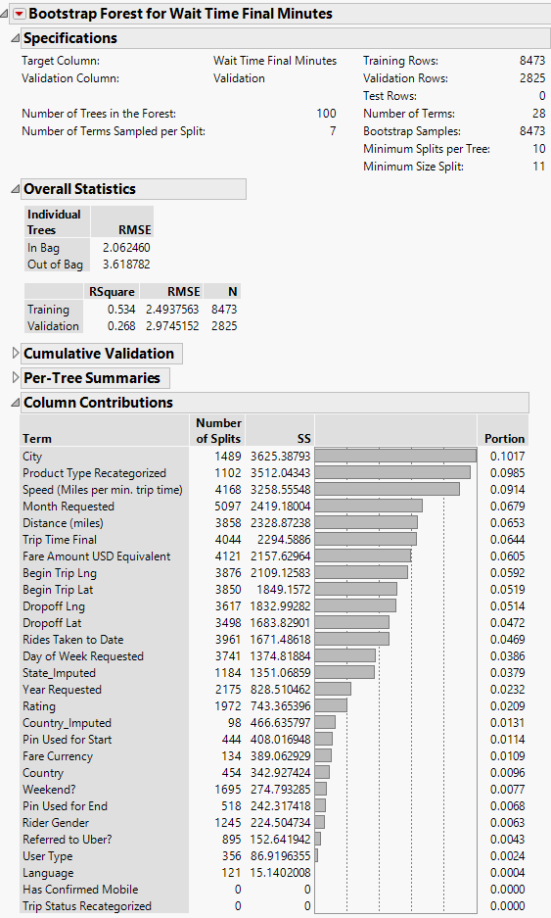
Bootstrap Forest
Pricing
Wait Time
Cancellation

Slide 29
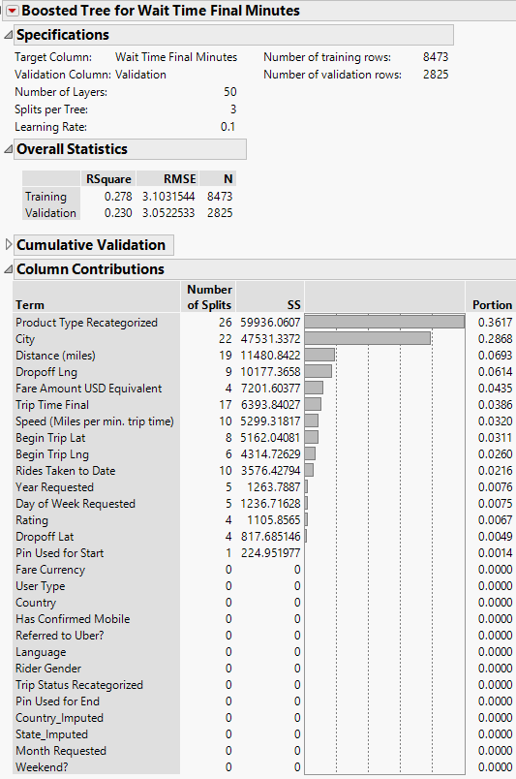
Boosted Tree
Pricing
Wait Time
Cancellation

Slide 30
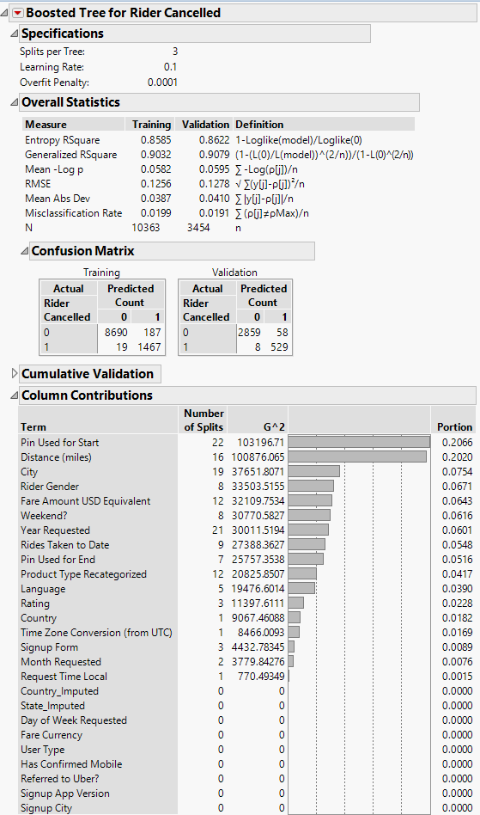
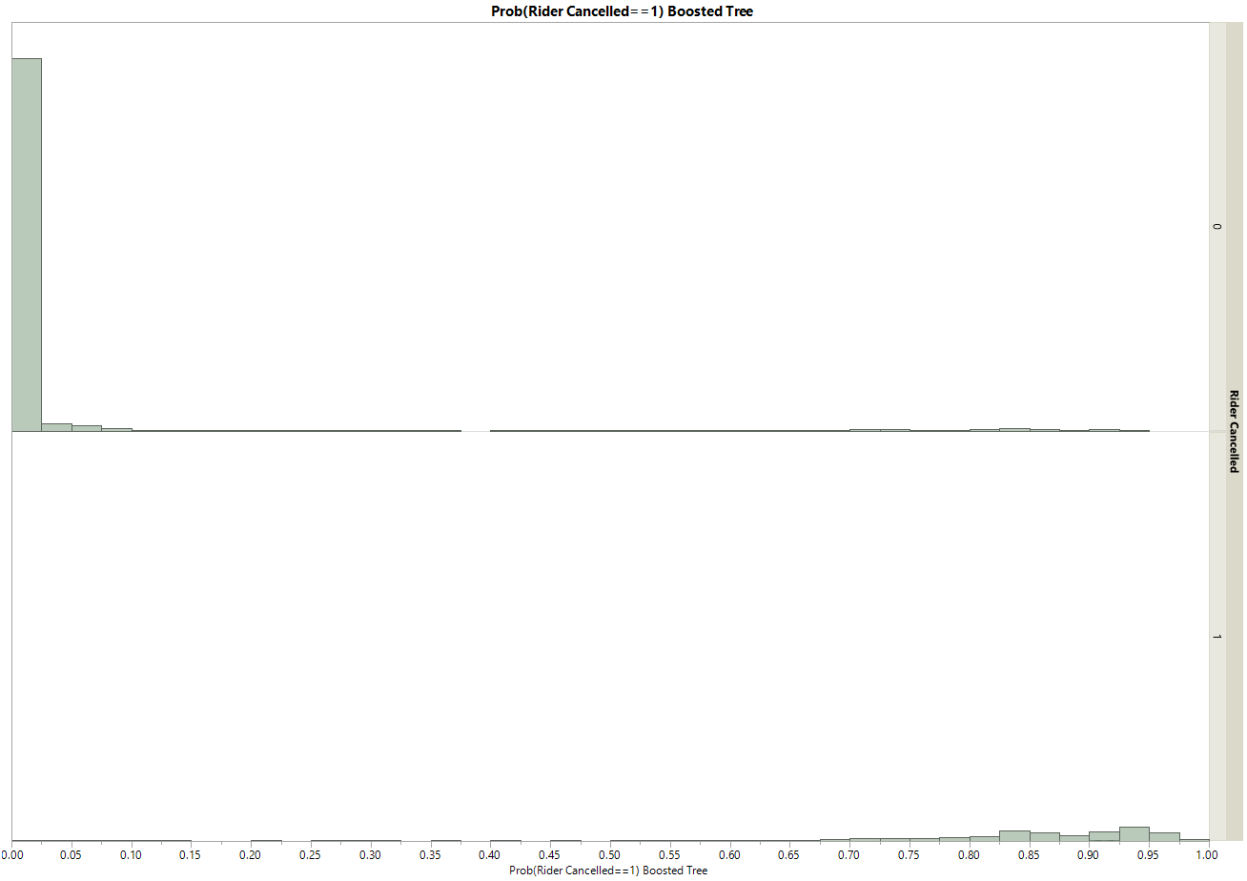
Boosted Tree
Pricing
Wait Time
Cancellation

Slide 31
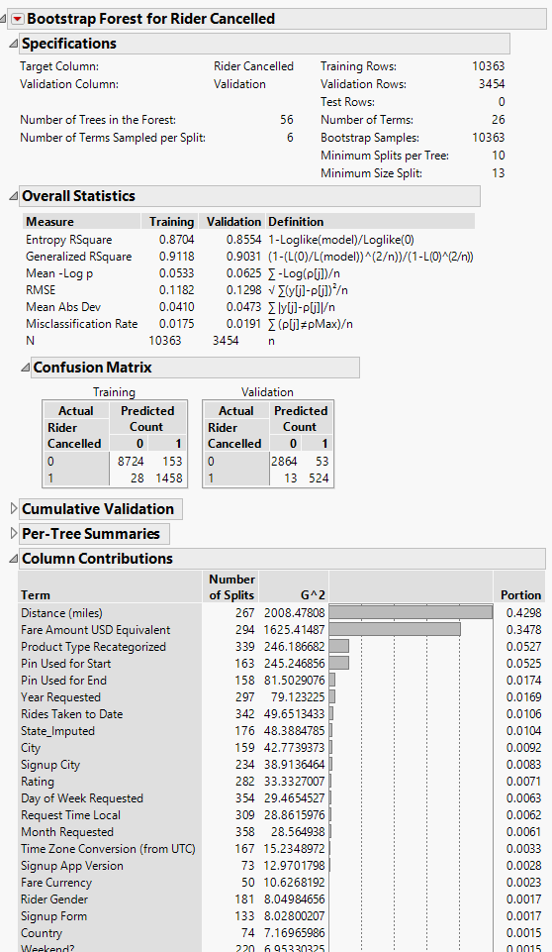
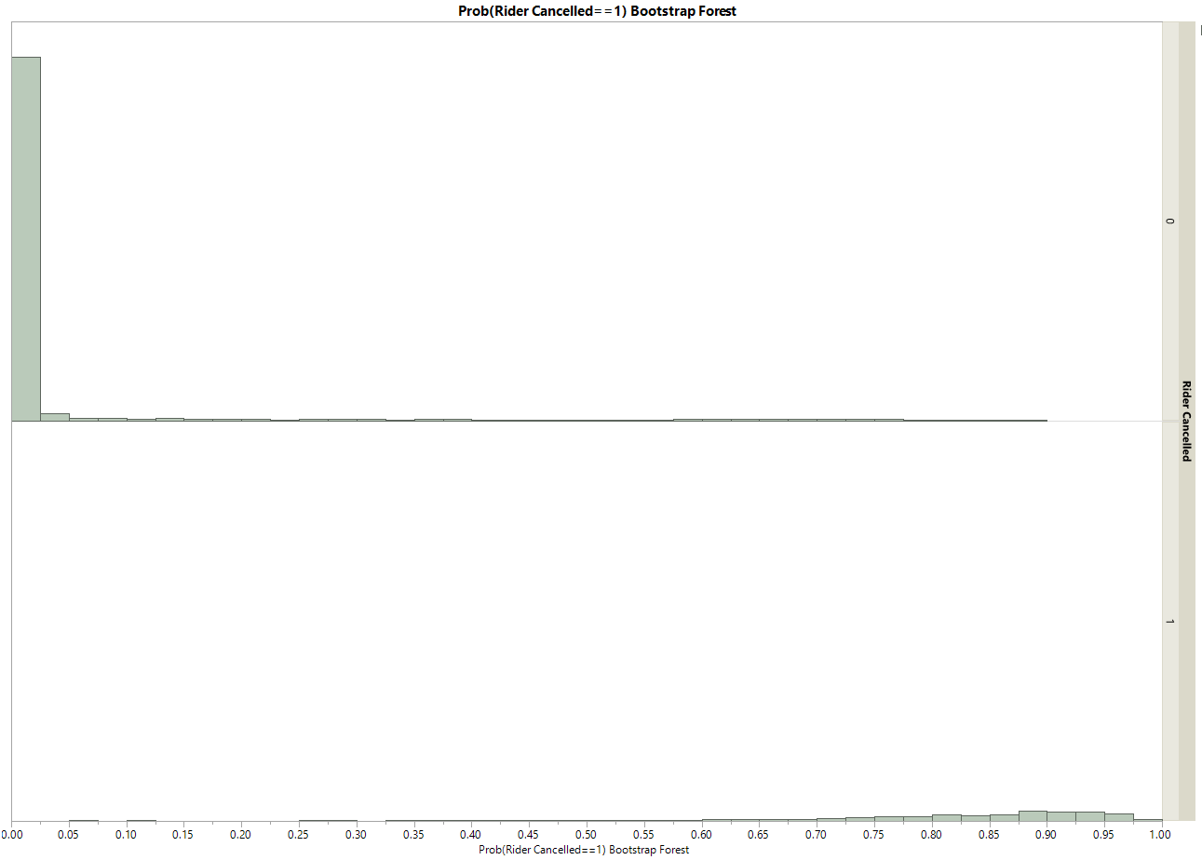
Bootstrap Forest
Pricing
Wait Time
Cancellation

Slide 32
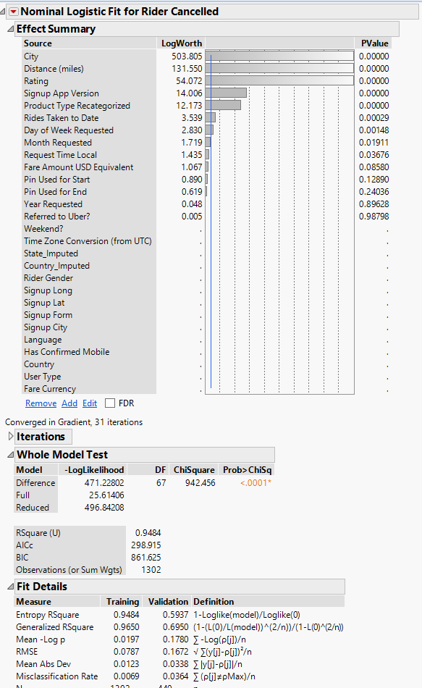
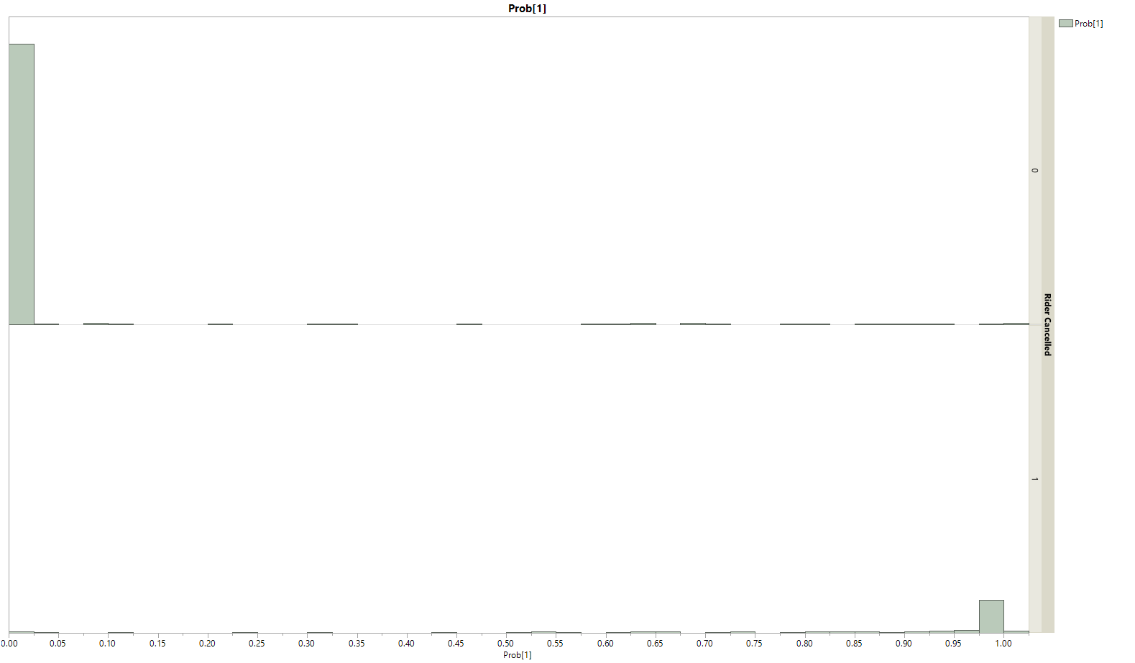
Logistic Regression
Pricing
Wait Time
Cancellation

Slide 33
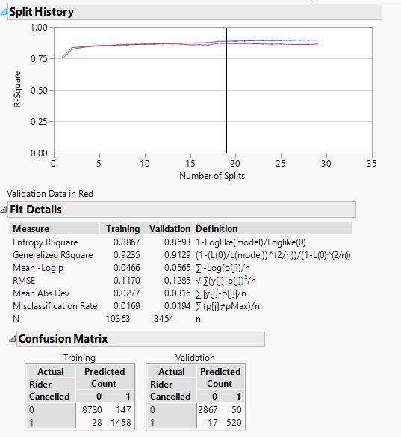
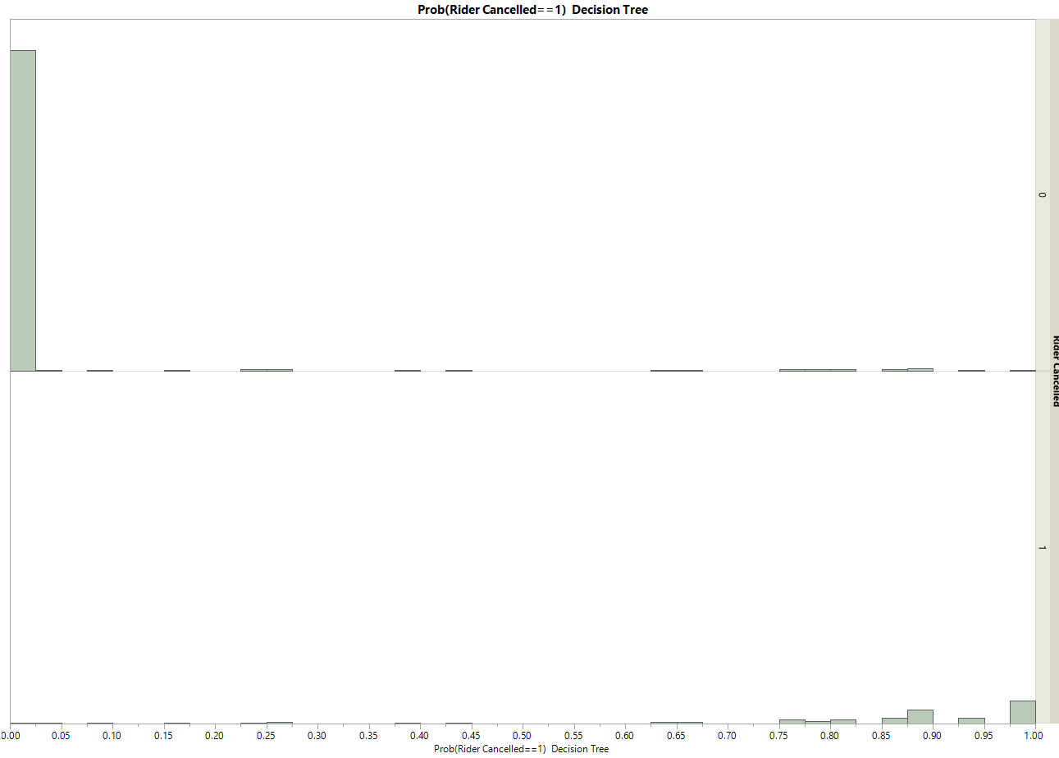
Decision Tree
Pricing
Wait Time
Cancellation

Slide 34
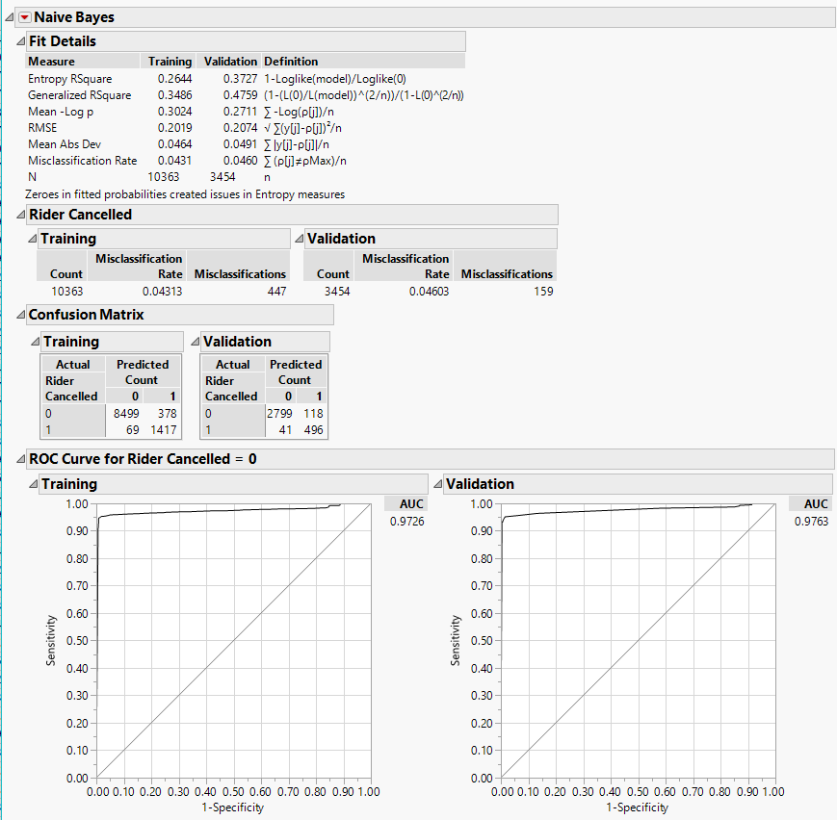
Naïve Bayes
Pricing
Wait Time
Cancellation

Slide 35
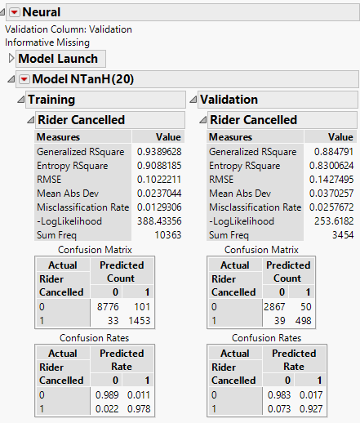
Neural Network
Pricing
Wait Time
Cancellation

