Slide 1
AI in Manufacturing
Alfredo Garza, Richard Rodriguez, Olaleye Bakare, Khizar Khan
09-July-2025

Slide 2
Manufacturing
Production Process
Workflow System
Transforming raw materials into finished goods using machinery, labor, or automation
Involves design, assembly, testing, packaging, and distribution
Scalability Focus
Inductry Backbone
Supports sectors from automotive to electronics by building everything we use
Aimed at producing items in bulk with consistent quality and efficiency

Slide 3
AI in Manufacturing
01
Predictive Maintenance
02
Process Organization
AI identifies early signs of equipment failure to minimize downtime and extend machine life
It analyzes production data to streamline operations, reduce waste, and maximize throughput
03
Quality Control
04
Supply Chain Intelligence
AI forecasts demand, adjusts inventory levels, and improves delivery precision across networks
Vision systems and pattern recognition detect defects in real time—faster and more accurately than manual inspection

Slide 4
Use Case – Quality Control with Machine Vision
AI-powered cameras detect defects in real time with greater accuracy than human inspectors.
Benefit: Minimizes recalls and ensures consistent product standards.
Example: Samsung uses robotic arms and AI to inspect 30,000 to 50,000 components per line* – often in real-time.
*Human inspectors, depending on complexity and fatigue, typically inspect 300–1,000 components per 8 hour shift manually

Slide 5
Techniques Used
Computer Vision
Predictive Analysis
Generative Design
Uses cameras and image analysis to detect defects, measure dimensions, and ensure quality during assembly
Applies machine learning to sensor and historical data to forecast maintenance needs and prevent failures.
AI-driven design algorithms generate optimal product structures based on constraints like materials, load, or cost.

Slide 6
Impacts & Benefits
Impact
Benefit
Increased Production Speed
Enhanced Quality Assurance
Shift in Workforce Roles
Cost Reduction
Data-Driven Decisions
Resource Efficiency
Notes:
Increased Production Speed: AI systems streamline workflows and reduce downtime, accelerating throughput.
Enhanced Quality Assurance: Real-time defect detection leads to fewer recalls and tighter compliance.
Shift in Workforce Roles: Repetitive tasks are automated, enabling human workers to focus on design, supervision, and innovation.
-------------------------
Cost Reduction: Predictive maintenance and smart inventory lower operating and waste-related expenses.
Data-Driven Decisions: AI converts sensor and production data into actionable insights for managers.
Resource Efficiency: Smarter scheduling and energy optimization reduce environmental impact and material waste.

Slide 7
Challenges & Risks
Challenges
Risks
Integration Complexity
Skill Gaps
Data Quality & Consistency
Unexpected Model Behavior
System Downtime
Workforce Disruption
Notes:
Integration Complexity: Merging AI systems with legacy infrastructure can be technically demanding and costly.
Skills Gap: Many facilities lack personnel trained in AI, data science, or advanced analytics—slowing rollout and scaling.
Data Quality & Consistency: AI models depend on clean, structured data—manufacturing environments often struggle with noisy or siloed datasets.
-------------------------
Unexpected Model Behavior: AI may produce misleading outputs if trained on biased or insufficient data, leading to poor decisions.
System Downtime or Overreliance: Heavy dependence on automated systems can create single points of failure if not properly backed up.
Workforce Disruption: Automation may displace certain roles, requiring retraining programs to prevent job loss and morale issues.

Slide 8
Future Trends
Industrial Metaverse & Digital Twins
Impact: Enhances training, quality control, and predictive planning.
Example: Boeing and Airbus use AR and LIDAR-equipped drones for immersive inspections.
AI + Web3 for Supply Chain Transparency
Impact: Boosts traceability, speeds up customs, and cuts paperwork.
Example: IBM and Maersk’s TradeLens system streamlines global shipping with AI-backed smart contracts.

Slide 9
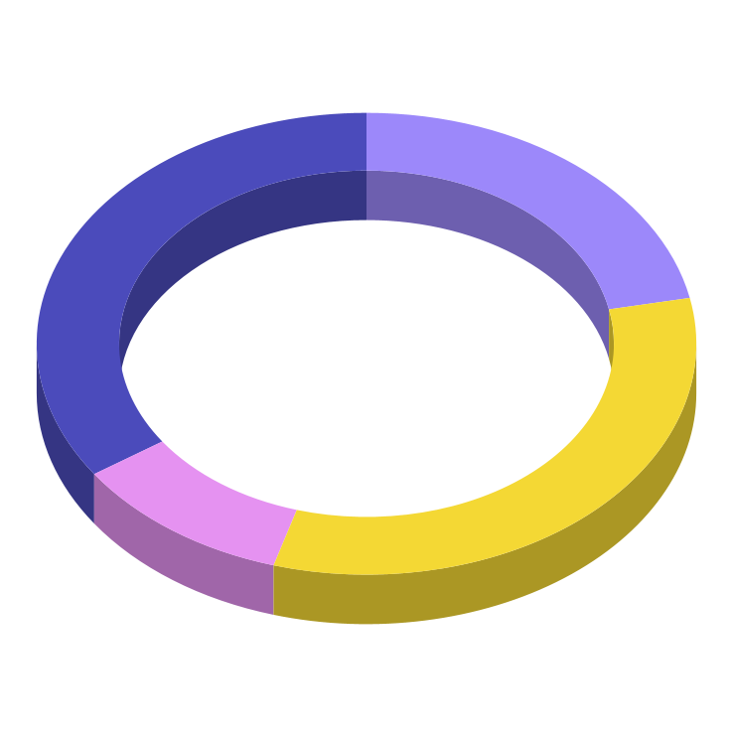
Impact of the risks
33%
20%
Saturn
Moon
Saturn has several rings
The moon is a nice satellite
16%
31%
Mars
Mercury
Despite being red, Mars is cold
Mercury is the smallest planet
Follow the link in the graph to modify its data and then paste the new one here. For more info, click here

Slide 10
“This is a quote. Words full of wisdom that someone important said and can make the reader get inspired.”
—Someone Famous

Slide 11
Strategic options: risks
Neptune is the farthest planet from the Sun
Venus has a beautiful name, but it’s terribly hot
Market development
Diversification
and correlation
New
Market
Market penetration
Product development
Current
Mars is terribly hot, even hotter than Mercury
Jupiter is the biggest planet in the Solar System
Recommended strategy
Current
Products
New

Slide 12
Key drivers of the profit
 | Description | Example
The situation | Saturn is a gas giant and the only planet with rings of them all | Venus has a beautiful name and extremely high temperatures
The complication | Jupiter is a gas giant and the biggest planet in our Solar System | Mars is a dusty, cold, desert world with a very thin atmosphere
The question | Mercury is the closest planet to the Sun and the smallest of them all | The Earth is the beautiful planet where we all live. It’s the blue planet

Slide 13
New market, new product, new company
Saturn is the planet with rings. It doesn’t have a solid surface
Desirability
Profitability
Feasibility
Jupiter is a gas giant and the biggest planet in our Solar System
Neptune is the farthest planet from the Sun. It’s an ice giant
Sweet spot

Slide 14
Consulting proposal
Services
Fees
Invoices
Mercury is the closest planet to the Sun
Venus is the second planet from the Sun
Mars is actually a very cold place
Expenses
Materials
Terms
Jupiter is the biggest planet of them all
Saturn is a gas giant and has rings
Neptune is very far away from the Earth

Slide 15

Cognizent: Gen AI Smart Manufacturing Demo

Slide 16
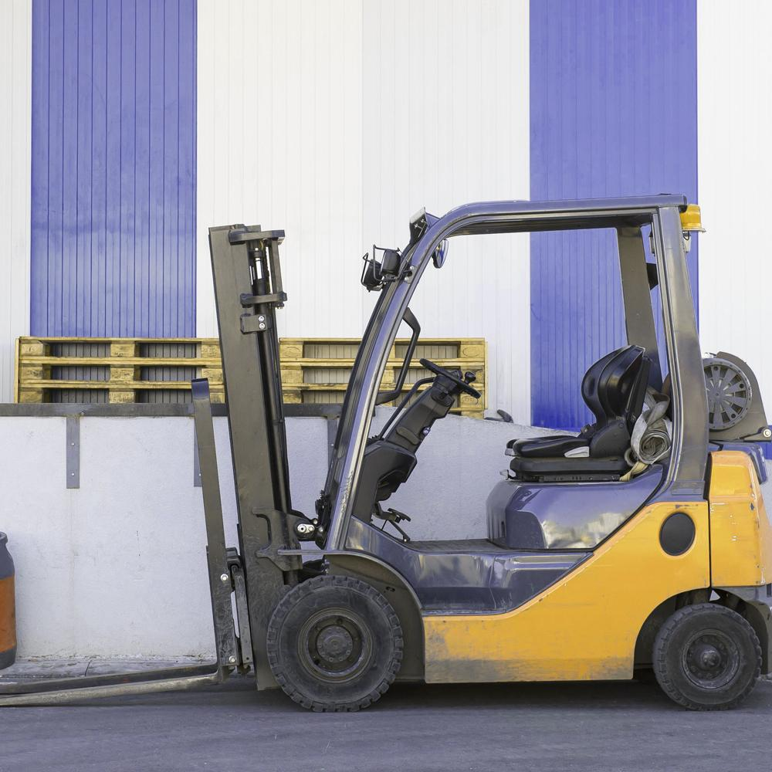
Conclusion
AI in manufacturing is revolutionizing how goods are designed, produced, and distributed, bringing unprecedented efficiency, precision, and adaptability to industrial workflows. By integrating intelligent systems into maintenance, quality assurance, and supply chain management, manufacturers can reduce waste, increase output, and make smarter, data-driven decisions. As adoption grows, AI will continue to reshape the workforce and unlock new frontiers in design innovation, sustainability, and operational resilience.

Slide 17
Annual profitable growth
Plan
Despite being red, Mars is a cold place. The planet is full of iron oxide dust
OCT 2022
Adapt
Saturn is the planet with rings. It’s a gas giant composed mostly of hydrogen
JAN 2023
Test
Mercury is the closest planet to the Sun and the smallest one in the Solar System
JUN 2024
Report
Jupiter is a gas giant and the biggest planet in the Solar System
FEB 2025

Slide 18
Answers and supporting arguments
Reduce costs by $5 millions through operational improvements
Outsource non-core functions to save $3M
Simplify core function processes to save $1M
Review supplier cost to save $1M
Evaluate cost and service level of potential partners
Design current processes
Select and review current supplier costs
Select non-core functions
Compare current process to best-in-class benchmarks
Evaluate cost of potential alternative suppliers
Choose one partner for each function
Adopt best practices based on benchmarks
Negotiate supplier contracts/choose options

Slide 19
Initiative prioritization matrix
High
Longer term
To be prioritized
List all your potential initiatives and projects
Assess the impact & effort level associate with each initiative
Impact
Unattractive
Low value
Insert the position each initiative on the matrix
Mainly focus on the initiatives located in the top of the matrix
Low
High
Effort
Low

Slide 20
Prioritization matrix
Initiative 1
Initiative 2
Initiative 3
You can describe here your initiative one
You can describe here your initiative two
You can describe here your initiative three
Jupiter is a gas giant and the biggest planet in our Solar System
Is the closest planet to the Sun and the smallest one in the Solar System
Is a gas-giant planet and therefore does not have a solid surface
Impact
Is the ringed one. It’s a gas giant, composed mostly of hydrogen
Venus has a beautiful name and is the second planet from the Sun
Earth is also the only planet in our solar system with liquid water
Effort

Slide 21
Business case
1
Mercury is the smallest planet
Business name
4
Earth is the planet we all live on
Company
logo here
2
Venus has a beautiful name
5
Saturn is a gas giant and has rings
3
Mars is actually a very cold place
6
Neptune is very far away from the Earth
XX/XX/XX

Slide 22
Competitor comparison table
 | Competitor 1 | Competitor 2 | Competitor 3
Revenue | 1,450,000$ | 1,050,000$ | 950,000$
Profit | 295,000$ | 325,000$ | 145,000$
Market share | 23% | 14% | 6%
Employees | 165 | 78 | 52
Product quality

Slide 23
Implement, track & manage progress
Manage progress
Progress
Status
Link
Venus
10%
www.yourlinkhere.com
Mars
20%
www.yourlinkhere.com
Neptune
30%
www.yourlinkhere.com
Jupiter
40%
www.yourlinkhere.com
Earth
50%
www.yourlinkhere.com
Ceres
60%
www.yourlinkhere.com

Slide 24
Changing management strategy & plan
Size of the change
Insert name of the change | Insert name of the change | Insert name of the change
 |  | Insert name of the change | Insert name of the change | Insert name of the change
 |  |  | Insert name of the change
 |  |  |  | Insert name of the change
 |  |  |  | Insert name of the change
Extreme
High
Medium
Complexity of the change
Moderate
Low
1 team impacted
1 business unit
1 division
Half company
Extreme

Slide 25
Sales and strategy plan
1
2
3
Implementation
Internal analysis
External analysis
5
4
Sales strategy
Sales plan

Slide 26
Management approach
Jupiter is the biggest planet of them all
Saturn is a gas giant and has several rings
February
April
June
August
January
Venus is the second planet from the Sun
Despite being red, Mars is a very cold place

Slide 27
Strategic alliances
Profitability
Feasibility
Jupiter is a gas giant and the biggest planet in our Solar System
Despite being red, Mars is a very cold place full of iron oxide dust

Slide 28
Answers and arguments
Write here your question
Write here your answer
Jupiter
Saturn
Sirius
It’s the farthest planet from the Sun
Saturn is the only planet with rings
Sirius is the brightest star in the night sky

Slide 29
Waterfall management plan
Requirements
Neptune is the farthest planet from the Sun
Design
Venus terribly hot, even hotter than Mercury
Implementation
Mercury is the closest planet to the Sun
Verification
Saturn is a gas giant and the only planet with rings
Maintenance
Jupiter is a gas giant and the biggest planet

Slide 30
Maturity model
Basic
Standard
Advanced
Mercury is the closest planet to the Sun and the smallest of them all
Venus has a beautiful name and is the second planet from the Sun
Despite being red, Mars is actually a cold place. It’s full of iron oxide dust
30%
50%
70%

Slide 31
Profitability ratios
Worst peer
Best peer
Return on sales (%)
%
%
Return on equity (%)
%
%
Return on net assets (%)
%
Return capital employed (%)
%
%
Return on funds employed (%)
%
%
Company 1
Company 2
Company 3

Slide 32
Top 10 questions of business plans
What is your current situation?
What are the requirements?
What is your vision?
What are the economics?
How will you reach your vision?
What will the marketing plan be?
What do you offer?
What are the economics?
How big is the market you are in?
What are the requirements?
1
6
2
7
3
8
4
9
5
10

Slide 33
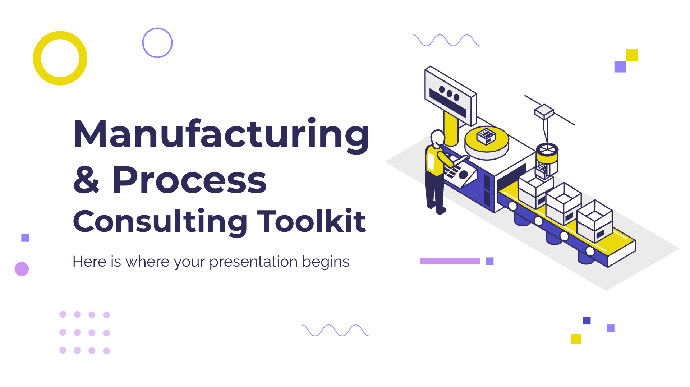
Demo software & app
You can replace the image on the screen with your own work. Right click on it and choose "Replace image" so you can add yours

Slide 34
Alternative resources

Slide 35
Alternative resources
Photos
Vectors
People working together in an warehouse I
People working together in an warehouse II
People in safety equipment working
Men working with heavy objects
Colleagues in safety equipment at work
Manufacturing infographic concept
Manufacturing infographic template

Slide 36
Resources
Cognizant. (2023). Gen AI Smart Manufacturing Demo of the Factory Whisperer [Video]. YouTube. https://www.youtube.com/watch?v=7Az5yEm-9K4
Microsoft. (2024). Transforming manufacturing with industrial AI [Video series]. Microsoft Videos. https://videos.microsoft.com/transforming-manufacturing-with-industrial-ai
OpenAI. (2023). ChatGPT (Mar 14 version) [Large language model]. https://chat.openai.com/chat
Grammarly. (2023, July 6). How to cite ChatGPT and AI in APA format. Grammarly Blog. https://www.grammarly.com/blog/citations/ai-citations-apa/
Detecting-AI.com. (2025, March 8). How to cite AI-generated content in APA style. https://detecting-ai.com/blog/how-to-cite-ai-generated-content-in-apa-style
McAdoo, T. (2024, February 23). How to cite ChatGPT. APA Style Blog. https://apastyle.apa.org/blog/how-to-cite-chatgpt

Slide 37
Fonts & colors used
This presentation has been made using the following fonts:
Montserrat
(https://fonts.google.com/specimen/Montserrat)
Raleway
(https://fonts.google.com/specimen/Raleway)
#2d2958
#4b4bbb
#9c88fa
#f4d834
#edc4f2
#e592f1
#ececec

