Slide 1
AI in Healthcare
Alfredo Garza
09-Jun-2025

Slide 2
What is Healthcare
Healthcare is the improvement or maintenance of health via the prevention, diagnosis, and treatment of disease, injury and physical or mental illness.
A key challenge in this field is many physicians and patients may be reluctant to start relying on AI-driven diagnostics and treatment recommendations.
Predictive analytics for disease prevention help analyze patient data to accurately predict potential health risks and recommend preventive measures .

Slide 3
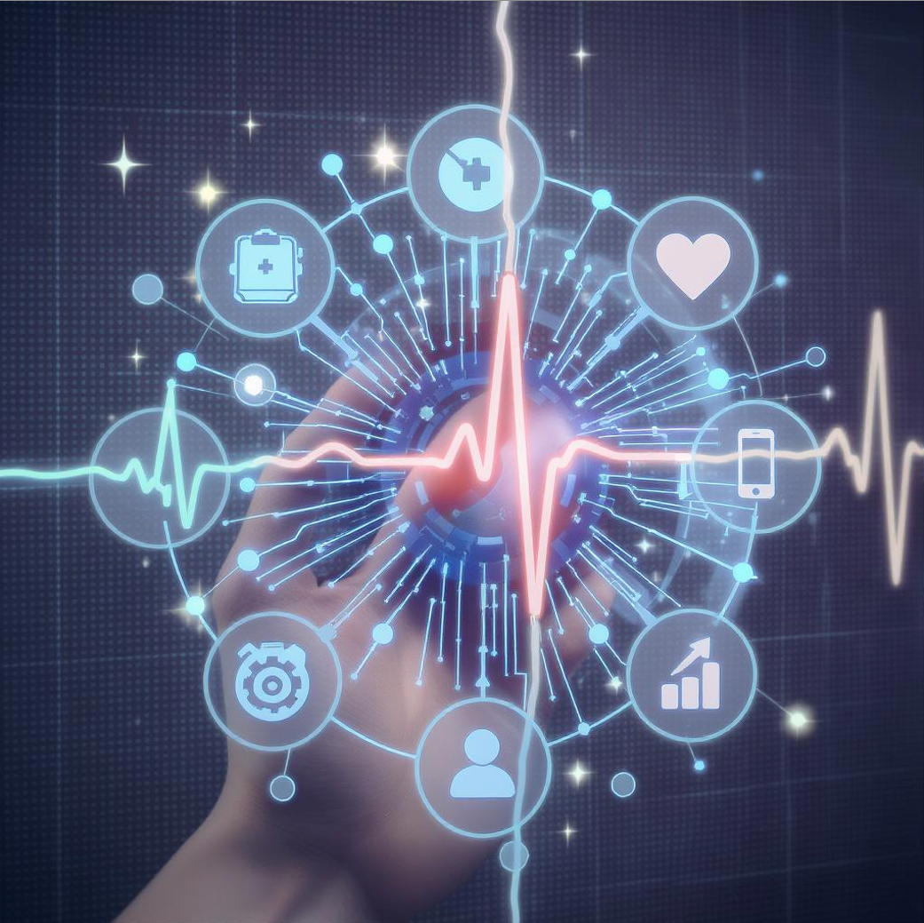
AI Use Case Motivation - Explainability
How to build trust in AI forecasts and predictive treatment recommendations
Example: Hospitals being adoption of explainable AI (XAI) to help Healthcare professionals verify AI-driven discoveries which are then relayed to patients

Slide 4
AI Techniques Used in Health care
Convolutional Neural Networks (CNNs): Analyse medical images (e.g., X-rays, MRIs) for disease detection.
Natural Language Processing (NLP): Extract insights from clinical notes, patient records.
Recurrent Neural Networks (RNNs): Predict patient outcomes from time-series data.
Reinforcement Learning: Optimize treatment plans, resource allocation.
Timeline: AI in radiology (2010s), NLP in EHRs (2020s).
Visual: Simplified CNN diagram for radiology.

Slide 5
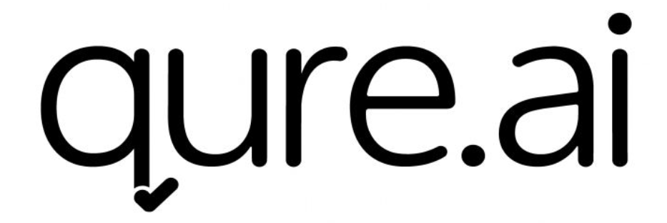
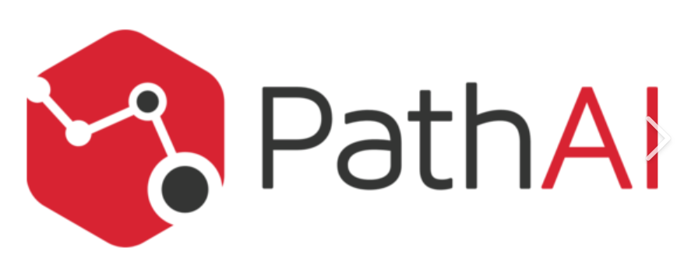

Key Applications (Case Studies)
Qure.ai – An FDA cleared solution to detect, measure and track biometrics. Products include Lung Caner Suite (detect early-stage lung cancers on chest X-rays) and Emergency Suite (detect expanding findings like Pulmonary Embolisms, brain bleeds and collapsed lungs.
PathAI – AI-powered pathology application used for drug and diagnostic development. These include quantifying cancer-causing biomarkers in patients, spatial characteristics of tumors on a microscopic scale.
Aidoc – A clinical AI solution to unify healthcare AI platforms to improve workflows and patient data accuracy. This connection of care teams across specialties and departments.
Notes:
https://www.qure.ai/us
https://www.acrobiosystems.com/L-408-PD-L1.html
https://www.aidoc.com/

Slide 6
Impact & Benefits
Improved Diagnostics : AI detects cancer at 95% accuracy, reducing misdiagnosis. Efficiency: Reduces radiologists time on image analysis by 30%. Cost Savings: Reduces healthcare expenditure through early diagnosis. Patient Outcomes: Treatments are adjusted to pateints to achieve higher recovery rates. Social Impact: Provides greater access to diagnostics in remote towns . Economic Benefit: Potential U.S. healthcare savings of $150B by 2026.

Slide 7
Challenges & Risks
Data Privacy: Protecting sensitive patient data according to HIPAA.
Fairness: Biased algorithms pose risk of unequal care provision.
Regulation: FDA approvals complicate hospital adoption of AI.
Data Quality: Poor quality EHR data affects model accuracy.
Ethical Concerns: Manipulative use of AI in patient triage.

Slide 8
Future Directions
Multimodal AI: Combines imaging, text, genomics for whole-patient diagnostics.
Federated Learning: Trains models across hospitals without data exchange.
Responsible AI: Focus on fairness, transparency in healthcare AI.
Precision Medicine: AI tailors treatments to individual patient genetics.
Open Problem: Real-time AI integration in emergency medicine.
Innovation: Wearable AI for continuous patient monitoring.

Slide 9
Conclusion
AI’s Role: Enhances diagnostics, efficiency, and personalized care in healthcare.
Key Impact: Saves lives, reduces costs, improves access.
Challenges Remain: Privacy, fairness, and regulatory hurdles.
Future Promise: Multimodal AI, federated learning for innovation.
Call-to-Action: Support ethical AI development for equitable healthcare.

Slide 10
Demo ??

Slide 11
References & Acknowledgments
Litjens, G., et al. (2017). Deep learning in medical imaging. Nature, 542(7640), 155–159. www.nature.com/articles/nature21056
MIMIC-III dataset: Critical care database. (2020). PhysioNet. physionet.org/content/mimiciii/1.4/
CheXpert dataset: Chest X-ray dataset. (2019). Stanford University. stanfordmlgroup.github.io/projects/chexpert/
TensorFlow: Open-source ML framework. (2025). Google. www.tensorflow.org
Acknowledgments: Team members for research, Dr. Smith for guidance.
FDA. (2024). AI/ML-based medical devices. www.fda.gov/medical-devices

Slide 12
Add a Slide Title - 4

Slide 13
Add a Slide Title - 5

