Slide 1
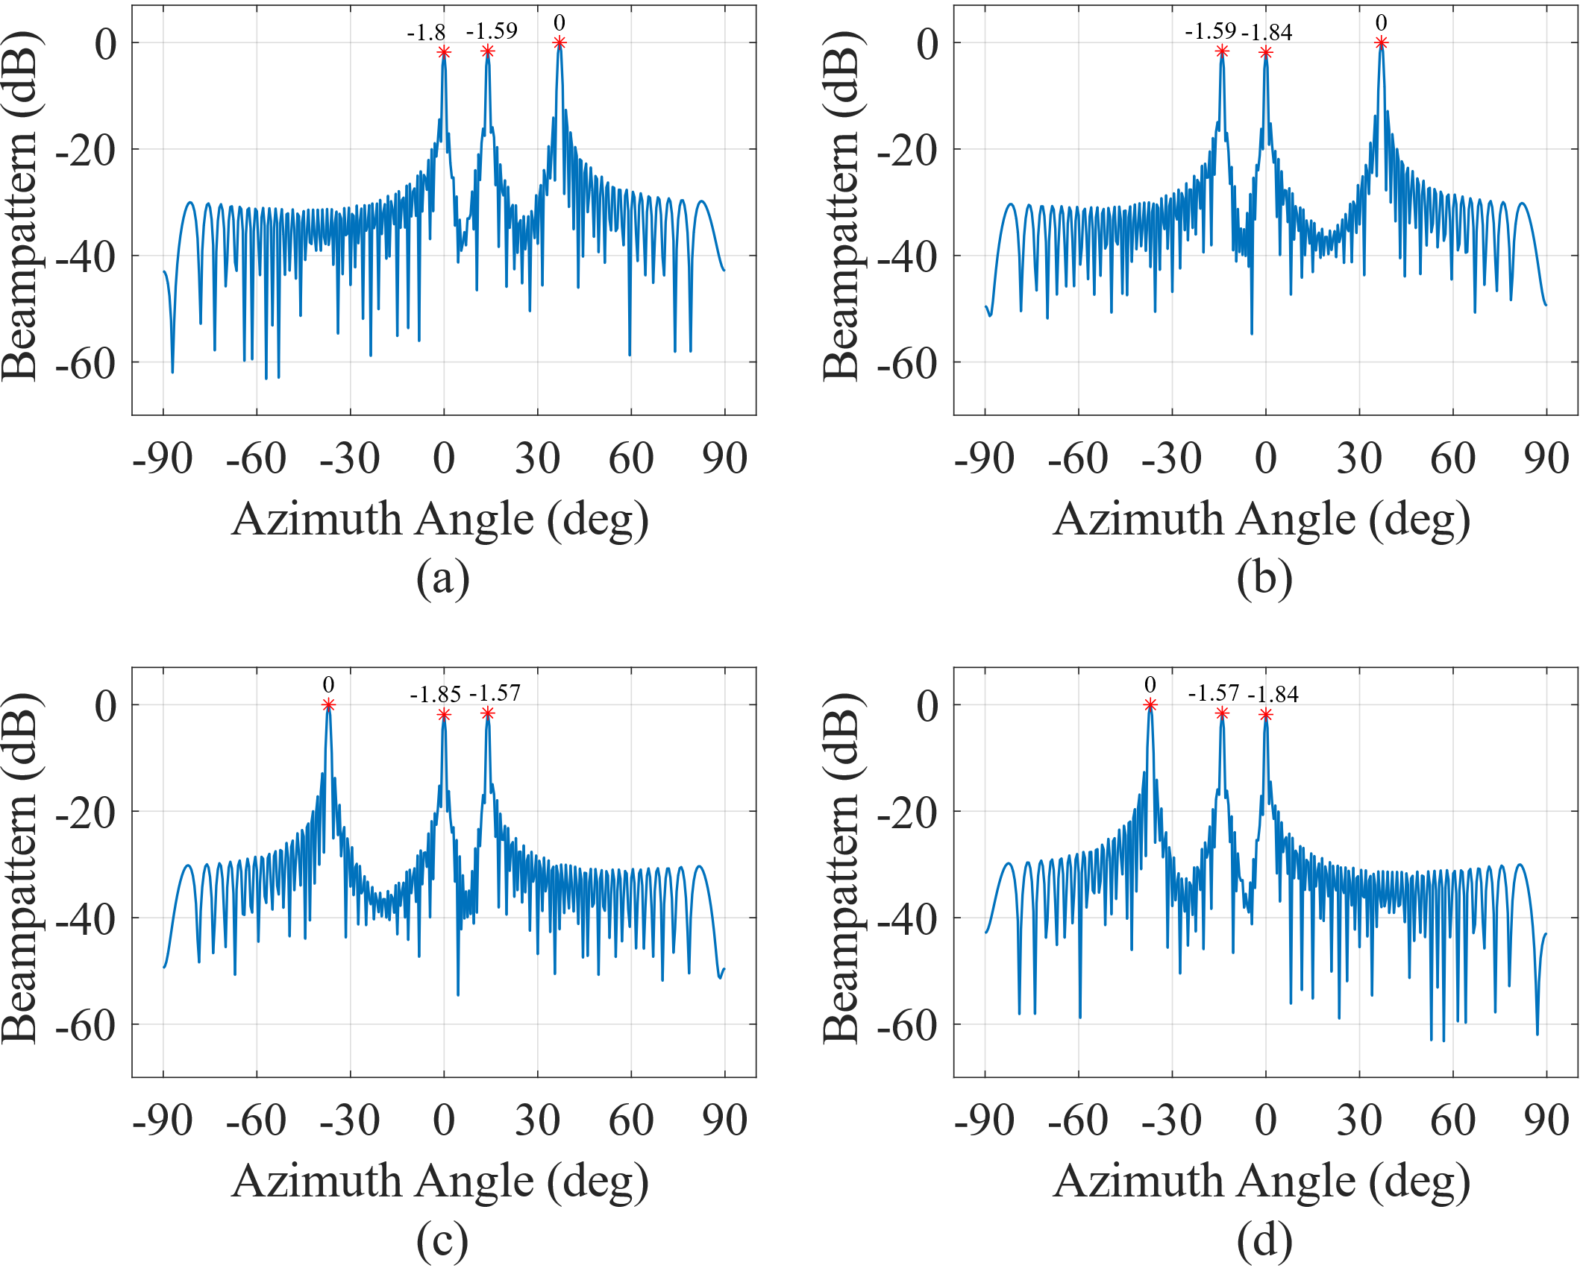
T1
T3
T1
T4
T2
T2
T1
T3
T4
T2
T3
T4

