Slide 1
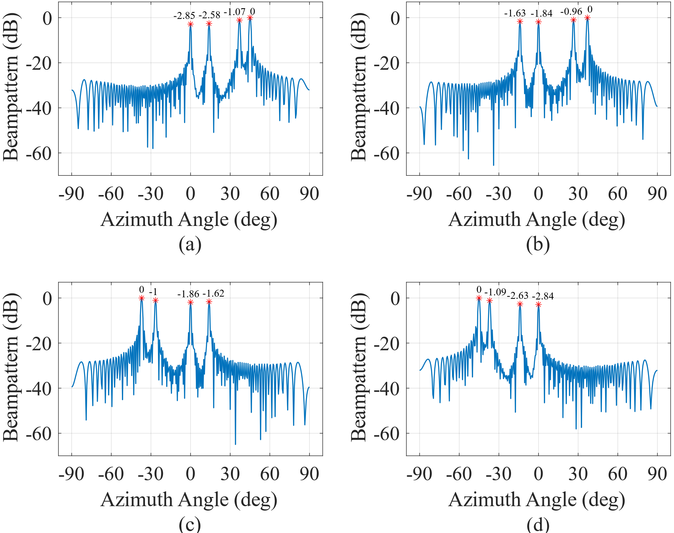
T1
T4
T1
T4
T2
T3
T2
T3
T1
T4
T1
T4
T2
T2
T3
T3

