Slide 1
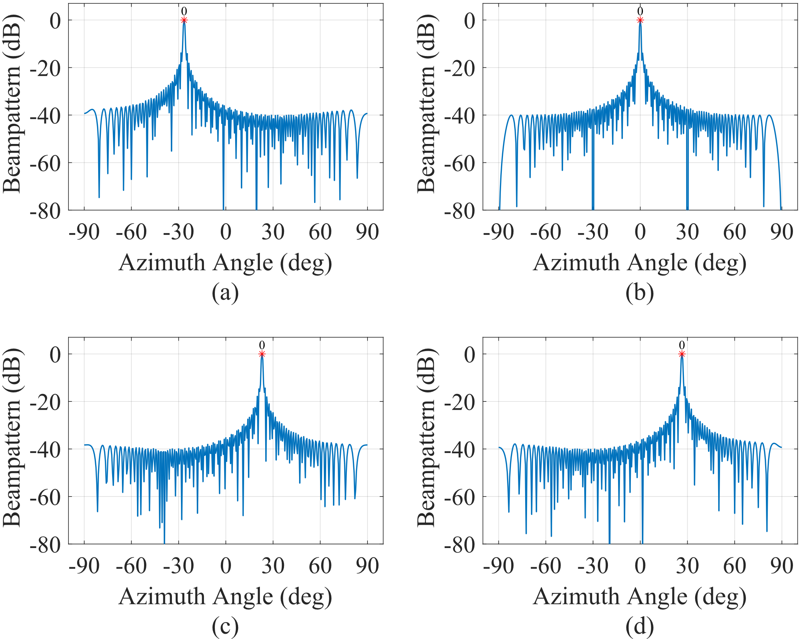
T1
T2
T3
T4

