Slide 1
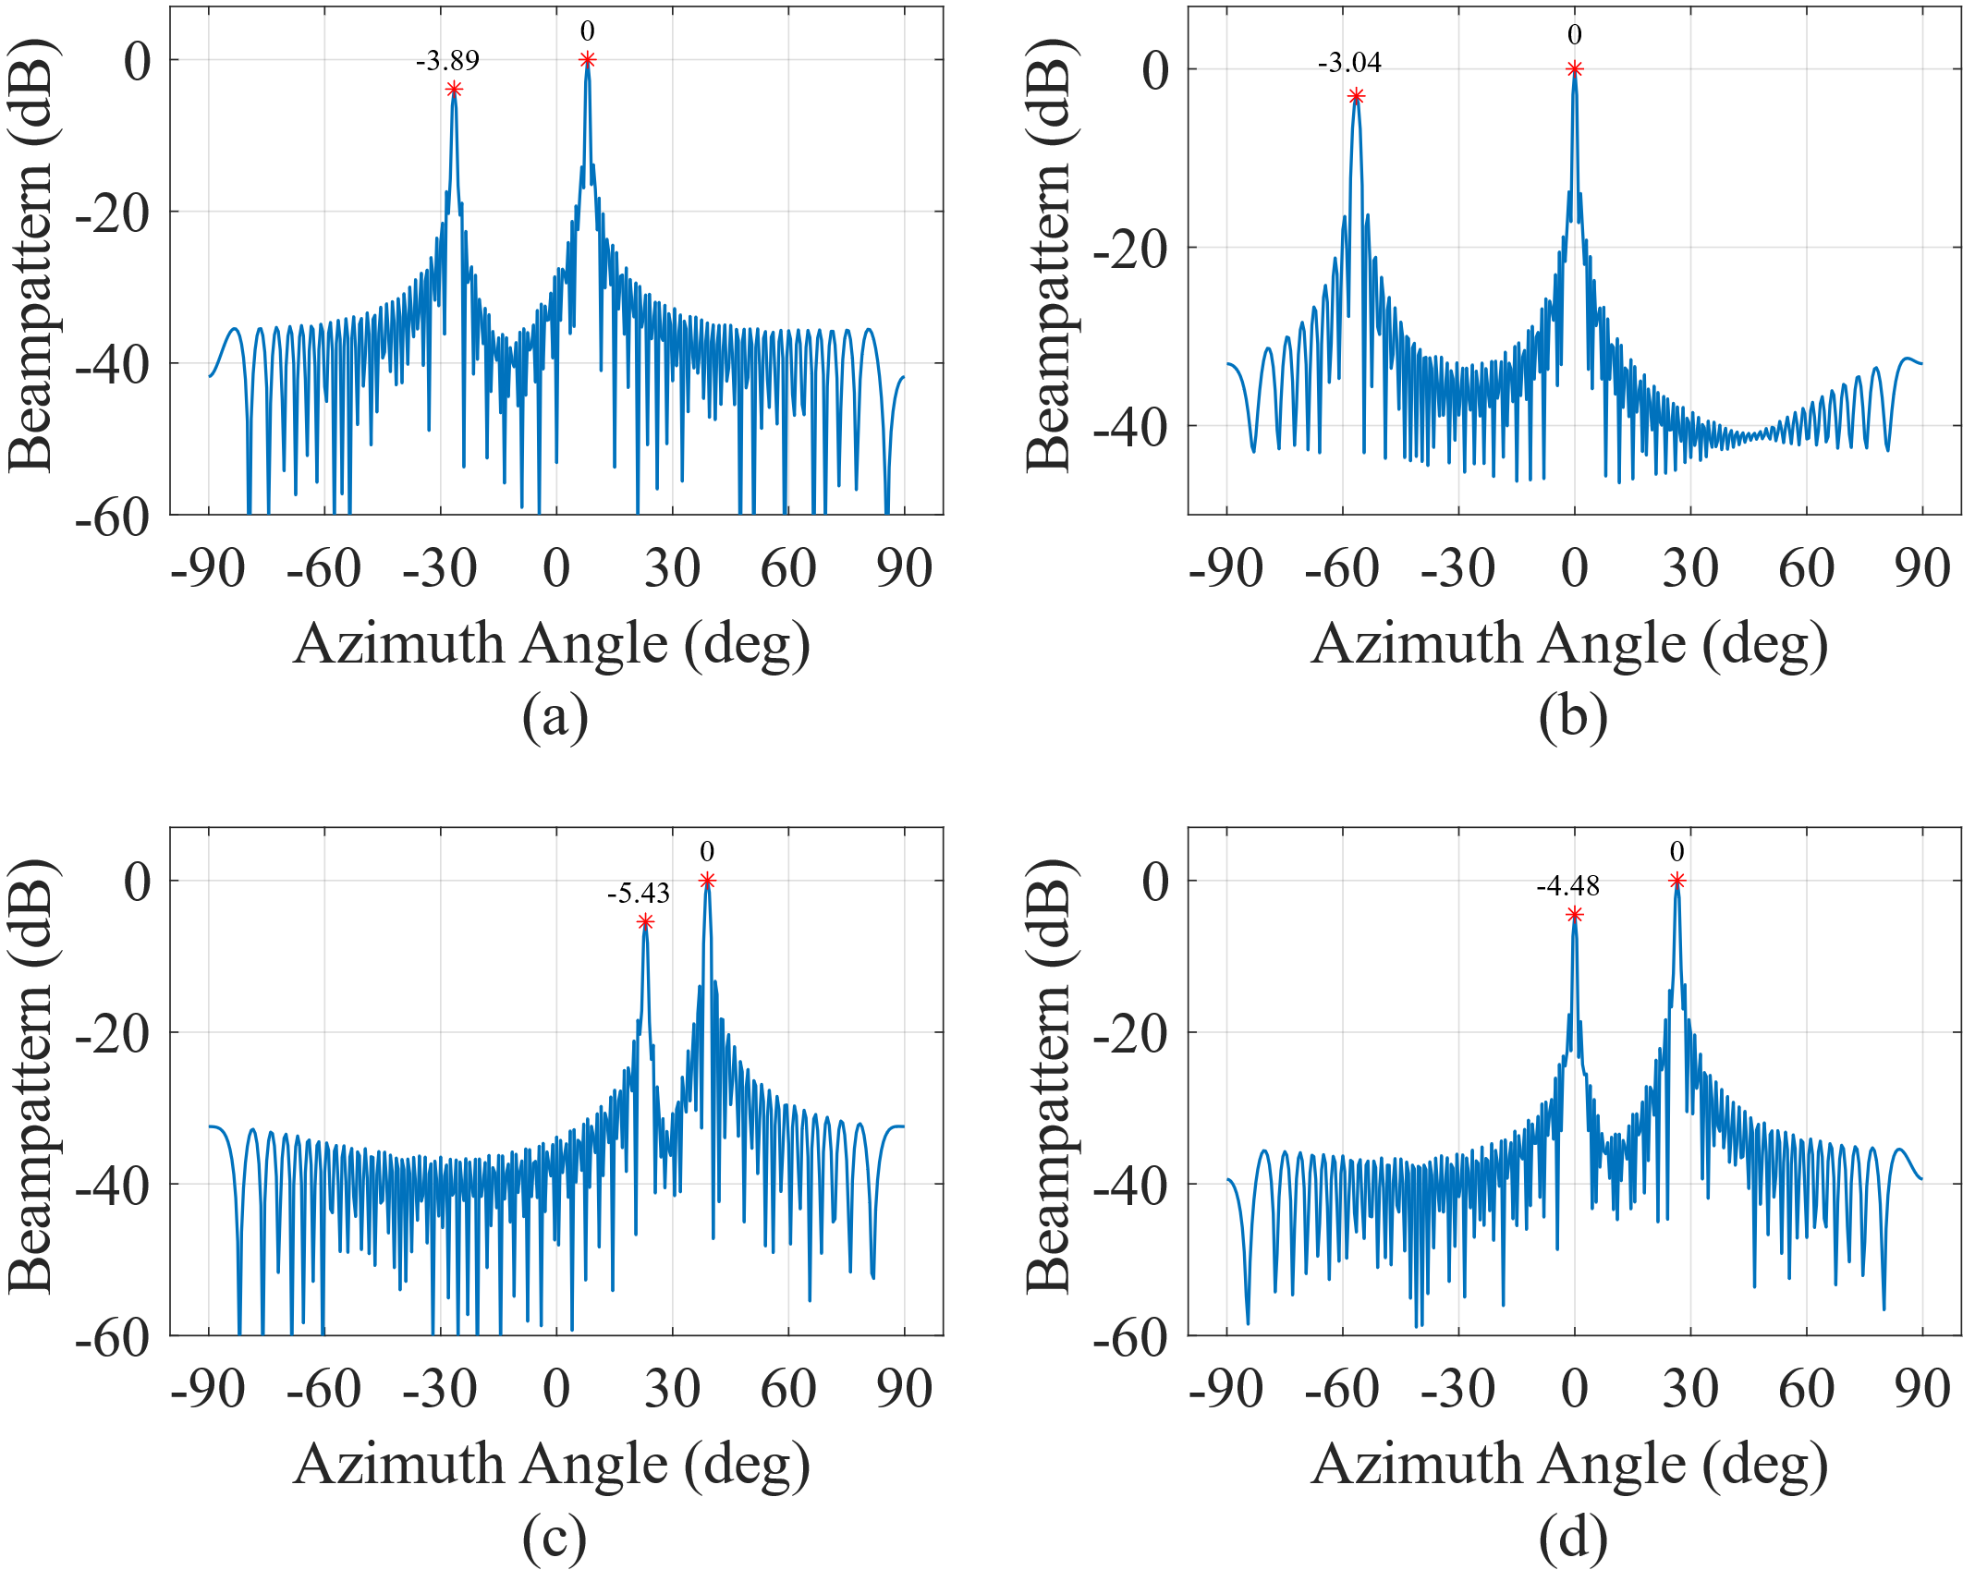
T1
T2
T1
T2
T4
T4
T3
T3

