Slide 1
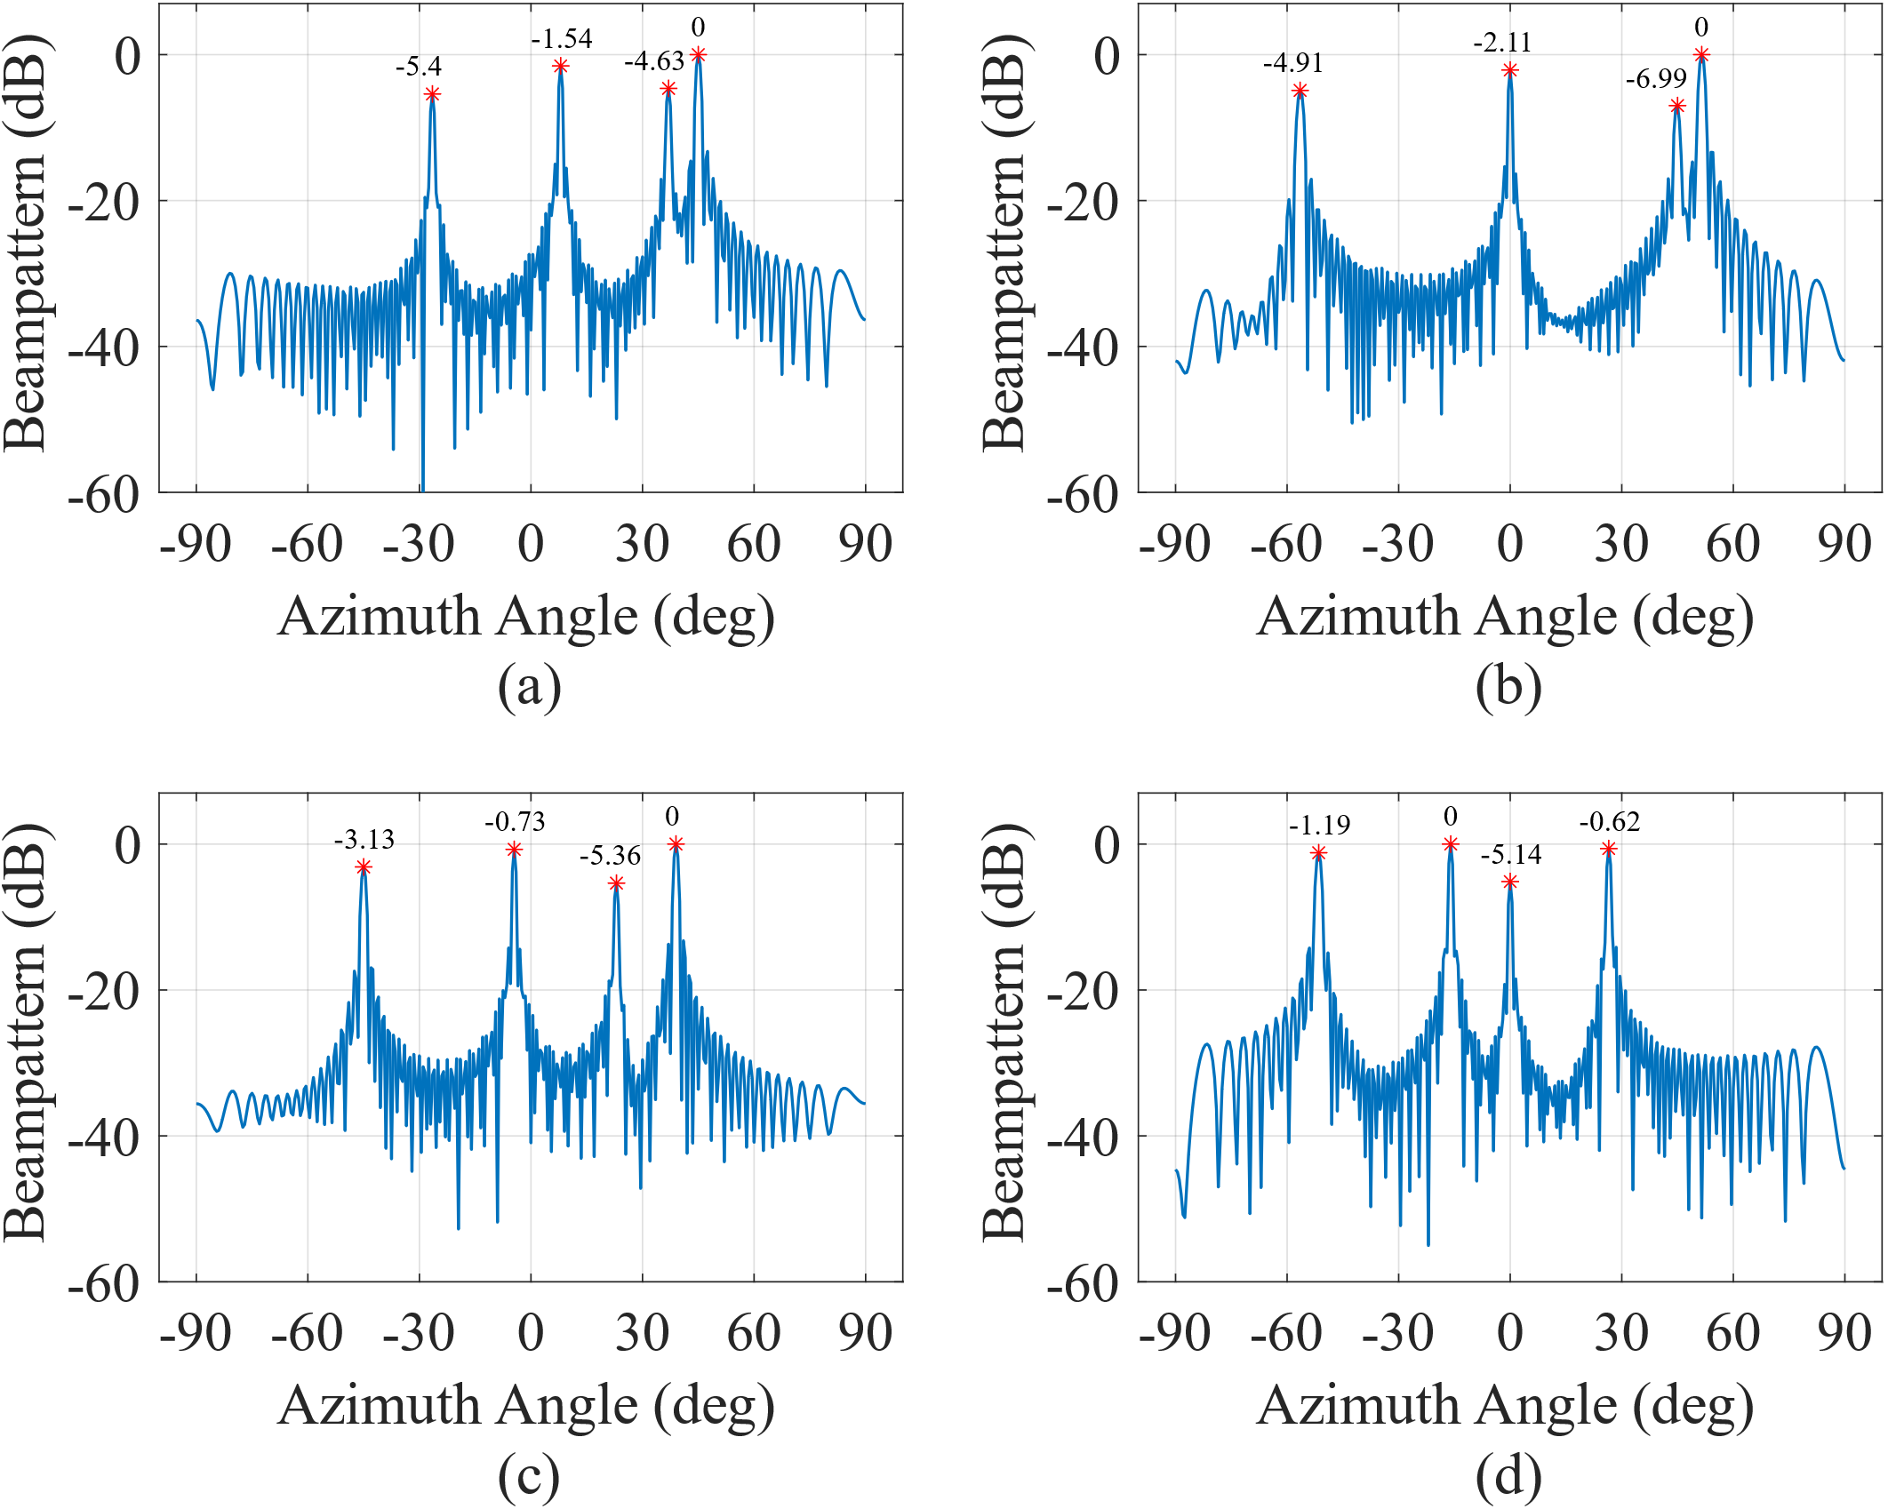
T2
T4
T2
T4
T1
T3
T1
T3
T1
T2
T4
T1
T2
T4
T3
T3

