Slide 1
CMUSV Smart Community Ontology Framework
Presenters: Mark Hennessy
Advisors: Steve Ray

Slide 2
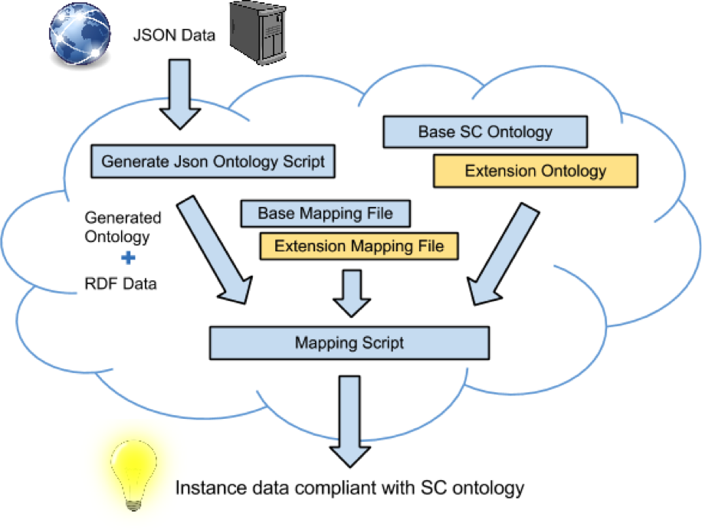
Overview

Slide 3
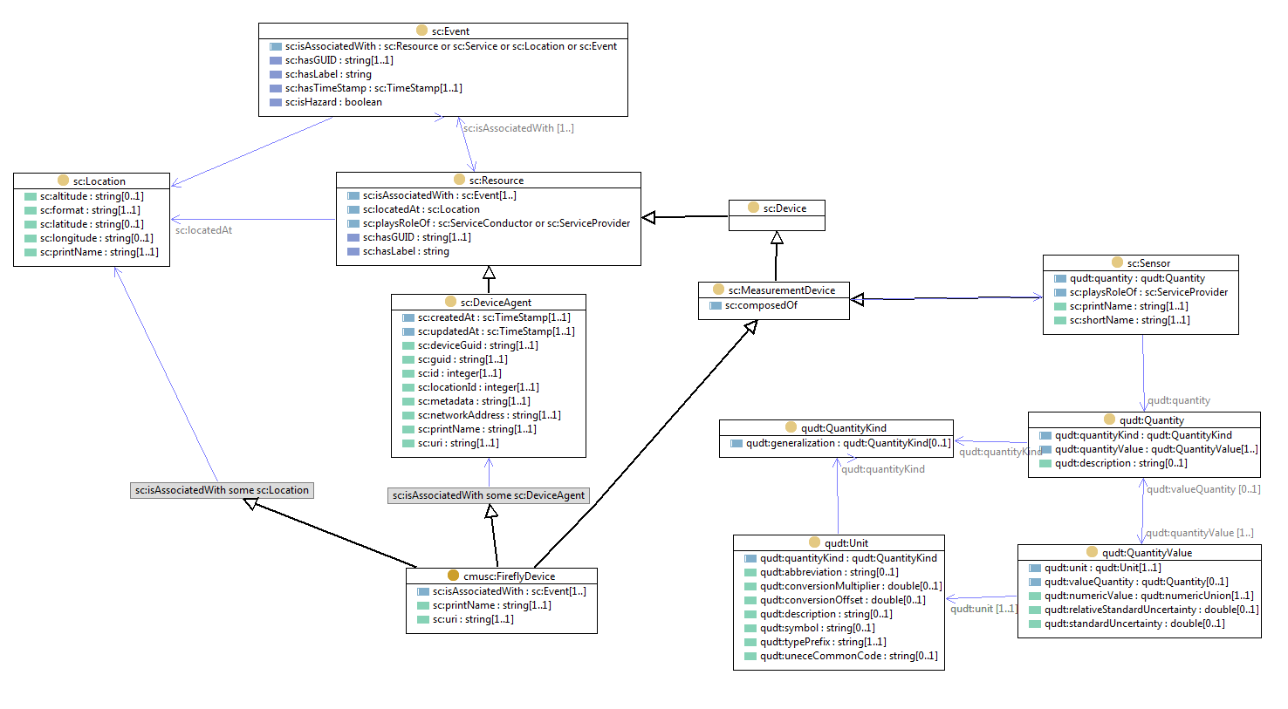
Smart Community Ontology Overview

Slide 4
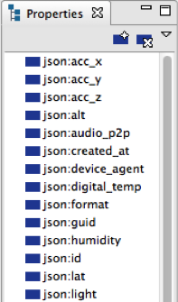
Properties Generated from JSON

Slide 5
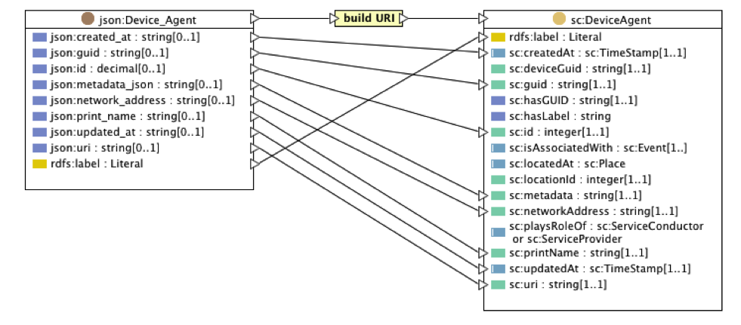
Mapping JSON to SC Ontology

Slide 6
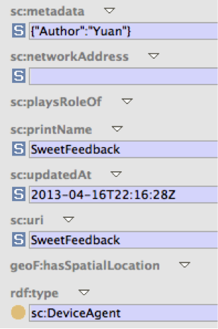
Output - SC Instance Data

Slide 7

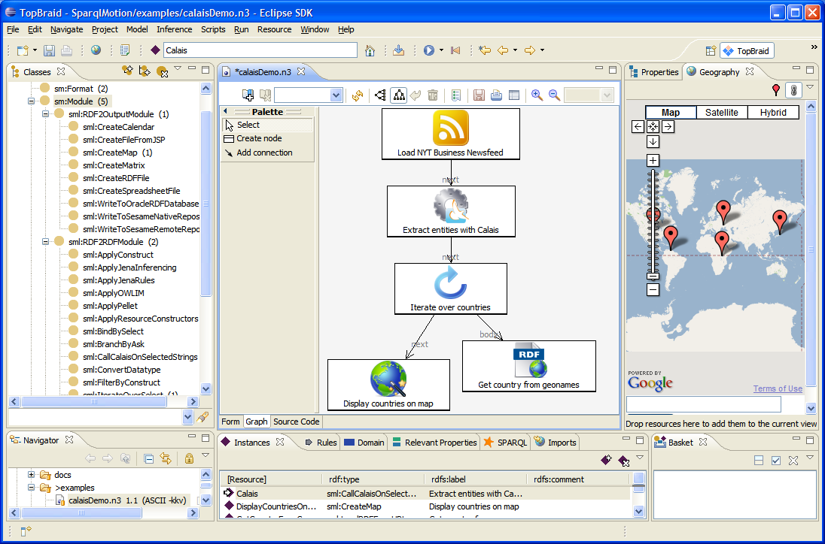
Dev Environment

Slide 8
Next Steps
Enhance ontology framework
Improve data-type generation
Generate multi-directional relationships
Improve process automation
Strengthen CMU-SV Smart Community Ontology
Use framework and output to learn about SC domain
Expand SC base ontology
Create extension ontologies for specialized domains

Slide 9
Git Repositories
Current: https://github.com/cmusv/SmartCommunity
Moving to: https://github.com/SensorServicePlatform/Ontology

Slide 10
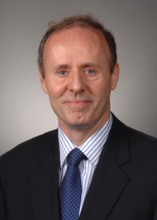
Contact Information
Steve Ray
Distinguished Research Fellow
Carnegie Mellon Silicon Valley
steve.ray@sv.cmu.edu
650-587-3780

