Slide 1
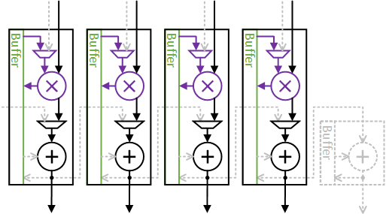
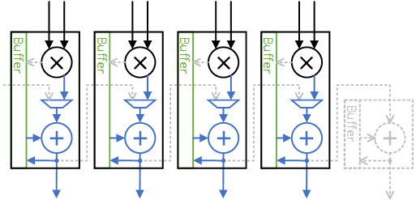
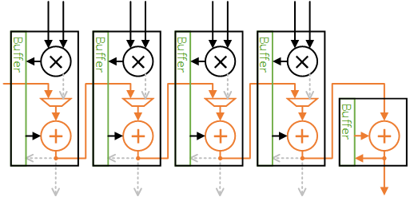
Parallel Mode
Cumulative product
Cascade Mode

Slide 2
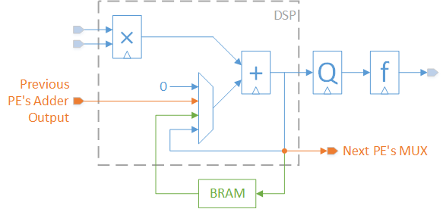
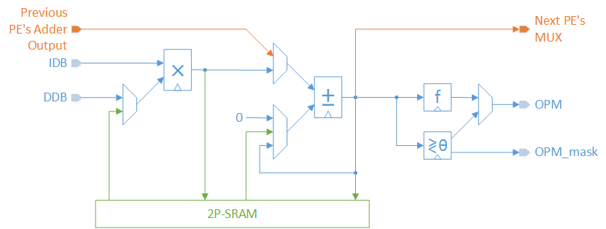

Slide 3
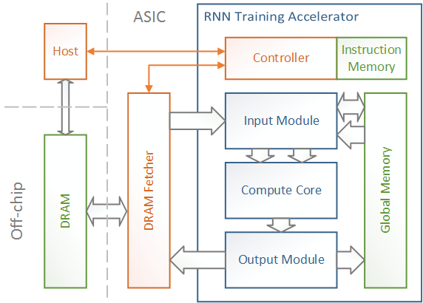
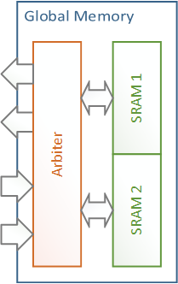

Slide 4
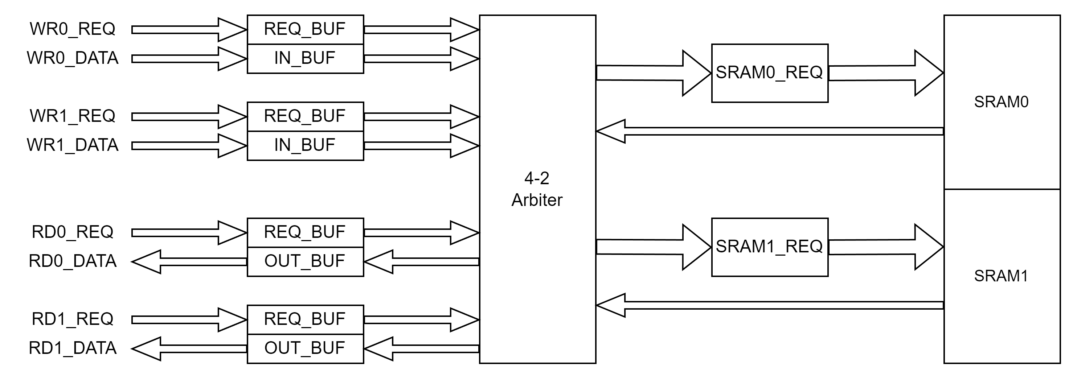
SMEM controller

Slide 5
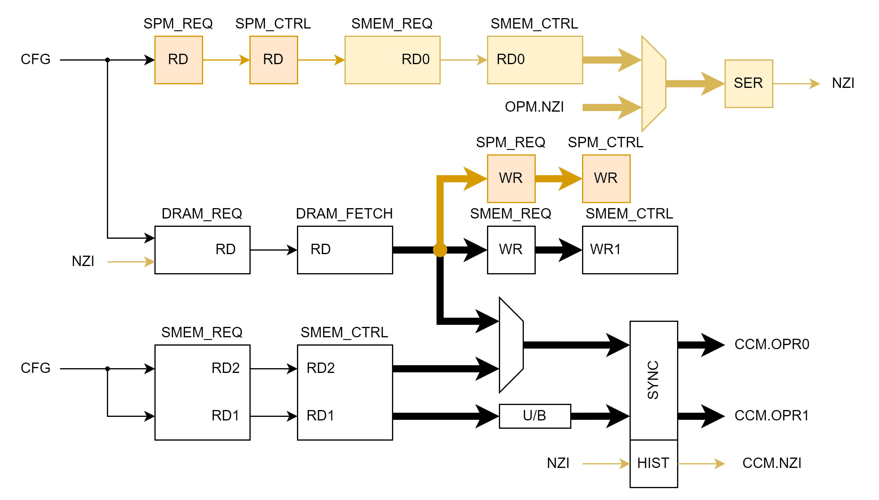
Input Module

Slide 6
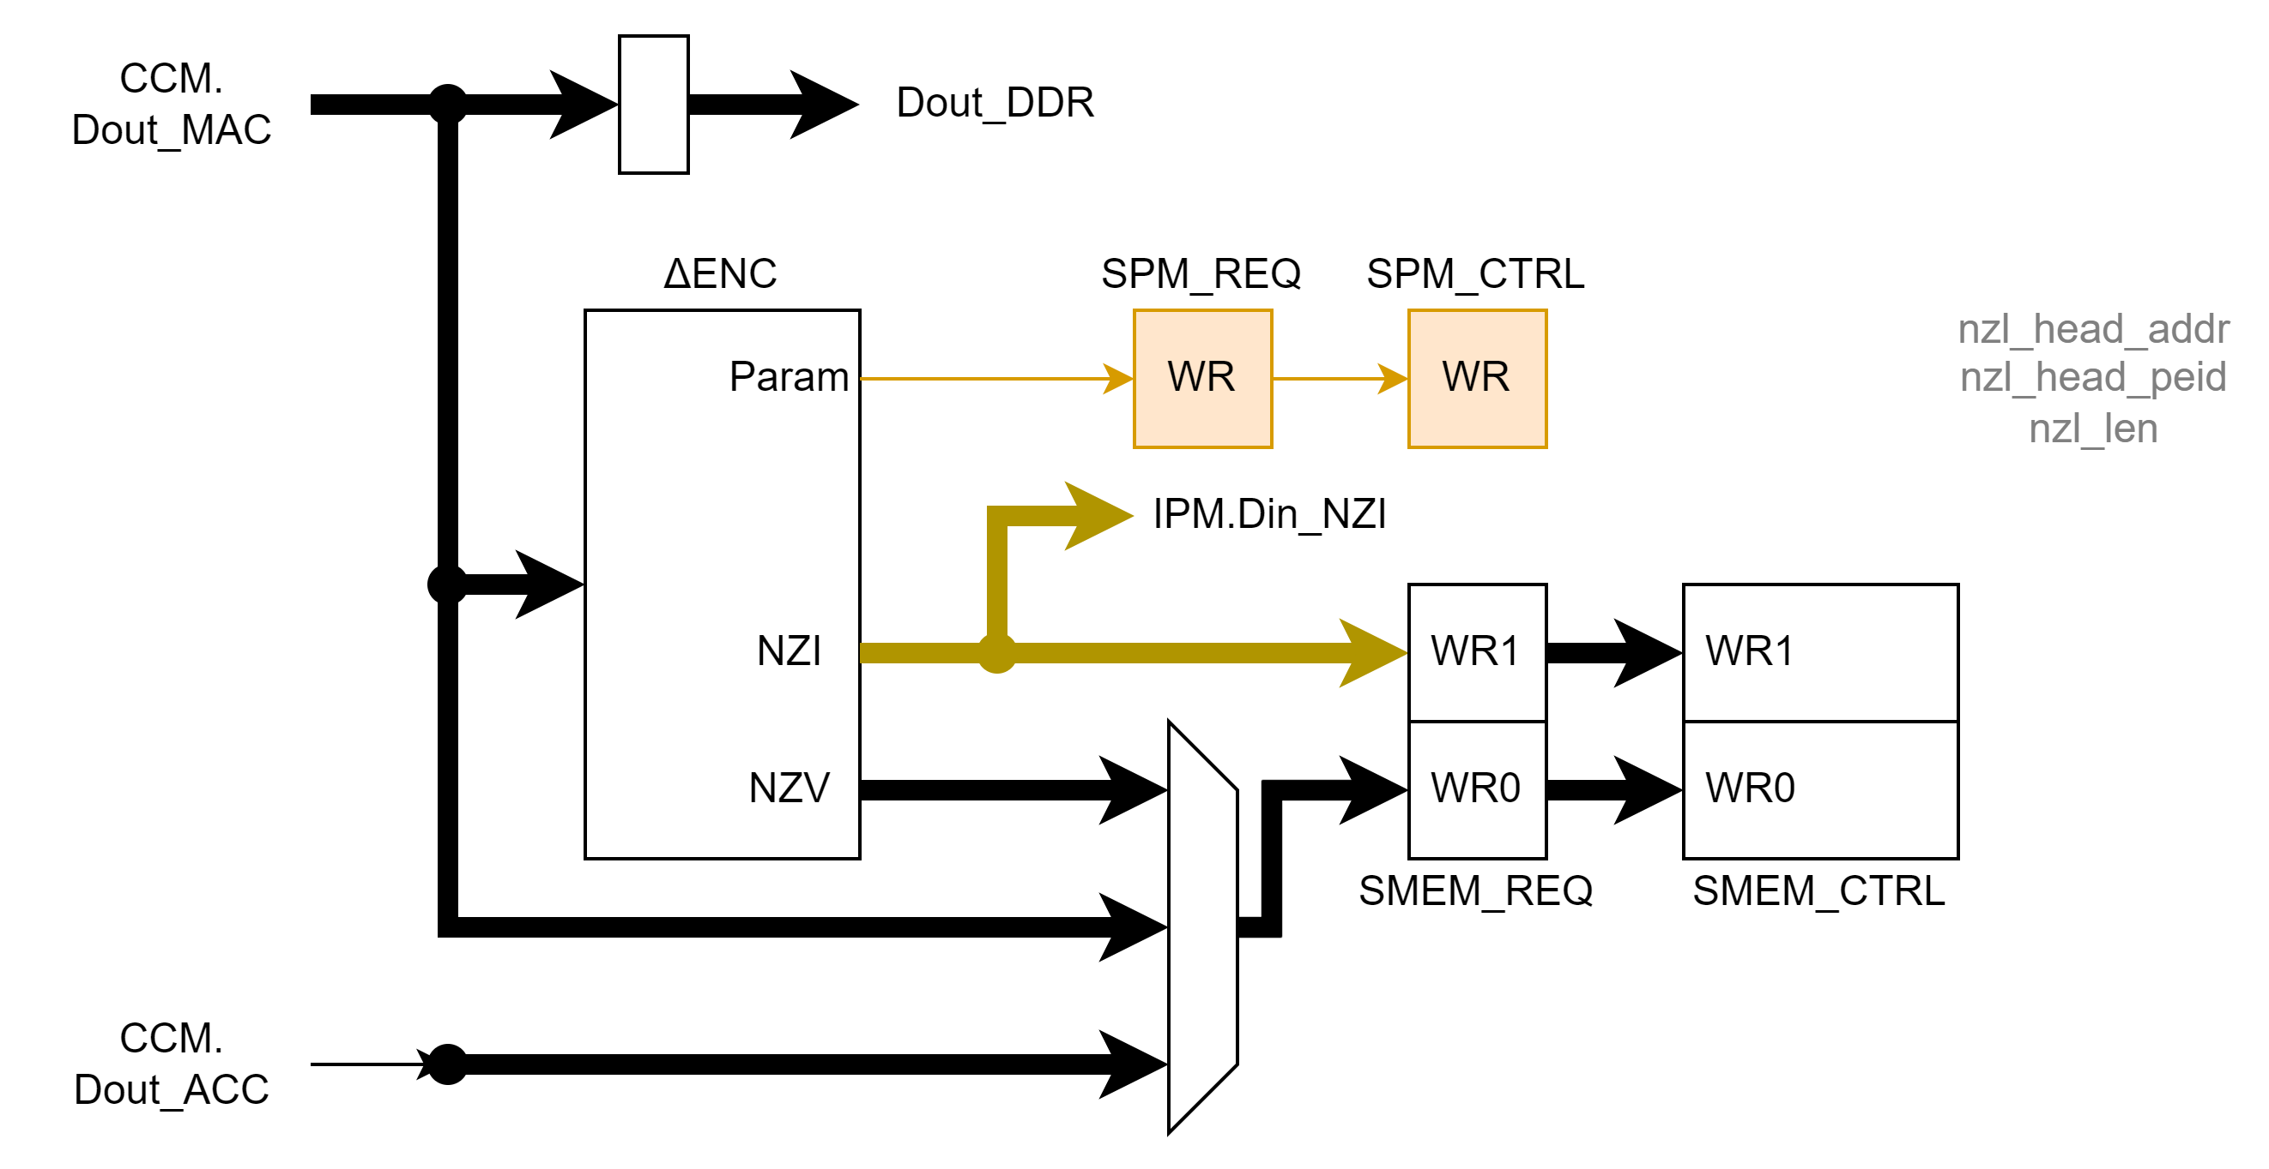
Output Module

Slide 7
Output DEST | Operand0 SRC | Operand1 SRC | IPM.CH_D Dim *Repeat | IPM.CH_S1 Dim *Repeat | IPM.CH_S2 Δx[t].NZI DEST | PE CNT | IPM SMEM addr peid | OPM SMEM addr peid
Z[:] D&SRAM | W DRAM | A[:] SRAM | *N_{t} N_{l-1} N_{l}/N_{p} | N_{t} N_{l-1} *N_{l}/N_{p} |  | N_{t} N_{l-1} N_{l}/N_{p} | {n_{l-1}/N_{p}, t} n_{l-1}%N_{p} | {n_{l}/N_{p}, t} [:]
M[t] SRAM | W DRAM Δx[t].NZI | Δx[t] SRAM | *1 Δx[t].NZN N_{l}/N_{p} | 1 Δx[t].NZN *N_{l}/N_{p} | IPM.DREQ | 1 Δx[t].NZN N_{l}/N_{p} | Δx_{hd_addr}[t] (Δx_{hd_peid}[t]+ n_{l-1})%N_{p} | {n_{l}/N_{p}, t} [:]
∂C/∂A[:] SRAM | W DRAM | ∂C/∂Z[:] SRAM | *N_{t} N_{l}/N_{p} N_{l-1} | N_{t} N_{l}/N_{p} *N_{l-1} |  | N_{t} N_{l}/N_{p} N_{l-1} | {n_{l}/N_{p}, t} [:] | {n_{l-1}/N_{p}, t} n_{l-1}%N_{p}
∂C/∂Δx[t] SRAM Δx[t].NZI | W DRAM Δx[t].NZI | ∂C/∂M[t] SRAM | *1 N_{l}/N_{p} Δx[t].NZN | 1 N_{l}/N_{p} *Δx[t].NZN | IPM.DREQ OPM.NZI | 1 N_{l}/N_{p} Δx[t].NZN | {n_{l}/N_{p}, t} [:] | _{(temp)} n_{l-1}/N_{p} n_{l-1}%N_{p}
∂C/∂W DRAM | ∂C/∂Z[:] DRAM? | A[:] SRAM? | *N_{l-1} N_{t} N_{l}/N_{p} | N_{l-1} N_{t} *N_{l}/N_{p} |  | N_{l-1} N_{t} N_{l}/N_{p} | {n_{l-1}/N_{p}, t} n_{l-1}%N_{p}
∂C/∂W DRAM Δx[:].NZI | ∂C/∂M[:] DRAM? | Δx[:] SRAM | *Δx[:].NZN N_{t} N_{l}/N_{p} | Δx[:].NZN N_{t} *N_{l}/N_{p} | CCM.NZI | (N_{l-1}) Δx[:].NZN N_{t} N_{l}/N_{p} | Δx_{hd_addr}[t] (Δx_{hd_peid}[t]+ n_{l-1})%N_{p}
CH_D.re
cnt_m==0
CH_S1.re
1’b1

Slide 8
Computation Instruction
Rsrv | Proc | Nt | t | Func | CNT2 | CNT1 | CNT0 | N1 | SRC1 | SRC0 | DST1 | DST0 | Paus
63:60 | 59:56 | 55:47 | 46:39 | 38:37 | 36:29 | 28:21 | 20:13 | 12:5 | 4 | 3 | 2 | 1 | 0
SMEM Instruction
Rsrv | SMEM DST0 addr | SMEM SRC1 addr | SMEM SRC0 addr
63:48 | 47:32 | 31:16 | 15:0
DRAM Instruction
DRAM DST1 addr | DRAM SRC0 addr
63:32 | 31:0
Bit-width
Paus 1
DST0 1
DST1 1
SRC0 1
SRC1 1
N1 8
CNT0 8
CNT1 8
CNT2 8
Func 2
t 8
Nt 9
Proc 4
SRC0:
DRAM/SMEM_RD2
SRC1:
SMEM_RD1
DST0:
SMEM/None
DST1:
DRAM/None
SRAM addr 14b
DRAM addr 32b
Notes:
P=16, MAX_N=MAX_M=256

Slide 9
