Slide 1
Model Minimization in Hierarchical Reinforcement Learning
Balaraman Ravindran
Andrew G. Barto
{ravi,barto}@cs.umass.edu
Autonomous Learning Laboratory
Department of Computer Science
University of Massachusetts, Amherst

Slide 2
Abstraction
A
B
D
C
E
A
B
D
C
E
Ignore information irrelevant for the task at hand
Minimization – finding the smallest equivalent model

Slide 3
Outline
Minimization
  Notion of equivalence
  Modeling symmetries
Extensions
  Partial equivalence
  Hierarchies – relativized options
  Approximate equivalence

Slide 4
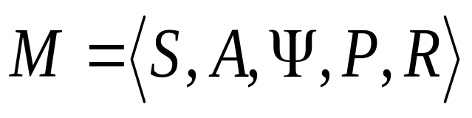



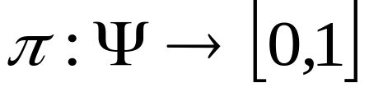
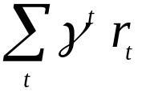
Markov Decision Processes
(Puterman ’94)
MDP, M, is the tuple:
  S : set of states
  A : set of actions
  : set of admissible state-action pairs
  : probability of transition
  : expected immediate reward
Policy
Maximize the return

Slide 5
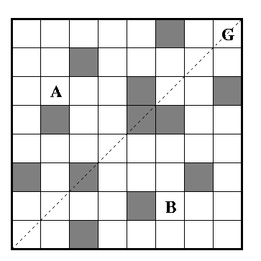
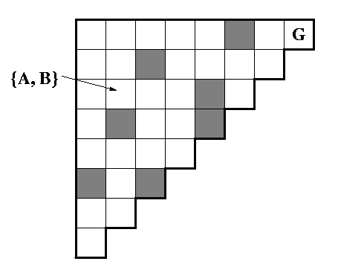



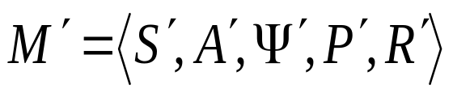


Equivalence in MDPs
N
W
E
S

Slide 6




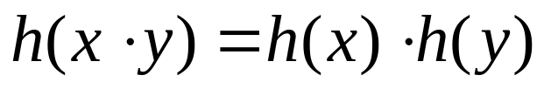











Modeling Equivalence
Model using homomorphisms
Extend to MDPs
h
agg.
h

Slide 7





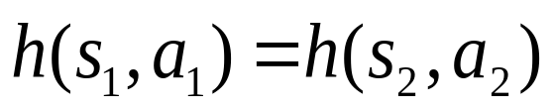

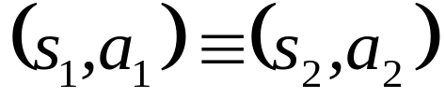
Modeling Equivalence (cont.)
Let h be a homomorphism from to
  a map from onto , s.t.
.
e.g.
is a homomorphic image of .

Slide 8
Model Minimization
Finding reduced models that preserve some aspects of the original model
Various modeling paradigms
  Finite State Automata (Hartmanis and Stearns ’66)
    Machine homomorphisms
  Model Checking (Emerson and Sistla ’96, Lee and Yannakakis ’92)
    Correctness of system models
  Markov Chains (Kemeny and Snell ’60)
    Lumpability
  MDPs (Dean and Givan ’97, ’01)
    Simpler notion of equivalence

Slide 9
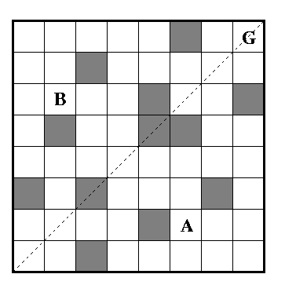
Symmetry
A symmetric system is one that is invariant under certain transformations onto itself.
  Gridworld in earlier example, invariant under reflection along diagonal
N
E
W
E
S
N
S
W

Slide 10
Symmetry example.
  Towers of Hanoi
Start
Goal
Such a transformation that preserves the system
properties is an automorphism.
Group of all automorphisms is known as the
symmetry group of the system.

Slide 11
Symmetries in Minimization
Any subgroup of a symmetry group can be employed to define symmetric equivalence
Induces a reduced homomorphic image
  Greater reduction in problem size
  Possibly more efficient algorithms
Related work: Zinkevich and Balch ’01, Popplestone and Grupen ’00.

Slide 12
Partial Equivalence
Fully
reduced
Partially
reduced
Equivalence holds only over parts of the state-action space
Context dependent equivalence

Slide 13
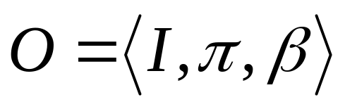
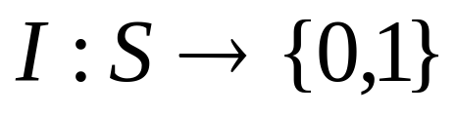
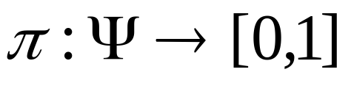
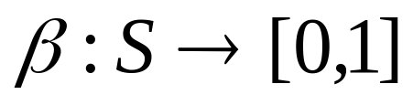
Abstraction in Hierarchical RL
Options (Sutton, Precup and Singh ’99, Precup ’00)
  E.g. go-to-door1, drive-to-work, pick-up-red-ball
An option is given by:
- Initiation set
- Option policy
- Termination criterion

Slide 14
Option specific minimization
Equivalence holds in the domain of the option
Special class –Markov subgoal options
Results in relativized options
  Represents a family of options
  Terminology: Iba ’89

Slide 15
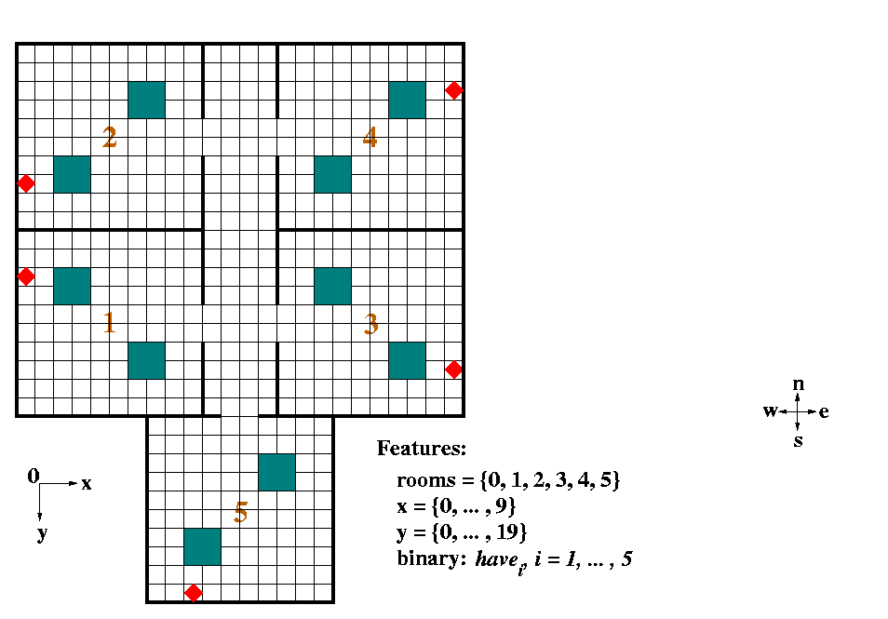
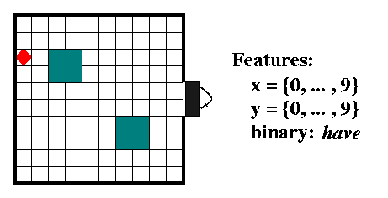
Rooms world task
Task is to collect all objects in the world
5 options – one for each room.
Markov, subgoal options
Single relativized option – get-object-exit-room
  Employ suitable transformations for each room

Slide 16
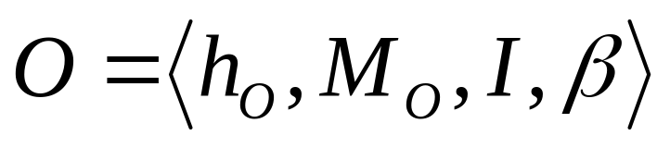
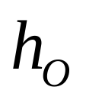
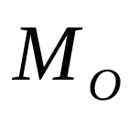
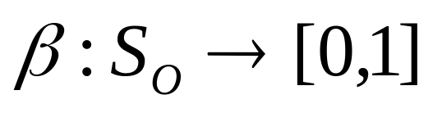
Relativized Options
reduced state
actions
Top level
e
n
v
option
action
percept
Relativized option:
- Option homomorphism
- Option MDP (Reduced representation of MDP)
- Initiation set
- Termination criterion

Slide 17
Rooms world task
Especially useful when learning option policy
  Speed up
  Knowledge transfer

Slide 18
Experimental Setup
Regular Agent
  5 options, one for each room
  Option reward of +1 on exiting room with object
Relativized Agent
  1 relativized option, known homomorphism
  Same option reward
Global reward of +1 on completing task
Actions fail with probability 0.1

Slide 19
Reinforcement Learning
(Sutton and Barto ’98)
Trial and Error Learning
Maintain “value” of performing action a in state s
Update values based on immediate reward and current estimate of value
Q-learning at the option level (Watkins ’89)
SMDP Q-learning at the higher level (Bradtke and Duff ’95)

Slide 20
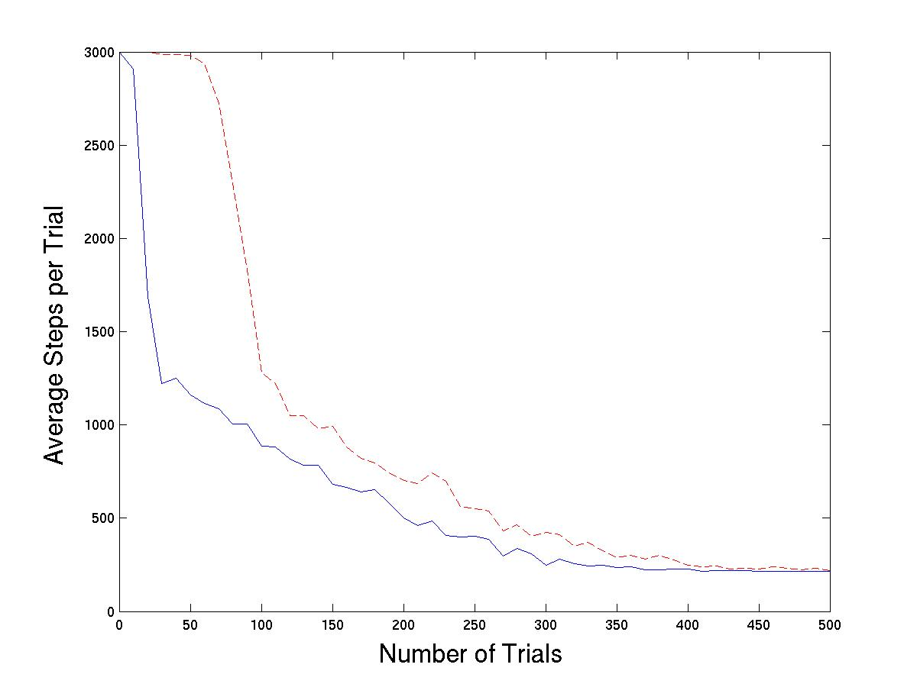
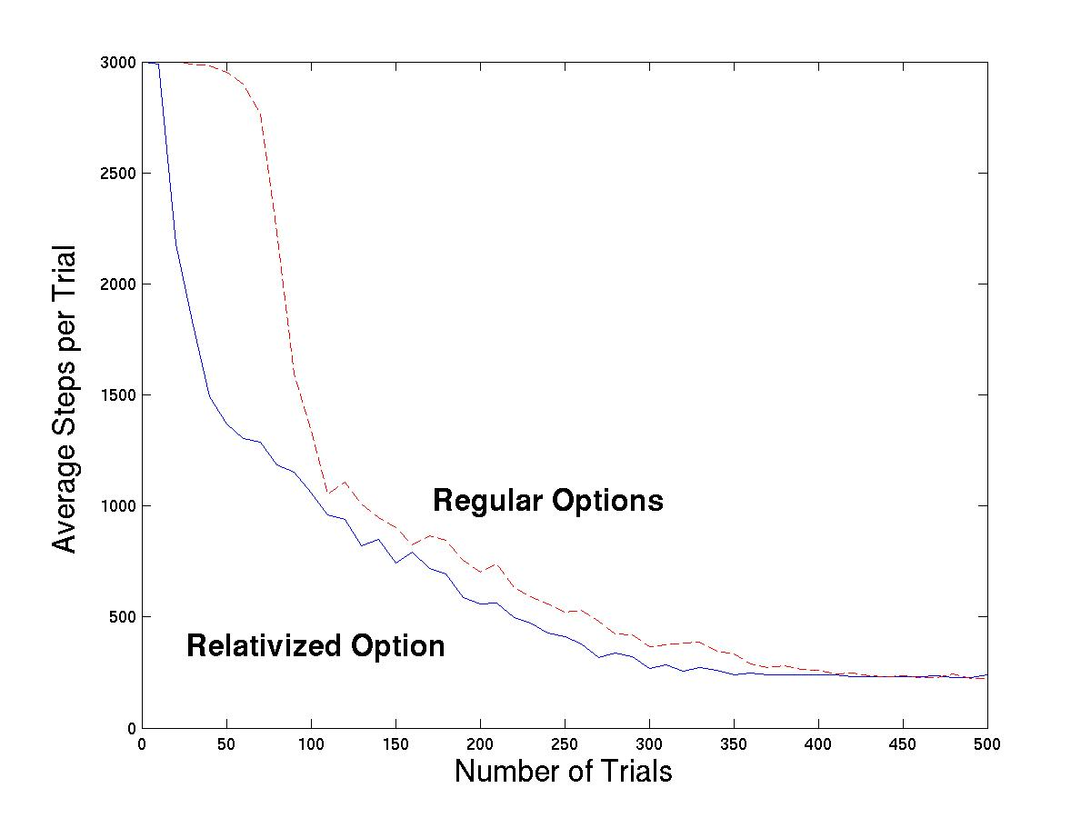
Results
Average over 100 runs

Slide 21
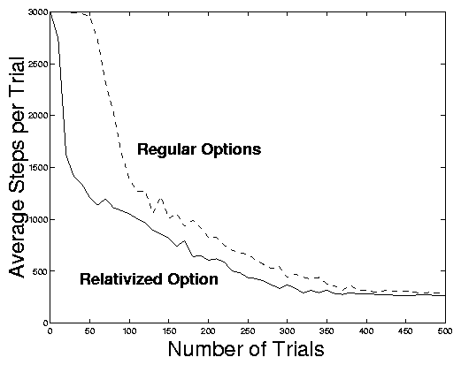
Modified problem
Exact equivalence does not always arise
Vary stochasticity of actions in each room

Slide 22
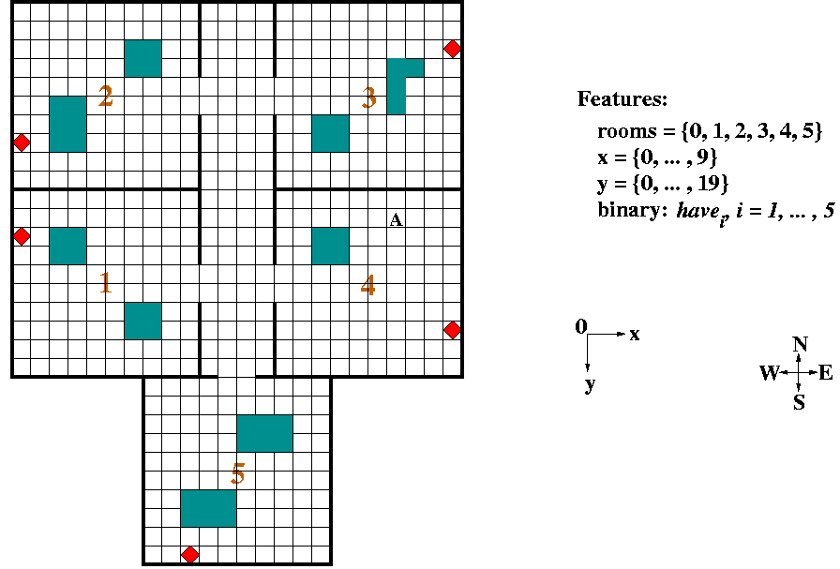
Asymmetric Testbed

Slide 23
Results – Asymmetric Testbed
Still significant speed up in initial learning
Asymptotic performance slightly worse

Slide 24
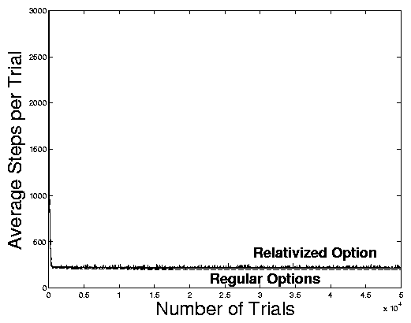
Results – Asymmetric Testbed
Still significant speed up in initial learning
Asymptotic performance slightly worse

Slide 25
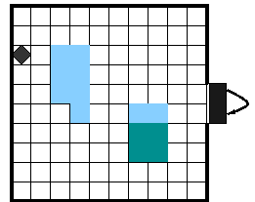
Approximate Equivalence
Model as a map onto a Bounded-parameter MDP
  Transition probabilities and rewards given by bounded intervals (Givan, Leach and Dean ’00)
  Interval Value Iteration
  Bound loss in performance of policy learned

Slide 26
Summary
Model minimization framework
Considers state-action equivalence
Accommodates symmetries
Partial equivalence
Approximate equivalence

Slide 27
Summary (cont.)
Options in a relative frame of reference
  Knowledge transfer across symmetrically equivalent situations
  Speed up in initial learning
Model minimization ideas used to formalize notion
  Sufficient conditions for safe state abstraction (Dietterich ’00)
  Bound loss when approximating

Slide 28
Future Work
Symmetric minimization algorithms
Online minimization
Adapt minimization algorithms to hierarchical frameworks
  Search for suitable transformations
Apply to other hierarchical frameworks
Combine with option discovery algorithms

Slide 29
Issues
Design better representations
Partial observability
  Deictic representation
Connections to symbolic representations
Connections to other MDP abstraction frameworks
  Esp. Boutilier and Dearden ’94, Boutilier et al. ’95, Boutilier et al. ’01

