Slide 1
Lecture 2 : Performance Metrics
Hema Murthy
Professor
Dept. of CSE, IIT Madras
Short Term Course on “Teaching Computer Networks Effectively”. Sponsored by AICTE.

Slide 2
Measures of Performance
Bandwidth
  Aka throughput
  Number of bits that can be transmitted
    In a certain period
  eg 100 Mbps, Gigabit ethernet
  Sometimes, think of how long to transmit data
    eg Gigabit ethernet takes 1 ns for each bit
Latency
  Time taken by a bit from end to another
  Aka delay
  Sometimes RTT is required
  eg ping times

Slide 3


Width of Bit and Bandwidth
1 sec
Each bit – 1 s wide
1 sec
Each bit – 0.5 s wide
Large Bandwidth

Slide 4
Bandwidth and Throughput
Confusing and (ab)used interchangeably
  Number of bits/sec that can be sent = Bandwidth
  Number of bits that are sent = Throughput
  What’s possible vs what’s measured
Bandwidth Requirements
  Whatever network can give…
  Fixed Number

Slide 5
Latency
Three components
  Speed of light propagation delay
    Can be different in different media
    eg only 2*10^8 m/s in fiber
  Time taken to transmit a unit of data
    f(network bandwidth, packet size)
  Queue delays
Propagation + Transmit + Queue delay = Latency
  Propagation = Distance / Speed of light
  Transmit = Size of packet/bandwidth

Slide 6
Performance Characteristics
channel could be 1 Mbps / 100 Mbps
Applications behave differently
  across the continent
  across the room
Round trip time:
  1 Mbps - 100ms
  100 Mbps - 1ms

Slide 7
Performance Characteristics
Example:
  Channel Capacity: 1x10 Mbps
  Datalength: 10 bits
  Transmit time = 10 microseconds
  Channel = 100 Mbps bits / sec
  Transmit time = 0.010 microseconds

Slide 8
Performance Characteristics
RTT = 100 ms, 1 ms
Latency = 100+10 × 10⁻³
= 100.010 ms
Latency = 1+10× 10⁻³
= 1.001 ms
  Latency dominated by RTT.

Slide 9
Performance Metrics
Large files
  Image of size 25x10⁶x8 bits
  Channel Capacity 10x10⁶ bits/s
  Time taken to transmit image 20 s
  Suppose RTT = 1 ms
    Latency = 20.001 sec
  Suppose RTT = 100 ms
    Latency = 20.1 sec
  Bandwidth dominates latency

Slide 10
Bandwidth vs Latency
What is more important?
  Latency is more important than bandwidth at times
    eg: Downloading files, course material
  Bandwidth is also important at times
    More bandwidth required to get images

Slide 11
Another Metric
Computation is getting faster and faster
Should computers wait for data?
Instructions per mile

Slide 12
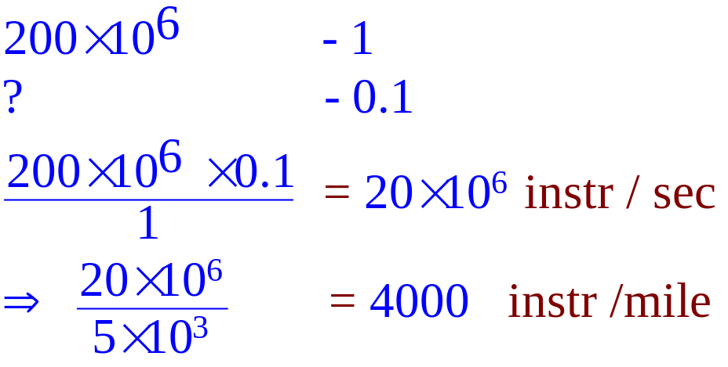
Performance Metrics
Large Latency
  Example: CPU = 200x10⁶ instructions/s
  Latency 100ms, for 5000 miles

Slide 13
Performance Metrics
4000 instr / mile is lost
  Is it worth going across network?
  Ramification
    Data centers, geographical spread, redundancy
Bandwidth wasted
  Solution
    Treat the channel as pipe

Slide 14
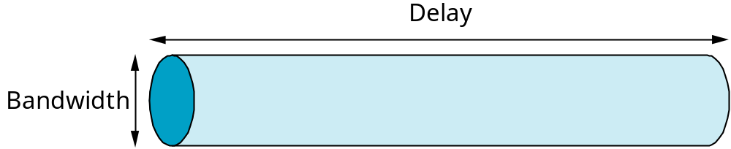
Delay x Bandwidth Product
Analogy :
Product = Volume of the pipe
Useful for :
  Given the latency and the bit width (units of time), how many bits can the network hold?

Slide 15
Network as a Pipe
Example
  Latency - 50 ms
  BW - 50 Mbps
Pipe can hold
  50×10⁻³×50×10⁶ bits of data
  Bandwidth wasted if sender does not fill the pipe

Slide 16
Inflight Data
Useful for high speed networks
Sender can send Bandwidth x Latency data before the first bit arrives at receiver
Sender can send another Bandwidth x Latency data for the receiver to respond back all is well
Total data in-flight = 2 * Bandwidth * Latency
If the receiver says stop
  expect latency * bandwidth data anyway to come in

Slide 17
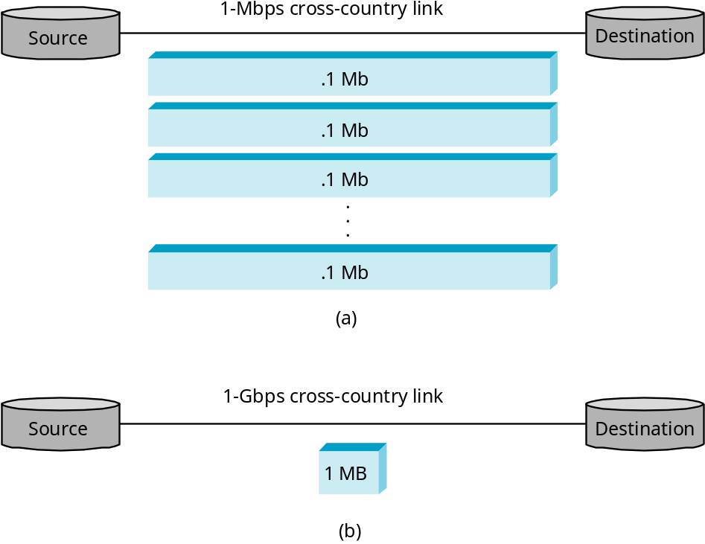
High Speed Networks
Fixed Latency Scenario
Eternally connected world
Bandwidth is increasing continuously
  Lay more cable !
Latency is harder to improve though
  Laws of physics
Eg : Let RTT = 100ms

Slide 18
Bandwidth vs Latency (contd.)
Infinite bandwidth
  In a single RTT, more data can be pushed across
RTT itself becomes a problem now
  100 vs 101 RTTs
  1 vs 2 RTTs

Slide 19
Throughput
Throughput:
  Transfer Size / Transfer Time
Transfer Time
  RTT + (Transfer Size / BW)
If RTT large, increase in BW does not reduce transfer time

Slide 20
Throughput
Example:
  Latency: 100ms
  Channel Capacity: 1 Mbps, 1 Gbps
  Data: 10 MB
  On 1 Mbps channel
    Time taken = 80.1s
  On 1 Gbps channel
    Time taken = 0.180s

Slide 21
Throughput
Throughput for 1 Mbps channel
  80/80.1 Mbps = 99.87 Mbps ➔ very efficient → reaches channel capacity
Throughput for 1 Gbps channel
  80/0.180 Mbps =444.4 Mbps ➔ very inefficient → very low compared to channel capacity

Slide 22
Application Performance Needs
Whatever you can give vs. fixed bandwidth requirement
Average requirement is not a good metric
  Bursts of requirements from the application
Characterizing burst
  Can I sustain peak rate for a fixed time
  Number of bytes I can send at peak requirement before reverting back to average rate

Slide 23
Application Performance Needs (contd.)
Delay can also be similar to bandwidth
  As little delay as possible vs a fixed delay requirement
Sometimes the one-way latency does not matter
  Latency variation from packet to packet is a concern though
Variation is called jitter
  Can be concern to certain kinds of applications

Slide 24
Jitter
Packets are generated every so many time units
  Difference is called the inter-packet gap
Fixed inter-packet gaps are good
Variations can be a problem
  Usually single links do not create considerable jitter
  Multi-hop networks are the worst affected
Interpacket gap
Interpacket gap
4
3
2
1
4
3
2
1
Packet
Network
Packet
source
sink

Slide 25
Jitter Case Study
Video – 30 frames a sec.
  => a packet every 33 ms
Receiver’s side : You need atleast one packet every 33 ms
Two scenarios
  Frame arrives early : Buffer it and play
  Frame arrives late : Bad Quality video
Should you remove jitter?
  No
  If jitter is known, you can work around it
  Unknown jitter is the problem

