Slide 1
Lecture 5 : Multiple Access Protocols
Hema Murthy
Professor
Dept. of CSE, IIT Madras
Short Term Course on “Teaching Computer Networks Effectively”. Sponsored by AICTE.

Slide 2
5.1 Medium Access Sublayer
Topology of the Network
  Bus, Ring, Tree
Protocols
  IEEE 802.3 for bus topology
  IEEE 802.4 for token bus
  IEEE 802.5 for token ring
  FDDI – for fibre ring
  IEEE 802.11 for wireless networks

Slide 3
Network Topology
Tree topology:
Hubs/switches
Bus topology
intermediate hubs

Slide 4
Network Topology
Ring topology
Star topology
Central hub

Slide 5
Network Topology
Multipoint media
terminators

Slide 6
Tree and Bus Topologies
multipoint medium
  all stations attach through appropriate hardware interface called tap directly to the medium
  full duplex operations on the bus
  data propagates the length of medium in both directions
  at each end bus terminated
    absorbs any signal ➔ removes it from the bus
  tree has a head end
  since data propagated to all stations – addressing required!

Slide 7
Star Topology
central node acts as a broadcast
although physically a star – logically a bus
  alternatively central node acts as a switch. frame switching – copy frame – send out on destination link
problem – central point failure

Slide 8
Ring Topology
Repeaters joined by point to point links in a closed loop.
  no buffering
unidirectional links
destination recognises its frames & copies it
frame removed by source
in all topologies ONLY one station transmits at a time

Slide 9
Transmission in Networks
Networks
  Point-to-Point
  Broadcast Networks
Broadcast networks
  Only one station transmits at a time →competition
    who gets access to the channel
  conference calls:
    between six people – only one channel –
      Who gets access?
  multiaccess or random access channels

Slide 10
Broadcast Network-Solutions
static allocation
  wasteful of Bandwidth
    more senders than channels
Solution: Dynamic allocation of channels!

Slide 11


Key Assumption in Broadcast Networks
Station model
  N independent stations
  Each user generates a frame for transmission
  Pr[frame generated in time Δt] =
    arrival rate for new frame
  Once frame generated – station blocks
    does nothing until frame transmitted.

Slide 12
Key Assumption in Broadcast Networks
Single channel assumptions:
  Single channel for all communication
  All stations can transmit and receive on it
  All stations get a fair share of the channel

Slide 13
Key Assumption in Broadcast Networks
Collision assumption:
  Two frames transmitted at the same time
    signal garbled
  All stations can detect collisions
  A collided frame is retransmitted
  Errors only due to collision

Slide 14
Key Assumption in Broadcast Networks
Continuous time:
  Frames can begin at any instant of time
  No master clock dividing time into discrete intervals.
Slotted time:
  time divided into slots
  frames start at the beginning of a slot
  multiple frame / slot

Slide 15
Key Assumption in Broadcast Networks
Carrier Sense:
  Station can tell whether channel is in use
  If carrier sensed – do not transmit
    What is carrier sense – an electrical signal
No carrier sense:
  Station cannot detect carrier
  go ahead and transmit
  Later worry about success or failure

Slide 16
5.2 Multiple Access Protocols: ALOHA
ALOHA
  pure
  slotted
Basic idea: User transmit whenever they have data to send
Collision detection:
  use feed back property to determine collisions
Originated as part of packet switched radio networks

Slide 17
ALOHA
Very inefficient: 18%
  Solution: Slotted ALOHA
Slotted ALOHA
  Time divided into Slots
    Transmission only in slots
    Efficiency : 36%

Slide 18
ALOHA
A
B
C
Collision, Contention
D
Collision Resolution: Wait random amount of time before retransmitting

Slide 19
ALOHA: Throughput
t₀
t₀+t
t₀+2t
t₀+3t
t – time required to send a frame
Throughput: maximised when frames across stations of same size

Slide 20
ALOHA: Efficiency
population: infinite number of users generate frame (in a frame time)
  S frames/frametime
  Assume Poisson Distributed
  S < 1 – only then possible to successfully transmit.
  S > 1 – almost all frames suffer collision
  G – number of attempts/frame

Slide 21
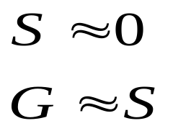

ALOHA: Efficiency
Throughput: S = GP₀
  P₀ – Probability that a frame does not suffer collision
Low Load:
Low Collisions, few transmissions
High Load:
High Collisions, almost every frame collides

Slide 22
ALOHA-Analysis
Probability of zero frames: e^{-G}
In an interval two frames long –
  number of frames generated is 2G
Probability that no other traffic – during vulnerable period
  P₀ = e^{-2G}
  S = G e^{-2G}
Max Throughput: G = 0.5, S = 1/2a (a is the propagation delay

Slide 23
ALOHA: Throughput vs Load
0.4
Slotted ALOHA
S = G e^{-G}
36.8%
Successful transmission/frame time S = G P₀
S (throughput per frame time
0.2
18.9%
Pure ALOHA
S = G e^{-2G}
0
0.5
1
2
3
G (attempts per packet time)

Slide 24
Carrier Sense Transmission
ALOHA: Utilisation very poor
  need a better solution
CSMA – Carrier Sense Multiple Access Protocols
CSMA / CD – Additional overhead over CSMA –
  once collision detected stop transmitting
Ethernet Xerox Palo Alto Research

Slide 25
Carrier Sense Transmission
All stations can detect when a station is idle / busy.
Collision detection (CD)
  collision a host listens as it transmits
  knows when a collision has occurred (change in signal levels on the line)

Slide 26
Carrier Sense Transmission
When station has data to send :
  Listen to the channel
    busy – then wait
    idle – transmit
  If collision occurs
    wait random amount of time and then retransmit
p–persistent:
  station transmits with a probability p – when idle

Slide 27
Carrier Sense Transmission
Issues – propagation delays become worse with large a.
  two stations back off for same time retransmit more collision

Slide 28
5.3 Ethernet: Miscellaneous
Cable: 10/100 Base T
  10/100 Mbps
  T – twisted pair
    Splice T-joint in cable
  Cables are connected to machines which connect to a hub
  Maximum cable length from machine to hub
    100m
Encoding: Manchester encoding

Slide 29
A Typical Ethernet LAN
. . .
. . .
. . .
Repeater
. . .
Terminator
Terminators attached at the end of each segment absorb the signal

Slide 30
Hub based communication
Hub
Hub
multiway repeaters
daisy chain a number of hosts
  almost like a star
  data transmitter on one segment received by every body else
  single channel multi access
  same collision domain

Slide 31
The Ethernet Frame Format
64 bit
48 bit
48 bit
16 bit
data
32 bit
preamble
Destaddr
Srcaddr
Type
Body
CRC
7 byte
Length of the data part
preamble
1 byte SFD

Slide 32
Ethernet Frame Format
Data in each frame – maximum 1500 bytes, minimum 46 bytes
Bit oriented protocol
Ethernet frame: 14 byte header (6 byte dest + 6 byte src + 2 byte type)
Adapter – attaches preamble, CRC, postamble before transmitting and receiving adapter, removes them

Slide 33
Ethernet Frame Format
Every ethernet host has a unique address
  48 – bit address:
  Example: 8 : 0 : 2b : e4 : b1 : 2
  4 bit nibbles
  each manufacturer of Ethernet device is allocated a fix prefix (24 bit)
  Example: AMD: 24 bit 8 : 0 : 20
  manufacturer ensures suffix is unique
  frame transmitted is received by every adapter connected to Ethernet

Slide 34
Adapter Functions
adapter recognises frame meant for itself passes to host (unicast address)
adapter runs in promiscuous mode
  listen to all frames
  adapter must be programmed to do this
adapter accepts frames with multicast address
  provided adapter has been programmed to listen that address

Slide 35
Adapter Functions
No centralised control
Two station begin transmitting at the same time
Each sender can detect collisions – receiver detects collision sends
A 32 bit jamming sequence is sent to indicate a collision

Slide 36
Ethernet Conventions
Minimal transmission:
64 bit + 32 = 96 bit
Preamble + jamming sequence
To ensure frame did not collide with another send
  14 bytes header + 46 bytes data + 4 byte CRC = 512 bits

Slide 37

Ethernet Example
2500 m + 4 repeaters
10 Mbps – delay 51.2
= 512 bits
collision detected –
  use binary exponential backoff
First: 0, 51.2
Second: 0, 51.2 ,102.4

Slide 38

Ethernet Conventions
Collision again
wait k 51.2
for 0, 2³ –1
randomly select k between 0 – 2^{n} – 1
n – number of collision experienced
retry upto 16 times

Slide 39
Popularity of Ethernet
200 hosts / NW
Most Ethernets shorter than 2500 m
  delay 5 rather than 51.2
No routing
No configuration
Easy to add new hosts
Cable cheap, adapter cheap – switch based approaches expensive

Slide 40
Ethernet: Overhead: Collision detection
Frame
Frame
Period (contention)
Frame
idle
Contention detection: Depends on propagation delay

Slide 41
Ethernet: Collision detection
A
B
A
B
B Transmits

Slide 42
Ethernet Analysis
B detects collision
  sends jammer to A
  Jammer takes 2a time to reach A
frame size 1
2a – end to end propagation delay
CSMA / CD : medium organised as slots
  length is 2a

Slide 43
Ethernet Analysis
slot time - max time from start of frame to detect collision = 2a.
CSMA analysis:Assumptions
  infinite population
  Poisson arrival
  unslotted non persistent
  fixed frame size

Slide 44
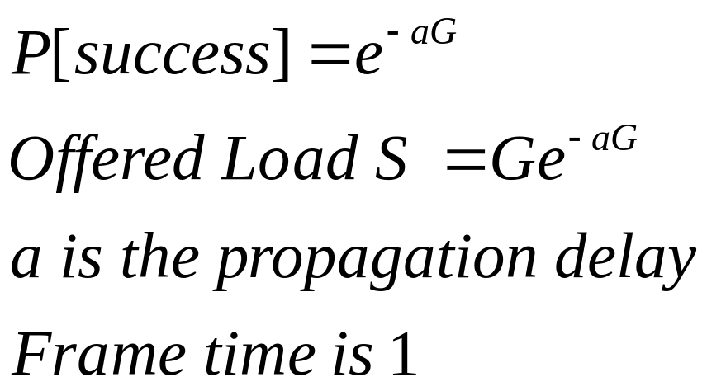
Ethernet Analysis

Slide 45
CSMA – p-persistent
Station acquires a slot
p- probability of transmission during a slot
Let k be the number of stations
The probability that only one station transmits in a slot is
A = kp(1-p)^{k-1}

Slide 46
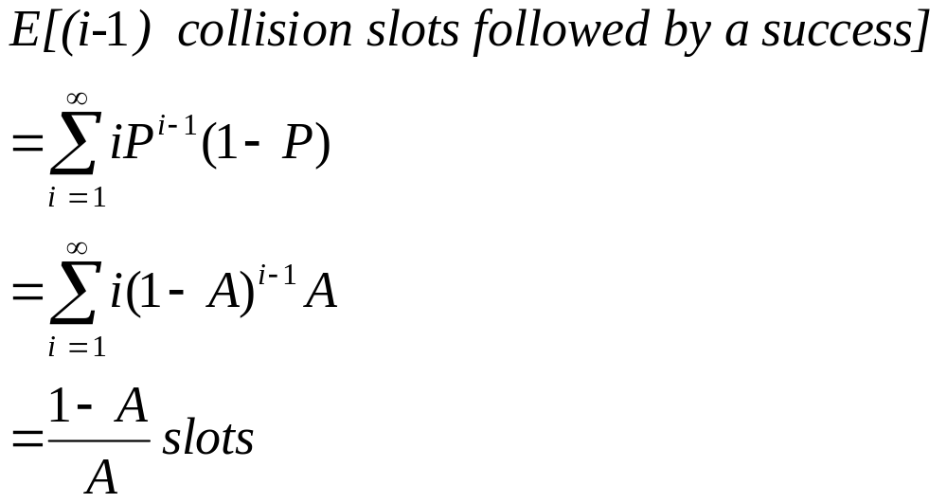
CSMA – p-persistent
Mean length of contention interval

Slide 47
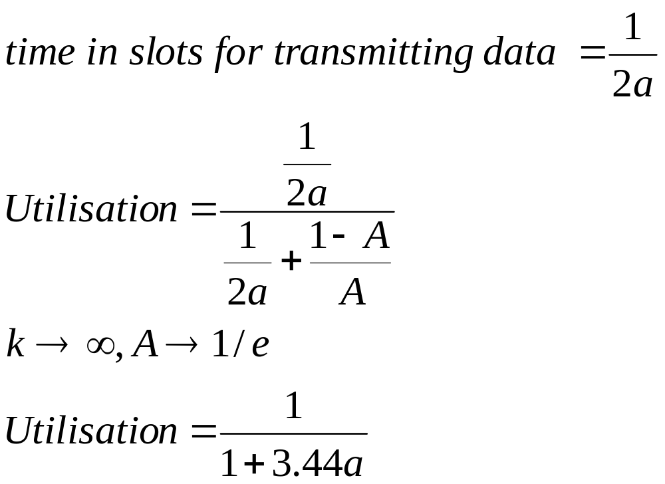
Efficiency

Slide 48
Timing Diagram
Transmission interval 1/2a slots
Sequence of slots with no transmission or collision

