Slide 1
Lecture 6 : MAC2
Hema Murthy
Professor
Dept. of CSE, IIT Madras
Short Term Course on “Teaching Computer Networks Effectively”. Sponsored by AICTE.

Slide 2
6.1 Collision free protocols
Reservation Protocols
Station have a unique address 0 ,…,N-1
Bit mapped protocol:
  Contention period – divide into N slots
station 0 can only send a 1 bit in that slot.

Slide 3
Collision free protocols
Station j announces that it has a frame to transmit by inserting a bit in slot j.
After all N slots have passed by –
  every station knows numerical order
  Now transmit in Numerical order
    no collision at all!

Slide 4
Collision free protocols
After last ready frame transmitted –
  an event generated
New N bit contention period
If a station misses
  wait for next contention period

Slide 5
Collision free protocols
After all stations have transmitted probability of having a frame to transmit middle of slot
  wait 1 ½ contention period before transmitting
Always 1 bit/station/frame transmitted is the overhead

Slide 6
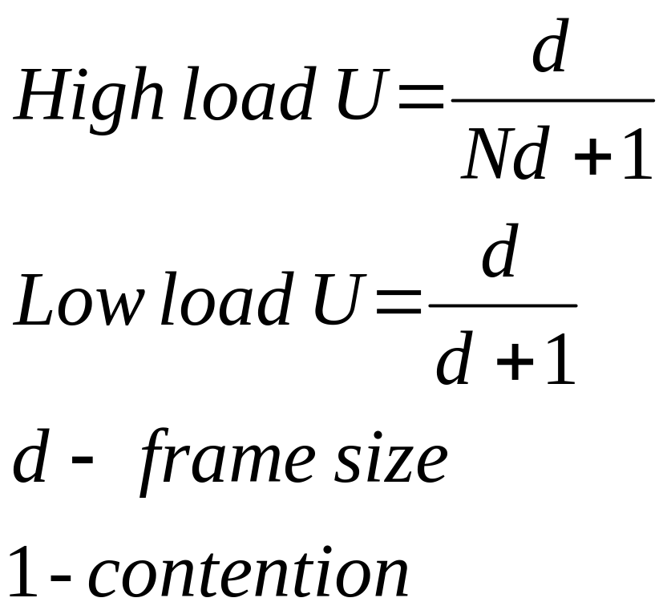
Efficiency
0
1
2
3
4
5
6
7
1
1
1
1
3
7

Slide 7
Contention Free Protocols
Binary Countdown:
Better than bit mapped protocols
Use binary station addresses
Each station broadcasts address
  Example: 0010 0100 1001 1100

Slide 8
Contention Free Protocols
All addresses same length
Bits in each position from different stations are ORed
Collision avoidance
  arbitration rule
  if high order bit position of station address overwritten by 1 give up!

Slide 9
Binary CountDown
0010
0100
1001
1100
1111
Compare give up
give up
Compare next bit
1001 gives up
Compare next bit
1100 – gets access!
Next new cycle of contention start

Slide 10
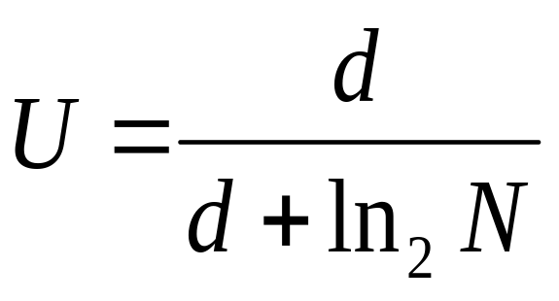
Binary CountDown:Analysis
If the higher order bits of a station j address are 1,
station j transmits continuously

Slide 11
Limited Contention Protocols
combine the properties of contention and collision free protocols
contention at low load to provide low delay
reservation at high load

Slide 12
Adaptive Tree Walk Protocol
Adaptive TreeWalk Algorithm
  low load
    every body contends
  collision –
    reduces number of stations

Slide 13
Adaptive Tree Walk Algorithm
1
2
3
4
5
6
7
a
b
c
d
e
f
g
h
First contention all stations permitted to contend
- if collision then next slot only nodes under 2 can contend
- if success next slot – Nodes under 3
- if collision then nodes under Node 4
- if success next slots Nodes under 5

Slide 14
Adaptive Tree Walk Algorithm
Depth first tree walk algorithm
Heavy load do not start searching at top of tree
  what level to start the search?
  depends on number of ready stations

Slide 15
Adaptive Tree Walk Algorithm
Each node at level i has N. 2^{–i} station under it.
q ready stations – uniformly distributed at level i 2^{-i}q
level at which search begins
  2^{-i}q =1
  i = log₂ q

Slide 16
6.2 IEEE 802.4 Token Ring
CSMA/CD – probabilities
  MAC model – bad link
  station wait for infinitely a long time!
  no priorities
    not useful for real time system.
Use a ring

Slide 17
IEEE 802.4 Token Ring
stations take time sending frames.
  n frame , nT sec to wait
  physical ring broken
    use logical ring
20
17
13
11
7

Slide 18
Token Bus Ring Organisation
Linear tree shaped cable on to which stations are attached.
Each station knows the address of its left and right neighbours.
Ring is first initialised
  coordinator to initialise ring.
  stations inserted in the order of station address

Slide 19
Token Bus Ring Organisation
Token passing from higher to lower order station address
Token acquired station transmits for certain amount of time
Hand over token either at end of time or no frame to transmit
prioritise tokens

Slide 20
Token Bus
each maintains a queue of frames
each one has a timer
handover token from higher priority to lower priority.
fraction of token holding time allocated to each priority.
useful for implementing real – time traffic.

Slide 21
Token Bus Frame Format
2 or 6
2 or 6
0 - 8182
4 bytes
dest
src
Data
Check sum
1
frame control 1 byte
Start delimiter 1 byte
end delimiter
preamble 1 byte

Slide 22
Token Bus Frame Format
Preamble – clock synchronisation
Starting and ending delimiter
frame boundaries
  analog encoding symbols (other than 0 or 1)
  does not occur in analog data
no need of length field

Slide 23
Token Bus: Issues
Frame Control
  Successors
  Predecessors
  Entry of new station
  Claim token
    Token lost, station with token dead
  Protocols to handle all issues
  Useful for real time traffic

Slide 24
6.3 IEEE 802.5 Token Ring
Consists of a set of nodes connected in a ring.
Data flows in a particular direction only.
Data received from upstream neighbour forwarded to downstream neighbour.
Token – access to the shared ring
  a special sequence of bits
  circulates around the ring.

Slide 25
IEEE 802.5 Token Ring
Each node receives and forwards token.
Frame makes its way back to sender
  frame removed by sender
  sender reinsert token.
As token circulates around ring, each station gets a chance to transmit
  Service round - robin fashion

Slide 26
Token Ring Issues
Any link or node failure
  Network rendered useless
Solution –
  electromechanical relay
  Station active relay is open and station included
  Station is inactive
    no power
    relay closed
    bypass station

Slide 27
Token Ring Issues
Host
Host
Previous host
To next host
Previous host
To next host
relay open - station included
relay closed bypass station

Slide 28
Multistation Access Unit (MSAU)
Several relays in a box
Add new station
  Plug into MSAU
H₂
H₁
H₃
From prev
MSAU
H₄
To next MSAU

Slide 29
Token Ring (Characteristics)
Date rate: 4 Mbps or 16 Mbps
encoding: differential manchester
802.5 upto 250 station
physical medium is +P for IBM – not specified in 802.5

Slide 30
Differential Manchester
clock
1
0
0
0
1
0
NRZ
Manchester
Differential Manchester

Slide 31
Token Ring Access Control
Network adapter: receiver, and transmitter, and one or more bits of data storage between them.
When no stations have anything to transmit token circulates
Ring has enough storage capacity to hold an entire token.
  1 bit / station

Slide 32
Token Ring Frame Format
1 byte
1 byte
1 byte
6 bytes
6 bytes
4 bytes
1 byte
1 byte
SD
AC
FC
DA
SA
Data
FCS
E0
FS
Check sum
PPPMRRR
No limit!
Frame status
E + I bit
Priority
Monitor
Reservation
Request for next token with requested priority
Set to indicate not last frame if a multiframe transmission
E bit is set if error
Frame control data / token
Invalid differential coding HH LL

Slide 33
IEEE 802.5
Token Size: 24 bits
  Minimum number of stations is 24
  Overcome this by including a monitor which adds the extra bits of delay
Token operation
  Token circulates
  Station seizes a token

Slide 34
IEEE 802.5
  Modifies a bit in the second byte of token
  Station that has token transmits data
  Station drains token out of the ring
  Station sends data
  Each packet has destination address
  All stations downhill check destination address
  Destination copies packet
  Packet finds its way back to sending station

Slide 35
IEEE 802.5
  Sending station removes packet from ring
  Station reinserts token into the ring
Size of packet stored in the ring
  Larger/smaller than ring
    Add/remove bits

Slide 36
IEEE 802.5
Issues
  Size of data that given node is allowed to transmit
  Token holding time (THT) = ∞ ?
    Utilisation is 100%
    Unfair to stations to other than the station holding the token
  THT affects ring performance

Slide 37
Token Holding Time
Token Rotation Time (TRT):
TRT ≤ Active nodes * THT + Ring Latency
Ring Latency – token circulation time

Slide 38
Reliable Transmission
Use A and C bits
Initially A and C zero.
Receiver sets A bit after seeing that it is the intended recipient
Receiver sets C bit after copying frame
If both A and C are not set – retransmit

Slide 39
Priorities in IEEE 802.5
Supports different levels of priority
  3 bits
  each station waiting to send, sets priority for packet packet’s priority as high current token
  then token can be seized
  Intending to send station – sets the priority on currently passing data frame

Slide 40
Priorities in IEEE 802.5
  releasing station sets priority of token to n.
  Lower priority packets circulate for long in ring
Token Release
  Early release
    After transmitting packet
  Delayed release
    After removing packet when it returns to the sender

Slide 41
Token Ring Maintenance
Designated monitor
  any station can become a monitor
  defined procedures for becoming a monitor
  healthy monitor announces that it is a monitor at periodic interval
  if a station does not see that packet for some time – then it sends a “claim token”
  if claim token comes back to station then it is monitor
  if another wants to claim see other stations claim first some arbitration rule.

Slide 42
Token Ring Maintenance
Role of monitor
  insert additional delay in ring
  ensure always that there is a token somewhere in the ring
  regenerate a vanished token
  no token seen for TRT => regenerate

Slide 43
Token Ring Maintenance
  orphaned / corrupted packets – drain them if orphaned
    (A and C bits set – parent dies)
    A bit set C bit not set – parent dies
  bit is initially set to 1 by monitor
    monitor notices back when packet passes by monitor a second time

Slide 44
Token Ring Maintenance
Detection of dead stations
  some problem un detected
  suspecting station sends a beacon frame –
  how far beacon goes decide which stations must be bypassed.

