Slide 1
Lecture 7 : FDDI
Hema Murthy
Professor
Dept. of CSE, IIT Madras
Short Term Course on “Teaching Computer Networks Effectively”. Sponsored by AICTE.

Slide 2
Fibre Distributed Data Interface
Runs on fibre and not copper
dual ring
  two independent rings transmitting data in opposite direction
  second not used for normal operation
  used only if primary fails

Slide 3
FDDI Ring

Slide 4
FDDI Ring
Expensive – twice the amount of fibre
  stations may be allowed to connect on a single cable
    single attachment station (SAS)
use concentrator to connect several SASs to dual ring

Slide 5

Fibre Concentrator
Upstream neighbour
Downstream neighbour
SAS
SAS
SAS
SAS
Concentrator detects failure of SAS
- Optical bypass to isolated failed SAS

Slide 6
FDDI Ring
Each NE Adapter hosts some number of bits between its input and output interfaces
  Variable buffer size
    9 ≤ buffersize ≤ 80 bit
Station transmits an amount equal to half buffer
Total time depends on buffer

Slide 7
Delay in FDDI
Example: 100 Mbps FDDI
- 10 ns for bit time
- Each station 10 bit buffer – waits until buffer half full before transmitting
  station introduces 50 ns delay into TRT

Slide 8
FDDI –Physical Characteristics
500 stations with a maximum distance of 2km between any pair
maximum network length : 200km
100 km connecting all stations (dual ring)

Slide 9
FDDI –Physical Characteristics
FDDI encoding:
  4B/5B encoding
  Replace 4B with 5B code such that no more than one leading zero,
  no more than two trailing zeros and no more than 3 consecutive zeros

Slide 10
Asynchronous vs. Synchronous Traffic
Synchronous traffic
  Traffic is delay sensitive
  station transmits data whether token is late or early
  But synchronous cannot exceed one TTRT in one TRT
Asynchronous traffic
  Station transmits only if token is early

Slide 11
Measurement of Token Rotation Time (TRT)
Target Token Rotation Time (TTRT – agreed upon time)
Time between successive token arrival – TRT observed by any node
TRT > TTRT
  token late station does not transmit data
TRT < TTRT
  station holds token until TTRT
  down stream station may not be able to transmit

Slide 12
Token Maintenance
Process of setting up TTRT
Monitor ring to ensure token has not been lost
Fix TTRT – each node bids for the TTRT
Idle time between valid transmissions that a given node experiences is
  ring latency + time to transmit a full frame
  2.5 ms maximally sized ring
If timer expired then claim token
  TTRT lower used
  Lower TTRT – new node enters the bidding process by

Slide 13
FDDI: Analysis
Worst Case
  Nodes with asynchronous traffic use one TTRT
  Next nodes with synchronous traffic in one TTRT
TRT at a node = 2 * TTRT
  Synchronous traffic TTRT
  Next no asynchronous – token late

Slide 14
FDDI Analysis
  No back to back transmission of TTRT
    When does a node transmit asynchronous data
      TRT + ε = TTRT => Transmit
      Total TRT = TTRT + full FDDI frame
  if claim frame makes it all the way back to the original sende
    node knows it is only active bidder => safely claim the token

Slide 15
FDDI Frame Format
24
Destination address
Source address
End of frame
Frame
Status
control
CRC
48
48
32
8
Start of frame

Slide 16
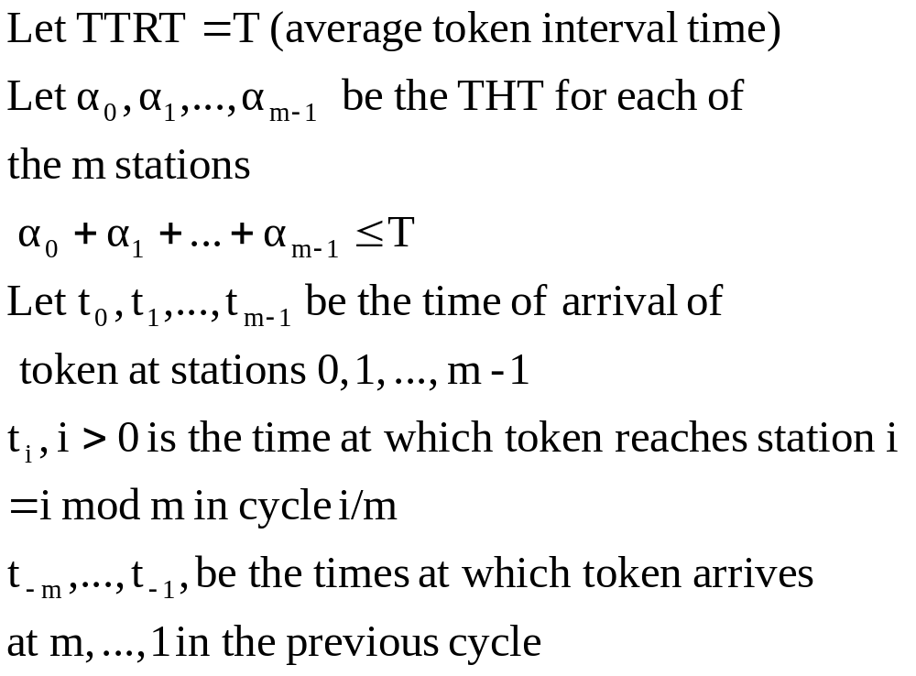
7.2 FDDI Analysis

Slide 17
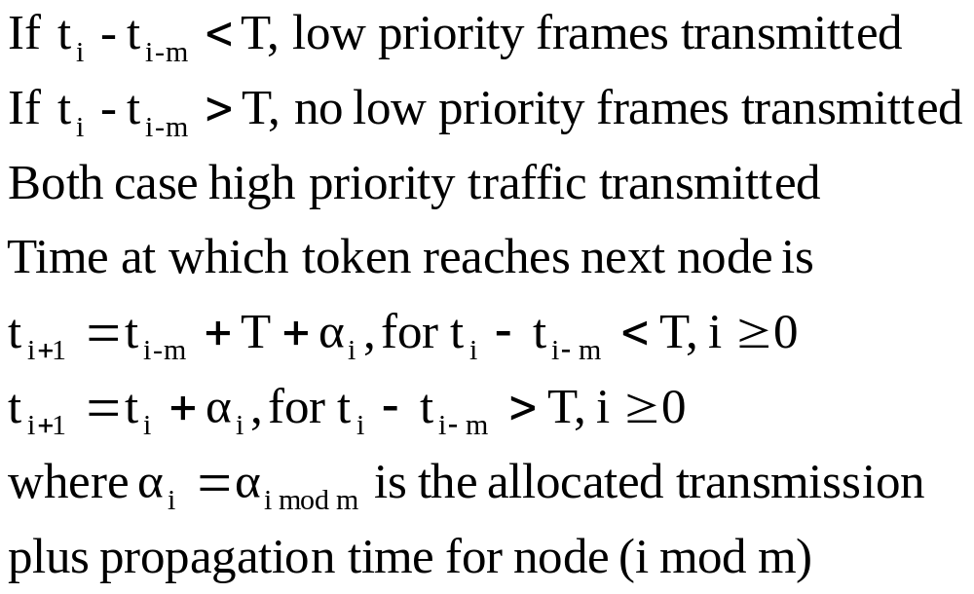
FDDI Analysis

Slide 18
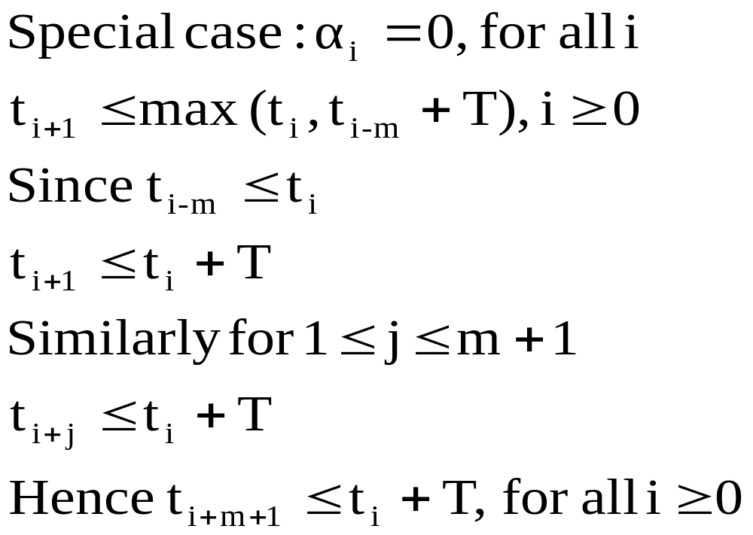
FDDI Analysis

Slide 19
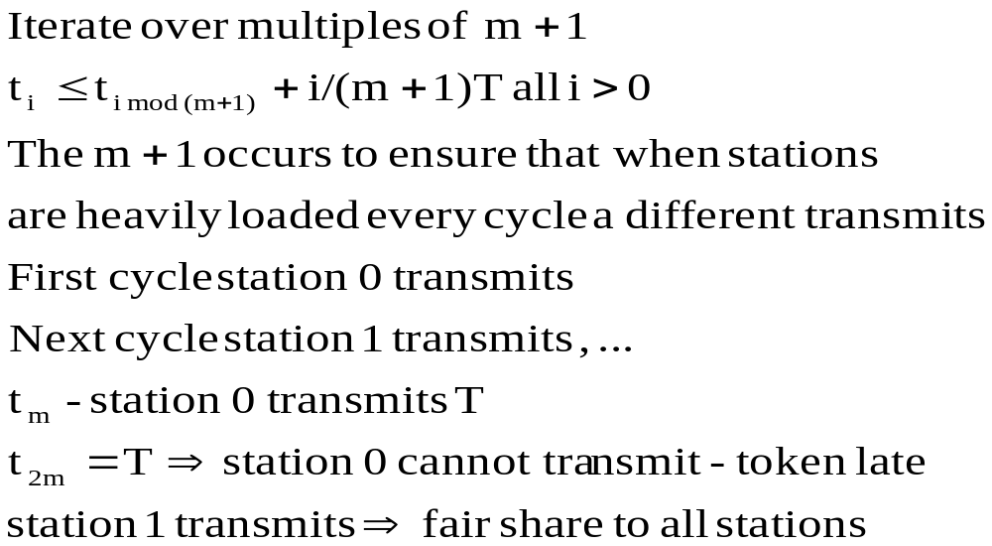
FDDI Analysis

Slide 20
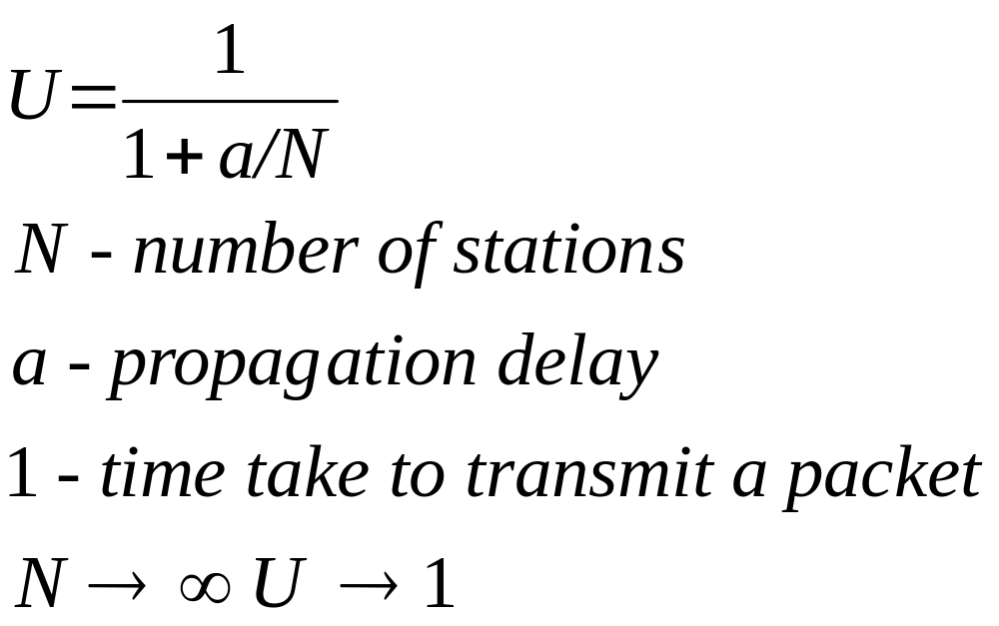
Utilisation

Slide 21
Wireless LANs
Infrared, radio
  Within room → Satellite communication
IEEE 802.11
  Limited geography
  Primary challenge
    Mediate access to a shared medium

Slide 22
Physical Properties
Three different mechanisms
Two based on spread spectrum
  Up to 2 Mbps
One – on diffused infrared
  ½ Mbps

Slide 23
Transmission in Wireless Media
Spread spectrum:
  frequency hopping (randomly choose frequencies)
  direct sequence
Direct sequence:
  represent each bit by multiple bits in the transmitted signal

Slide 24
n-Bit Chipping sequence based transmission
1
0
1
0
random sequence
1 0 1 1 0 0 1 0 0 0 1 1
XOR of sequence

Slide 25
n-Bit Chipping Sequence
n – bit chipping code spreads the signal across frequency band
that is n time 3 bit chipping sequence.
802.11: 79 MHz wide frequency bandwidths
  2.4 GHz frequency range
  11 bit chipping sequence
Collision Avoidance in 802.11
  similar to Ethernet problem

Slide 26
Hidden Nodes
A
B
C
D
Each node has a finite range
A can reach B, C can also reach B
A and C want to communicate with B
A and B are unaware of each other
Collision can happen at B
A and C are hidden nodes

Slide 27
Exposed Nodes
Transmission from B to A
  C is aware of this
    Since C in the range of B
  But C can transmit to D

Slide 28
Multiple Access Collision Avoidance
Sender and receiver exchange control frames:
Request to Send (RTS) – Sender → Receiver
  (includes the time for which it wants to hold the medium)
Clear to Send (CTS) – Receiver → Sender
  (echoes length field back)
Any node sees CTS
  close to Receiver therefore cannot access medium for time = length of frame

Slide 29
Multiple Access Collision Avoidance
Node sees RTS but not CTS
  It is not close to receiver
  It can transmit to some other node
Two or more nodes send RTS, donot hear CTS
  Collision, therefore backoff
Include Ack (MACAW)
  Receiver to sender after frame successfully received
Issues: Nodes mobile – require a distributed system

Slide 30
Distributed System
Problem of mobility
  Some nodes are mobile, some are connected to a wired infrastructure
    Access points (AP)
    Each AP connected to a distribution system
    Each node selects its own AP
DS
B
AP-3
AP-1
AP-2
F
A
C
C
H
G
D
E

Slide 31
Scanning for AP
Node sends a Probe frame
All APs nodes within reach reply with a probe response frame
Node selects one and sends that AP an associate request
AP responds with association response
Node uses this when it moves / changes
New AP notifies old AP
Nodes scan APs and APs also send Beacon frames

Slide 32
Frame Format
Ctrl
Duration
Addr 1
Addr 2
Addr 3
Seq ctrl
Addr 4
Payload
CRC
16
16
48
48
48
16
48
0-18, 496
32
Addr1 – destination AP
Addr 2 – destination address
Addr 3 – source AP
Addr 4 – source address
Ctrl
  Type - 6 bit (CTS, RTS, Scanning)
  ToDS - 1 bit
  From DS – 1bit

