Slide 1
Lecture 10 : Network Layer
Shankar Balachandran
Assistant Professor
Dept. of CSE, IIT Madras
Short Term Course on “Teaching Computer Networks Effectively”. Sponsored by AICTE.

Slide 2
10.1 Internetworking
Single network
  Shared media
  Point to point links
  Switches
In real world, people use different kinds of networks
Problem : Heterogeneity and Scale
  Not addressed so far
Hosts of different networks may want to talk
  Paths may be through other kinds of networks
  Each step in between may have it’s own
    addressing mechanism
    Media Access Control (MAC) protocol
    …

Slide 3
Organization
Internet Protocol (IP)
  Handling heterogeneity
  Scale
    Many other protocols available, but IP is the most interesting of all
Finding paths from one network to another
  aka routing
Problems with internet
Recent trends

Slide 4
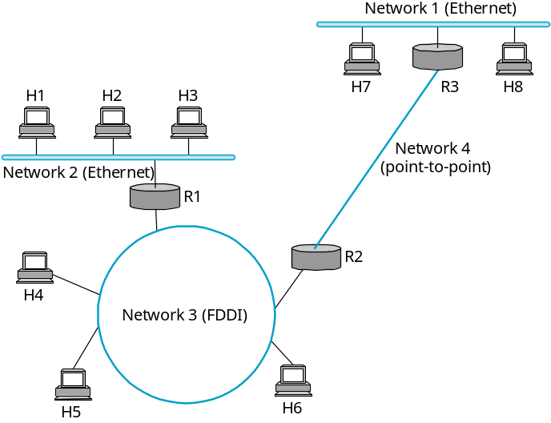
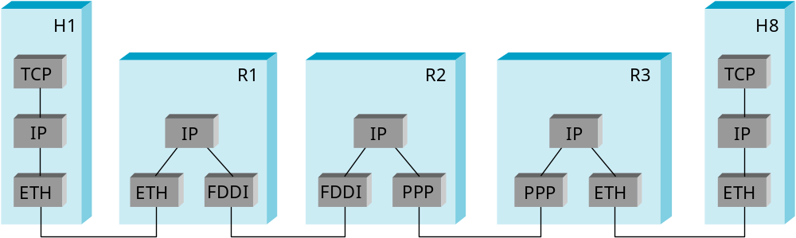
IP Internet
Concatenation of Networks
Protocol Stack

Slide 5
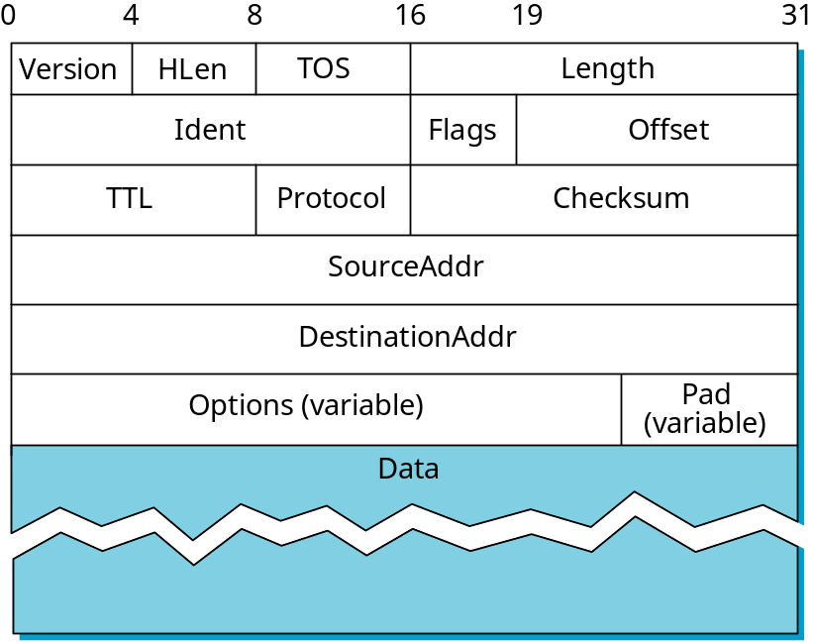
Service Model
Provide common services
  Kept intentionally simple and less demanding
  Any network technology can participate
Connectionless (datagram-based)
Best-effort delivery (unreliable service)
  packets are lost
  packets are delivered out of order
  duplicate copies of a packet are delivered
  packets can be delayed for a long time
Datagram format

Slide 6
Datagram
Grouped as words(32 bits)
Version : 4, 6 etc
  Location
HLen : 20 bytes max
TOS : Type of service
Length = < 64K
Second Word : Fragmentation
Third Word :
  TTL in number of hops
  TCP or UDP or …
Source and destination address in every single packet

Slide 7
Fragmentation and Reassembly
Each network has some MTU
Design decisions
  fragment when necessary (MTU < Datagram)
  try to avoid fragmentation at source host
  re-fragmentation is possible
  fragments are self-contained datagrams
  delay reassembly until destination host
  do not recover from lost fragments

Slide 8
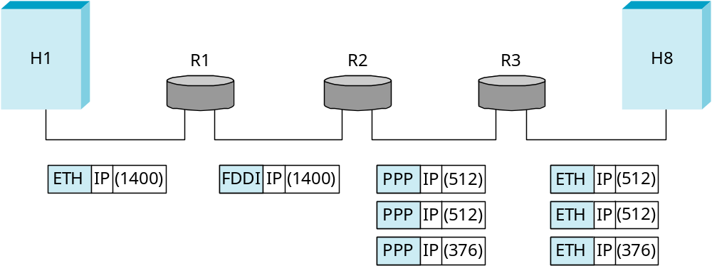
Example
Start of header
Ident = x
0
Offset = 0
Rest of header
(a)
1400 data bytes
Start of header
Ident = x
1
Offset = 0
Rest of header
512 data bytes
(b)
512/8
Start of header
Ident = x
1
Offset = 64
Rest of header
512 data bytes
Start of header
Ident = x
0
Offset = 128
Rest of header
376 data bytes

Slide 9
Global Addresses
Thought process
  Why don’t we use Ethernet addresses directly?
    After all, they are unique
    Problem : Does not reveal structure of the network.
    Problem : Not all hosts have ethernet interfaces
  Need : A mechanism to provide
    Unique addresses
    hierarchical: network + host

Slide 10
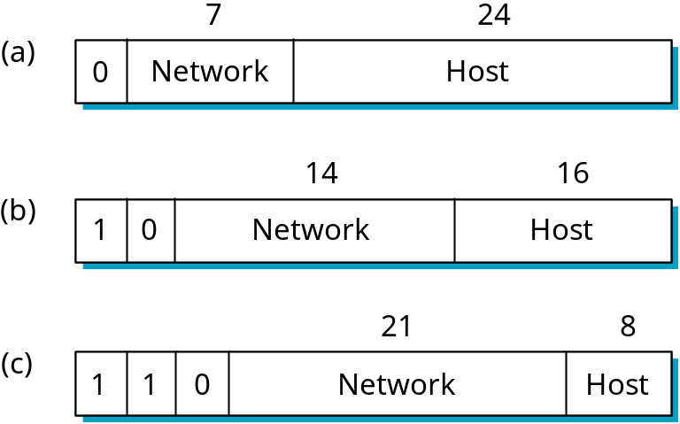
Global Addresses
Dot Notation
  10.3.2.4
  128.96.33.81
  192.12.69.77
Class A
  126 n/ws possible
  2^24 – 2 hosts in every n/w
Class B
  14 bits for n/w; 64K hosts per network
Class C
  2^21 Class C networks possible
Addressing is flexible
  Can arrange networks in their natural way and take care of naming with one of the classes

Slide 11
Datagram Forwarding
Strategy
  every datagram contains destination’s address
  if connected to destination network, then forward to host
  if not directly connected, then forward to some router
  forwarding table maps network number into next hop
  each host has a default router
  each router maintains a forwarding table
Example (R2) Network Number Next Hop
1 R3
2 R1
3 interface 1
4 interface 0

Slide 12
Router Implementation
Control
processor
Switching
fabric
Input
Output
port
port

Slide 13
Address Translation
Map IP addresses into physical addresses
  destination host
  next hop router
Techniques
  encode physical address in host part of IP address
  table-based
ARP
  table of IP to physical address bindings
  broadcast request if IP address not in table
  target machine responds with its physical address
  table entries are discarded if not refreshed

Slide 14
ARP Details
Request Format
  HardwareType: type of physical network (e.g., Ethernet)
  ProtocolType: type of higher layer protocol (e.g., IP)
  HLEN & PLEN: length of physical and protocol addresses
  Operation: request or response
  Source/Target-Physical/Protocol addresses
Notes
  table entries timeout in about 10 minutes
  update table with source when you are the target
  update table if already have an entry
  do not refresh table entries upon reference

Slide 15
ARP Packet Format
0
8
16
31
Hardware type = 1
ProtocolType = 0x0800
HLen = 48
PLen = 32
Operation
SourceHardwareAddr (bytes 0
―
3)
SourceHardwareAddr (bytes 4
―
5)
SourceProtocolAddr (bytes 0
―
1)
SourceProtocolAddr (bytes 2
―
3)
TargetHardwareAddr (bytes 0
―
1)
TargetHardwareAddr (bytes 2
―
5)
TargetProtocolAddr (bytes 0
―
3)

Slide 16
Host Configuration (Assigning Host ID’s)
Thought Process :
  Use ethernet : Will fix hosts to networks
Need : Something that’s reconfigurable
  Letting a host participate in any network that it wants to
  IP addresses may just help
What else is needed?
  Default router : Router that you are going to connect to if sender and receiver not on same shared network
Manually configure IPs
  Error-prone
  Centralized
  Cumbersome

Slide 17
Dynamic Host Configuration Protocol (DHCP)
DHCP Server
  At least one per administrative domain
  Configuration info is stored in the server
  Clients retrieve on Power Up
  Admin still controls who gets what
Variation of configuration
  List of unassigned addresses maintained

Slide 18
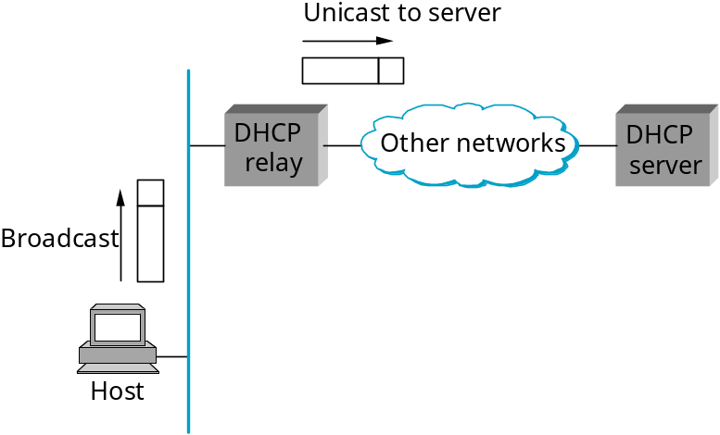
Mechanism
A host powers up
Sends a DHCPDISCOVER
to 255.255.255.255
Retrieved by all hosts and routers on that n/w
  Routers do not forward
Cases :
  One node is the DHCP server. It responds.
    So many DHCP servers all around !!
  Relay Agent : One relay agent per network
    Knows IP Address of the DHCP server
    A DHCPDISCOVER observed is unicast to the DHCP server
    Reply from DHCP server is passed on to the host

Slide 19
Internet Control Message Protocol (ICMP)
Echo (ping)
Redirect (from router to source host)
Destination unreachable (protocol, port, or host)
TTL exceeded (so datagrams don’t cycle forever)
Checksum failed
Reassembly failed
Cannot fragment

Slide 20
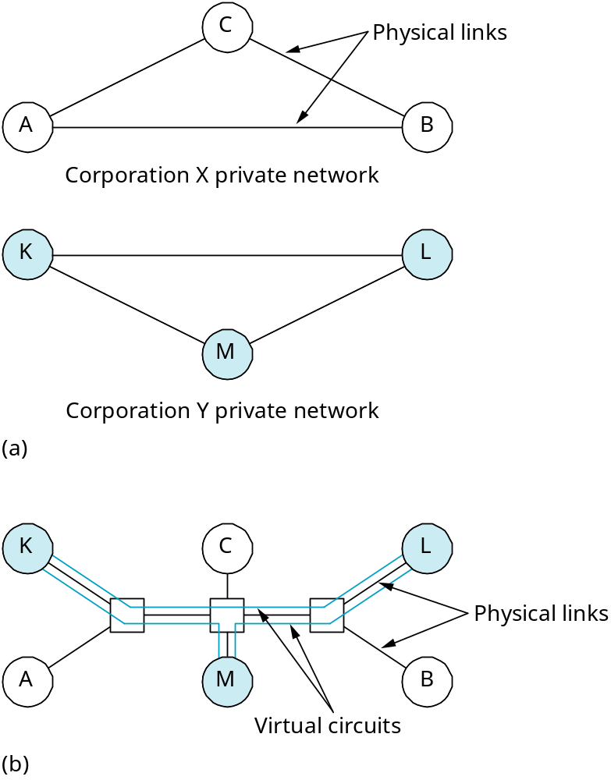
Virtual Networks

Slide 21
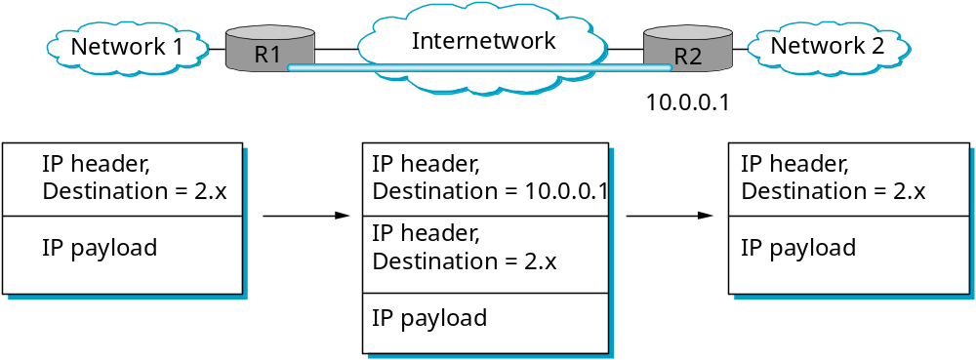
Implementing a VPN
Routing table
Encapsulate traffic from R1 to R2 inside IP packets addressed to R2. Together with encryption, this tunneling of packets is an effective way to implement a VPN.
NetworkNum | NextHop
1 | Interface 0
2 | Virtual Interface 0
Default | Interface 1

Slide 22
10.2 Congestion vs. Flow Control
Flow control:
  End-to-end
Congestion control
  Router to Router

Slide 23
Congestion control vs. Flow control:
I₁
I₂
OL
Queue
I₃
I₄
Congestion -
  buffer length
    Drop packets
  Slow processor at the router even though line capacity is high
  Mismatch between different parts of the system

Slide 24
Congestion vs. Flow Control
Router discards packets when it cannot serve
  Sender retransmits until acknowledged
  Congestion builds up
Flow Control
  Pt – Pt links between a given sender and a given receiver
  Fast sender does not overwhelm receiver
  Receiver can tell sender directly to slow down

Slide 25
Congestion Control
General principle of congestion:
  Monitor system to detect when and where congestion occurs
  Pass this information to places where action can be taken
  Adjust system operation to correct the problem

Slide 26
Congestion vs. Flow Control
Policing traffic at routers
  Token bucket / leaky bucket
  non trivial
Alternative flow specifications:
  Agreed between sender and receiver
  pattern of injected traffic
  QoS desired by Application

Slide 27
Congestion Control Algorithm:
Maximum capacity of
subnet sent
Perfect
Packet delivered
Desirable
Congested
Packets sent
- Routers loose packets
- Buffering?
- No use
- Packet reaches front of Queue, duplicate generated

Slide 28
Traffic Shaping
Traffic monitoring:
  Monitoring a traffic flow
  VC no problem
    Can be done for each VC separately since connection oriented
DG - Transport layer

Slide 29
Congestion: Reasons
Congestion causing policies:
Transport Layer
  Retransmission
  Out of order caching policy
  Ack policy
  Flow control policy
  Time out
Network Layer:
  VC versus datagram inside subnet
  Packet queuing and service policy
  Packet discard policy
  Routing algorithm policy
  Packet lifetime management policy

Slide 30
Congestion Control (contd.)
Solution:
  Traffic prediction?
  Router informs neighbour of possible congestion
  Traffic shaping
  Regulate the packet rate
  VC - traffic characteristics
    Not too important for file transfer but important for audio and video

Slide 31
Congestion Control (contd.)
Send probe packets periodically ask about congestion
  Road congestion – use helicopters flying over cities
  Bang bang operation of router – how does one prevent it
  Feed back and control required

Slide 32
Congestion Control Algorithms
Leaky Bucket Algorithm
  Regulate output flow
    Packets lost if buffer is full
Token Bucket Algorithm
  Buffer filled with tokens
    transmit ONLY if tokens available

Slide 33
Leaky bucket algorithm:
Host comp
Unregulated
water
Bucket hold packets
Regulated flow
Bucket full – lost packets
Output flow constant
  when water in bucket – zero when no water
Converts uneven flow to even flow
  Packets Queued
  Packets output at regular intervals only

Slide 34
Leaky Bucket Algorithm
Queue full, packet discarded.
  What if packets are different size and fixed bytes/ unit time.
Leaky bucket example
  Input burst 25 Mb/s every 40 ms
    Network speed 25 Mbps – every second
    Capacity of bucket C – 1 Mb
    Reduce average rate – 2 Mbps
    bucket can hold upto 1 Mb without data loss,
    burst spread over 500 ms irrespective of how fast they come

Slide 35
25 Mbps
0
40 ms
500 ms
500 ms
2 Mbps
25 X 40 = 1 Mb
1000
25 - 1000 40 X 25
1000
? - 40 = 1 Mb every sec
- spread it over 500 ms

Slide 36
40 ms 25 Mbps
0
1 Mb of burst
500 ms
spread
1 Mb over 500 ms
output rate 2 Mbps
Leaky bucket issues:
* Drops packets
* Does not allow host to save permission to transmit large burst
later

Slide 37
Token bucket Algorithm
Host
Host
- Host save packets upto maximum size of bucket, n
- n packets send at once – some burstiness
- Host captures token
- Never loose data
- Tokens not available packets queue up! – not discarded

Slide 38
Token Bucket Algorithm
Packet gets tokens and only then t
transmitted
  A variant – packets sent only if enough token available - token - fixed byte size
  Token bucket holds up n tokens
    Host captures tokens
    Each token can hold some bytes
    Token generated every T seconds
    Allows bursts of packets to be sent - max n
    Responds fast to sudden bursts
    If bucket full – thrown token packets not lost

Slide 39

Token Bucket Algorithm (example)
Calculation of length of maximum rate burst:
- Tokens arrive while burst output
Example
S – burst length in S
M – Maximum output rate
MS – Maximum length in bytes
– Token arrival rate
C – Capacity of token bucket in byte

Slide 40

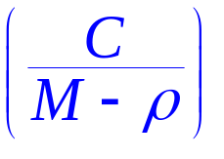
Token Bucket Algorithm (Example)
Maximum output burst = C + S = MS
S =
C = 250 Kb
M = 25 Mbps
= 2 Mbps
S = 11 ml
25 Mbps for 11 ms
364 ms 2 Mbps
2 Mbps
11 ms

Slide 41
Flow Control
Flow Control is specified end to end
  Sliding window protocol
  Fast sender vs. slow receiver
    Sender does not overwhelm receiver
  Advertisement of window size
    receiver tells sender DIRECTLY
  Process to process
See More about flow control in TCP

