Slide 1
Lecture 11 : Routing Algos + Scale
Shankar Balachandran
Assistant Professor
Dept. of CSE, IIT Madras
Short Term Course on “Teaching Computer Networks Effectively”. Sponsored by AICTE.

Slide 2
Overview
Forwarding vs Routing
  forwarding: to select an output port based on destination address and routing table
  routing: process by which routing table is built
Routing table
Forwarding table
NetworkNum | NextHop
5 | 192.168.1.1
NetworkNum | Iface | MAC addr
10 | eth0 | a:b:c:d:e:f

Slide 3
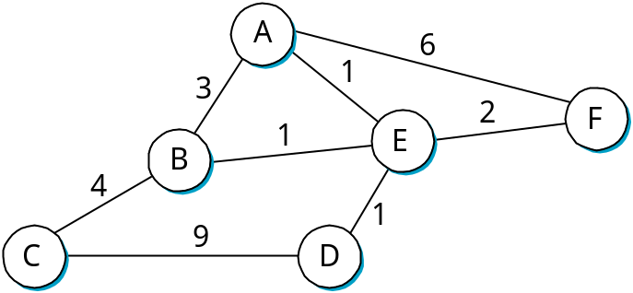
Overview
Network as a Graph
Problem: Find lowest cost path between every pair of nodes
  Sounds familiar??
Factors
  static: topology
  dynamic: load

Slide 4
1. Distance Vector Routing
Each node maintains a set of triples
  (Destination, Cost, NextHop)
Directly connected neighbors exchange updates
  periodically (on the order of several seconds)
  whenever table changes (called triggered update)
Each update is a list of pairs:
  (Destination, Cost)
Update local table if receive a “better” route
  smaller cost
  came from next-hop
Refresh existing routes; delete if they time out

Slide 5
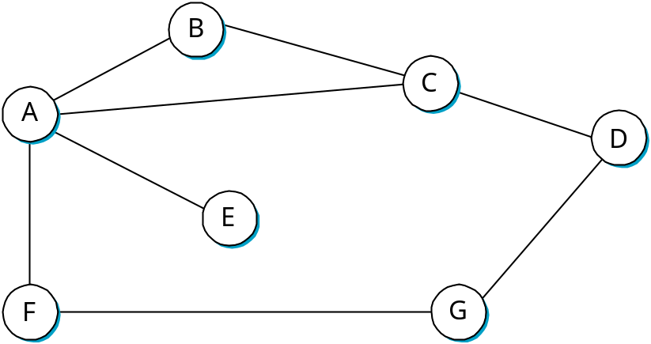


Distance Vector
Global view (Never available at any single node)
@node | Distance to node
 | A | B | C | D | E | F | G
A | 0 | 1 | 1 |  | 1 | 1
B | 1 | 0 | 1
C | 1 | 1 | 0 | 1
D |  |  | 1 | 0 |  |  | 1
E | 1 |  |  |  | 0
F | 1 |  |  |  |  | 0 | 1
G |  |  |  | 1 |  | 1 | 0
A’s view: vector
Dest | Cost | NextHop
B | 1 | B
C | 1 | C
D |  | -
E | 1 | E
F | 1 | F
G |  | -

Slide 6
Distance Vector Routing
Every node starts by building it’s own local view of what nodes are 1 hop away.
Next, every node sends its vector to its directly connected neighbors.
Example :
  C tells B it can reach D in one
  hop
  B updates D’s distance to 2
  ( B to C + C to D)
  If any other path comes along with higher cost, discard
  After a few iterations, the routing table converges

Slide 7
Example
At B
Destination Cost NextHop
A 1 A
C 1 C
D 2 C
E 2 A
F 2 A
G 3 A

Slide 8
Routing Loops
Example 1
  F detects that link to G has failed
  F sets distance to G to infinity and sends update t o A
  A sets distance to G to infinity since it uses F to reach G
  A receives periodic update from C with 2-hop path to G
  A sets distance to G to 3 and sends update to F
  F decides it can reach G in 4 hops via A
Example 2
  link from A to E fails
  A advertises distance of infinity to E
  B and C advertise a distance of 2 to E
  B decides it can reach E in 3 hops; advertises this to A
  A decides it can read E in 4 hops; advertises this to C
  C decides that it can reach E in 5 hops…
  Count to infinity problem

Slide 9
Loop-Breaking Heuristics
Set infinity to 16 (or some such value)
  Any problem with the technique?
Split horizon
  When you update a neighbor, do not send a route that you learned from the neighbor
Split horizon with poison reverse
  When you update a neighbor, “poison” the routing information that you learnt from the neighbor
    Set value to infinity
Split horizon techniques break 2-node loops only

Slide 10
2. Link State
Assumptions :
  As before; Links status, cost of links
Strategy
  send to all nodes (not just neighbors) information about directly connected links (not entire routing table)
  every node can reconstruct the graph and hence find the shortest path
  a sufficient condition (not necessary though) to find shortest path
Two mechanisms needed
  Reliable dissemination of link information
    Reliable flooding
  Calculation of routes from the link states collected

Slide 11
Link State Packet (LSP)
id of the node that created the LSP
  to know who you got the information from
cost of link to each directly connected neighbor
sequence number (SEQNO)
  recent update overrides older one
time-to-live (TTL) for this packet
  old ones must eventually die

Slide 12
Link State (cont)
Reliable flooding
  store most recent LSP from each node
  forward LSP to all nodes but one that sent it
  generate new LSP periodically
    increment SEQNO
  start SEQNO at 0 when reboot
  decrement TTL of each stored LSP
    discard when TTL=0

Slide 13
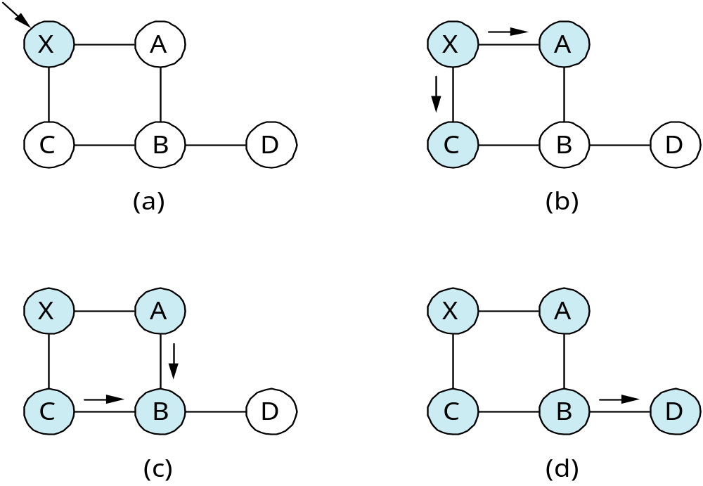
Example
X floods A and B;
Nothing backwards
X gets LSP
A and C flood B
Flooding is complete

Slide 14
Route Calculation
Dijkstra’s shortest path algorithm
Let
  N denotes set of nodes in the graph
  l (i, j) denotes non-negative cost (weight) for edge (i, j) or ∞
  s denotes this node
  M denotes the set of nodes incorporated so far
  C(n) denotes cost of the path from s to node n
M = {s}
for each n in N - {s}
  C(n) = l(s, n)
while (N != M)
  M = M union {w} such that C(w) is the minimum for
  all w in (N - M)
  for each n in (N - M)
    C(n) = MIN(C(n), C (w) + l(w, n ))

Slide 15
Properties of Link State Routing
Stabilizes quickly
Keeps routing control traffic low
Responds rapidly to topology changes
Doesn’t scale well: the amount of information stored in each node is large.

Slide 16
Difference Between DV and LS
In DV
  Talk only to neighbor
  Tell the neighbor everything that you learnt
In LS
  Talk to everyone
  Tell them about the only thing that you are sure of (namely the neighbor’s link state)

Slide 17
Metrics
Original ARPANET metric
  measures number of packets queued on each link
  took neither latency or bandwidth into consideration
New ARPANET metric
  stamp each incoming packet with its arrival time (AT)
  record departure time (DT)
  when link-level ACK arrives, compute
    Delay = (DT - AT) + Transmit + Latency
  if timeout, reset DT to departure time for retransmission
  link cost = average delay over some time period
Fine Tuning
  compressed dynamic range
  replaced Delay with link utilization

Slide 18
11.2 How to Make Routing Scale?
Flat versus Hierarchical Addresses
Inefficient use of Hierarchical Address Space
  class C with 2 hosts (2/255 = 0.78% efficient)
  class B with 256 hosts (256/65535 = 0.39% efficient)
Still Too Many Networks
  routing tables do not scale
  route propagation protocols do not scale

Slide 19
Internet Structure
Recent Past
Stanford
NSFNET backbone
ISU
BARRNET
MidNet
regional
Westnet
■ ■ ■
regional
regional
Berkeley
PARC
NCAR
UNM
UNL
KU
UA
Autonomous
System (AS)

Slide 20
Internet Structure
Today
Large corporation
“Consumer”
ISP
Peering
point
Backbone service provider
Peering
point
“Consumer”
ISP
Large corporation
“Consumer”
ISP
Small
corporation

Slide 21
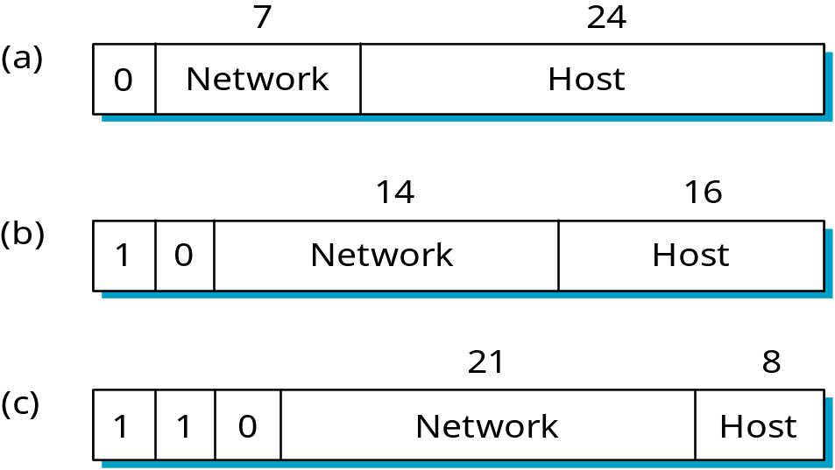
Global Addresses
What will you assign if I have 2 hosts on the network?
What if I have 280 machines that needed global addresses?
CLASS A
CLASS B
CLASS C

Slide 22
Scalability
Routing
  Minimize the number of network numbers
  Routing table information reduces
Address Utilization
  IP address space should not get used up quickly
Problem
  Every network would uniquely identify one physical network
    2^14 networks = 16K networks would exhaust Class B addresses

Slide 23
Network Address Translation
local addresses
global addresses
10.0.1.5
globally unique
10.0.1.5
171.69.210.246
10.0.1.5
NAT Box
10.0.1.8
10.0.1.2

Slide 24
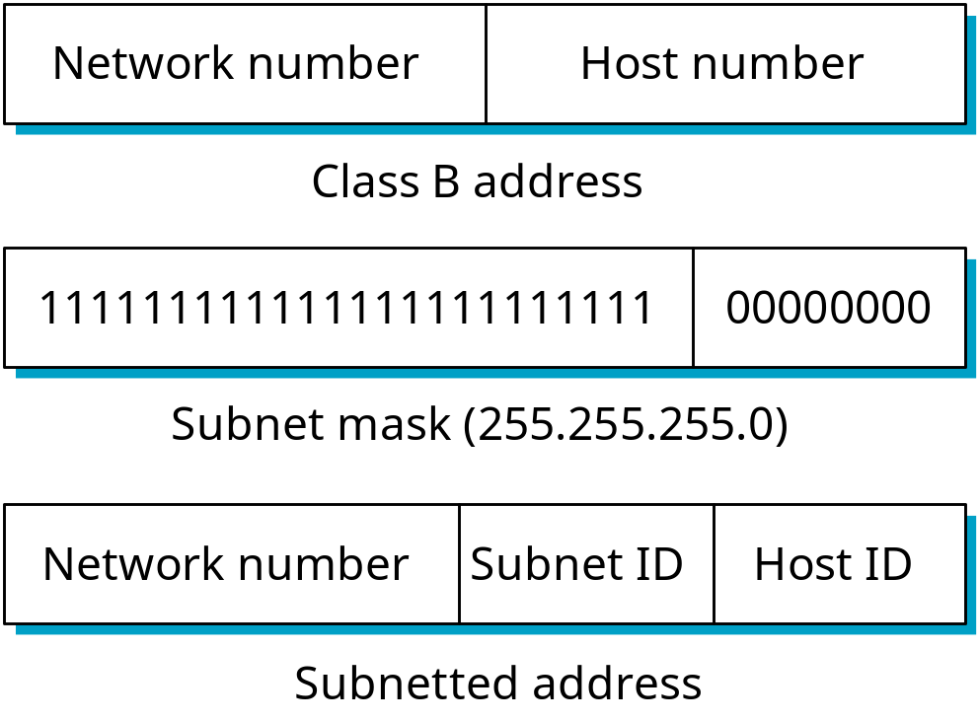
Subnetting
Take a network address and break it up into subnets that can be assigned to individual physical networks.
Define a subnet mask to help create a new level of hierarchy in the addressing scheme.
The bitwise AND of the subnet mask with the full address gives the subnet number.
Added Hierarchy

Slide 25
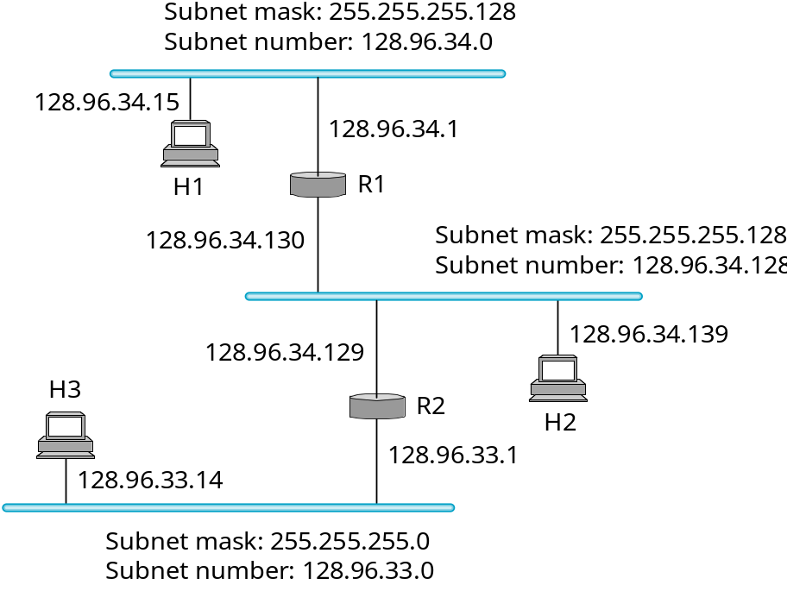
Subnet Example
All hosts in a subnet are configured with the same subnet mask.
Forwarding table at router R1
Subnet Number Subnet Mask Next Hop
128.96.34.0 255.255.255.128 interface 0
128.96.34.128 255.255.255.128 interface 1
128.96.33.0 255.255.255.0 R2

Slide 26
Example
H1 wants to send to H2
  H1 ANDs its subnet mask with address of H2
    255.255.255.128 w/ 128.96.34.139
    Result : 128.96.34.128
    Does not match with 128.96.34.0
    H1 now knows H2 is on a different subnet
    H1 sends it to default router R1

Slide 27
Forwarding Algorithm
D = destination IP address
for each entry (SubnetNum, SubnetMask, NextHop)
D1 = SubnetMask & D
if D1 = SubnetNum
if NextHop is an interface
deliver datagram directly to D
else
deliver datagram to NextHop (a router)
Use a default router if nothing matches
Not necessary for all 1s in subnet mask to be contiguous
Can put multiple subnets on one physical network
Subnets not visible from the rest of the Internet

Slide 28
Subnetting
Assign close subnet numbers to closer networks
  Addresses the issue of reducing routing table sizes
  Does not deal with inefficiencies

Slide 29
Supernetting
Assign block of contiguous network numbers to nearby networks
  Aggregation
Called CIDR: Classless Inter-Domain Routing
  Pronounced “cider”
Example :
  Suppose we need to assign 192.4.16 to 192.4.31
  Observe:Top 20 bits are the same (11000000 00000100 0001)
  Effectively a 20-bit number
  Something between a Class B and Class C network

Slide 30
CIDR
Needs classless addressing
  Routers must understand that networks can be of any length
Represent blocks with a single pair
(first_network_address, count)
Restrict block sizes to powers of 2
Use a bit mask (CIDR mask) to identify block size
All routers must understand CIDR addressing

Slide 31
IP Forwarding Revisited
We so far assumed that we could find the network number in a packet
  CIDR packets can be of any length (2 to 32)
Possible to have prefixes that “overlap”
Example :
  171.69 and 171.69.10 can be both in the forwarding table of a router
  What if you want to route to 171.69.10.5?
    Both match
Do the longest prefix match : 171.69.10
171.69.20.5 would match 171.69
Enormous potential for hardware design

Slide 32
Route Propagation
Know a smarter router
  hosts know local router
  local routers know site routers
  site routers know core router
  core routers know everything
Autonomous System (AS)
  corresponds to an administrative domain
  examples: University, company, backbone network
  assign each AS a 16-bit number
Two-level route propagation hierarchy
  interior gateway protocol (each AS selects its own)
  exterior gateway protocol (Internet-wide standard)

Slide 33
Popular Interior Gateway Protocols
RIP: Route Information Protocol
  developed for XNS
  distributed with Unix
  distance-vector algorithm
  based on hop-count
OSPF: Open Shortest Path First
  recent Internet standard
  uses link-state algorithm
  supports load balancing
  supports authentication

Slide 34
EGP: Exterior Gateway Protocol
Overview
  designed for tree-structured Internet
  concerned with reachability, not optimal routes
Protocol messages
  neighbor acquisition: one router requests that another be its peer; peers exchange reachability information
  neighbor reachability: one router periodically tests if the another is still reachable; exchange HELLO/ACK messages; uses a k-out-of-n rule
  routing updates: peers periodically exchange their routing tables (distance-vector)

Slide 35
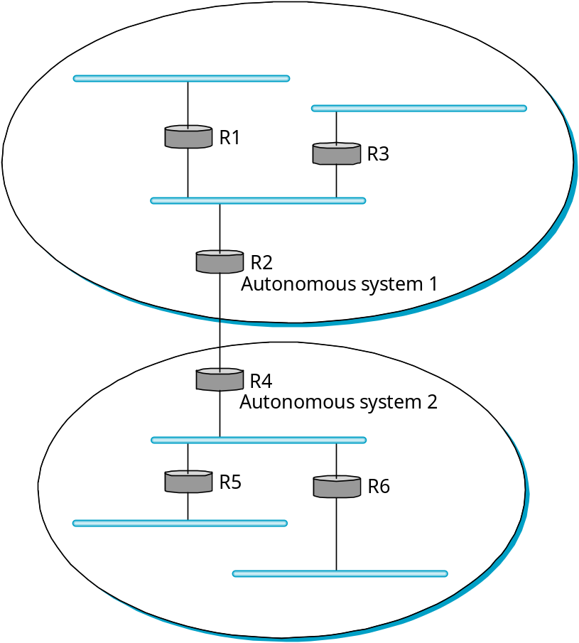
Autonomous Systems
domain
Goal: To hierarchically aggregate routing information in a large internetwork to improve scalability.
Border routers: this is the default destination of all packets bound to hosts outside the AS.
domain
The AS model decouples the intradomain routing that happens within one AS from what is done in another AS.
Prefix: as in classless routing, this is expressed as IP/length, i.e. 192.4.16/20.

Slide 36
The BGP Model of the Internet
Large corporation
“Consumer”
ISP
Peering
point
Backbone service provider
Peering
point
“Consumer”
ISP
Large corporation
“Consumer”
ISP
Small
corporation
Multihomed AS: An AS with connections to multiple ASs, which refuses to carry external traffic.
Stub AS: Only one connection to another AS.
Transit AS: An AS with connections to multiple AS and carries internal and external traffic.

Slide 37
BGP Routing
Challenges:
  Scale (over 140,000 prefixes),
  Domains are autonomous and can assign arbitrary metrics to its internal paths,
  ASs can only cooperate if they can trust one another to publicize accurate routing information and to carry out their promises,
  Policies should be flexible to allow ASs freedom of action. This choice may override optimal paths and determine the use of paths that are “good enough”.

Slide 38
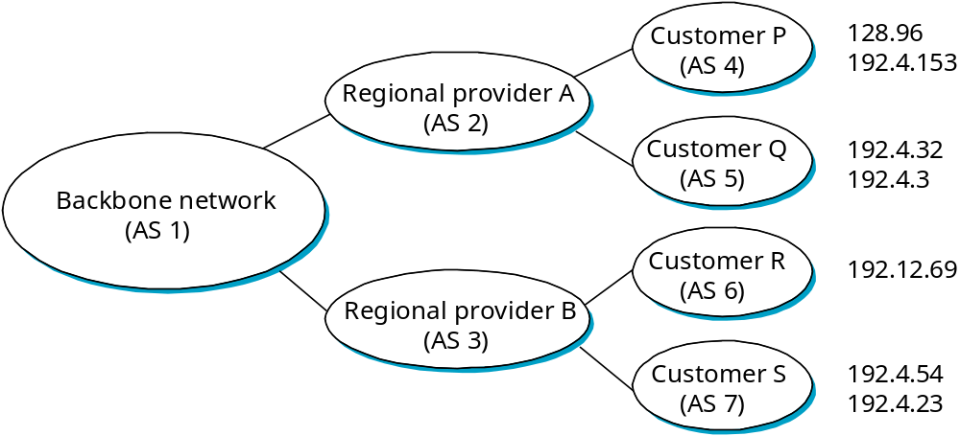
BGP Example
Speaker for AS2 advertises reachability to P and Q
  network 128.96, 192.4.153, 192.4.32, and 192.4.3, can be reached directly from AS2
Speaker for backbone advertises
  networks 128.96, 192.4.153, 192.4.32, and 192.4.3 can be reached along the path (AS1, AS2).
Speaker can cancel previously advertised paths

Slide 39
Integrating Interdomain and Intradomain Routing
Stub AS: The border router injects a default route into the intradomain routing protocol.
Multihomed and Transit ASs: The border routers inject routes that they have learned from outside the AS.
Transit ASs: The information learned from BGP may be “too much” to inject into the intradomain protocol: if a large number of prefixes is inserted, large link-state packets will be circulated and path calculations will get very complex.

Slide 40
IP Version 6
Features
  128-bit addresses (classless)
  multicast
  real-time service
  authentication and security
  autoconfiguration
  end-to-end fragmentation
  protocol extensions
Header
  40-byte “base” header
  extension headers (fixed order, mostly fixed length)
    fragmentation
    source routing
    authentication and security
    other options

Slide 41
Address Space Allocation
Prefix | Use
0000 0000 | Reserved
0000 0001 | Unassigned
0000 001 | Reserved for NSAP allocation
0000 010 | Reserved for IPX allocation
0000 011, 0000 1, 0001 | Unassigned
001 | Aggregatable Global Unicast
010, 011, 100, 101, 110, 1110, 1111 0, 1111 10, 1111 110, 1111 1110 0 | Unassigned
1111 1110 10 | Link local use
1111 1110 11 | Site local use
1111 1111 | Multicast
Classes A, B, and C
May not be unique
May not be unique
Class D

Slide 42
Address Notation
X:X:X:X:X:X:X:X where X is a 16-bit value
When there are many consecutive 0s, omit them:
47CD:0000:0000:0000:0000:0000:A456:0124 becomes
47CD::A456:0124 (double colon means a group of 0s)
Two types of IPv6 address can contain embedded IPv4 addresses. For example, an IPv4 host address 128.96.33.81 becomes
    ::FFFF:128.96.33.81 (the last 32 bits are an IPv4 address)
This notation facilitates the extraction of an IPv4 address from an IPv6 address.

Slide 43
Aggregatable Global Unicast Addresses
001 prefix: How are these addresses assigned to ISPs, autonomous systems, networks, hosts, and routers?
Subscriber: non-transit AS (stub and multihomed)
Provider: transit AS
Direct: connected directly to subscribers
Indirect or Backbone network: connected to other providers
Plan: Aggregate routing information to reduce the burden on intradomain routers. Assign a prefix to a direct provider; within the provider assign longer prefixes that reach its subscribers.

Slide 44
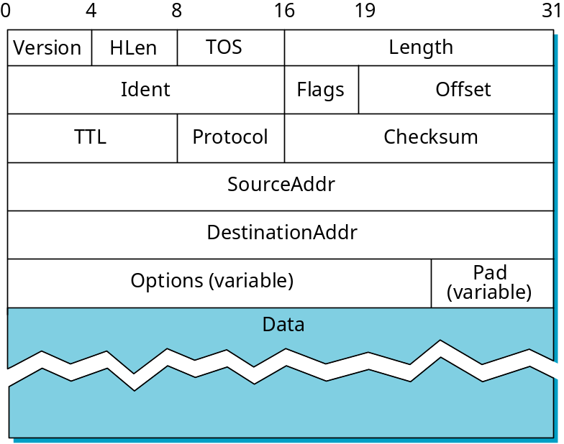
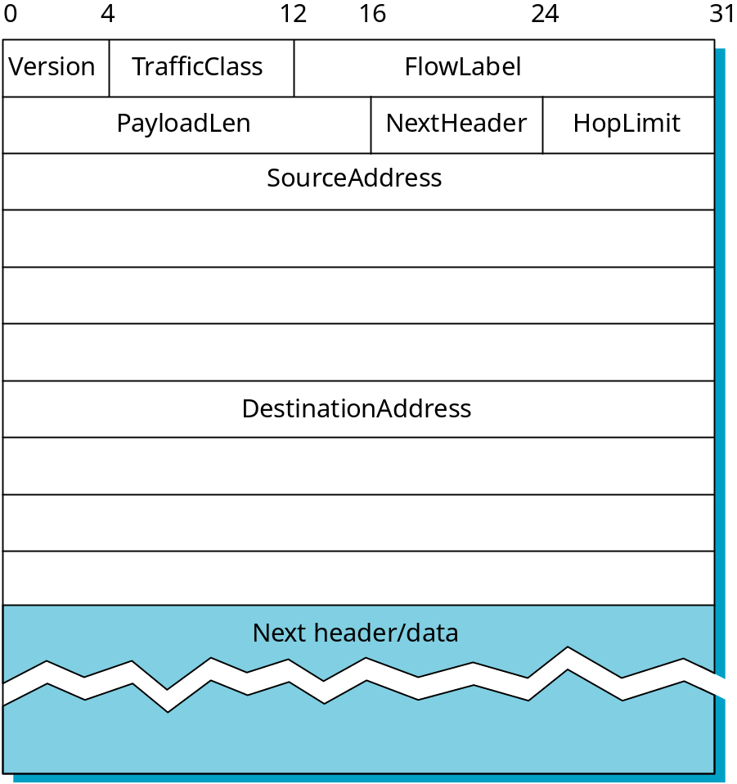
Packet Format
IPv4
IPv6

