Slide 1
Lecture 13 : Transport Layer
Shankar Balachandran
Assistant Professor
Dept. of CSE, IIT Madras
Short Term Course on “Teaching Computer Networks Effectively”. Sponsored by AICTE.

Slide 2
Network Layer Properties
Underlying best-effort network
  drop messages
  re-orders messages
  delivers duplicate copies of a given message
  limits messages to some finite size
  delivers messages after an arbitrarily long delay

Slide 3
End to End Services
Common end-to-end services
  guarantee message delivery
  deliver messages in the same order they are sent
  deliver at most one copy of each message
  support arbitrarily large messages
  support synchronization
  allow the receiver to flow control the sender
  support multiple application processes on each host

Slide 4
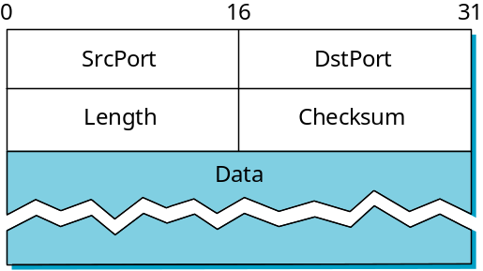
Simple Demultiplexer (UDP)
Unreliable and unordered datagram service
Adds multiplexing
No flow control
Endpoints identified by ports
  servers have well-known ports
  see /etc/services on Unix
Header format
Optional checksum
  psuedo header + UDP header + data

Slide 5
TCP Overview
Connection-oriented
Byte-stream
  app writes bytes
  TCP sends segments
  app reads bytes
Full duplex
Flow control: keep sender from overrunning receiver
Congestion control: keep sender from overrunning network
Application process
Application process
Write
Read
bytes
bytes
TCP
TCP
Send buffer
Receive buffer
Segment
Segment
■ ■ ■
Segment
Transmit segments

Slide 6
Data Link Versus Transport
Potentially connects many different hosts
  need explicit connection establishment and termination
Potentially different RTT
  need adaptive timeout mechanism
Potentially long delay in network
  need to be prepared for arrival of very old packets
Potentially different capacity at destination
  need to accommodate different node capacity
Potentially different network capacity
  need to be prepared for network congestion

Slide 7
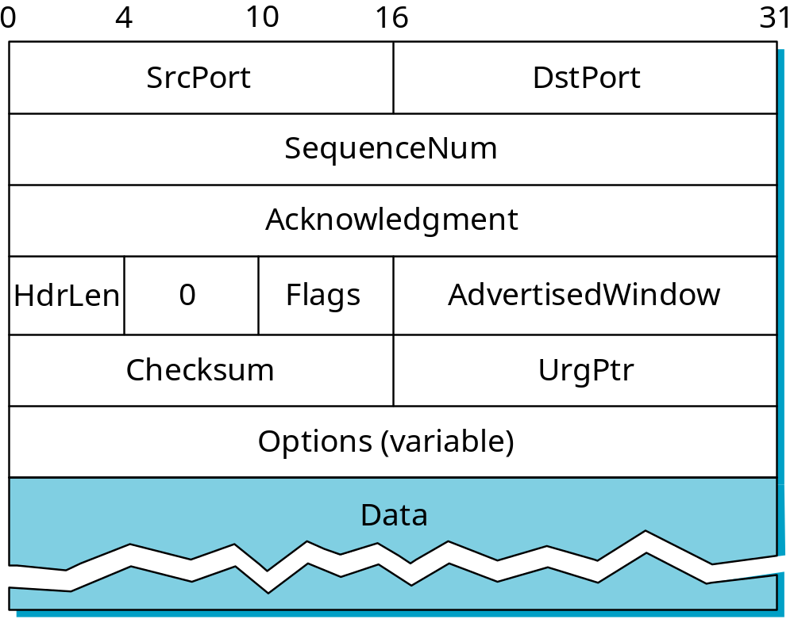
Segment Format

Slide 8
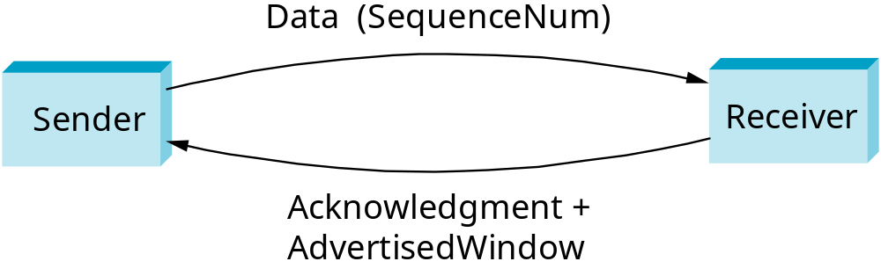
Segment Format (cont)
Each connection identified with 4-tuple:
  (SrcPort, SrcIPAddr, DstPort, DstIPAddr)
Sliding window + flow control
  acknowledgment, SequenceNum, AdvertisedWindow
Flags
  SYN, FIN, RESET, PUSH, URG, ACK
Checksum
  pseudo header + TCP header + data

Slide 9
Connection Establishment
Active participant
Passive participant
(client)
(server)
SYN, SequenceNum =
x
SYN+ACK, SequenceNum=y,
Acknowledgment =x+1
ACK, Acknowledgment =y+1

Slide 10
Socket Functions
TCP Server
socket()
TCP Client
bind()
socket()
listen()
connect()
accept()
TCP 3-way handshake
block until connection from client
write()
data (request)
read()
process request
data (reply)
write()
read()
end-of-file notification
read()
close()
close()

Slide 11
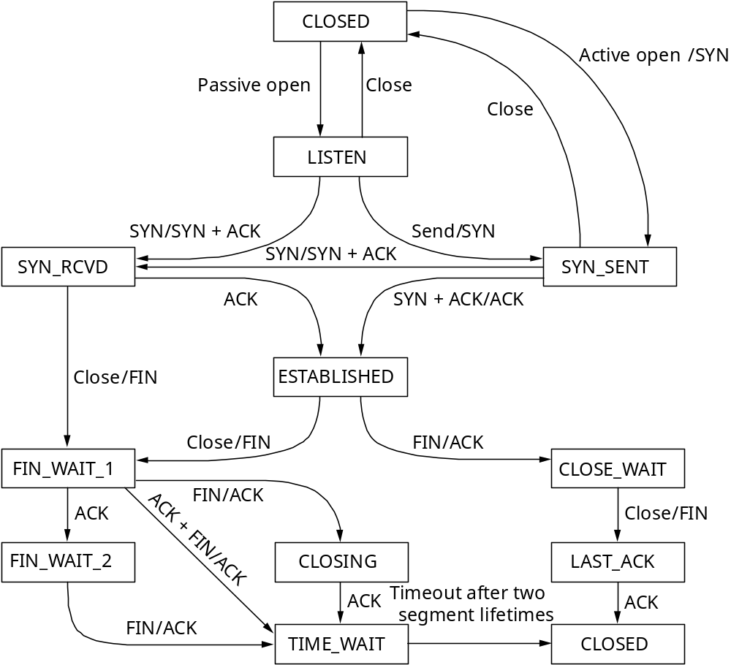
State Transition Diagram

Slide 12
Connection Establishment
Client
Server
CLOSED
CLOSED
Active open
/SYN
1
Active open
/SYN
Passive open
Close
Passive open
Close
Close
Close
LISTEN
2
LISTEN
3
SYN/SYN + ACK
SYN/SYN + ACK
Send
/
SYN
SYN/SYN + ACK
Send
/
SYN
SYN_RCVD
SYN_SENT
SYN_RCVD
SYN/SYN + ACK
SYN_SENT
ACK
SYN + ACK/ACK
5
ACK
SYN + ACK/ACK
4
Close
/FIN
ESTABLISHED
Close
/FIN
ESTABLISHED
Close
/FIN
FIN/ACK
Close
/FIN
FIN/ACK
FIN_WAIT_1
CLOSE_WAIT
FIN_WAIT_1
CLOSE_WAIT
ACK
FIN/ACK
Close
/FIN
FIN/ACK
ACK + FIN/ACK
ACK
Close
/FIN
FIN_WAIT_2
CLOSING
LAST_ACK
FIN_WAIT_2
ACK + FIN/ACK
CLOSING
LAST_ACK
ACK
Timeout after two
ACK
ACK
Timeout after two
ACK
FIN/ACK
segment lifetimes
FIN/ACK
segment lifetimes
TIME_WAIT
CLOSED
TIME_WAIT
CLOSED
Steps 2,3,4 achieves the 3-Way Handshake
Question : What if ACK is lost? (@ step 4)

Slide 13
TCP Connection Termination
(client)
(server)
close (active close)
FIN, SequenceNum=M
(passive close) read returns 0
ACK,Acknowledgement=M+1
FIN,SequenceNum=N
close
ACK, Acknowledgement=N+1
It takes 4 TCP segments to terminate a connection.

Slide 14
Connection
Teardown
CLOSED
Active open
/SYN
Passive open
Close
This side closes
first
Close
LISTEN
SYN/SYN + ACK
Send
/
SYN
SYN/SYN + ACK
Other side closes
first
SYN_RCVD
SYN_SENT
ACK
SYN + ACK/ACK
Close
/FIN
ESTABLISHED
Both sides close
together
Close
/FIN
FIN/ACK
FIN_WAIT_1
CLOSE_WAIT
FIN/ACK
ACK
Close
/FIN
ACK + FIN/ACK
FIN_WAIT_2
CLOSING
LAST_ACK
ACK
Timeout after two
ACK
FIN/ACK
segment lifetimes
TIME_WAIT
CLOSED

Slide 15
13.2 Sliding Window
TCP’s sliding window algorithm:
  Guarantees reliable delivery.
  Guarantees in-order delivery.
  Enforces flow control.
Look again at the TCP segment header:
The receiver tells the sender the number of unacknowledged bytes of data it will allow (based on buffer size).

Slide 16
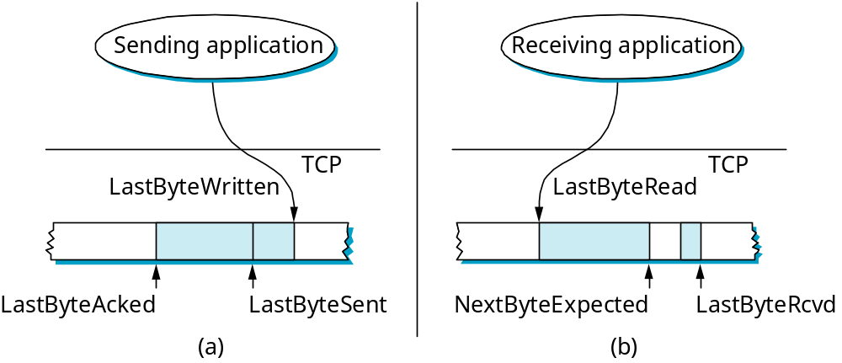
Flow Control
LastByteAcked ≤ LastByteSent
LastByteRead < NextByteExpected
NextByteExpected ≤ LastByteRcvd+1
LastByteSent ≤ LastByteWritten
Buffer bytes between
LastByteAcked &
LastByteWritten

Slide 17
Flow Control
Send buffer size: MaxSendBuffer
Receive buffer size: MaxRcvBuffer
Receiving side
  LastByteRcvd - LastByteRead < = MaxRcvBuffer
  AdvertisedWindow = MaxRcvBuffer - (NextByteExpected - NextByteRead)
Sending side
  LastByteSent - LastByteAcked < = AdvertisedWindow
  EffectiveWindow = AdvertisedWindow - (LastByteSent - LastByteAcked)
  LastByteWritten - LastByteAcked < = MaxSendBuffer
  block sender if (LastByteWritten - LastByteAcked) + y > MaxSenderBuffer
Always send ACK in response to arriving data segment
Persist when AdvertisedWindow = 0

Slide 18
Triggering Transmission
When does TCP decide to send a segment?
As soon as MSS (maximum segment size) bytes have been collected from sender.
Whenever the sending application explicitly requests it (push).
Whenever a “timer” fires and then however many bytes have been buffered so far are sent.
Sending application
TCP

Slide 19
Maximum Segment Size (MSS)
Rule of thumb: Usually set to the size of the largest segment TCP can send without causing the local IP to fragment.
IP header
TCP header
MSS= sizeof(MTU) -
sizeof(IP header) –
sizeof(TCP header)
MTU of the directly connected network

Slide 20
“Aggressive Send”
Now, consider what happens in the presence of flow control:
  AdvertisedWindow=0, so the sender is accumulating bytes to send.
  ACK arrives and AdvertisedWindow=MSS/2.
  Question: Should the sender go ahead and send MSS/2 or wait for AdvertisedWindow to increase all the way to MSS?

Slide 21

Silly Window Syndrome
Consequence of aggressively taking advantage of any available window. Think of the TCP stream as a conveyor belt:
full data containers
Sender
Receiver
empty data containers (ACKs)
If the sender fills an empty container as soon as it arrives, then any small container introduced into the system remains indefinitely: it is immediately filled and emptied in each end.

Slide 22
Nagle’s Algorithm
How long does sender delay sending data?
  too long: hurts interactive applications
  too short: poor network utilization
  strategies: timer-based vs self-clocking

Slide 23
Nagle’s Algorithm
when (application has data to send) {
  if (available data>MSS) && (AdvertisedWindow>MSS)
  send full segment // OK to send full segment
  else
  if (unACKed data in transit)
  buffer the new data until an ACK arrives // wait for in-flight ACKs
  else
  send all the new data immediately // OK to send one small segment
  }
Interactive applications like telnet
  App writes one byte at a time
  Segment = one byte or as many bytes that can be typed in one RTT
For other apps :
  TCP_NODELAY in socket should take care of it

Slide 24
Adaptive Retransmission
(Original Algorithm)
Measure SampleRTT for each segment / ACK pair
Compute weighted average of RTT
  EstRTT = α x EstRTT + β x SampleRTT
  where α + β = 1
  α between 0.8 and 0.9
  β between 0.1 and 0.2
Set timeout based on EstRTT
  TimeOut = 2 x EstRTT
Question : What happens if α is too small?

Slide 25
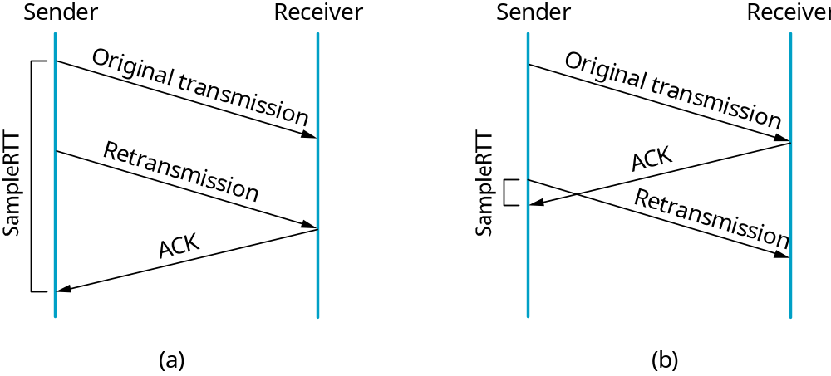
Karn/Partridge Algorithm
ACK doesn’t acknowledge a particular transmission.
ACK acknowledges the receipt of data.
Question: If you don’t know which transmission is being ACKed, how do you compute SampleRTT?
Surprisingly noticed after a very long time.

Slide 26
Karn/Partridge
Algorithm
Solution:
Compute RTT only for the first transmission of a packet.
Each time TCP retransmits a packet, set the timeout value to 2xTimeOut.
Rationale: If packets are being lost, this is likely to be the consequence of congestion, so the sender should be less aggressive.

Slide 27
Jacobson/ Karels Algorithm
New Calculations for average RTT
Diff = SampleRTT - EstRTT
EstRTT = EstRTT + (δ x Diff)
Dev = Dev + δ( |Diff| - Dev)
  where δ is a factor between 0 and 1
Consider variance when setting timeout value
TimeOut = μ x EstRTT + φ x Dev
  where μ = 1 and φ = 4
Notes
  algorithm only as good as granularity of clock (500ms on Unix)
  accurate timeout mechanism important to congestion control (later)

Slide 28
Protection Against Wrap Around
32-bit SequenceNum
Bandwidth Time Until Wrap Around
T1 (1.5 Mbps) 6.4 hours
Ethernet (10 Mbps) 57 minutes
T3 (45 Mbps) 13 minutes
FDDI (100 Mbps) 6 minutes
STS-3 (155 Mbps) 4 minutes
STS-12 (622 Mbps) 55 seconds
STS-24 (1.2 Gbps) 28 seconds

Slide 29
Keeping the Pipe Full
16-bit AdvertisedWindow
Bandwidth Delay x Bandwidth Product
T1 (1.5 Mbps) 18KB
Ethernet (10 Mbps) 122KB
T3 (45 Mbps) 549KB
FDDI (100 Mbps) 1.2MB
STS-3 (155 Mbps) 1.8MB
STS-12 (622 Mbps) 7.4MB
STS-24 (1.2 Gbps) 14.8MB
assuming 100ms RTT
Lot worse than Seqnum; Cannot handle T3

Slide 30
TCP Extensions
Implemented as header options
Store timestamp in outgoing segments
  Receiver sends the timestamp back in acknowledgment
  Global synchronization is not necessary
    Why?
Extend sequence space with 32-bit timestamp
  64 bit value : Time stamp + Sequence Number
  Seqnum will not wrap around now
    Time always shifts
Shift (scale) advertised window

Slide 31
Summary
End to end argument
UDP
TCP
Flow control in TCP

