Slide 1
Lecture 14 : Congestion Control
Shankar Balachandran
Assistant Professor
Dept. of CSE, IIT Madras
Short Term Course on “Teaching Computer Networks Effectively”. Sponsored by AICTE.

Slide 2
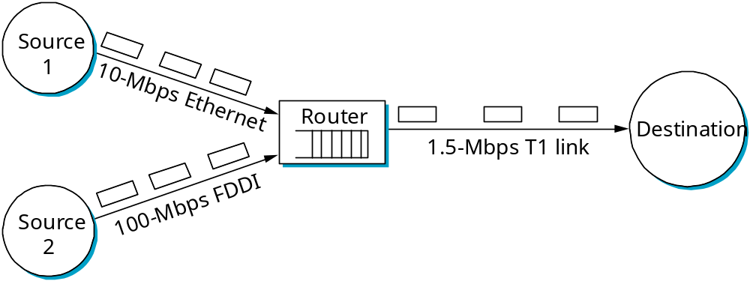
Congestion Issues
Two sides of the same coin
  pre-allocate resources so at to avoid congestion
  control congestion if (and when) it occurs
Two points of implementation
  hosts at the edges of the network (transport protocol)
  routers inside the network (queuing discipline)
Underlying service model
  best-effort (assume for now)
  multiple qualities of service (later)

Slide 3
Congestion
Congestion vs Access Control
  Congestion is different from Access Control (MAC)
  You can observe traffic and choose not to send data in local networks
Can we always route around congested links?
  Second order congestion possible
  Oscillation
  Lack of alternate routing paths

Slide 4
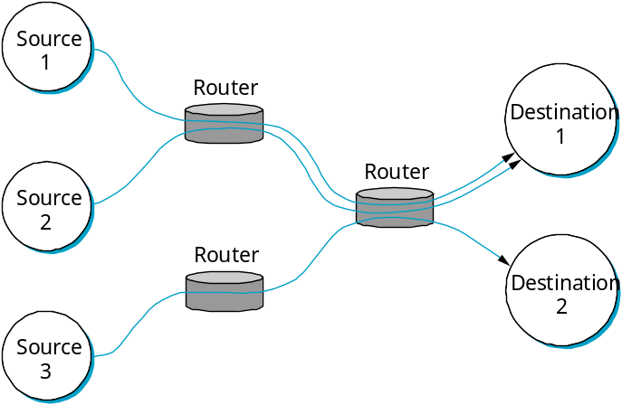
Framework
Connectionless flows
  sequence of packets sent between source/destination pair
  maintain soft state at the routers
    unlike connection oriented service, resources are not blocked
Issues
  Why analyze in a connectionless setup?
  If datagrams are independent of each other, what’s the point?
Abstraction
  Datagrams follow a flow
  A sequence of packets follow the same route
Flow
  Can be used at various levels of granularity

Slide 5
Fairness and Efficiency
Two running themes in congestion control
Can we allocate efficiently?
  Where do we allocate?
  What resources do we allocate?
  When can you do it ?
Can we allocate resources fairly?
  What is fairness?
  Who should you be fair to?
  How can you adapt to situations?

Slide 6
1. Service Model
Best effort
  Every one is a first class citizen
  No specific treatment for any packet or connection
QoS
  Specific flows may need preferential action
Applications need different guarantees
Very challenging to come up with a unified model

Slide 7
2. Router centric vs Host Centric
Address issues from inside the network
  Routers, switches
  Routers take responsibility for which to forward or drop
  Inform hosts about the packets that are allowed
Address from outside the network
  In the hosts, inside the transport protocol
  Observe the connections from outside
Not completely mutually exclusive
  Even if routers control, hosts must handle advisory messages
  Even if hosts handle, routers must have at least simple policies

Slide 8
3. Reservation vs Feedback
Reservation :
  End hosts ask the network for a certain amount of capacity
  Routers allocate
    If not possible, routers can reject the flows
Feedback :
  Send data and observe what happens
  Use this to control
Reservation system goes with router-centric approach
Feedback can go with either one

Slide 9
4. Window Based or Rate Based
Window
  Like in TCP’s Advertised_Window
  Sender and receiver negotiate using buffer sizes as a metric
    Even buffer size is abstracted away
Rate
  Bits/second
  Logical in a reservation based system with QoS
    Routers along the way can determine if the flow can be accepted with other commitments in mind.
    E.g. Video

Slide 10
Two General Strategies
Best effort + Feedback
  Users must not be able to reserve
  Congestion control is done at the hosts
  Usually window-based
  Model of the internet; Will see more
QoS + Reservation
  Significant router involvement
  Explicit rates
  Will see more too

Slide 11
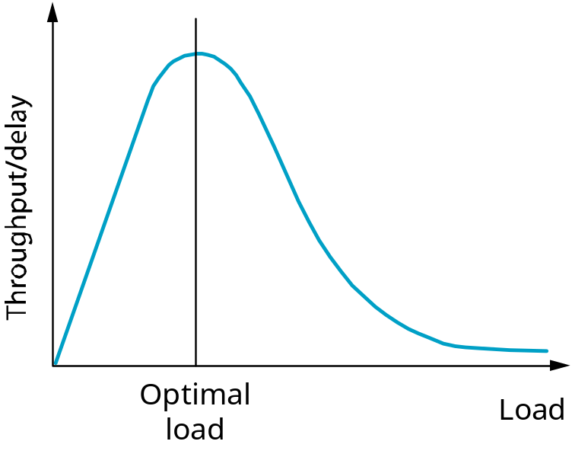
Evaluation
Fairness
Throughput and Delay
Power (ratio of throughput to delay)
More overhead;
Very conservative
Longer Queues;
Very aggressive

Slide 12
1. Power Ratio
Not the best metric
Depends on M/M/1* queuing model
  Infinite queues
  Not true in real world and hence drops packets
Power is with respect to a single flow
  Not quite clear what power is for multiple flows
Very popular metric though; No competing metrics
* - Exponential Arrival, Exponential Service Time, 1 Server

Slide 13
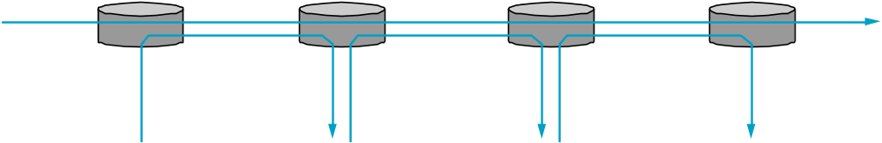
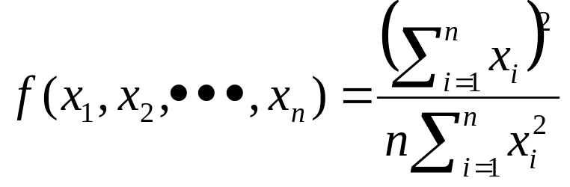
2. Fairness
What is fair?
  Equal bandwidth?
    Files don’t require as much as videos
  Equal share may not mean fairness
    What about pathlength?
Jain’s Fairness Index

Slide 14
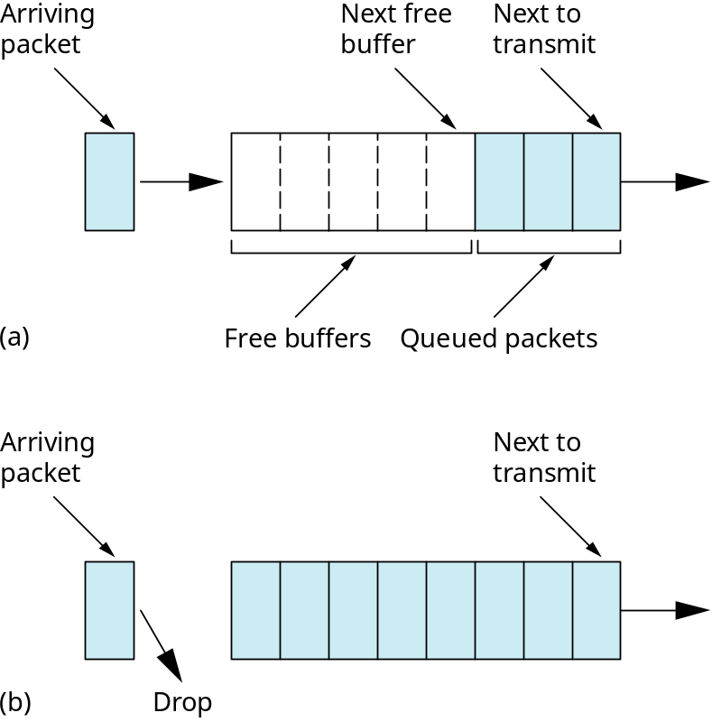
Queuing Discipline (1)
Scheduling Discipline: FIFO
Drop Policy: tail drop
This is the most widely used queueing discipline in the Internet. It pushes the responsibility for resource allocation and congestion control to the edges of the network.
TCP detects and responds to congestion without much help from routing.
Schedule and Drop policies are different ideas.
Possible Variation : Priority Based

Slide 15
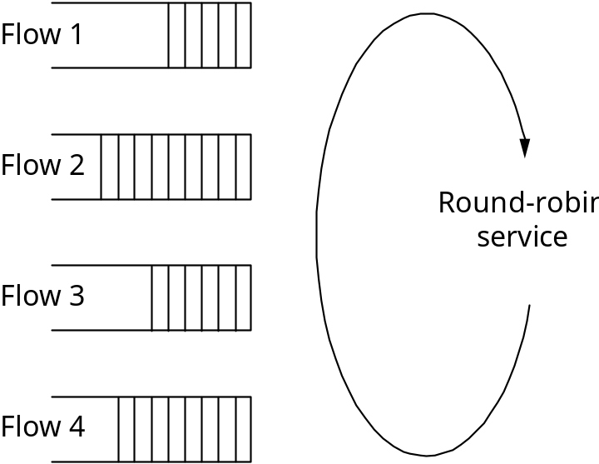
Queuing Discipline (2)
Fair Queuing (FQ)
  explicitly segregates traffic based on flows
  ensures no flow captures more than its share of capacity
  variation: weighted fair queuing (WFQ)
Problems?
  Packets need not be of same length; One flow can hog resources
  What we need is a bit by bit mechanism.
    Transmit one bit from each flow
    Overhead?

Slide 16







FQ Algorithm : 1. For a Single Flow
A flow is active when there’s a packet in its queue.
How do we determine arrival times? The clock we define advances by one tick when one bit from each active flow is transmitted.
Compute all F_{i}: the next packet to transmit has the lowest F_{i}.
TX start for packet i
TX end for packet i
Clock ticks to send i
Arrival time for Packet i

Slide 17
FQ Algorithm : 2. Multiple Flows
For multiple flows
  calculate F_{i} for each packet that arrives on each flow
  treat all F_{i}’s as timestamps
  next packet to transmit is one with lowest timestamp
Not perfect: can’t preempt current packet
Example
Flow 1
Flow 2
Flow 1
Flow 2
Output
(arriving)
(transmitting)
Output
F = 8
F = 10
F = 10
F = 5
F = 2
(a)
(b)

Slide 18
TCP Congestion Control
Idea
  assumes best-effort network (FIFO or FQ routers) each source determines network capacity for itself
  uses implicit feedback
  ACKs pace transmission (self-clocking)
Challenge
  determining the available capacity in the first place
  adjusting to changes in the available capacity

Slide 19
Additive Increase/Multiplicative Decrease
Objective: adjust to changes in the available capacity
New state variable per connection: CongestionWindow
  limits how much data source has in transit
  MaxWin = MIN(CongestionWindow, AdvertisedWindow)
  EffWin = MaxWin - (LastByteSent - LastByteAcked)
Idea:
  increase CongestionWindow when congestion goes down
  decrease CongestionWindow when congestion goes up

Slide 20
AIMD (cont)
Question: how does the source determine whether or not the network is congested?
Answer: a timeout occurs
  timeout signals that a packet was lost
  packets are seldom lost due to transmission error
  lost packet implies congestion

Slide 21
AIMD (cont)
Source
Destination
Algorithm
  increment CongestionWindow by one packet per RTT (linear increase)
  divide CongestionWindow by two whenever a timeout occurs (multiplicative decrease)
In practice: increment a little for each ACK
Increment = (MSS * MSS)/CongestionWindow
CongestionWindow += Increment

Slide 22
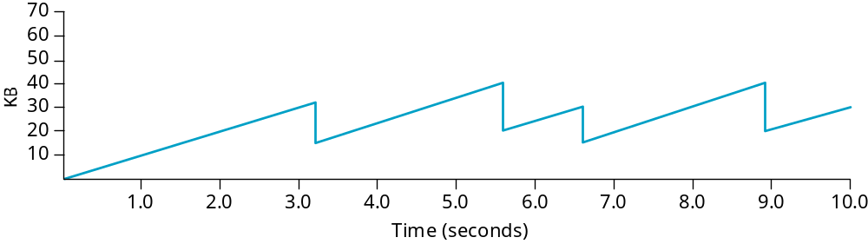
AIMD (cont)
Trace: sawtooth behavior

Slide 23
Slow Start
Source
Destination
Problem : Ramp up takes a lot of time in the beginning
Objective: determine the available capacity first
Idea:
  begin with CongestionWindow = 1 packet
  double CongestionWindow each RTT (increment by 1 packet for each ACK)

Slide 24
Slow Start (cont)
Exponential growth, but slower than all at once
  That’s why it is called Slow Start
Used…
  when first starting connection
  when connection goes dead waiting for timeout

Slide 25
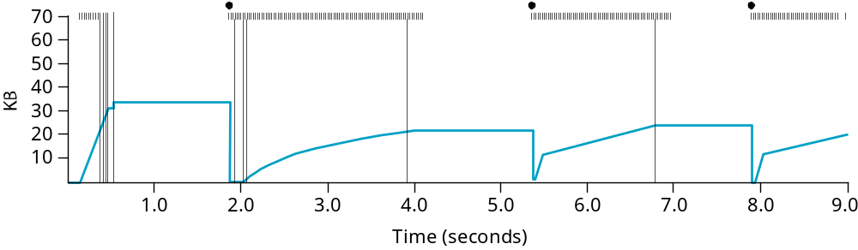
Trace
^{Heavy packet}
^{loss due to}
^{n/w discovery}
^{Cong. Win} ^{/= 2}
Timeout: CW halved, CT set
Packet loss: no new packets sent
Linear ramp up
Exponential ramp up
Linear ramp up
Exponential ramp up til CT
Packet loss: no new packets sent
Problem: lose up to half a CongestionWindow’s worth of data

Slide 26
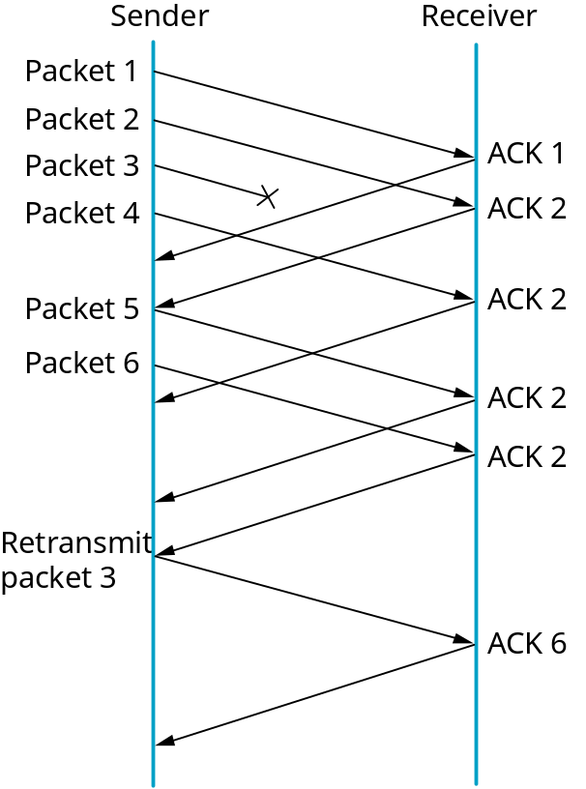
Fast Retransmit and Fast Recovery
Problem: coarse-grain TCP timeouts lead to idle periods
Fast retransmit: use duplicate ACKs to trigger retransmission
  Receiver gets out of order
  Sends ACK for previous one received in correct order
  Sender sees a duplicate ACK
    Implies packet loss
  Delayed or lost?
    Wait for a few more duplicates; Then retransmit

Slide 27
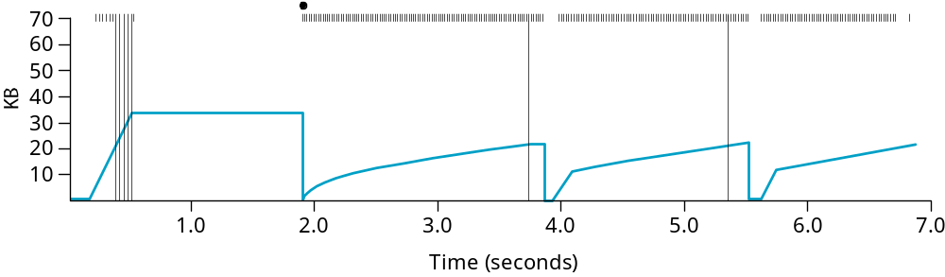
Results
Compare this to Slow Start :
Fast recovery
  skip the slow start phase
  go directly to half the last successful CongestionWindow (ssthresh)
  do not drop all the way to 1

Slide 28
Congestion Avoidance
TCP’s strategy
  control congestion once it happens
  repeatedly increase load in an effort to find the point at which congestion occurs, and then back off
Alternative strategy
  predict when congestion is about to happen
  reduce rate before packets start being discarded
  call this congestion avoidance, instead of congestion control
Two possibilities
  router-centric: DECbit and RED Gateways
  host-centric: TCP Vegas

Slide 29
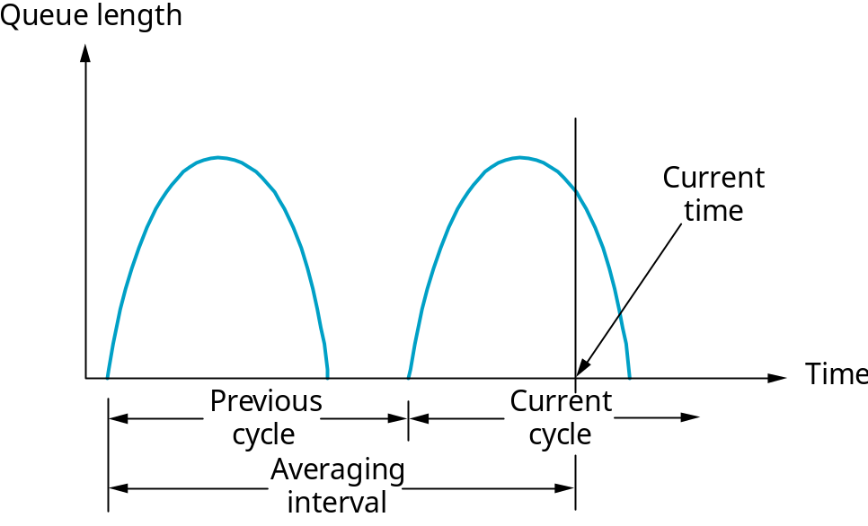
DECbit
Add binary congestion bit to each packet header
Router
  monitors average queue length over last busy+idle cycle
  set congestion bit if average queue length > 1
  attempts to balance throughput (queuing) against delay (idle time)

Slide 30
End Hosts
Destination echoes bit back to source
Source records how many packets resulted in set bit
If less than 50% of last window’s worth had bit set
  increase CongestionWindow by 1 packet
If 50% or more of last window’s worth had bit set
  decrease CongestionWindow by 0.875 times
AIMD

Slide 31
Random Early Detection (RED)
Notification is implicit
  just drop the packet (done in RED)
    TCP will timeout; Host will know
  could make explicit by marking the packet
    done in DECbit
Early
  Do it before congestion happens
Random drop
  rather than wait for queue to become full, drop each arriving packet with some drop probability whenever the queue length exceeds some drop level

Slide 32
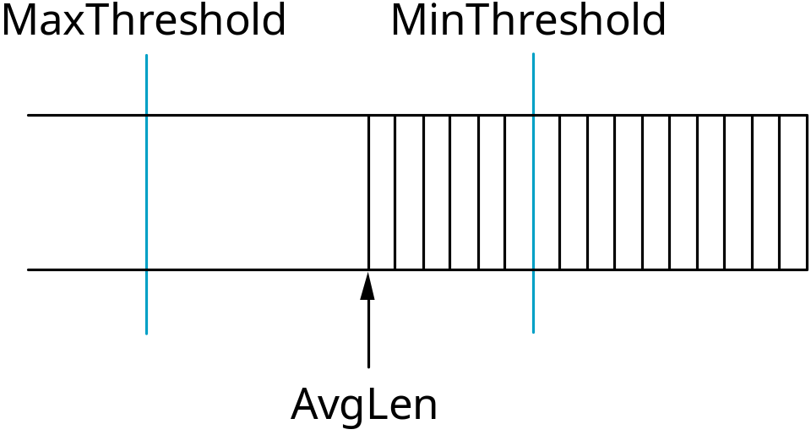
RED Details
Compute average queue length
  AvgLen = (1 - Weight) * AvgLen +
  Weight * SampleLen
    0 < Weight < 1 (usually 0.002)
    SampleLen is queue length each time a packet arrives
^{Randomly Accept}
^{Drop}
^{Accept}

Slide 33
RED Details (cont)
Two queue length thresholds
  if AvgLen <= MinThreshold then
  enqueue the packet
  if MinThreshold < AvgLen < MaxThreshold then
  calculate probability P
  drop arriving packet with probability P
  if ManThreshold <= AvgLen then
  drop arriving packet

Slide 34
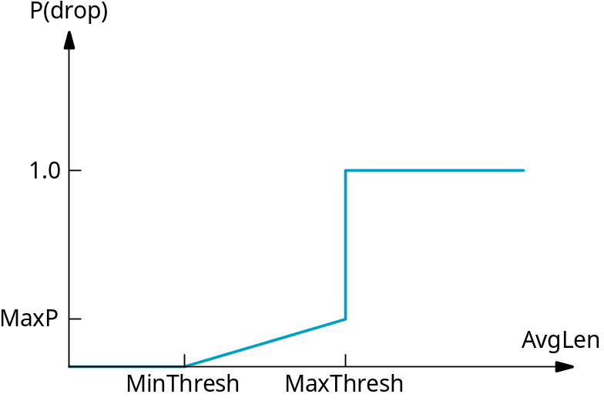
RED Details (cont)
Computing probability P
    TempP = MaxP * (AvgLen - MinThreshold)/ (MaxThreshold - MinThreshold)
    P = TempP/(1 - count * TempP)
Drop Probability Curve

Slide 35
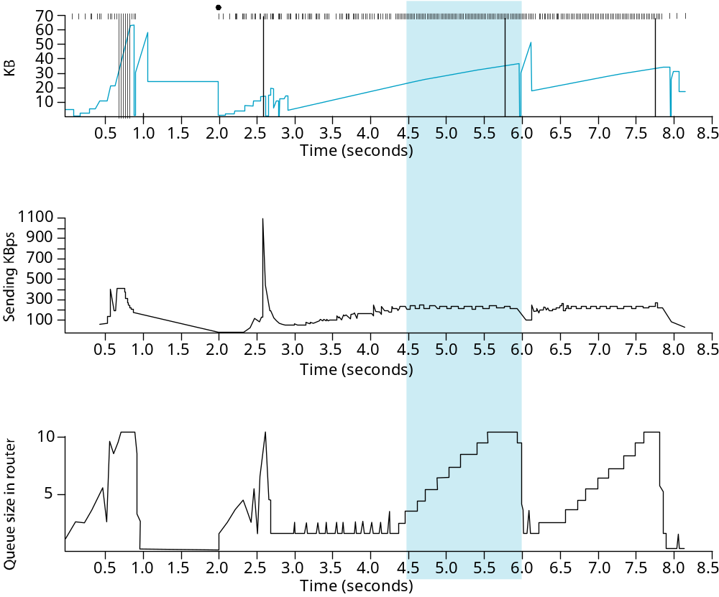
TCP Vegas
Idea: source watches for some sign that router’s queue is building up and congestion will happen too; e.g.,
  RTT grows
  sending rate flattens

Slide 36
Algorithm
Let BaseRTT be the minimum of all measured RTTs (commonly the RTT of the first packet)
If not overflowing the connection, then
ExpectRate = CongestionWindow/BaseRTT
Source calculates sending rate (ActualRate) once per RTT
Source compares ActualRate with ExpectRate
Diff = ExpectedRate - ActualRate
if Diff < α
increase CongestionWindow linearly
else if Diff > β
decrease CongestionWindow linearly
else
leave CongestionWindow unchanged

Slide 37
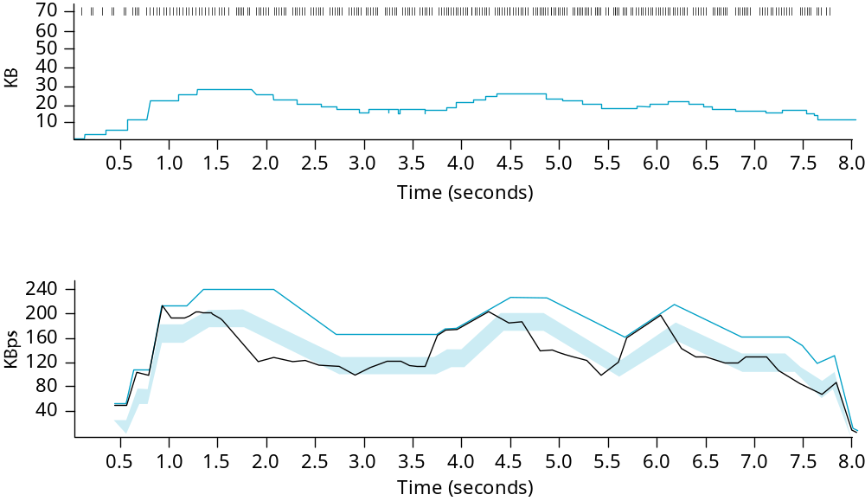
Algorithm (cont)
Parameters
  α = 1 packet
  β = 3 packets
Even faster retransmit
  keep fine-grained timestamps for each packet
  check for timeout on first duplicate ACK

Slide 38
Summary
Congestion control
Host vs router centric, best effort vs QoS, reservation vs feedback
Congestion Window
Congestion Avoidance

