Slide 1
Introduction to Network Security
Dr. Usha Rani
Vice President, NMSWorks Software Limited

Slide 2
Network security threats are real!
Basic technologies have evolved from collaborative computing requirements where security was not much of a concern

Slide 3
Trends
Connectivity is no longer an option, it is a necessity to organizations
Along with the undeniable benefits, there are threats that arise

Slide 4





The way it was …
Assets
Employees
Firewall, VPN
RAS
Remote employees

Slide 5

And then…
Customer
Vendor
Secure
extranet
Public website
Partner
(Assets)
Servers
Applications
Directory services
Remote employees
Legacy systems

Slide 6
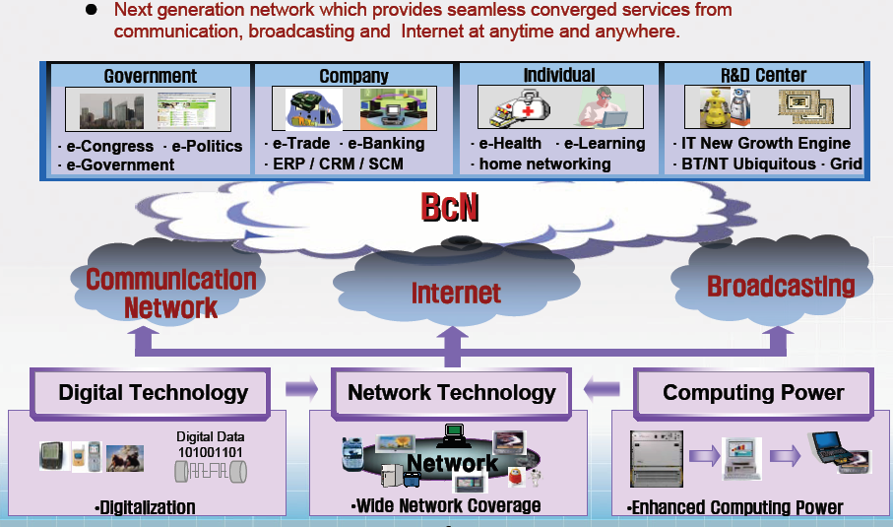
The way it is today
Source: ETRI Korea

Slide 7


The need for security
Prior to this “computer era”, information felt to be valuable was protected by physical
and administrative means

Slide 8
Hacking no longer esoteric
Hackers develop tools that are freely available and easy to use
Anyone with browser access can download them from common sites like rootshell.com, securityfocus.com, insecure.org
Leading search strings from any search engine give overwhelming responses

Slide 9
What makes cyber crime easy
Not easy to introduce legislation to punish malfeasors
However, in the last few years, awareness of the painful reality has been hammered in
Escalation from term “hacktivism” to “cyberterrorism” to “information warfare”
In India, the first cyber-crime-only police station has been set up in Bangalore

Slide 10
Security incidents
BARC network was successfully attacked
Ministry of External Affairs (MEA) website defaced
Done by GForce, a Pakistan based hacker group
GForce has admitted to repeatedly hacking the Indira Gandhi Centre for Atomic research and 13 other Indian websites over a month
In addition, there are….

Slide 11
Acknowledged and known surveillance systems
Echelon is a global surveillance system built and operated by the US, UK, Canada, Australia and New Zealand
  Can eavesdrop and spy on any telephone, email and telex communication around the world
  Satellite communications, land based communications and radio communications impartially monitored
  Indiscriminately spies on all the communications and then extracts ones of interest

Slide 12
Acknowledged and known surveillance systems
Carnivore is a network traffic interceptor
Is deployed at ISPs
The traffic of interest can be filtered out from the mainstream traffic intercepted

Slide 13
Acknowledged and known surveillance systems
Magic lantern is a key stroke logger
The implications are obvious
Self proclaimed FBI motto
In God we trust, the rest we monitor…….

Slide 14
A classification of attacks
Most security attacks can be classified into one of the following generic types
  Interruption
  Interception
  Modification
  Fabrication

Slide 15

Interruption
Source
Destination
Attack on availability
Denial of service attacks
Malicious code such as viruses, worms, Trojans
Destruction of hardware or
communication lines

Slide 16

Interception
Source
Destination
Attack on confidentiality
Eavesdropping, wiretapping, keystroke logging
  Physical layer by tapping the communication
  medium
At network layer, use packet sniffers and protocol analysers

Slide 17

Modification
Source
Destination
Attack on integrity
Attacker could modify
  Data
  Programs
  Authentication data

Slide 18
Fabrication
Source
Destination
Happens due to weak authentication of entities
Results in spurious records or false message in a network

Slide 19



Passive attacks
Passive attacks
  Eavesdropping to enable adversary to get message contents
  Traffic analysis

Slide 20
Active attacks
Masquerade - Impersonation of some other entity
  Results as a result of authentication or access control violation
Replay – passive capture of some data and its subsequent retransmission
Data modification – Data which is captured by unauthorized means is modified
Denial of service – render normal facilities unfit for use

Slide 21


Goals of security
Provide confidentiality of sensitive information – only intended persons can see the information
Authenticate legitimate entities – make
sure they are who they claim to be
Provide access control - prevent unauthorized entry to information
systems

Slide 22
Goals of security
Enforce non-repudiation of transactions – an entity cannot later disavow a transaction
Ensure freshness of transactions
  a message, or a portion of a message, is recorded and replayed later
Ensure availability of systems and services to legitimate users

Slide 23
Electronic security services and mechanisms
Most mechanisms that provide the services of confidentiality, integrity, authentication, access control and non-repudiation are cryptography based
Availability of systems and services requires other mechanisms as well
  Firewalls, Intrusion Detection / Prevention Systems

Slide 24
Authentication
Password based is the most familiar technique
  Based on something a user “knows”
Smart cards / tokens
  Based on what the user “has”
Biometric systems – finger print, retina, palm geometry
  Based on what the user “is”
Multi-factor authentication systems combine several of the above
Cryptographic techniques – digital signatures
Notes:
These technologies will be discussed in detail in other modules.

Slide 25
Confidentiality
Two kinds of crypto systems
  Symmetric key cryptosystems
    Classical and familiar method
    Sender and receiver share a key (secret)
    Egs. DES, 3-DES, AES, Blowfish
  Asymmetric or public key cryptosystems
    Sender and receiver have no shared secret
    RSA, El Gamal, Diffie Hellman, elliptic curve based systems
Notes:
These technologies will be discussed in detail in other modules.

Slide 26
Symmetric key ciphers
Block ciphers
  Message is broken up into equal sized blocks and encryption transformation is applied to each block
  Eg. DES, AES, Blowfish, Twofish etc.
Stream ciphers
  Message is operated on a bit at a time
  Eg. RC4 used in WEP

Slide 27



Symmetric key systems
Sender
Encryption
transform
Receiver
Decryption
transform

Slide 28
WEP
ICV = Integrity Check
Value
CRC
802.11 Frame
Header
Payload
Payload
ICV
32
ICV computed – 32-bit CRC of payload
RC4, a stream cipher is applied on this payload
  This is a well-known cipher, and the designers were wise to choose it

Slide 29
WEP encryption
WEP frame
IV
Concat
Seed
Key stream
Cipher
text
RC4
IV
Key
Plaintext
CRC
ICV
Concat
IV – Initialization Vector, one per packet
Key – Shared secret key
ICV – Integrity check value

Slide 30
WEP decryption
IV
Concat
Seed
Key stream
Plain
text
RC4
IV
Key
ICV
Ciphertext
ICV’
IV – Initialization Vector, one per packet
Key – Shared secret key
ICV – Integrity check value
Plaintext
CRC
If ICV’ = ICV, integrity
preserved

Slide 31
Stream ciphers – some pitfalls
C = P ⊕ KS
Key streams must never be reused
  C1 ⊕ C2 = (P1 ⊕ KS) ⊕ (P2 ⊕ KS) = P1 ⊕ P2
    => if a part of one plaintext is known, corresponding part of the other can be obtained
Forgery is easy – Bit flip attack
  If P2 = P1 ⊕ X
  Then C2 = C1 ⊕ X

Slide 32
WEP solution
ICV – Prevents forgery
  Checksum on the data prevents bit flipping
IV – Prevents key reuse
  Each packet a new key that starts a new stream is used
Practically however
The keystream for WEP is RC4(IV,K), which depends only on IV and K
  k is a fixed shared secret - every user in WLAN shares the same k
So the keystream depends only on IV
  If two packets ever get transmitted with the same value of IV means keystream reuse
Since IV gets transmitted in the clear for each packet, the adversary can even easily tell when a value of IV is reused (a "collision")

Slide 33
Public key systems
Each communicating entity has a key pair – one public and one private
The public key is made available to others in some fashion, private key is kept secret

Slide 34
Public key systems
Public repository
of public keys
Sender A
B_{Pub}
Encryption
transform
B_{Pub}
Receiver B
Decryption
transform
B_{Priv}

Slide 35
Integrity
Simplest technique – XOR
Checksums, CRC systems
Hash functions
  Message digests
  Condense an arbitrary length message to constant length output
  Egs: SHA-1, MD5
Message Authentication Code (MAC)
  Keyed hash
Notes:
These technologies will be discussed in detail in other modules.

Slide 36
Hybrid systems
A chooses a secret symmetric key that will be used as a session key.
A uses the session key to encrypt message to B
A uses B’s public key to encrypt the session key
A sends the encrypted message and the encrypted session key to B
On receipt, B the session key using his own private key.
B uses the session key to decrypt A's message.

Slide 37
Digital signature
A digital signature has to bind the message with sender’s identity
Signature
  Compute hash of message M to be signed
  Encrypt hash using sender’s private key
  Attach to message M
Verification
  Receiver retrieves sender’s public key
  Decrypts signature block using this
  Computes hash of message and compares it with decrypted value

Slide 38
Ensuring freshness
Digital timestamp
  Message and timestamp must be tied together and encrypted
Sequence numbers
  Not effective in connectionless network
Nonces
Challenge response protocols

Slide 39
Ensuring availability
Provision for alternate network paths
Provision for redundancy of critical servers
and services
  Computing power
  Storage
Provision for redundancy of data and within
data
Firewalls, intrusion detection systems

Slide 40
Denial of service attacks
Intention
  Prevent legitimate users from accessing resources
Common resources targetted
  Bandwidth, processing power, memory
  Abundance of these resources can only raise the bar, not eliminate impact
Defence against DoS attacks
  Rate limiting, packet filtering etc.
  Far from an exact or complete science
Interdependency of security on the Internet
  The exposure to DoS attack of SiteA depends on the security of SiteB
  There are huge numbers of SiteB’s

Slide 41
Early DoS attacks
  Packet floods to consume bandwidth
    UDP flood
    ICMP echo request/reply flood
    Amplification attacks
  TCP SYN flood to consume memory
  Finger bomb to consume CPU
    finger xyz@victim.com@differ.com - fingers user xyz at victim.com and makes it appear as if the request is from differ.com
    finger xyz@victim.com@victim.com@victim.com@victim.com..
  IP fragmentation attacks
    Based on limits to packet sizes

Slide 42
Pre-1999 DoS attacks
  DoS Tools:
    Single-source, single target tools
    IP source address spoofing
    Packet amplification (e.g., smurf)
  Deployment:
    Widespread scanning and exploitation via scripted tools
    Hand-installed tools and toolkits on compromised hosts
  Use:
    Hand executed on source host

Slide 43
Smurf Attack
(2-tier)
Broadcast Pings
Attacker
slaves
Ping Replies
victim

Slide 44
Distributed Denial of Service
Control Infrastructure – The classic DDoS model
attacker
handler
handler
agent
agent
agent
agent
agent
agent
agent
agent
victim

Slide 45
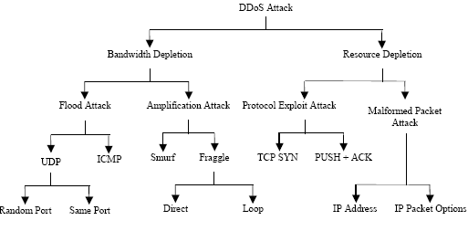

Slide 46
Degree of Automation
Manual
  attacker manually scans, breaks in, installs attack code, then directs the attack
  Used by early DDoS attacks only
Fully Automated
  exploit/recruitment phase and attack phase both automated
    everything is preprogrammed in advance
    no need for further communication between master & agent
    minimal exposure for attacker
    inflexible - attack specification is hard coded
    hybrid of auto/semi-auto

Slide 47
Overview of DoS/DDoS
DDoS
  entities: attacker, [masters], agents, target
  stages:
    recruit - scan potentially vulnerable hosts
    exploit - compromise a vulnerable host using some exploitable vulnerability
    infect - propagate the attack code to the new agent
    attack – use attack code to inflict denial of service

Slide 48
Degree of Automation
Semi-Automated
  recruitment phase automated, attack phase manually initiated
  requires communication between master & agents to initiate attack:
    direct communication
      network packets exchanged between master & agent
      need to know each other's IP address
    indirect communication
      use some pre-existing legitimate communication channel
      IRC commonly used
      discovery of agent may only tell us IRC server & channel
      channel hopping used to further disguise

Slide 49
Agent Recruitment - vulnerability scanning
Horizontal
  Looks for specific port/vulnerability
Vertical
  Look for multiple ports/vulnerabilities on the same host
Coordinated
  Scan multiple machines on the same subnet for a specific vulnerability
Stealthy
  Any of the above, but do it slowly to avoid detection
Attack code propagation
  Central server
  From machine that was used to exploit system

Slide 50
Exploited Weakness
Semantic (TCP SYN, NAPTHA)
  Exploits a specific feature or bug of a protocol or application on the victim in order to consume excessive amounts of its resources
  Can potentially be mitigated by deploying modified protocols/applications
Brute Force
  Intermediate network has more resources than victim - can deliver higher volume of packets than victim can handle
  Overwhelms victim resources using seemingly legitimate packets
    hard to filter without also harming legitimate traffic
  Requires higher volume of attack packets
    modifying protocols to counter semantic attacks raises the bar somewhat for the attacker

Slide 51
Source Address Validity
Spoofed Address
  Avoids accountability, helps avoid detection
  Required for reflector attacks
Valid Address
  Some attacks (NAPTHA) require a valid source address, since the attack mechanism requires several request/reply exchanges between agent & victim

Slide 52
Reflector Attacks
Attacker sends packets to some (non-hostile) intermediate entity
  spoofed source address of the packets is the victim’s IP address
  response from the intermediate entities overwhelms the victim
SMURF (1998)
  ICMP echo requests sent to various IP broadcast addresses
  amplifier effect: many responses from a single packet
  Feb. 2000 attack against Yahoo was based on SMURF
DNS Reflector Flood (2000)
  agents generate a large number of DNS requests, with the spoofed source address of the victim
  amplifier effect: DNS responses can be significantly larger than the DNS request
CERT: Advisory CA-1998-01, Incident Note IN-2000-04

Slide 53
Attack Rate Dynamics
Constant Rate (most)
  agents send packets as fast as they can after attack is started
  large traffic stream may aid detection
Variable Rate
  used in an attempt to avoid or delay detection
  Increasing Rate
    start slow, gradually increase, perhaps over long period of time
    harder to distinguish from a legitimate increase in traffic
  Fluctuating Rate
    could respond to victim behavior or preprogrammed timing
    could be used to pulse the attack intensity
    agents could coordinate pulsing, so attack intensity is steady, but set of agents attacking at any one time varies
      makes it harder to detect & mitigate at the source network of the agent

Slide 54
Possibility of Characterization
Characterizable
  Filterable vs. Non-Filterable
    Filterable:
      packets may be malformed
      protocol or application may not be needed by target
        ex: UDP flood against a web server, http flood against an SMTP server
        traffic can be filtered by a firewall
    Non-Filterable:
      well formed packets that request legitimate/critical services
        no way to distinguish attack packets from legitimate service requests
        ex: http flooding a web server

Slide 55
Possibility of Characterization
Non-characterizable
  attack packets use variety of protocols/applications
    may be randomly generated
  some attacks characterizable in theory, but not in practice

Slide 56
Victim Type
Specific Application
  example: send bogus signature packets to an authentication service
    other services on the host may be unaffected
  detection difficult
    attack volume usually small
    host operates normally except for targeted application
  may be able to distinguish legit. from attack packets at application level (or maybe not)
    even if we can, a defense strategy would need to take into account each application we want to protect

Slide 57
Victim Type
Host
  aims to disable all legitimate access to target host
    overload or disable network communication subsystem
    otherwise cause host to crash, freeze, or reboot
  hosts can try to limit their exposure by patching known holes, updating protocols w/DDoS resistant versions
    however, by themselves cannot defend against attacks that consume all of their network resources
      need upstream help - i.e., a firewall that can recognize and help filter the attack

Slide 58
Victim Type
Resource
  any resource critical to the victim (server, router, bottleneck link)
Network
  aims to consume all available incoming bandwidth for target network
    packet destination can be any host on target network
  packet volume, not content, is key
  can be easy to detect due to high traffic volume
  target network dependant on upstream network for help in defending
    even if it could detect & filter attack traffic, entire resources of ingress routers may be consumed doing so

Slide 59
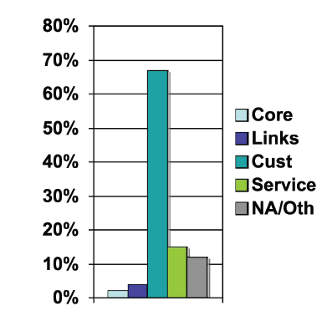
Victim Type
Infrastructure
  coordinated targeting of distributed services crucial to the global internet
    attacks on root DNS servers, core routers, etc.
  from point of view of a single target, may be same as a host-type attack
  difference in category is due to simultaneous targeting of multiple instances of some critical service
    coordinated defense may be necessary to counter

Slide 60
Impact on Victim
  Self-Recoverable
    after influx of attack packets ends, life returns to normal w/o human intervention
    a prompt defense (i.e., recognition & filtering) potentially can make these transparent to legit. Clients
  Human-Recoverable
    after influx of attack packets ends, rebooting or reconfiguration is required
  Non-Recoverable
    inflict permanent damage to hardware
      conceivable, but none are known

Slide 61
DDoS countermeasures
Three categories
  Preventing the setup of the DDoS attack network, including preventing secondary victims, and detecting and neutralizing handlers.
  Dealing with a DDoS attack while it is in progress, including detecting or preventing, mitigating or stopping, and deflecting the attack
  Post-attack category involving network forensics

Slide 62
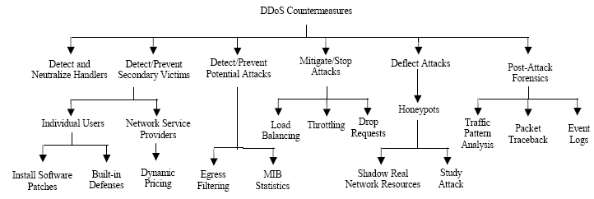

Slide 63
Application security
Spamming, viruses, Trojans, worms, hoaxes….

Slide 64
Spam
Unsolicited commercial email
SPAM costs everyone more- in productivity, online fees, bandwidth, etc.
“Legitimate Spam”
  Signing up for newsletters, mailing lists, online services opens us to this

Slide 65
Spam
  Spammers can send a piece of e-mail to one, 100, or a distribution list in the millions for roughly the same cost to them.
  Spammers expect only a tiny number of readers will respond to their offer.
  5 to 7% of email users buy something from a spam message
  Often motive is just to confirm email address

Slide 66
Email address source
Email lists -- Buying, stealing, renting, trading
Trickery – e-greeting cards, freeware, and anything else that asks you to enter your email address
Spambots, Harvesters – search the Internet for email addresses on forums, web pages, newsgroups, blogs, etc.
Dictionary attacks – sends out emails to guessed/random addresses
Blanket attacks – “send this to anyone@nmsworks.co.in”

Slide 67
Virus, Trojans, Worms…
Virus: Malicious software that causes damage when executed
Trojan: Malicious code contained in apparently harmless code
Worm: Self propagating malicious code
Phishing: Fake but authentic looking messages/websites to trick users into giving up personal information

Slide 68
Simple Viruses
Replicates itself and is easiest to detect
Always makes exact replica of itself
Detection: Scan for a sequence of bytes found in the virus

Slide 69
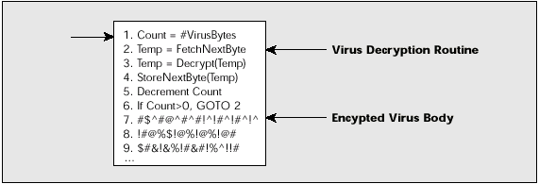
Response
Encrypting the virus
  Hide the fixed bytes by encrypting the virus

Slide 70
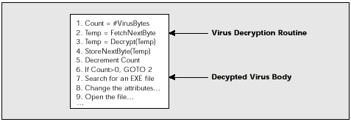
Detecting encrypted virus
Decryption remained constant, thus detection was a sequence of bytes of the decryption routine

Slide 71
Polymorphism
Adds a mutation engine that generates randomized decryption routines with each use
No fixed signature!

Slide 72
Phishing, Phaxing, Vishing …
Phishing: Fake but authentic looking messages/websites to trick users into giving up personal information
Phaxing: fax phishing
Vishing: use VoIP to build bogus switchboard systems, mimicking thoseof genuine online banks and other organizations

Slide 73
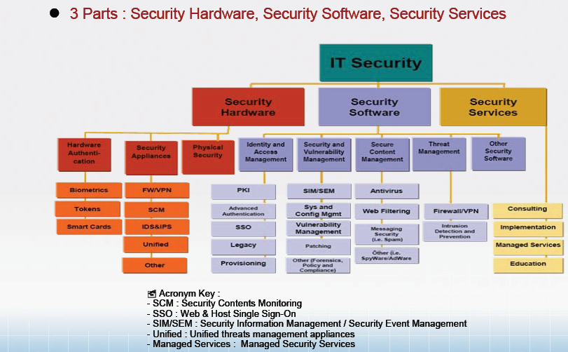

Slide 74
Summary
Awareness of information security is crucial
Security has to be achieved at service level, network level, end-point or host level
Use a combination of technology, processes and people

Slide 75
Thank you!

