Slide 1

Network Management
Powered by TeNet
Prof. T.A. Gonsalves
TeNeT Group
Dept of CSE, IIT-Madras

Slide 2
Promise of Telecom
  Basic infrastructure that provides:
  voice + FAX + Internet
  That promises:
  Widespread access to knowledge
  reduce have/have-not divide by leap-frogging
  ⇒ must be affordable and reliable

Slide 3
Network “Storms”
Powered by TeNet
Rapid escalation of cascading failures
Example:
Noise on a link
⇒ packet loss
⇒ link-level ARQ
⇒ queue buildup
⇒ source retransmits
⇒ congestion on other links
noise

Slide 4

TX = trunk exchange
LE = local exchange
LE
LE
LE
TX
TX
TX1
TX2
LE
LE
LE
Trunk line fails
  alarms at TX1 and TX2
Call failure rate exceeds threshold at several LEs
  alarms at many LEs

Slide 5
alarms at many LEs
- LE operator ignores alarms
- network operator sees long list of alarms,
important ones may be missed
need integrated network management system
  - only relevant alarms to the right person

Slide 6
Affordability
Cost
0.1 1 10 100 1000
Distance, km
Cost of bandwidth increases with distance
=> install minimal required capacity including growth factor

Slide 7
Network Management
Powered by TeNet
Why?
Manage — monitor and control— heterogeneous,
graphically-distributed elements
What?
Configuration identify and control managed objects
Faults detect, isolate, repair
Accounting charges for resource usage
limits on resource usage
Security protect access to objects
authentication, manage keys, logs
Performance gather statistics
analyze and plan
F C A P S

Slide 8
Basics
Standards
  Standards organizations
  Protocol standards of transport layers
  Protocol standards of management
  (application) layer
Management Models
Language

Slide 9
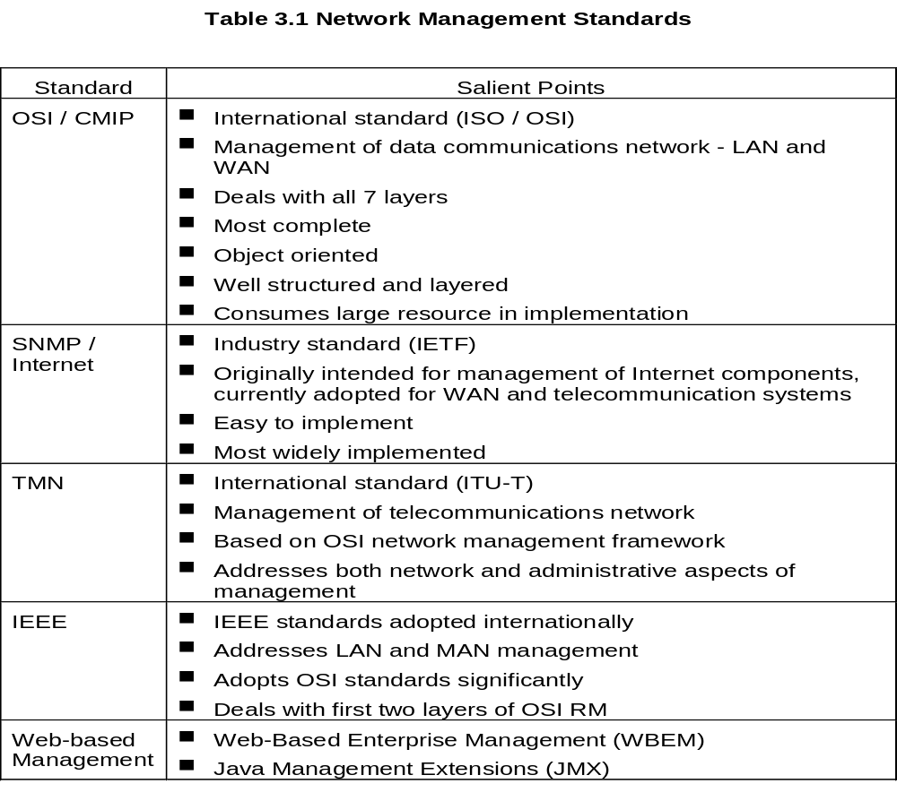

Slide 10
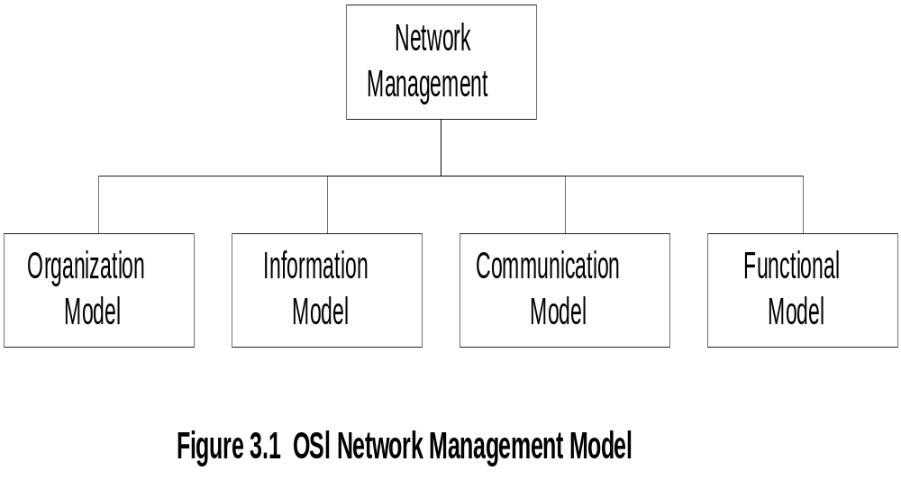

Slide 11
OSI Network Management
Model
Organization
  Network management components
  Functions of components
  Relationships
Information
  Structure of management information (SMI)
    Syntax and semantics
  Management information base (MIB)
    Organization of management information
  Object-oriented

Slide 12
OSI Network Management
Model
Communication
  Transfer syntax with bi-directional messages
  Transfer structure (PDU)
Functions
  Application functions
    Configure components
    Monitor components
    Measure performance
    Secure information
    Usage accounting

Slide 13
Protocol
messages (PDUs) for operations and notifications
Data representation
ASN.1:
encodes as a sequence of bytes
machine-independent
Standards
SNMP
simple network management protocol
        widely used in IP networks
CMIP
common management information protocol
        based on OSI stack
        used in TMN (telecom management network)
Powered by TeNet

Slide 14
SNMP Network Management
Model
Organization
  Same as OSI model
Information
  Same as OSI, but scalar
Communication
  Messages less complex than OSI
  Transfer structure (PDU)
Functions
  Application functions
    Operations
    Administration
    Security

Slide 15
TMN Architecture
Addresses management of telecommunication
networks
Based on OSI model
Superstructure on OSI network
Addresses network, service, and business
management

Slide 16
“Managed Object”
Management Station
Powered by TeNet
Network
Element
Agent
Manager
Protocol
Network
Object
attributes - name, uptime, load,…
operations - create/delete, get, set, actions. (reboot,…)
notifications - unusual events (load > threshold,…)
behaviour - how it reacts to operations
MIB or MOL = collection of managed objects
management information base
managed object library

Slide 17
NMS application
SNMP Manager
Free port
Port 162
SNMP get/set
requests
SNMP
responses
SNMP
trap
Port 161
Free port
SNMP Agent
MIBS
OS
Managed device

Slide 18
Two-Tier Model
Agent built into network element
Example: Managed hub, managed router
An agent can manage multiple elements
Example: Switched hub, ATM switch
MDB is a physical database
Unmanaged objects are network elements
that are not managed - both physical (unmanaged
hub) and logical (passive elements)

Slide 19
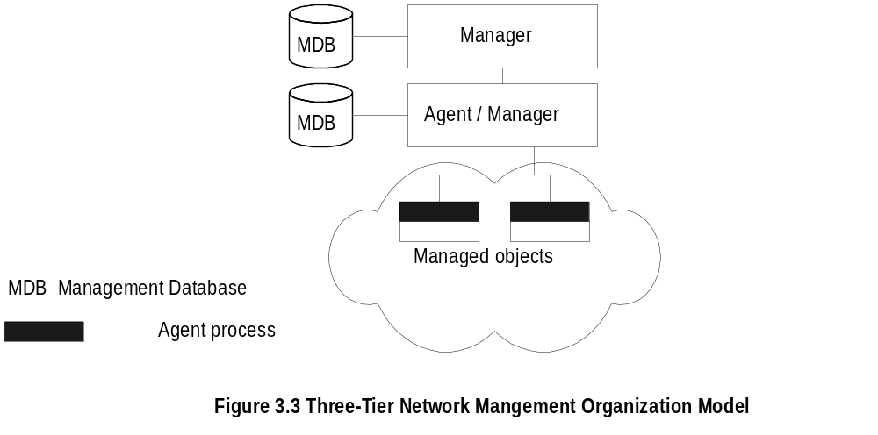

Slide 20
Three-Tier Model
Middle layer plays the dual role
  Agent to the top-level manager
  Manager to the managed objects
Example of middle level: Remote monitoring
agent (RMON)

Slide 21
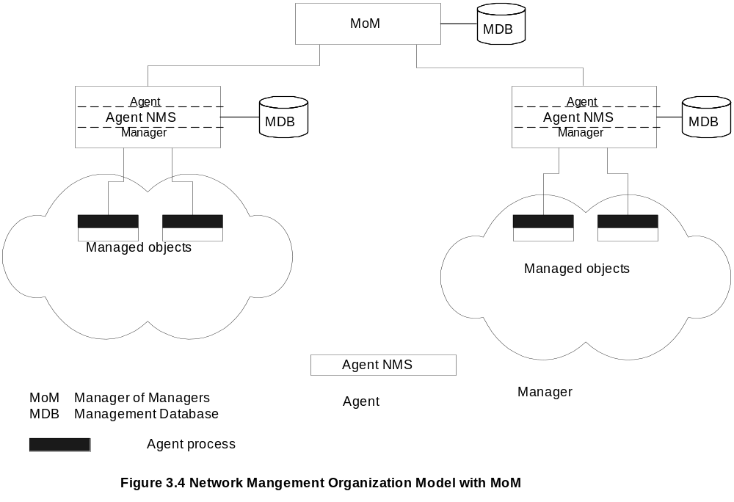

Slide 22
Manager of Managers
Agent NMS manages the domain
MoM presents integrated view of domains
Domain may be geographical, administrative,
vendor-specific products, etc.

Slide 23
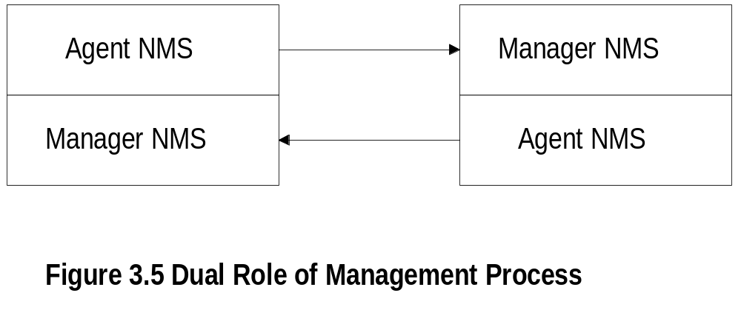
Peer NMSs
Dual role of both NMSs
Network management system acts as peers
Dumbbell architecture discussed in Chapter 1
Notice that the manager and agent functions are
processes and not systems

Slide 24
Structure of Management Information (SMI)
SMI defines for a managed object
  Syntax
  Semantics
  plus additional information such as status
Example
sysDescr: { system 1 }
Syntax: OCTET STRING
Definition: "A textual description of the entity. "
Access: read-only
Status: mandatory

Slide 25
Structure of Management Information (SMI)
Powered by TeNet
Agent names:
DNS — domain naming system
e.g. lantana.tenet.res.in
cordect53.hfcl.co.in
Object names:
Hierachical naming tree
globally unique

Slide 26
Management Information Base (MIB)
Information base contains information about objects
Organized by grouping of related objects
Defines relationship between objects
It is NOT a physical database. It is a virtual
database that is compiled into management module

Slide 27
MIB View and Access of an Object
A managed object has many attributes - its
information base
There are several operations that can be
performed on the objects
A user (manager) can view and perform only
certain operations on the object by invoking
the management agent
The view of the object attributes that the agent
perceives is the MIB view
The operation that a user can perform is the
MIB access

Slide 28
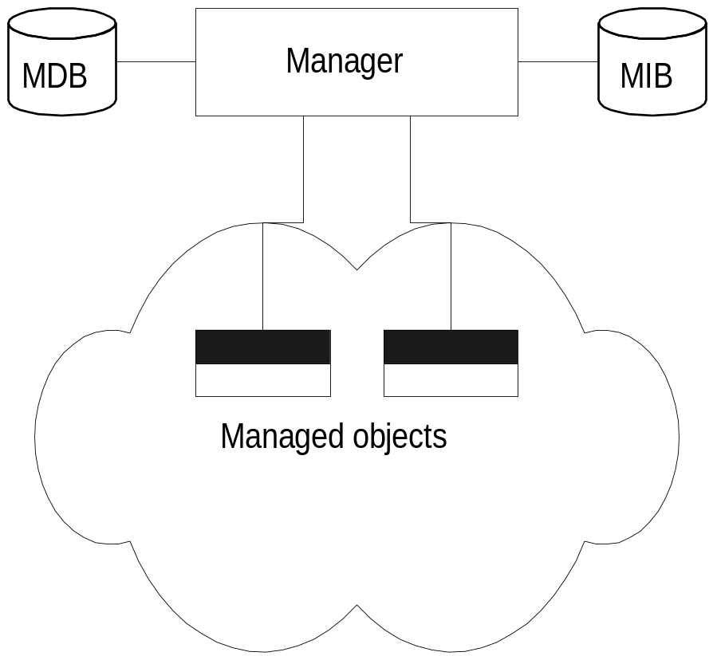
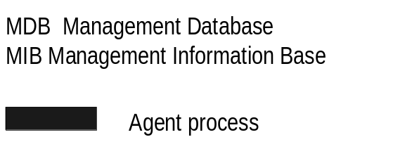

Slide 29
Management Data Base / Information Base
Distinction between MDB and MIB
  MDB physical database; e.g.. Oracle, Sybase
  MIB virtual database; schema compiled into
  management software
An NMS can automatically discover a managed
object, such as a hub, when added to the network
The NMS can identify the new object as hub only
after the MIB schema of the hub is compiled into
NMS software

Slide 30
Managed Object
Managed objects can be
  Network elements (hardware, system)
    hubs, bridges, routers, transmission facilities
  Software (non-physical)
    programs, algorithms
  Administrative information
    contact person, name of group of objects
    (IP group)

Slide 31
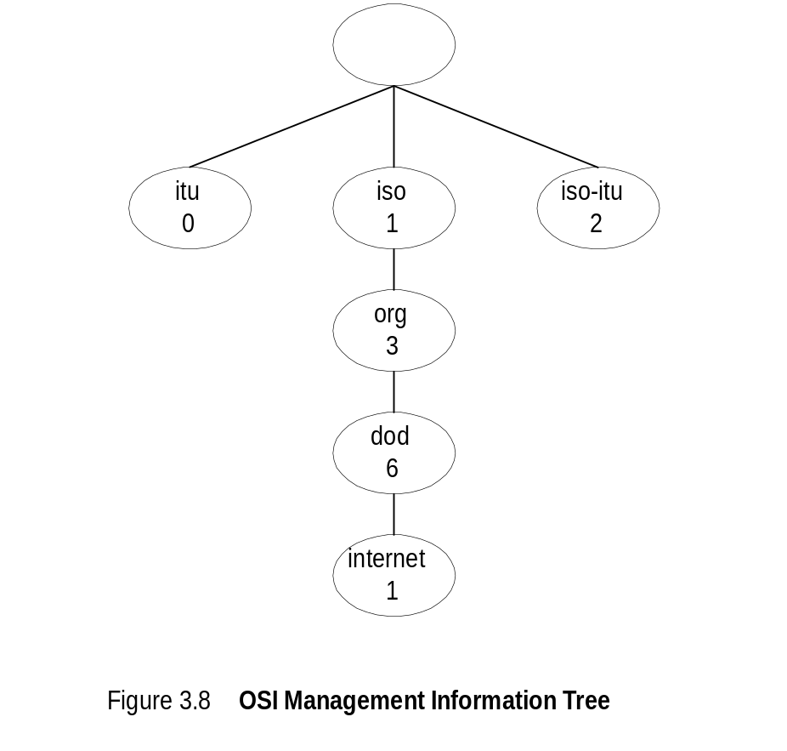
OSI Management Information Tree
iso International Standards Organization
itu International Telecommunications Union
dod Department of Defense
Designation:
  iso 1
  org 1.3
  dod 1.3.6
  internet 1.3.6.1

Slide 32
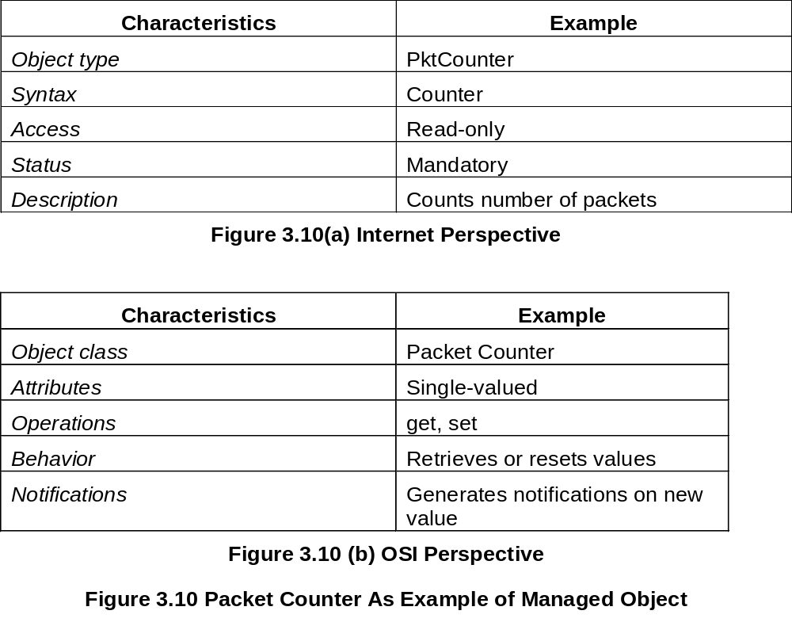

Slide 33
ASN.1
Powered by TeNet
Abstract Syntax Notation 1
ISO 8824, X.208
Abstract syntax = language for describing information objects
ASN.1= language for describing abstract syntaxes
BER= basic encoding rules for transfer of information objects
ISO 8825, X.209

Slide 34
Powered by TeNet
ASN.1— Basic Encoding Rules (BER)
  Example: 28510
  M/c X: 0000 0001, 0001 1101
  M/c Y: 1011 1000, 1000 0000, 0000 0000, 0000 0000
  ASN.1: 0000 0001, 0000 0010, 0000 0001, 0001 1101
  Integer Len = 2 1×2561 + 29×2560
    Identifier:
Class | p/c | Tag
p=primitive, c=constructed

Slide 35
itu-t 0 iso 1 joint-iso-itu-t 2
Powered by TeNet
std 0 org 3
dod 6
internet 1
mgmt 2
Exp 3 Private 4
mib 1
system 1
interfaces 2
sysDesc 1 sysUptime 3
Human-readable names:
{iso.reg.org.dod.internet.mgmt.mib.system.sysUptime}
{mib 1,3}
Used in PDUs: {1,3,6,1,2,1,1,3}

Slide 36
Powered by TeNet
Sub-tree of the registration hierarchy:
MIB view/group/module
Standard MIB views:
  MIB-II: all network elements
  Ethernet MIB: all Ethernet devices
  FDDI MIB: all FDDI devices
  RMON MIB: remote network monitoring
Object Types:
  IP Address
  Time Ticks
  Gauge 32-bit counter, no wraparound
  Counter 0..232-1, with wraparound
  Opaque any octet string

Slide 37
MIB-II Groups
system: overall information about the system
interfaces: about each of the interfaces from the system to a subnetwork
ip, icmp, tcp, udp, egp, snmp: related to the implementation and execution of each protocol on this system
dot3: information about the transmission schemes and access protocols at each system interface

Slide 38
system Group (mib-2 1)
sysDescr (1) -- descriptive text
sysObjectID (2) -- vendor’s id for this mgmt subsystem
sysUpTime (3) -- in 10 ms ticks
sysContact (4) -- administrative contact person
sysName (5) -- name of the managed node
sysLocation (6) -- physical location of this node
sysServices (7) -- 7-bit integer indicating the OSI layers of this node’s primary services

Slide 39
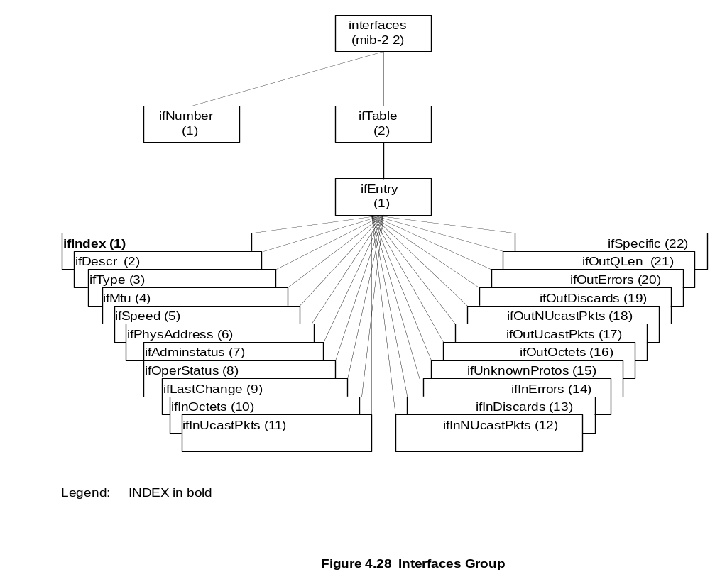

Slide 40
Example: Interface table (RFC 1213)
ifTable OBJECT-TYPE
SYNTAX SEQUENCE OF ifEntry
ACCESS not-accessible
STATUS mandatory
DESCRIPTION “A list of interfaces….”
::= { interfaces 2}
ifEntry OBJECT-TYPE
SYNTAX IfEntry
ACCESS not-accessible
STATUS mandatory
DESCRIPTION “Details of one interface...”
INDEX { ifIndex }
::= {ifTable 1 }
Powered by TeNet

Slide 41
Powered by TeNet
IfEntry ::= ---- a type
SEQUENCE {
ifIndex INTEGER,
ifDescr DisplayString,
ifType INTEGER,
:
:
}

Slide 42
Powered by TeNet
ifIndex OBJECT-TYPE
SYNTAX INTEGER
ACCESS read-only
STATUS mandatory
DESCRIPTION “……”
::= {ifEntry 1}
ifDescr OBJECT-TYPE
SYNTAX DisplayString (SIZE (-0…..255))
ACCESS read-only
STATUS mandatory
DESCRIPTION “…..”
::= {ifEntry 2}

Slide 43
Powered by TeNet
interfaces 2
ifNumber 1 ifTable 2
2
1
0
ifEntry 1
ifIndex 1 ifDescr 2 ifType 3

Slide 44
SNMP
Powered by TeNet
Versions
V1: simple, most widely-used
drawbacks esp. security
V2: improved security, other features
more complex, not yet widely-used
“v2c”:V2 with community-based security
“v3”: full V2
SNMP objects
attributes
operations: get, set
notifications “traps”
behaviours
Uses UDP/IP
Maximum PDU size = 468 bytes
Get, set — port161
Traps — port162

Slide 45
Messages
Agent Manager Manager
Powered by TeNet
Get, GetNext
V1
Set
GetResponse
Trap
GetBulk
InformReq
V2
InformResp

Slide 46
PDU Formats
Powered by TeNet
Version
0, 1
Community
“public”
PDU Type
Request Id
Error Status
0 = Get
1 = GetNext
2 = GetResp
3 = Set
4 = Trap
0 = noError
1 = tooBig
2 = noSuchName
Error Index
Name Value
1 1
N2 V2
N3 V3
… …

Slide 47
Trap PDU (V1)
Powered by TeNet
Enterprise
Agent Address
Generic Trap
Type of object
0 = coldStart 3 = linkUp
1 = warmStart 4 = auth. failure
2 = linkDown 5 = enterpriseSpecific
Specific Trap
Time Stamp
N1 V1
N2 V2
N3 V3
… ...
Uptime in
10 ms ticks
Related variables
V2 Trap PDU same format as other messages

Slide 48
SNMP GetRequest
Atomic: all values returned, or none
In case of error, errorIndex indicates which variable binding has errorStatus

Slide 49
SNMP GetNextRequest
Given varible name N, returns the value of the lexicographically next variable in MIB view
GetNext(system) ⇒system.sysDescr.0 = "Linux ..."
GetNext(system.sysDescr) ⇒
system.sysDescr.0 = "Linux ..."
GetNext(system.sysDescr.0) ⇒
system.sysObjectID.0 =OID: ...ucdSnmpAgent.linux
Traverse a sub-tree without knowing names
GetNext(icmp.27.0) ⇒ tcp.tcpRtoAlgorithm.0 = other(1)
Get(icmp.27.0) ⇒ Error: (noSuchName) icmp.27

Slide 50
...SNMP GetNextRequest
Read a table without knowing the size of the table
GetNext Parameter Returned value
interfaces.ifTable ifTable.1.1.1 = 1 -- index
interfaces.ifTable.1.1.1 ifTable.1.1.2 = 2
interfaces.ifTable.1.1.2 ifTable.1.2.1 = "lo0" -- descr
interfaces.ifTable.1.2.1 ifTable.1.2.2 = "eth0"
interfaces.ifTable.1.2.2 ifTable.1.3.1 = softwareLoopback
interfaces.ifTable.1.3.1 ifTable.1.3.2 = ethernet-csmacd
-- type
Table is read column-wise
index(1) descr(2) type(3) ... ifSpecific(22)
1 1 lo0 softwareLoopback
2 2 eth0 ethernet-csmacd

Slide 51
SNMP SetRequest
Atomic: all values set and returned, or none
In case of error, errorIndex indicates which variable binding has errorStatus

Slide 52
SNMP Trap
From agent to manager
Manager registers with agent for traps of interest
No response — to guarantee receipt, agent must periodically retransmit until manager takes action

Slide 53
SNMP v2
Key Concepts
revised OBJECT definitions
  counter64 type
improved tables
  unambiguous row selection
  procedures for creation and deletion of rows
  augmenting of tables
Notification definition
Manager-manager communication

Slide 54
GetBulk
With Get and GetNext:
one OID per message ⇒ inefficient
OR
many OIDs per message ⇒ manager must use trial-and-error to fit into a PDU
GetBulk: Repeated GetNext in one message
Example:
GetBulk(1, 6, sysUptime, ifOperStatus, ifInOctets, ifOutOctets)
Response(sysUptime=345923,
ifOperStatus.1=1, ifInOctets.1=54678, ifOutOctets.1=345239,
ifOperStatus.2=1, ifInOctets.2=345, ifOutOctets.2=9324,
...)

Slide 55
... GetBulk
GetBulk(N, M, v1, ..., vN, vN+1, ..., vL)
1 value
each
M values
each
Order in PDU:
1st successor for all variables,
...,
Mth successor for all variables
⇒ if variables are columns
PDU contains values row-wise
If response too big, puts as much as possible in PDU
⇒ simplifies managers task

Slide 56
InformRequest
Manager-manager
A→B
InformRequest(reqID, n1, v1, n2, v2, ...)
B→A
Response(reqID, n1, v1, n2, v2, ...)

Slide 57
SNMP Utilities
snmpbulkwalk, snmpdelta, snmpget, snmpgetnext, snmpnetstat, snmpset, snmpstatus, snmptable, snmptest, snmptranslate, snmptrap, snmpwalk
snmpget localhost public system.sysDescr.0
system.sysDescr.0 = "Linux oriole.ooty.tenet.res.in"
snmpgetnext localhost public system.sysDescr.0
system.sysObjectID.0 = OID: enterprises.ucdavis.ucdSnmpAgent.linux
snmpset localhost public system.sysLocation.0 s "Ooty”
system.sysLocation.0 = "Ooty" Hex: 4F 6F 74 79
snmpget localhost public system.sysLocation.0
system.sysLocation.0 = "Ooty" Hex: 4F 6F 74 79

Slide 58
SNMP Utilities
snmpwalk localhost public system
system.sysDescr.0 = "Linux oriole.ooty.tenet.res.in”
system.sysObjectID.0 = OID: enterprises.ucdavis.ucdSnmpAgent.linux
system.sysUpTime.0 = Timeticks: (272328) 0:45:23.28
system.sysContact.0 = "Root <root@localhost>”
system.sysName.0 = "oriole.ooty.tenet.res.in”
system.sysLocation.0 = "Unknown”
system.sysServices.0 = 72
OID: for a simple variable, end with .0
for a table variable, end with index (>0)
Full form: initial “.”
E.g. “.1.3.6.1.2.1.1.3.0” or “system.sysUptime.0”

Slide 59
Summary
Manager-Agent model for NMS
Data transfer — ASN.1 basic encoding
Object definition — ASN.1 macros
MIB — hierachical collection of objects
SNMP — get, getnext, set, trap
SNMPv2
  GetBulk for efficiency
  InformRequest for manager-manager

