Slide 1
SNMP – v3
Prof. T.A. Gonsalves
TeNeT Group
Dept of CSE, IIT-Madras

Slide 2
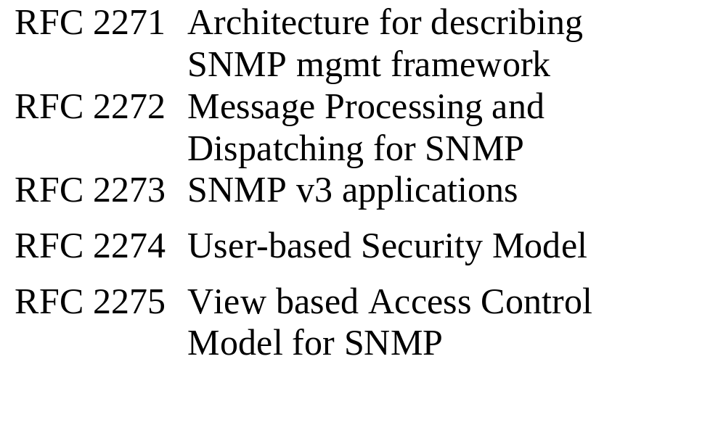
SNMP v3

Slide 3
SNMPv3
“SNMPv3 = SNMPv2 + security + admin”
Msg = MsgHeader + msgSecurityParms + msgData
MsgHeader =
msgVersion (3)
msgId
msgMaxSize (484 — 2³¹-1)
msgFlags (authFlag, privFlag, reportFlag)
msgSecurityModel (1 (v1), 2 (v2), 3 (v3 - USM))

Slide 4
msgVersion
msgId
SNMP v3
message format
msgMaxSize
msgFlags
msgSecurityModel
msgSecurityParameters
ContextEngineId
ContextName
Scope of
authentication
Scope of
encryption
PDU

Slide 5
SNMPv3 engine
An engine consists of
  Dispatcher
  Message processing subsystem
  Security subsystem
  Access control subsystem

Slide 6
SNMP architecture
Managers and agents are ‘entities’
An entity consists of an SNMP engine and one or more SNMP applications
Applications
SNMP engine
Command
generator
Command
responder
Notification
receiver
Dispatcher
Mesg
proc sys
Access
ctrl
subsys
Notification
originator
Proxy
forwarder
Other
Security
subsys

Slide 7
SNMPv3
Dispatcher
  Allows for multiple versions of SNMP in the engine
  Transmits SNMP messages to other entities
  Hands off PDUs to Message Processing subsystem
Message processing subsystem
  Prepares messages for sending
  Extracts data from received messages

Slide 8
SNMPv3
Security subsystem
  Authentication and privacy services
  Multiple security models
Access control subsystem
  Authorisation services that can be used to check access rights

Slide 9
SNMP applications
Command generator to initiate get, getNext, getBulk and set requests
Command responder
  Receives requests and performs the appropriate operation
Notification originator
  Generates Trap and/or Inform messages
  Needs to know where to send notification, ver of SNMP to use etc
Notification receiver
  Generates responses to Inform messages

Slide 10
Traditional manager
Command
Generator
apps
Notification
Originator
apps
Notification
Receiver
apps
User based
Security
model
PDU
Dispatcher
v1MP
v2cMP
Message
Dispatcher
v3MP
Other
Security
model
Transport
mapping
OtherMP
Message Proc
subsystem
Security
subsystem
Dispatcher
UDP, IPX..
Traditional manager
Network

Slide 11
Traditional manager
MIB instrumentation
Command
Responder
apps
Notification
Originator
apps
Proxy
forwarder
apps
User based
Security
model
View based
Access ctrl
PDU
Dispatcher
v1MP
v2cMP
Message
Dispatcher
v3MP
Other
Security
model
Other
Access ctrl
Transport
mapping
OtherMP
Security
subsystem
Access ctrl
subsystem
Message Proc
subsystem
Dispatcher
UDP, IPX..
Traditional agent
Network

Slide 12
Cryptographic techniques
SNMP v3 uses four algorithms
  DES (encryption)
  MD5, SHA-1, HMAC for authentiaction

Slide 13
Encryption
Conventional or symmetric key encryption has five ingredients
  Plaintext
  Encryption algorithm
  Secret key
  Ciphertext
  Decryption algorithm

Slide 14

Secret key
Secret key
Plaintext
Encryption
algorithm
Decryption
algorithm
Plaintext
Conventional encryption algorithm

Slide 15
Hash functions
Used for verifying integrity of messages
Accept an arbitrary length input, produce a fixed length output
  Standard output lengths - 16 byte, 20 byte

Slide 16
Message Authentication Codes
Allows communicating parties to verify that received messages are authentic
  Source is authentic
  Contents have not been altered
Communicating parties share a key
Key is used to generate a short block of data which is appended to message
On getting the message, recipient generates the same block of data

Slide 17
User-based Security Model
Provides
  timeliness: attacker cannot delay/replay a message
  authentication: verify sender’s identity
  privacy: protect message contents
  key management: generation of keys

Slide 18
USM Definitions
Defined by FRC 2274
Authoritative SNMP Engine: source of time for an SNMP transaction
if request-response (eg. Get, getNext, getBulk, set, inform): receiver is authoritative, sender is non-authoritative
if request-only (v2 trap, response): sender is authoritative
Engine ID: unique identifier for each SNMP entity (agent or manager)

Slide 19
... USM Definitions
EngineBoots: number of times the authoritative engine has rebooted
A boot occurs when clock reaches 2^31 - 1
EngineTime: time in seconds since the last reboot of the authoritative engine
non-authoritative engine has an estimate only, updated whenever it receives a message from the authoritative engine

Slide 20
... USM Definitions
AuthenticationParameters: uses HMAC to compute a signature of the message
PrivacyParameters: encrypts message data using cipher-block chaining mode of DES with 56-bit key

Slide 21
... USM Definitions
Non-authoritative
Engine
Time
Authoritative
Update
Update
Update
Time

Slide 22
USM Timeliness
Four aspects
Management of authoritative clocks
Synchronization
Timeliness checking by receiver (Authoritative)
Timeliness checking by receiver (nonauthoritative)

Slide 23
Authoritative clocks
Authoritative engine maintains snmpEngineBoots, snmpEngineTime (both initialised to 0)
Thereafter, snmpEngineTime is incremented once per second
If snmpEngineTime reaches its max of 2^31 -1, it is reset to 0 as if the engine has rebooted
snmpEngineReboot incremented by 1

Slide 24
Synchronization
Synchronization between each nonauthoritative engine and each authoritative engine with which it communicates
Following variables maintained for this
  snmpEngineBoots
  snmpEngineTime
  latestReceivedEngineTime
Appropriate field in message header are updated with these values
Update occurs if boot value has increased since last update
If boot value has not increased, incoming engine time should be greater than latest received engine time

Slide 25
msgVersion
msgId
msgMaxSize
msgAuthoritativeEngineId
msgFlags
msgAuthoritativeEngineBoots
msgSecurityModel
msgAuthoritativeEngineTime
msgSecurityParameters
msgUserName
ContextEngineId
msgAuthenticationParameters
ContextName
msgPrivacyParameters
PDU

Slide 26
USM Timeliness
Receiver accepts message only if within a time window
Else, may be replay attack or partner malfunctioning
Authoritative receiver accepts if:
msg.engineBoots = authEngineBoots AND
msg.engineTime = authEngineTime ± 150 secs
Non-authoritative receiver accepts if:
engineBoots = authEngineBoots AND
authEngineTime ≥ engineTime − 150 secs

Slide 27
USM Key Management
Localised key
Hash2
Hash1
Password
Key
Localised key
User
Localised key
Agents
Hash1:
repeat password to get 2²⁰ octet string (digest0)
take MD5 or SHA hash of digest0 to get 16- or 20-octet key
Hash2:
take MD5 or SHA hash of key+agent engine ID to get 16- or 20-octet localised key

Slide 28
... Key Management
cracking the password is difficult
if one agent is compromised, other agents are not affected
user can manage agent from anywhere, not only from an NMS
Key Update
deliver localised key to agent (outside SNMP)
set(keyChange) ⇒ agent changes to next key

Slide 29
View-based Access Control
V1 and V2 use a single community string for many purposes
V3 provides several variables for finer access control via VACM

Slide 30
... VACM
Groups: set of <securityModel, principal> tuples (vacmSecurityToGroupTable) on whose behalf managed objects can be accessed
Security Level: noAuthNoPriv, authNoPriv, authPriv
agent may allow greater access for more secure messages
Contexts: named subsets of object instances in the local MIB (vacmContextTable)
MIB Views: collection of MIB sub-trees, each included or excluded from the view (vacmMIBViews)
each entry in vacmAccessTable has read, write, notify views

Slide 31
... VACM
Access Policy:
permit or deny access based on:
  principal
  security level
  context
  object instance
  type of access

Slide 32
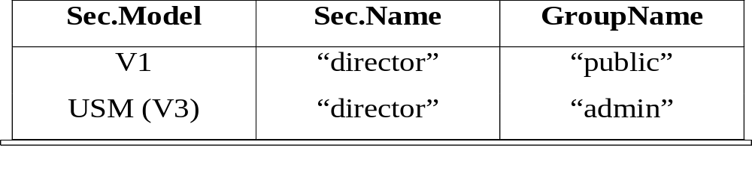
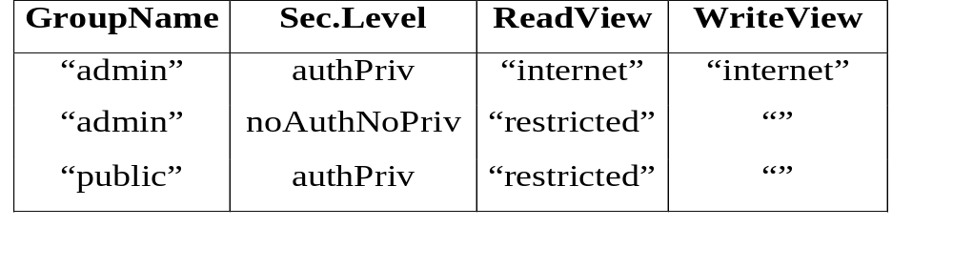
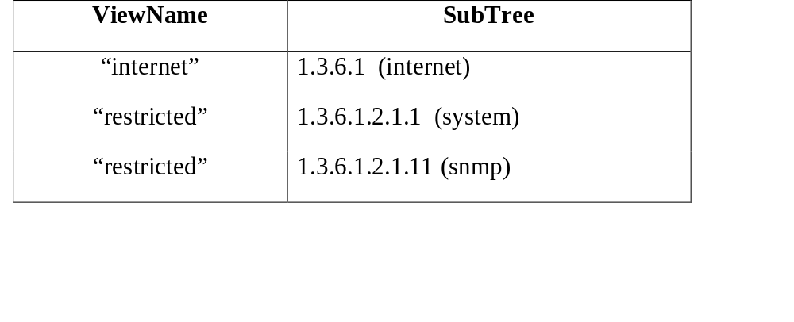
... VACM Example
SecurityToGroupTable
ViewAccessTable
ViewTreeFamilyTable

Slide 33
Who
Where
How
Why
What
Which
contextName
object-type
securityModel
Object-instance
securityName
vacmContextTable
viewType
(read/write/
notify)
vacmSecurityToGroupTable
securityModel,
variableName
(oid)
securityLevel
groupName
vacmAccessTable
vacmViewTreeFamilyTable
Yes/No
viewName

Slide 34
Summary
SNMPv3
Security: authentication and encryption
Flexible view-based access control

