Slide 1
DSL Technology
R Thirumurthy
Midas Communication Technologies
rtm@midascomm.com

Slide 2
Agenda
Broadband Trends
xDSL Technologies
DSL Network
Summary

Slide 3
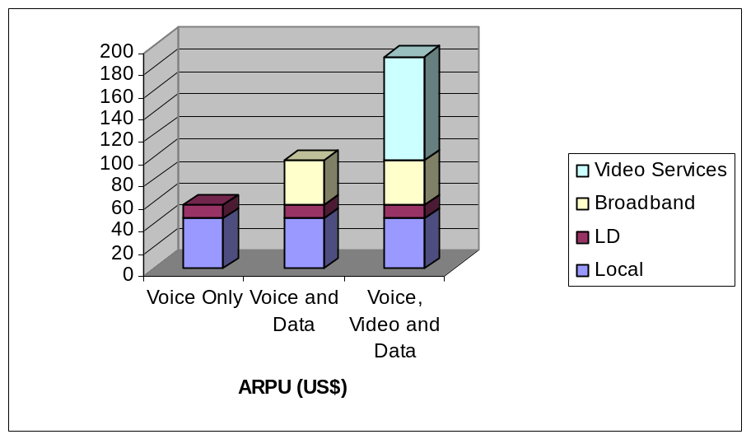
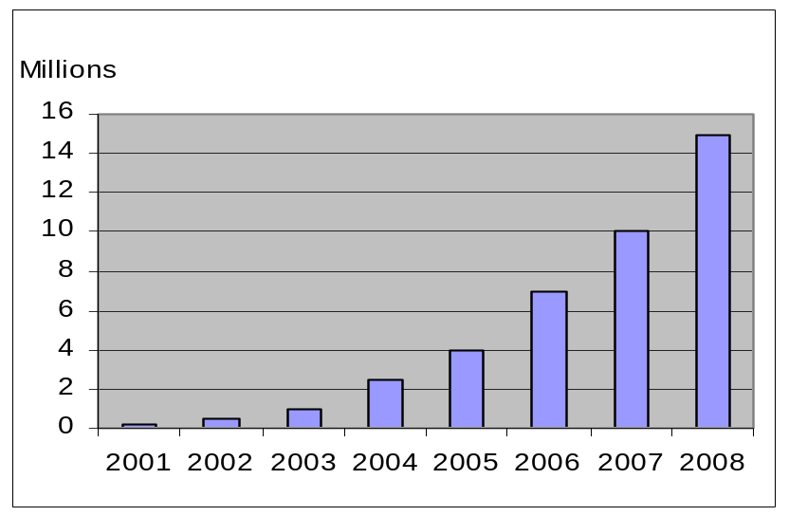
Broadband Business Trend
Source : DSL Forum
Source : In-Stat/MDR 4/04
Projected Broadband TV Growth
US $
Technology Requirements
Triple Play Network is essential.
All components in the network should be triple play aware,
Fully Packetized network
The Network and its components should be scalable.
Transport Network should be scalable without fork-lift upgrade
Lower OPEX and CAPEX

Slide 4



Telephone Network
ISP Network
Exchange
Router
TDM Network
RAS
POTS
BRI

Slide 5

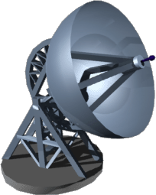
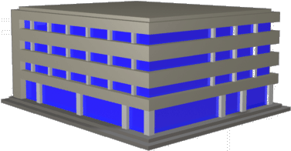
DLC Network
Reduces the last mile copper
DLC outdoor installation
Reduces the density of the line
DLC
SDH /SONET
COT
POTS
NX64 & E1
PSTN
BRI/PRI

Slide 6
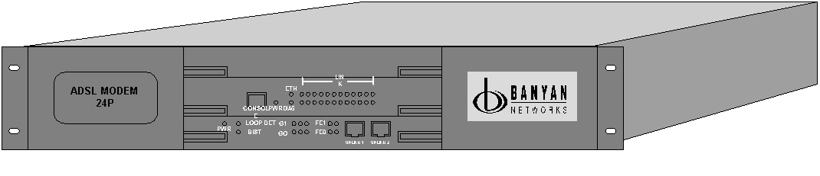
NG – Access Network
Wireless Broadband
(WiMax)
NOC
(EMS, NMS, Billing)
TDM Transport
SDH
(STM-1/4/16)
MSAN
FTTB/FTTH
(Fiber)
FE (Fiber)
VoD
Soft-switch
MSAN
GPON
Internet
E1 over CE
VDSL2
RPR
ADSL2+
MSAN
E1/STM-1
Gig-Ethernet
DSL Access
(Copper)
TDM
E1 over CE
Narrowband Services
NG Packet Transport
(Circuit Emulation)
POTS
NX64 & E1
Subtending
DSLAMs
MSAN
BRI/PRI
Metro Switch
Metro Switch

Slide 7

Broadband Network Architecture
Aggregation
N/w
Core
N/w
xDSL
Aggr
Node
BRAS/
IP Edge
Access Node
Access Network
Fibre
POTS
AAA Server

Slide 8
Triple Play Requirements
100M
Full Rate Ethernet
38M
Enhanced Triple Play
8M Internet
HD Gaming
2 X HDTV
18M-38M
HD Vid
Phone
12-24M
19M
Triple Play
2 STD TV
3-4 VoIP
1 M Internet
Downstream
Enhanced Triple Play Downstream
Enhanced Triple Play Upstream
ADSL2+ Downstream
BPON Downstream
GPON Downstream
VDSL/VDSL2 Downstream
Active Ethernet Symmetric
Wireless Broadband

Slide 9
DSL
What is DSL?
  Digital Subscriber Loop Technology - Digital Communication Technique used in the subscriber loop cable to increase the bit rate.
  The technology that came to uncover the potential of the ubiquitous Copper cable.
Subscriber Loop - The portion of the cable between Central Office (CO) till the Customer Premises (CP) or homes. This is also called as Last Mile Copper.

Slide 10
XDSL Technology Evolution
VDSL
ADSL
SHDSL
Up to 100 Mbps
ISDN
1.5 - 26Mbps
Dial up
up to 100 Mbps
56 kbps
160 kbps
0.3 / 2 Mbps
> 15000 feet
12 - 1200

Slide 11
Telephone Network
ISP Network
Exchange
Router
TDM Network
RAS
POTS
BRI

Slide 12
ADSL
By far the most heavily used broadband internet delivery method in the world.
ADSL is worldwide standardized in ITU Standard G.992.1
Uses DMT with symbol rate 'T' = 250us.
Annex A (typical ADSL) provides Downstream rate upto 8 Mbps and Upstream rate upto 1 Mbps.
The Spectrum (0 to 1.104 Mhz) is divided into 256 subcarriers or bins, each 4.3125 Khz wide.
They can be independently modulated from zero to a maximum of 15 bits/sec/Hz. This allows up to 60kbps per tone.

Slide 13
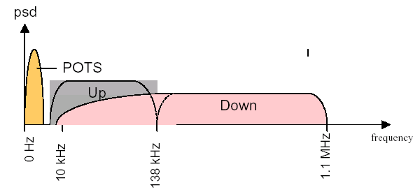
ADSL

Slide 14
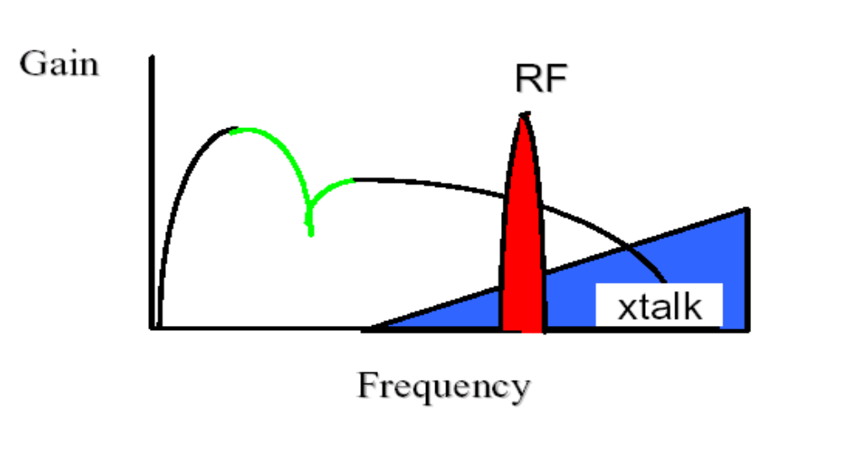
Channel characteristic
Low frequencies are attenuated, due to DC notching of transformer coupling to the telephone line.
Attenuation at high frequencies (cable is a LPF)
Notch caused by a bridged tap - open circuit i.e. unterminated extension phone of line, that branches from the phone line. (Decreases Data Capacity)

Slide 15
Channel characteristics
The non-flat response of the channel will lead to ISI (intersymbol interference), as the Nyquist criterion requires it to be flat.
Any adaptive equalization will be extremely difficult for this kind of channel response, as they only mildly consider that channel impulse response. i.e. The modulator basis functions are fixed.
In practice, a particular modem may have to work with acceptable performance over a range of variation in transmission channels.
There are nearly a billion telephone lines worldwide that exhibit significant variation in channel response and noise PSD.

Slide 16
Solution -Multi tone Modulation
Large performance improvement can be attained in these applications when the modulator basis functions can be designed as a function of measured channel characteristics.
Multi-channel modulation methods allow such modulator adaptation to channel.
The available spectrum is divided into multiple subbands called bins (256 for ADSL).
Each of the subbands (bins) are modulated with non-overlapping narrowband QAM signals or 'tones'.
The constellations (number of symbols transmitted) for the various QAMs are a function of the capacity of that particular bin.

Slide 17
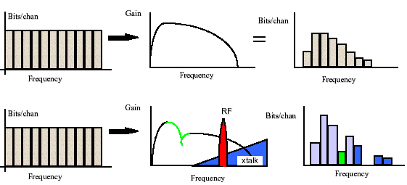
Adaptive Multi tone transmission

Slide 18
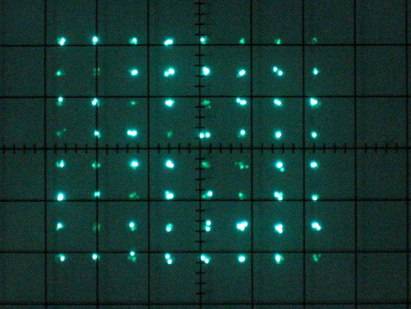
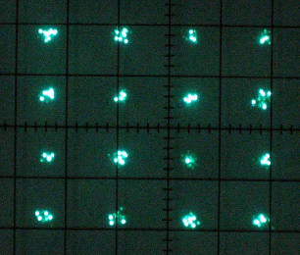
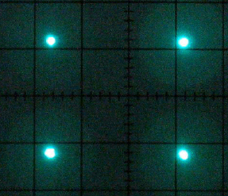
QAM Constellations
Each of the bins carries QAM constellations with varying number of bits, depending upon the capacity (SNR).
QPSK 2bits/symbol .
64 QAM
6 bits/symbol
16 QAM
4 bits/symbol .

Slide 19
Multi tone Modulation contd.
Now the energy and the amount of information carried on each QAM channel roughly follows the channel transfer function.
Multitone designs thus avoid the need for equalization on any 'tone', by making each sufficiently narrow, that the associated channel response appears to be 'flat'. Hence it satisfies the Nyquist's criterion.
Thus multitone modulation methods extracts maximum capacity or data rate from the copper channel.

Slide 20
Discrete Multitone
Channel Partitioning methods divide a transmission channel into a set of parallel, and ideally independent, subchannels to which the loading algorithms can be applied.
Multitone modulation is a kind of channel partitioning.
Discrete-time channel partitioning, partitions a discrete-time description of the channel, i.e. the sampled channel.
Continuous time partitioning is difficult to implement, hence ADSL uses a discrete discrete channel partitioning method called – Discrete MultiTone (DMT).

Slide 21
Bin Loading
In digital modulation, the energy of a modulated signal is related to the number of bits it carries.
Total number of bits carried by the multitone system is the sum of bits carried by the individual tones.
Hence the total date rate of the multitone system is sum of the individual data rates in each of the bins.
The Loading Algorithms compute the optimal number of bits to be carried in each of the bins.
One such loading algorithm is the 'Waterfilling Algorithm'

Slide 22
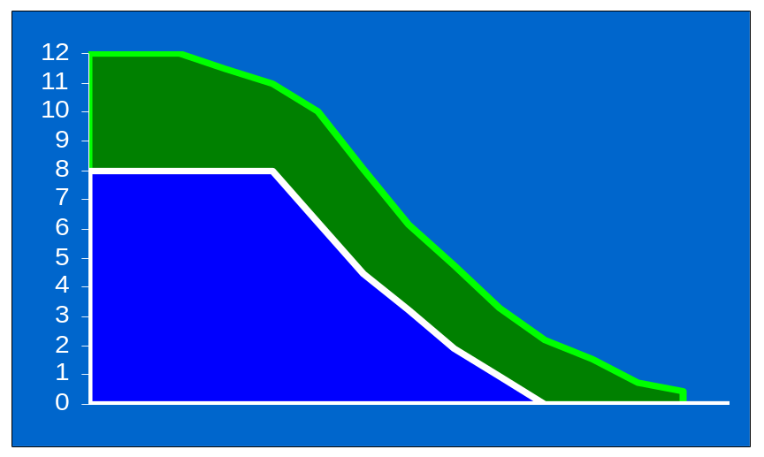
ADSL2
ADSL2 enables service providers to extend existing rates plans at longer loop lengths using rate enhancement technologies

Slide 23
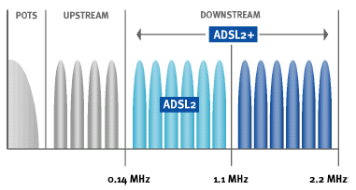
ADSL2+
Double spectrum uses 512 bins of 4.3125 kHz each.

Slide 24
ADSL2+
Higher rates through many small changes.
Improved and flexible framing.
SRA.
New line diagnostics (DELT and in datamode).
Improved initialization for improved rates and interoperability.
Power Management to reduce power dissipation at CO.
Improved reach with 1 bit/bin and READSL2.

Slide 25
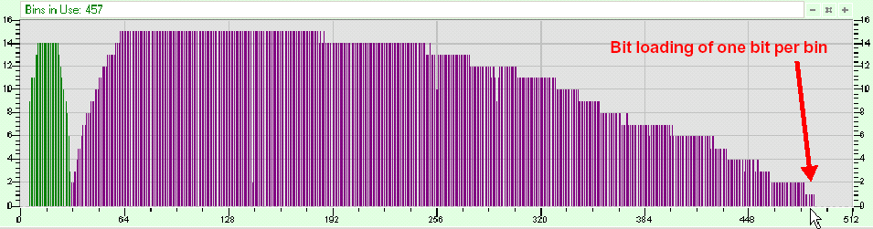
BIN Loading in ADSL2+

Slide 26
Rate Vs Reach in ADSL2+

Slide 27
VDSL
Very high-speed Digital Subscriber Line2
Latest DSL standard ( VDSL2) from ITU ( G993.2)
Transmission rates up to 100/100 Mbps over a single copper pair.
Supports both Asymmetric and Symmetric Data rate
Bandwidth upto 30 Mhz
Supports seamless Ethernet Backbone
Backward compatibility to all DMT based xDSL

Slide 28
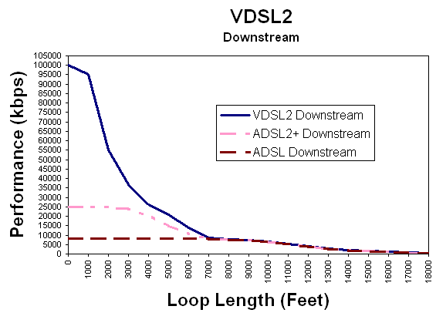
VDSL2 Rate Vs Reach

Slide 29
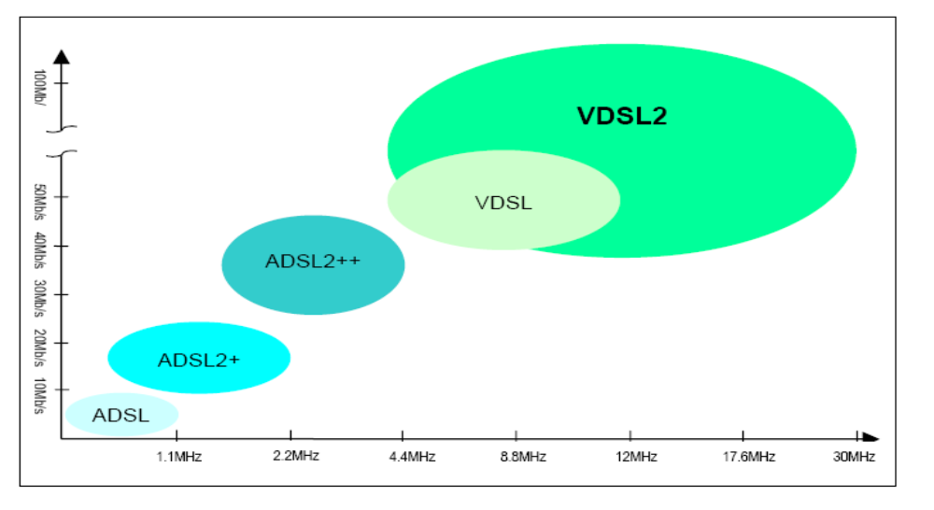
DSL data rate Vs Frequency

Slide 30
Issues faced in DSL deployment
Crosstalk Noise due to other ADSL and POTS lines in the same binder cable.
Presence of Bridged taps - i.e. open-circuit unterminated extension phone lines, that branch from the main line.
Background Noise in the copper line and RF Interference.
Load Coils inserted in order to increase the POTS reach, affect the ADSL data rate.
Patching of copper cable and use of split-pair (separated Tip & Ring).

Slide 31
Issues faced in Deployment
Use of muti-gauges of wire in a line (using both 0.5mm and 0.4mm)
Water seeping into the cable causes longitudinal imbalance.
Bunching of spectrally incompatible services in the same binder cable.
Stacks overheads, in Ethernet service over ADSL.

Slide 32
DSL Fault Isolation
The ADSL impairments are isolated by executing Line Evaluation by using SELT/DELT Tests
  Estimated loop length.
  Loop termination and wire gauge.
  Upstream and Downstream capacity.
  Inband Noise.
  Termination Response, which helps in isolation of bridged-taps.
  DMT SNR Margin vs Rate.

Slide 33
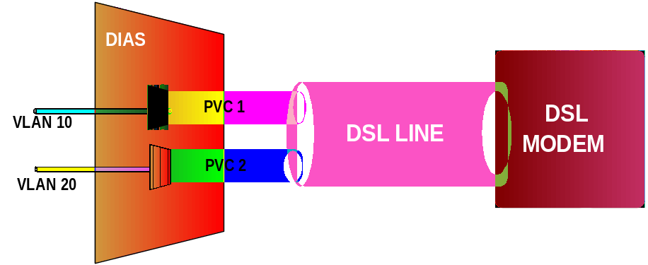
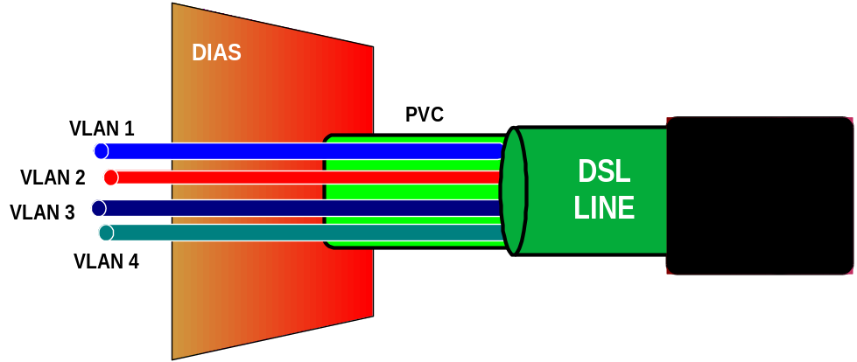
Subscriber/Service Identification
Multiple PVCs
  Each PVC can be alloted to carry different services
  In upstream, CPE classify and transmit traffic to different PVCs
Single PVC, Multiple VLAN
  Each VLAN is alloted to carry different services
  In upstream CPE separate traffic onto separate VLAN’s

Slide 34




Triple Play Network
QinQ for Tunneling and Scalability
BRAS
Policing, Marking of VLAN/802.1p marking
Classification and assigning traffic to PVC/VLAN
Data
Access Network
X
X
Access
Device
CPE
Voice
Separate PVC or VLAN for different classes of traffic
Video

Slide 35
Thanks…

