Slide 1
IT23502 · WEB PROGRAMMING · MINI-PROJECT
S
Scholaris
Student Record and Grading System
A Spring Boot MVC application with a documented REST API and a second, independently deployed grading service.
Senthil Raja R · Mini-project, Batch 2 · October 2026
2 Spring Boot services
52 automated tests
23 REST endpoints

Slide 2
AGENDA
What this walkthrough covers
01
Problem & motivation
10
API testing evidence
02
Objectives
11
Grading microservice
03
Scope & users
12
REST vs SOAP
04
System architecture
13
Monolith vs microservices
05
Domain model
14
Spring Cloud
06
Database & identifiers
15
Testing & quality
07
Implementation layers
16
DevOps pipeline
08
HQL & diagnostics
17
Results & demonstration
09
REST API design
18
Limitations & conclusion
Scholaris · Student Record and Grading System · IT23502
02 / 19

Slide 3
PROBLEM
Student records are fragmented and error-prone
Duplicate records
The same student appears in class lists, marks sheets and fee registers.
The opportunity
• One source of truth for people, courses and marks.
• Consistent grade rules in one place.
• Live HQL reports instead of manual spreadsheets.
• A documented API that other systems can consume.
Manual grade calculation
Letter grades, points and GPA are computed by hand with different rules.
Slow reporting
Top performers and course averages require copying data between spreadsheets.
No integrity or audit
There is no validation, referential integrity or controlled access.
No API for other systems
A spreadsheet cannot serve a dashboard, mobile app or examination system.
Batch 2 demo data
9 students · 6 courses · 40 enrollments
Scholaris · Student Record and Grading System · IT23502
03 / 19

Slide 4
OBJECTIVES
Twelve objectives, four tangible outcomes
The project is assessed on working evidence, not only on the use of frameworks.
FRAMEWORK
DATA
Spring Boot + MVC
JPA / Hibernate
• Server-rendered Thymeleaf UI
• Constructor injection and ApplicationContext
• AOP logging around service methods
• Full CRUD through repositories
• JOINED inheritance + IDENTITY keys
• Five explicit HQL reports
SERVICES
DELIVERY
REST + microservice
Maven + DevOps
• GET, POST, PUT and DELETE
• Grading service on port 8081
• RestClient call with local fallback
• Multi-module reactor and 52 tests
• Docker Compose and GitHub Actions
• Git history, docs and evidence
Scholaris · Student Record and Grading System · IT23502
04 / 19

Slide 5
SCOPE
Who uses it, and what is inside the boundary
FUNCTIONAL COVERAGE
Administrator
Instructor
• Student CRUD, search and transcript with GPA
• Instructor CRUD and department views
• Course CRUD with roster and capacity
• Enrollment create, edit, delete and grade evaluation
• Dashboard with live grading-service health
• Five HQL reports: top performers, missing enrollments, departments, course performance, grade distribution
• REST API documented with OpenAPI 3.1 and Swagger UI
• Bean validation and one consistent JSON error contract
Students, instructors and courses
Enrollments, marks and grades
Student
Evaluator
Transcript and GPA read view
H2 console, API and diagnostics
OUT OF SCOPE
Authentication and roles, fee management, timetable, production hardening and a full Spring Cloud deployment.
Scholaris · Student Record and Grading System · IT23502
05 / 19

Slide 6
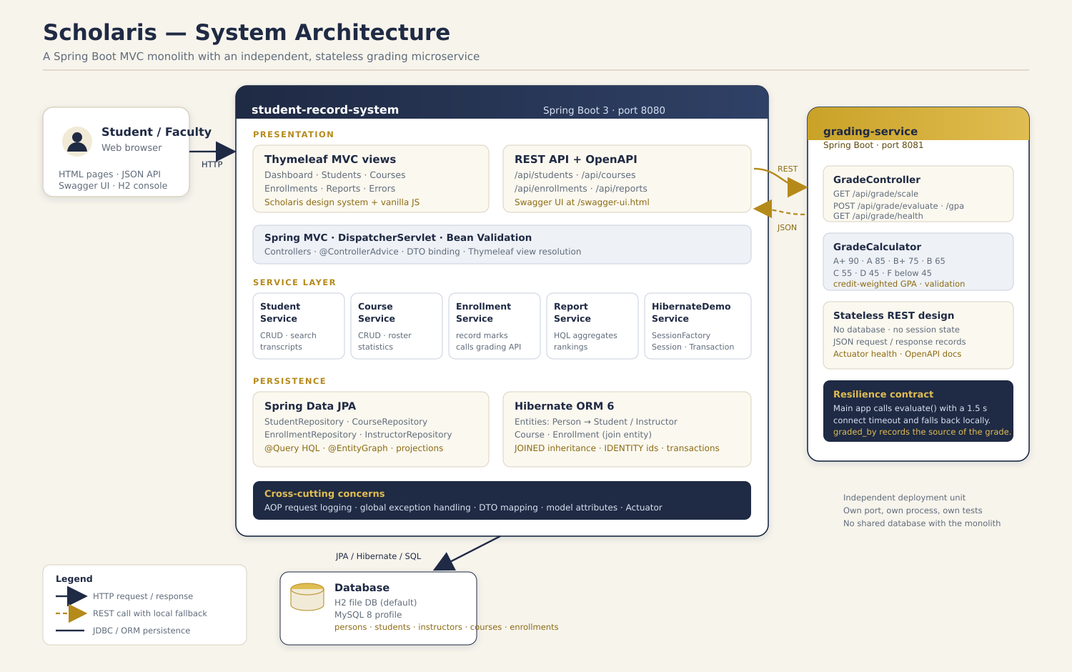
SYSTEM DESIGN
A modular monolith with one focused microservice
MVC + Thymeleaf
Server-rendered pages for students, courses, enrollments, reports and dashboard.
JPA + Hibernate
H2 file database locally; MySQL profile and schema scripts provided.
REST + RestClient
JSON API on 8080 calls the grading service on 8081; fallback keeps marks saveable.
Scholaris · Student Record and Grading System · IT23502
06 / 19

Slide 7
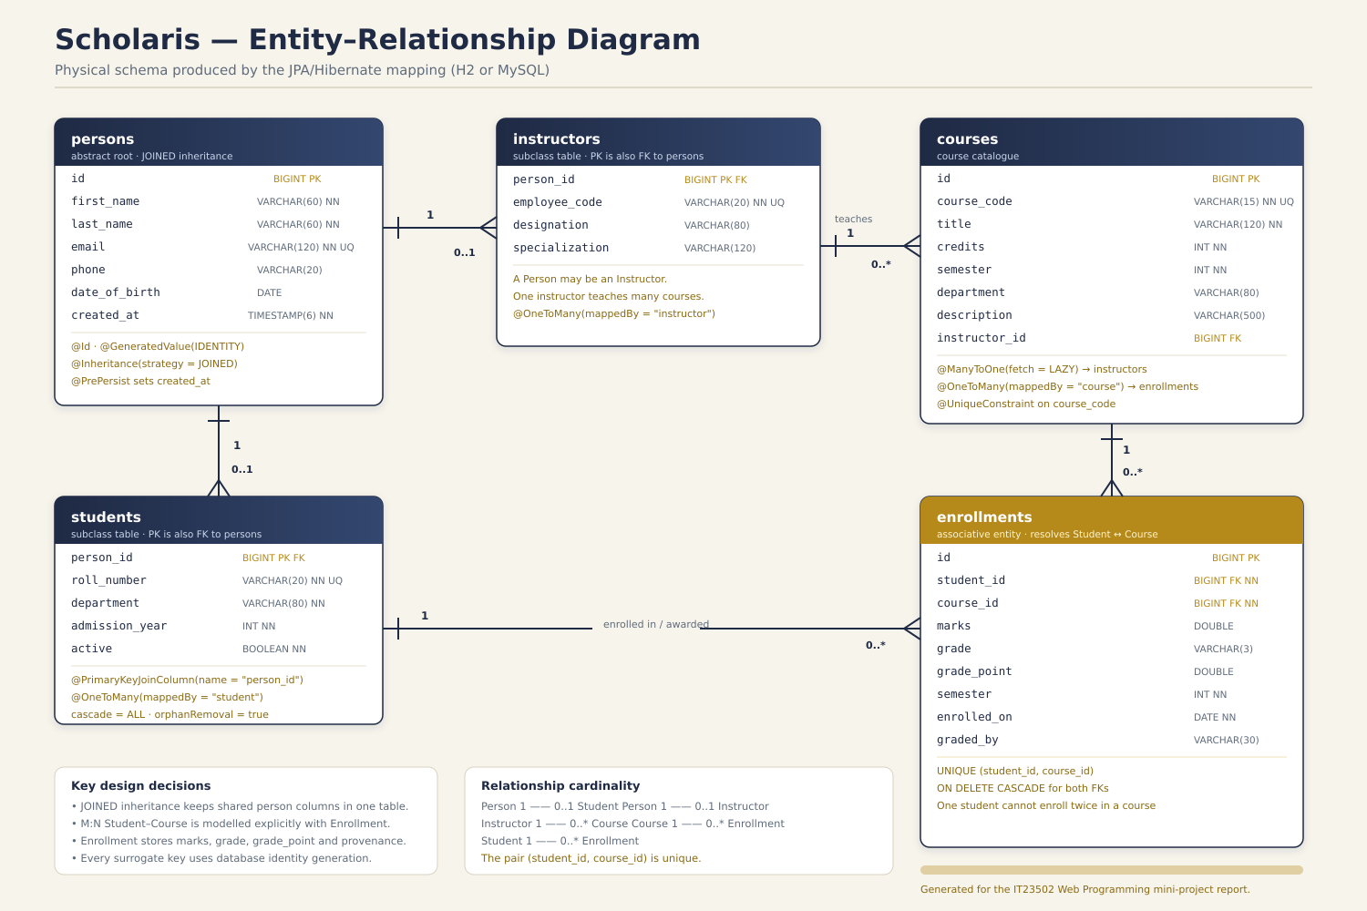
DOMAIN MODEL
A small model with a real inheritance hierarchy
• Person is abstract; Student and Instructor share identity and personal details.
• InheritanceType.JOINED creates persons, students and instructors tables.
• Course 1:N Enrollment and Student 1:N Enrollment form the academic core.
• Enrollment owns marks, letter grade, grade point and evaluated_by.
• @OneToMany, @ManyToOne, @JoinColumn and cascade rules are used deliberately.
• Every surrogate key uses GenerationType.IDENTITY.
@Inheritance(strategy = JOINED)
Scholaris · Student Record and Grading System · IT23502
07 / 19

Slide 8
DATABASE
Five tables, clean keys and repeatable sample data
Table | Rows | Purpose
persons | 13 | Shared identity for students and instructors
students | 9 | Roll number, department, admission year
instructors | 4 | Employee number, department, designation
courses | 6 | Code, title, credits, capacity, instructor
enrollments | 40 | Marks, grade, grade point and evaluation source
Person.java
@Entity
@Inheritance(strategy = JOINED)
public abstract class Person {
@Id
@GeneratedValue(strategy = IDENTITY)
private Long id;
private String firstName, lastName;
private String email;
}
IDENTITY → database-generated, compact surrogate keys
40
5
78.7
H2 file database for the demo; a MySQL profile and database/schema.sql are included for portability.
enrollments
tables
average mark
Scholaris · Student Record and Grading System · IT23502
08 / 19

Slide 9
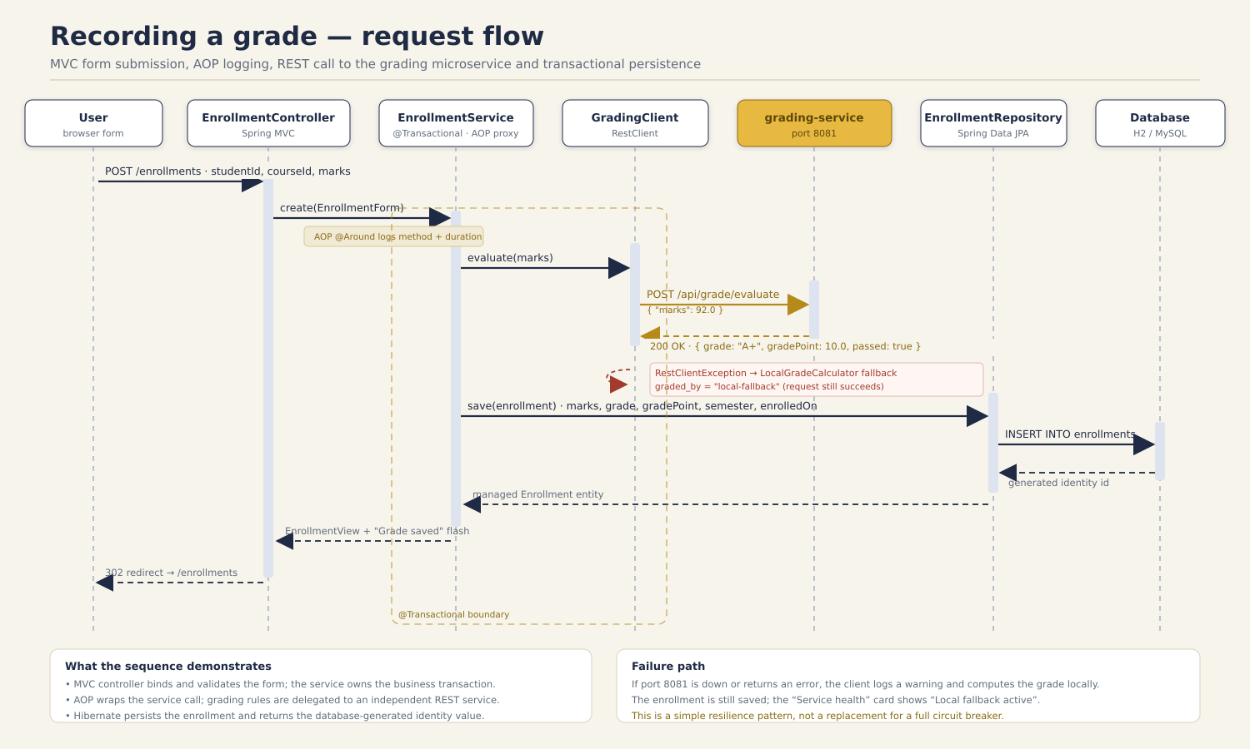
IMPLEMENTATION
Controller → service → repository, with AOP logging
Web / REST
Thymeleaf controllers and @RestController endpoints
Service
@Transactional business rules and grade orchestration
Repository
Spring Data JPA plus explicit HQL queries
Domain
Entities, relationships, validation and inheritance
LoggingAspect around every service method
Scholaris · Student Record and Grading System · IT23502
09 / 19

Slide 10
DATA ACCESS
Five HQL reports plus an observable Hibernate session
Top performers
Average mark ≥ threshold
HibernateDemoService.java
Session session = sessionFactory.openSession();
Transaction tx = session.beginTransaction();
List<Student> top = session.createQuery(
"select s from Student s ...", Student.class)
.setParameter("min", minAverage)
.getResultList();
tx.commit();
session.close();
Students without enrollments
LEFT JOIN / null check
Department distribution
COUNT and GROUP BY
Course performance
AVG, MAX and MIN per course
openSession → beginTransaction → HQL → commit → close
Grade distribution
COUNT by letter grade
/api/diagnostics/session-factory and /hibernate/top-performers expose the SessionFactory, Session and Transaction at runtime.
Scholaris · Student Record and Grading System · IT23502
10 / 19

Slide 11
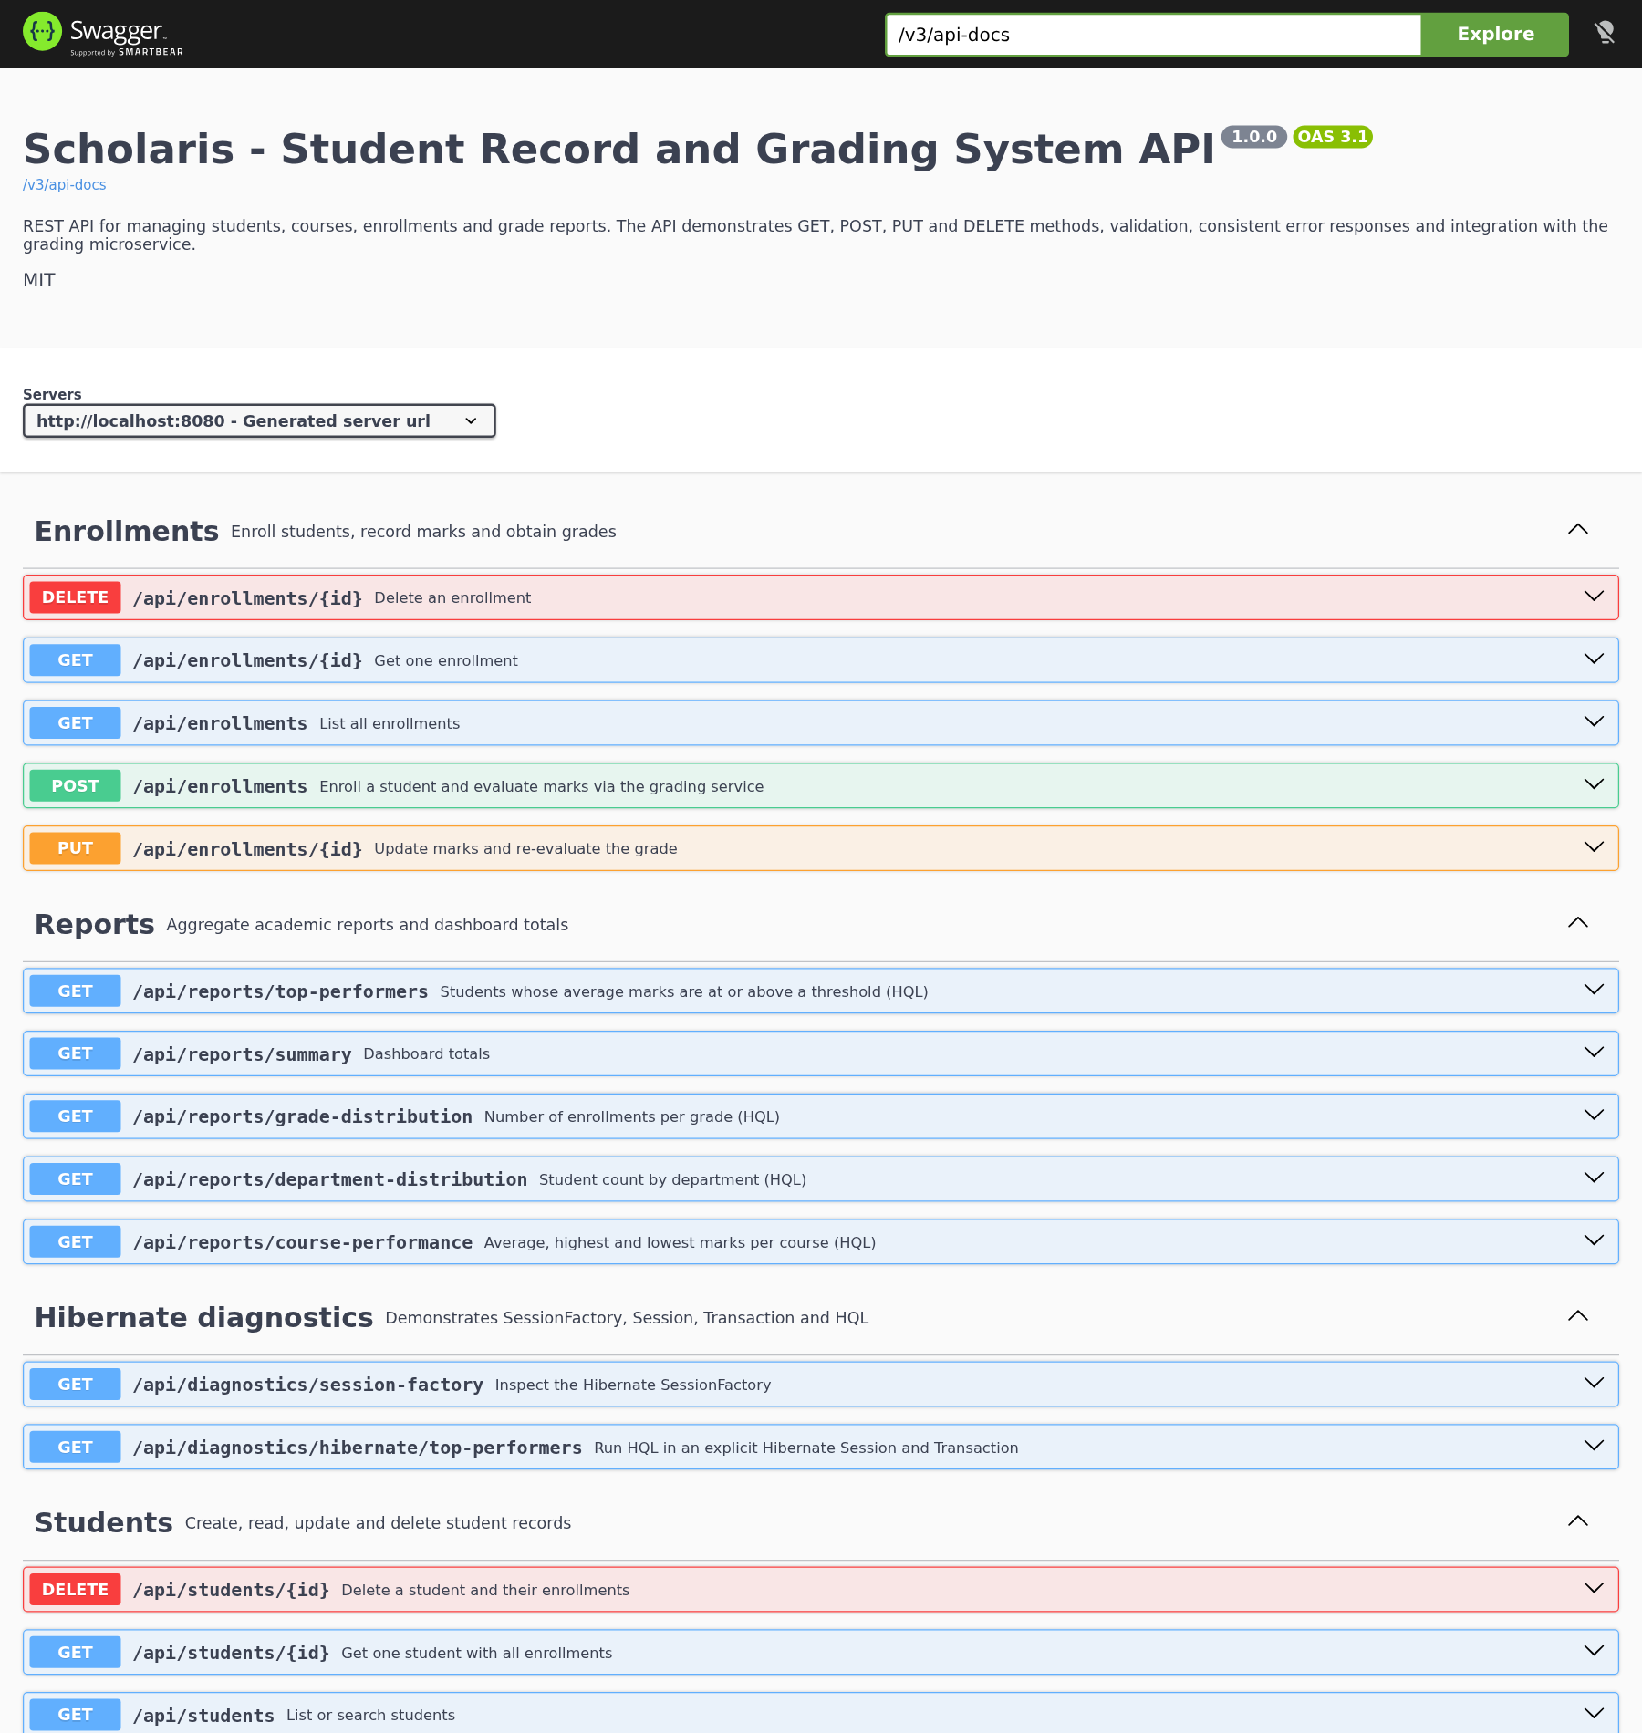
REST API
A documented contract over the same business services
Resource | Methods | Base path
Students | GET · POST · PUT · DELETE | /api/students
Courses | GET · POST · PUT · DELETE | /api/courses
Enrollments | GET · POST · PUT · DELETE | /api/enrollments
Reports | GET | /api/reports/*
Diagnostics | GET | /api/diagnostics/*
OpenAPI 3.1
Swagger UI
23 main-app endpoints and 5 grading-service endpoints. Consistent status codes, bean validation and a single JSON error shape.
Scholaris · Student Record and Grading System · IT23502
11 / 19

Slide 12
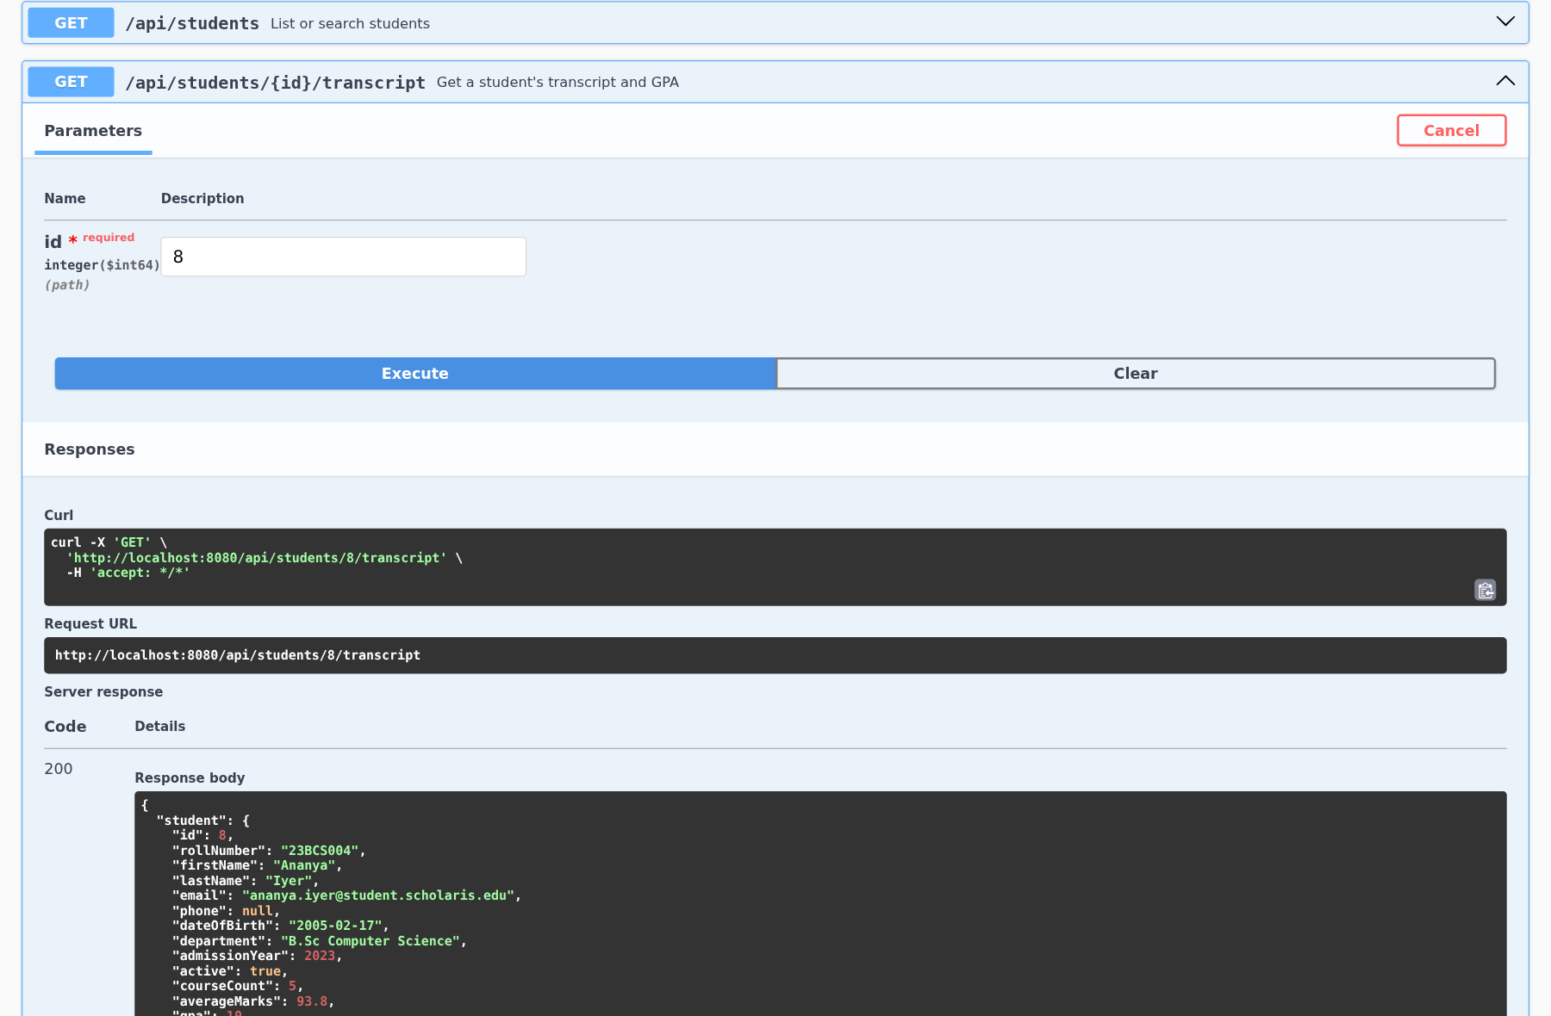
EVIDENCE
The contract is exercised, not just described
34
59
0
NEWMAN SUMMARY
0 failed · 59 assertions
Postman requests
assertions
failures
34 requests across 8 folders
• Swagger UI executes every endpoint against the running application.
• Postman collection + environment reproduced with Newman.
• MockMvc and REST integration tests cover happy paths and failures.
• 52 automated tests: 29 in the main app, 23 in the grading service.
Scholaris · Student Record and Grading System · IT23502
12 / 19

Slide 13
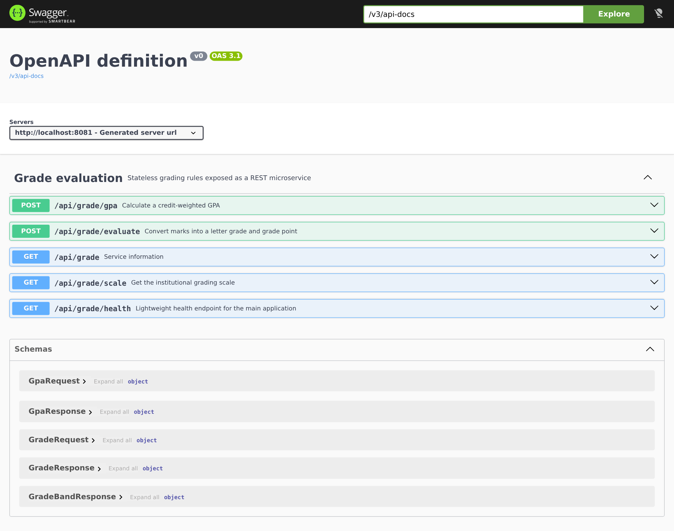
MICROSERVICE
A second service, called over REST
Main app :8080
RestClient
Grading :8081
EnrollmentService
marks + credits
POST /api/grade/evaluate
2 s timeout
Stateless grade rules
grade + grade point
GradeResponse (JSON) · grade, grade point, pass flag
Resilience
Independent deployment
If the service is unavailable, LocalGradeCalculator computes the result and evaluated_by records the fallback.
The grading service has its own port, POM, tests, JAR and Docker image. No shared database.
The same request/response DTO contract is exercised by unit tests and the main application's integration tests.
Scholaris · Student Record and Grading System · IT23502
13 / 19

Slide 14
WEB SERVICES
REST vs SOAP: the trade-offs in one view
Aspect | REST | SOAP
Style | Resource-oriented; HTTP verbs | Operation-oriented; RPC style
Protocol | HTTP/HTTPS | HTTP, SMTP, JMS and others
Payload | JSON or XML; typically JSON | XML envelope with headers and body
Contract | OpenAPI / JSON Schema | WSDL + XSD
Caching | Native HTTP caching | Limited; needs infrastructure
Coupling | Loose; evolvable representations | Tighter; strict contract and tooling
Project use | Chosen for both services | Explained and compared, not used
REST fits this project because the domain is resource-oriented and the browser, Swagger and Postman all speak JSON. SOAP remains a good fit where formal WS-* contracts and transactions are mandatory.
Scholaris · Student Record and Grading System · IT23502
14 / 19

Slide 15
ARCHITECTURE CHOICE
Monolith, microservices and Spring Cloud
Monolithic core
Microservice boundary
• One deployment and one transaction boundary
• Simple joins across students, courses and enrollments
• Lower operational cost for a small team
• Independent deployment and scaling
• Clear bounded context for grading rules
• Network calls add latency and failure modes
SPRING CLOUD — WHAT IT ADDS
At this scale Spring Cloud would add infrastructure without improving the demonstration. The project instead shows the real boundary: an HTTP contract, a timeout and a fallback.
Config
Eureka
Centralised configuration
Service discovery
Gateway
Resilience4j
Routing and cross-cutting edge concerns
Circuit breakers and retries
RestClient + fallback is the honest first step
Scholaris · Student Record and Grading System · IT23502
15 / 19

Slide 16
QUALITY
52 automated tests and a repeatable verification path
52
29
23
Manual / Postman
tests passing
main application
grading service
Integration
Unit
Grade boundaries, GPA, fallback rules
MVC
MockMvc page rendering, forms, validation
MVC + repository
REST
JSON status codes and error contract
Persistence
HQL repositories and JOINED inheritance
Unit
End-to-end
Postman/Newman against running services
Test confidence grows downwards
Scholaris · Student Record and Grading System · IT23502
16 / 19

Slide 17
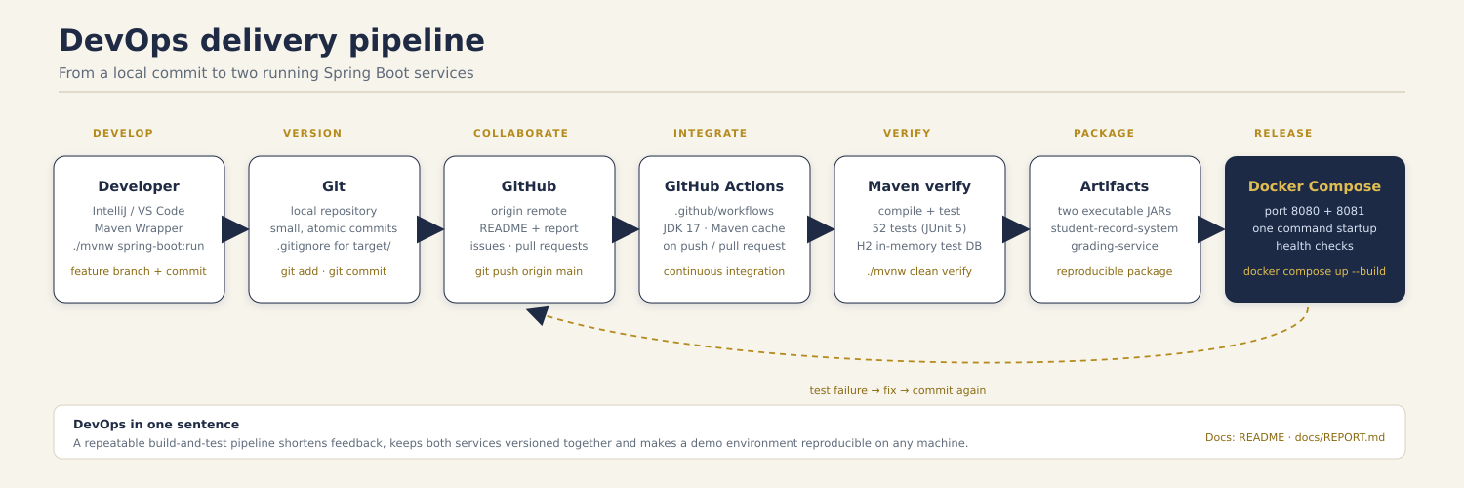
DEVOPS
A repeatable path from commit to running services
Git + GitHub
Maven Wrapper
GitHub Actions
Docker Compose
branch, review, history
./mvnw clean verify
build + test on push
two services, one network
Scholaris · Student Record and Grading System · IT23502
17 / 19

Slide 18
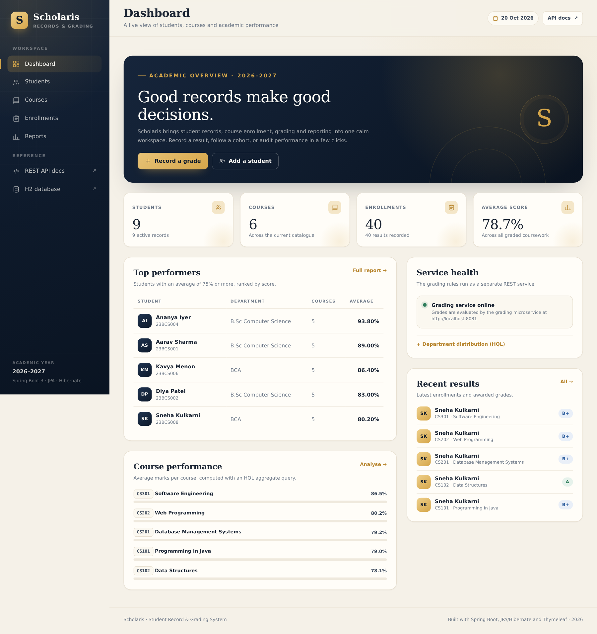
RESULTS
A working application with evidence behind every claim
9
6
students
courses
40
78.7
enrollments
average mark
• Dashboard reports live grading-service health.
• Five HQL reports produce rankings, distributions and course averages.
• CRUD, validation and friendly error pages are demonstrated end to end.
• H2 console and diagnostics make the persistence layer observable.
Scholaris · Student Record and Grading System · IT23502
18 / 19

Slide 19
CONCLUSION
Delivered, demonstrated and ready to extend
DELIVERED
EVIDENCE
NEXT
• Spring Boot MVC application with a full academic workflow
• JPA/Hibernate model with JOINED inheritance and IDENTITY keys
• REST API, Swagger documentation and a grading microservice
• AOP logging, constructor injection and diagnostics
• 52 automated tests with zero failures
• 34 Postman requests and 59 assertions
• 9 students, 6 courses and 40 seeded enrollments
• A complete report, schema, diagrams and demo script
• Authentication, roles and audit trails
• Pagination, search and production database tuning
• Spring Cloud Config, discovery and resilience
• Observability and a full CI/CD deployment
Thank you — questions?
IT23502 · Web Programming
Mini-project, Batch 2
github.com/Senthil455/Student-Record-Grading-System
Scholaris · Student Record and Grading System · IT23502
19 / 19

