Slide 1
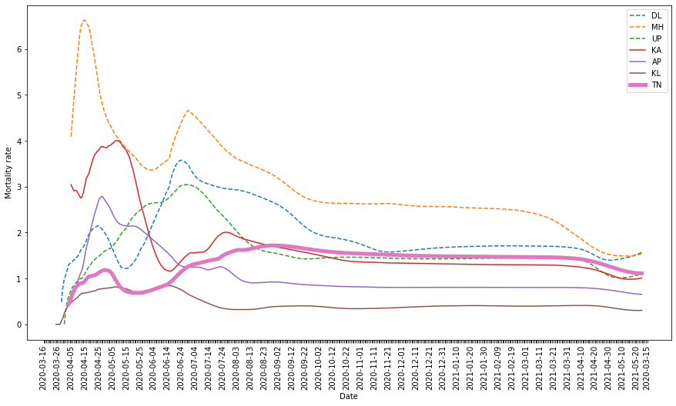
1st wave
2nd wave

Slide 2
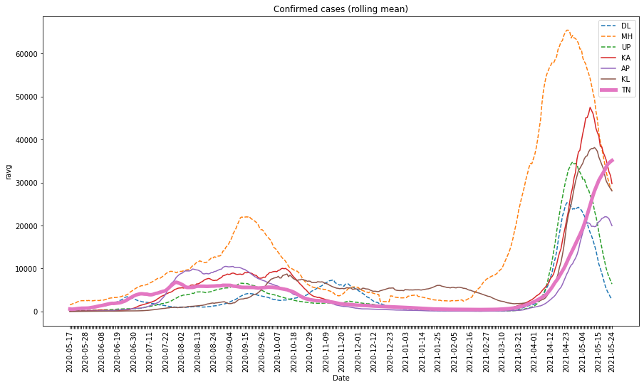
2nd wave
1st wave

