Slide 1
ADABOOST REGRESSION
Ada boost stands for adaptive boosting
The model adjust the weights of weak leaners and try to make the model better
Let assume male and female with age and need the check the marriage eligibility based on their sex and age
Step1 : Create sample weights
It will create a sample weight for all the features example below. The sample weight will be created between as 1.
Sex | Age | O/P
Female | 12 | No
Male | 23 | Yes
Male | 34 | Yes
Female | 21 | Yes
Male | 45 | Yes
Male | 12 | No
Female | 34 | Yes
Female | 16 | No
Sample weights
1/8
1/8
1/8
1/8
1/8
1/8
1/8
1/8

Slide 2
Step2: Creating stumps
It will create a stumps for each features, what is stumps.
A tree with one node and 2 leaves is called stumps.
Stumps are comparatively weak leaners as it using only 1 feature.
Errors/accuracy of the stumps may vary.
Step 3: Select Stumps
It will create weight for each features called as entropy or gini value.
And it will select the minimum value of the entropy
F1
YES
NO
F2
F3
YES
NO
YES
NO
F1
Entropy:0.48
YES
NO
F3
Entropy:0.37
Entropy:0.50
F2
YES
NO
YES
NO

Slide 3
Step 4: Calculate Total Error
Total error is the sum of weights of misclassified records.
The total error is the sum of all the errors in the classified record for sample weights
It will be always between 0 and 1, 0 represents perfect stump(correct classification) and 1 represents weak stump(Misclassification).
For example: consider below highlighted is error, actual is Yes but it results NO
Sex | Age | O/P
Female | 12 | No
Male | 23 | Yes
Male | 34 | Yes
Female | 21 | Yes
Male | 45 | Yes
Male | 12 | No
Female | 34 | Yes
Female | 16 | No
Sample weights
1/8
1/8
1/8
1/8
1/8
1/8
1/8
1/8
TE=1/8

Slide 4
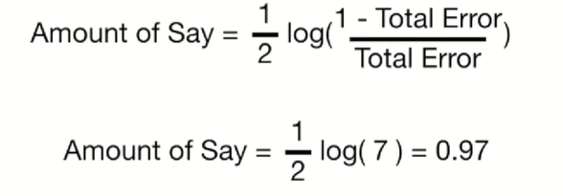
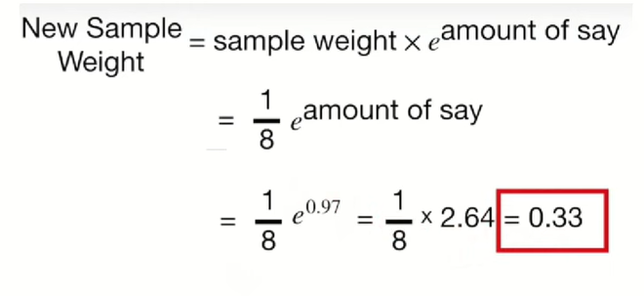
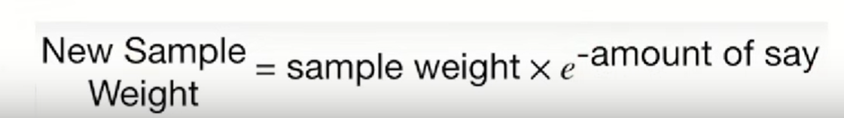
Sex | Age | O/P
Female | 12 | No
Male | 23 | Yes
Male | 34 | Yes
Female | 21 | Yes
Male | 45 | Yes
Male | 12 | No
Female | 34 | Yes
Female | 16 | No
Sample weights
1/8
1/8
1/8
1/8
1/8
1/8
1/8
1/8
Step 5: Calculate amount of say (or) Performance say
Formula
Step 6:Update weights
It will update weights first for the misclassification and formula is below
To update weight for the rest of the features we have to use below formula
Now we will have the updated weights for all the features.
When you calculate the total sum of update weight is 0.68 but sum of sample
weight is 1.
So to make updated weight 1 we have to normalize the weights.
Updated weights
0.05
0.05
0.05
0.33
0.05
0.05
0.05
0.05

Slide 5
Step 7: Normalize the weights
We have divide each updated weight with sum of updated weight.
Example: 0.05/0.68 =0.07
Now we will have sum of update weight is 1.
Step 8: New Sample Formation
Based on normalized weight it will create bucket for each samples.
Normalized value intervals splits the value between 0 to 1.
It will generate random numbers, based on random numbers getting created, the samples will be added to new data set.
Sex | Age | O/P
Female | 12 | No
Male | 23 | Yes
Male | 34 | Yes
Female | 21 | Yes
Male | 45 | Yes
Male | 12 | No
Female | 34 | Yes
Female | 16 | No
Sample weights
1/8
1/8
1/8
1/8
1/8
1/8
1/8
1/8
Updated weights
0.05
0.05
0.05
0.33
0.05
0.05
0.05
0.05
Normalized weights
0.07
0.07
0.07
0.49
0.07
0.07
0.07
0.07

Slide 6
Now based on the data we will get the results in random manner because creating random samples it will not overfit the values.
The amount of weight first stump made second tree can do better prediction
So if we give value 25 then it will take the bucket between 0.21-0.70 then give the value.
Prediction will stand with the class where sum of performance stumps is higher.
Sex | Age | O/P
Female | 12 | No
Male | 23 | Yes
Male | 34 | Yes
Female | 21 | Yes
Male | 45 | Yes
Male | 12 | No
Female | 34 | Yes
Female | 16 | No
Normalized weights
0.07
0.07
0.07
0.49
0.07
0.07
0.07
0.07
Buckets
0-0.07
0.07-0.14
0.14-0.21
0.21-0.70
0.70-0.77
0.77-0.84
0.84-0.93
0.93-1
Thank you

