Slide 1
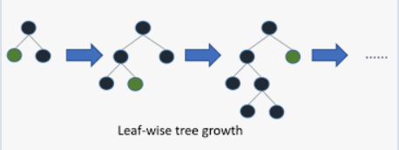
LightGMBoosting
LightGMB
It specializes in handling large data sets and high-dimensional data for supervised learning tasks.
It defines the loss that the model tries to minimize during the training process.
The LightGBM algorithm utilizes two novel techniques called Gradient-Based One-Side Sampling (GOSS) and Exclusive Feature Bundling (EFB) which allow the algorithm to run faster while maintaining a high level of accuracy.
Lightgbm help make smart feature engineering and smart samples.
It has leaf wise tree growth.

Slide 2
Histogram:
It will bin the data for each input and make it more simpler.
For example you have 5 input like ID, Name, AGE, Gender, Salary and in salary we have data
like
Then histogram will make it in 2 bins like
So it will be more light on data to work on samples.
Exclusive feature Bundling:
If the you take Gender input it have only Male or Female consider as 1 or 0 either any one value can be present for one date, so there will be no together of 11 or 00.
So here feature bundling create a new feature and make it as if Male is 1 then 11 or Female is 0 then it will take it as 10. it will reduce two dimension in single dimension.
It will be more helpful on working larger data.
50,55,60,65,70,75,80,85,90
50,55,60,65
70,75,80,85,90
50-65
70-90

Slide 3
Gradient base one ide sampling:
Here were in we work on models for example M1 has 500 data, then you gradient will be G1,G2,G3,………….G500
Lightgbm will take those gradient into decending order based on high value. So it will be like G48, G151, G499………..G50.
After gradient it will take top some samples which is 20% and rest you will have 80% data.
From that 80% again random take 10% of data and that is called bottom.
So sum of Top and Bottom you will get new sub sample.
G48,G151,G499,……..
G389,G2,G65…………..G50
Top 20%
80% data, from this it will take random 10%-Bottom
Top
Bottom
New sub samples

Slide 4
LightGMB focus on accuracy of results and takes low memory to run.
LightGBM uses the leaf-wise tree growth algorithm, while many other popular tools use depth-wise tree growth. Compared with depth-wise growth, the leaf-wise algorithm can converge much faster.
Formula = Y=Base_tree(X)-lr*Tree1(X)-lr*Tree2(X)-lr*Tree3(X)
Thank you

