Slide 1
XG Boosting
Xetreme Gradient boosting
It will regularization for avoiding overfitting.
Efficient handling of missing data.
Parallelized tree building.
Tree pruning using depth first approach.
Cross validation capability.
Let assume we have to predict how many people like gaming, so for that we have data input as Age, Sex, Occupation and output as Yes or No.
Sex | Age | Occupation | Output
Male | 14 | Studying | Yes
Female | 20 | Job | No
Male | 28 | Job | Yes
Female | 15 | Studying | No
Male | 35 | Job | yes
Male | 43 | Job | No

Slide 2
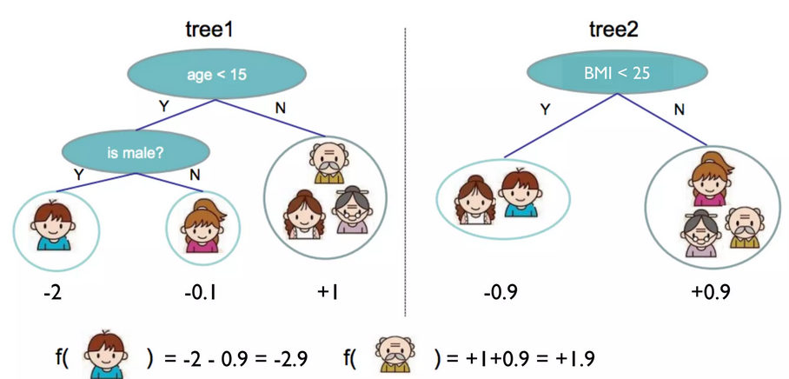
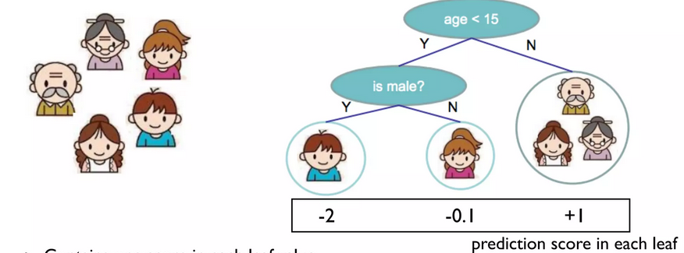
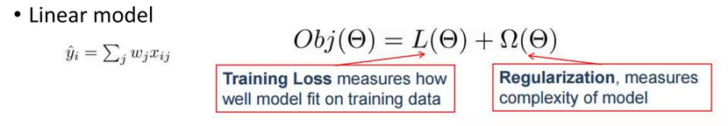
XG boost also tells you how important of each feature is, for example 2nd feature is most important and 3rd feature is least important
Age is most important / Occupation is least important.
XG boost contains one score in each leaf value.
Recall A function that maps the attribute to the score.
Optimizing training loss encourages predictive model.
Optimizing regularization encourages simple models.

Slide 3
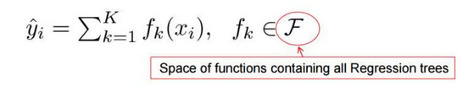
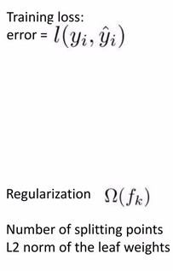
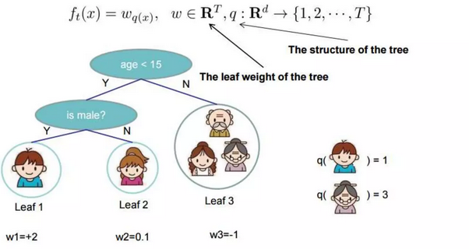
Formula
We define tree by a vector of scores in leaf’s and a leaf Indexing mapping function that maps an instance to leaf

Slide 4
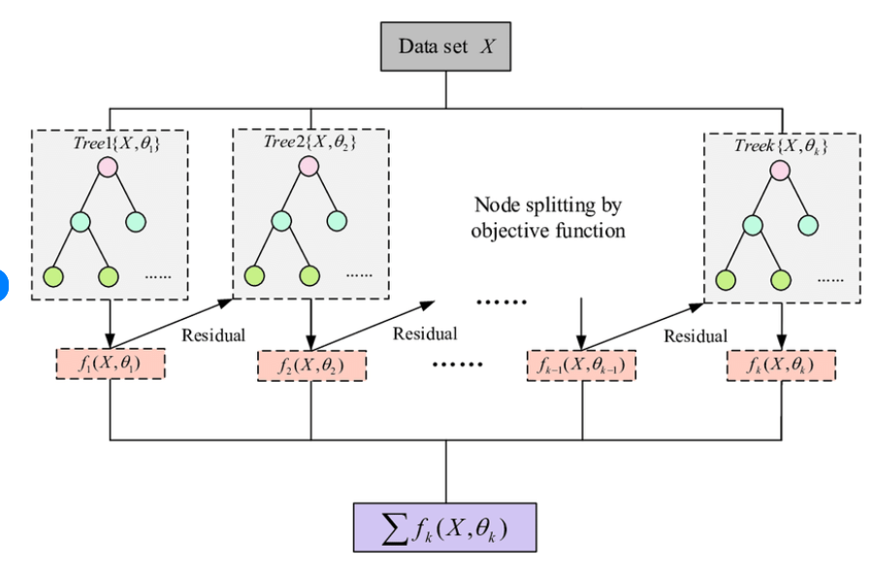
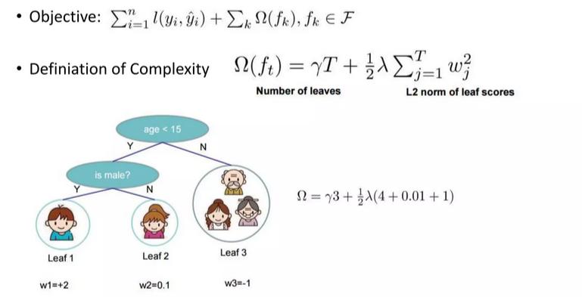

Slide 5
Start from constant prediction add a new function each time.
For each node enumerate overall features.
It will take the best split solution along all the features.
Node Splitting by objective functions.
At last of each calculate weighted then it will summation of all the calculated weight and find the best splits as mentioned in slide 4.
Thank you

