Slide 1


LLMs vs Humans
Cognitive evaluation using AMRs
Crînganu Denis-Florin
Cristea Petru-Theodor
Ghețoiu Gheorghe-Laurențiu

Slide 2
Table of contents
01
02
Introduction
AMRs
03
04
05
Gemma
AMR Comparisons
Conclusion

Slide 3
Introduction
01

Slide 4
Introduction
Natural Language Generation (NLG) involves the automatic production of human-like text.
This study explores differences between human-written and LLM-generated texts.
We analyze Abstract Meaning Representations (AMRs) to compare structural and linguistic features.
Parallel datasets were collected:
Human data: keystroke timings, deletions, final sentences.
LLM data: token probabilities, sequence-level perplexity, generated text.
Examples of questions asked:
Describe a morning at a busy bakery.
Describe the calm of a meditation room adorned with candles and cushions.

Slide 5
AMRs
02

Slide 6
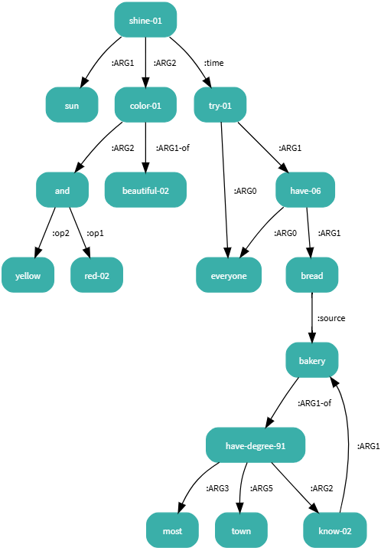
Abstract Meaning Representations
AMR is a structured representation of sentence meaning.
It captures "who did what, to whom, where, and why.“
Nodes represent concepts; edges show relationships.
AMRs can be manually created by linguists or generated by machine learning models.
Example:
The sun is shining with beautiful colors of red and yellow while everyone is trying to have a bread from the most known bakery in the town.

Slide 7
Gemma
03

Slide 8
Gemma
google/gemma-2-2b-it model used for text generation.
2.2 billion parameters.
Trained on diverse datasets.
Fine-tuned for instruction-following.
Hyperparameters for current task:
Max Length: 80 tokens – to control the output size;
Sampling Method: top-p sampling with p=0.9 and top-k sampling with k=30 to introduce controlled randomness
Temperature: 0.5

Slide 9
04
AMR Comparisons

Slide 10
Responses Comparisons
LLM-generated texts are:
More descriptive and lexically diverse.
More poetic and sensory-rich.
Often longer in sentence structure.
The air was thick with the smell of freshly baked bread and sugar, and the rhythmic thumping of the dough mixer filled the room.
Human-generated texts are:
More concise and structured.
Tend to use multiple sentences or punctuation for clarity.
Use more neutral or straightforward descriptions.
The sun is shining with beautiful colors of red and yellow while everyone is trying to have bread from the most known bakery in the town.

Slide 11
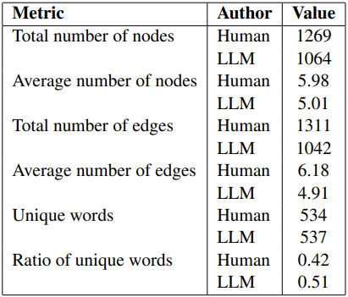
AMR Comparisons
Human-generated AMRs tend to be more complex with a higher number of nodes and edges.
LLMs use a slightly larger vocabulary but with a higher unique word ratio, indicating a more varied selection of words.
LLM-generated AMRs exhibit slightly lower structural complexity but higher lexical complexity.
Human responses show a structured, logical breakdown of ideas, while LLM responses emphasize varied word choices and rich descriptions.

Slide 12
Lexical Complexity
Lexical complexity measured using an XGBoost model.
Human AMR Complexity: 0.224
LLM AMR Complexity: 0.234
LLMs exhibit slightly higher lexical complexity.

Slide 13
05
Conclusion

Slide 14
Future Work
Exploring additional LLMs to compare AMR structures.
Expanding human sample size for better benchmarks.
Investigating multilingual and domain-specific AMRs.

Slide 15
Conclusion
LLMs create richer, more descriptive responses.
Human responses prioritize clarity and conciseness.
AMR analysis provides insights into semantic representation differences.
Findings contribute to improving LLM training and evaluation.

Slide 16

Thank you!
Questions?

