Slide 1
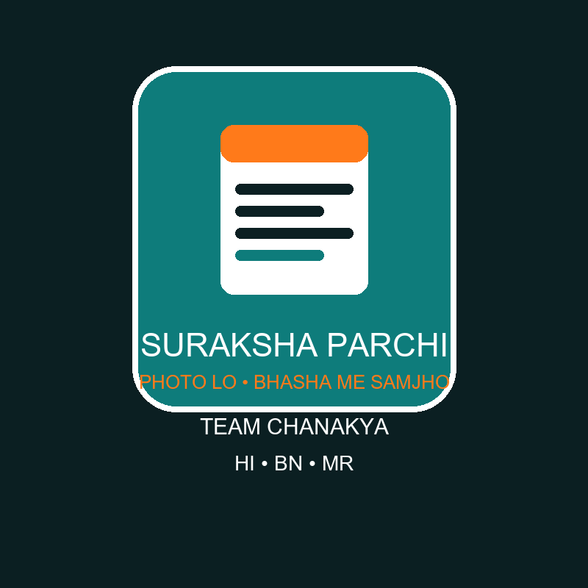
BHARAT INNOVATION CHALLENGE 2.0 • HEALTHCARE & HEALTHTECH
Suraksha Parchi
Clear Parchi, Safe Patient
• Team CHANAKYA — Ayush Pandey (Leader) • Kaushal Rawat (CMO) • +2 joining
• Mentor: [To Fill] • ayush4ru@gmail.com • Hindi • Bengali • Marathi
• Photo lo, Bhasha me samjho — a working app, not a concept
Team CHANAKYA • Suraksha Parchi — Clear Parchi, Safe Patient • ayush4ru@gmail.com
Notes:
Open with the hand-raise question. One line on who we are, then the tagline. Keep it warm, not robotic.

Slide 2
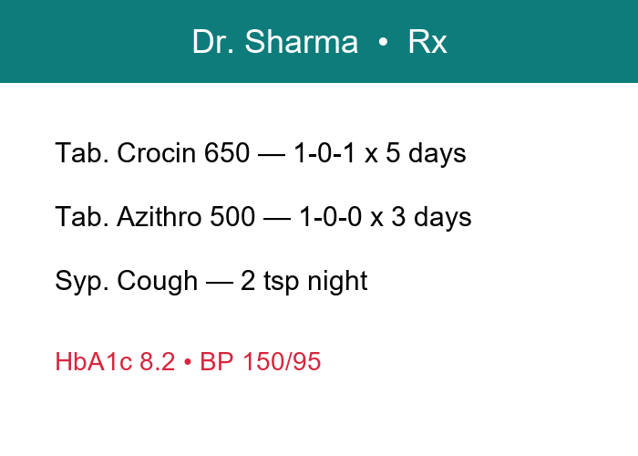
2 PROBLEM & OPPORTUNITY
Nobody can read the parchi
• 60%+ prescriptions still handwritten in English — elders and migrants just guess
• Half of all patients take the wrong dose; 1L+ deaths a year from medication errors
• Half-finished antibiotics are fuelling drug resistance across India
• 10L+ ASHA workers carry village healthcare — with zero tools for this
A real parchi: Crocin + Azithro + HbA1c 8.2 — to most families, just scribble.
Team CHANAKYA • Suraksha Parchi — Clear Parchi, Safe Patient • ayush4ru@gmail.com
Notes:
Tell dadi's story first, then the numbers. Jury remembers stories, slides prove them.

Slide 3
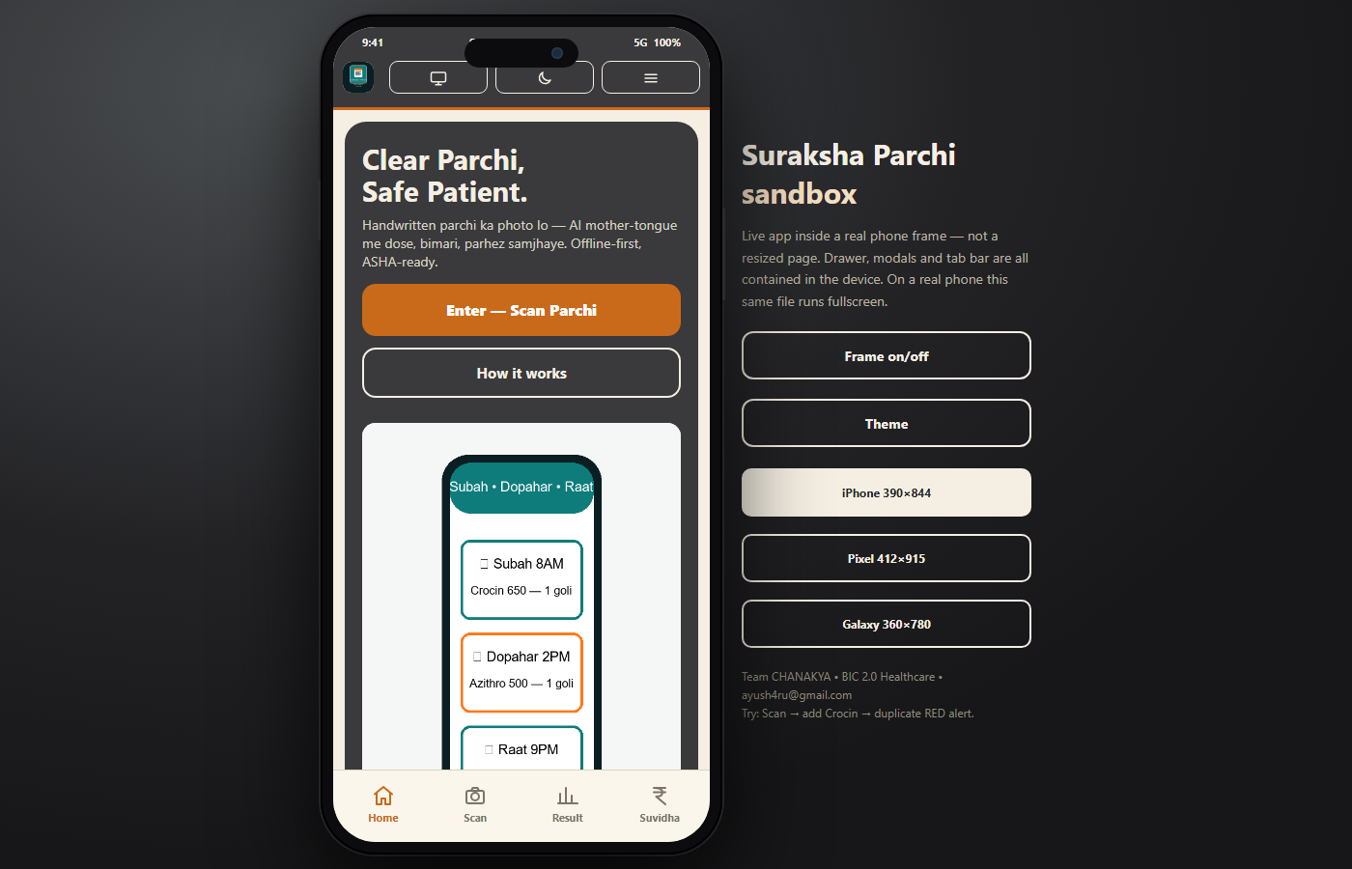
3 EXISTING SOLUTIONS & GAP ANALYSIS
Apps exist. Not for Bharat.
• City health apps need English + internet — and ignore handwriting completely
• Basic scanners read print, fail on cursive; our test: barely half the drugs right
• Symptom chatbots guess doses and hallucinate — dangerous with medicines
• Nobody combines: messy-handwriting read + mother-tongue voice + pictograms + duplicate alerts + ASHA offline mode
Our answer runs as a real phone app — full-screen on mobile, sandbox on desktop.
Team CHANAKYA • Suraksha Parchi — Clear Parchi, Safe Patient • ayush4ru@gmail.com
Notes:
Be fair to competitors, then land the punch: nobody does all five things we do.

Slide 4
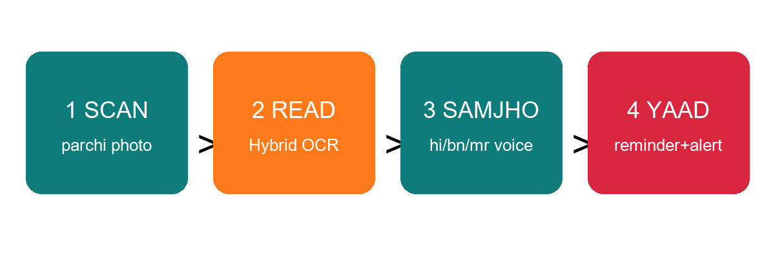
4 PROPOSED SOLUTION
Photo lo → samjho → yaad rakho
• Scan the parchi → hybrid AI reads it → explains disease + dose by voice → timetable reminds, red flags warn
Team CHANAKYA • Suraksha Parchi — Clear Parchi, Safe Patient • ayush4ru@gmail.com
Notes:
Walk the four steps slowly. This is the slide the jury photographs.

Slide 5
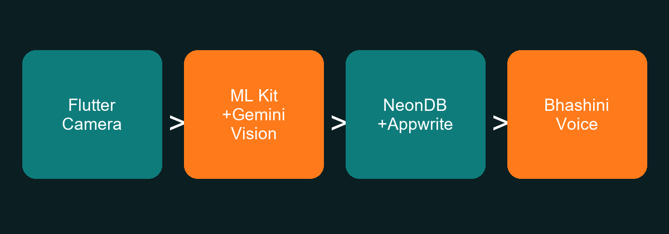
5 TECHNOLOGY & INNOVATION
14MB of AI that lives in the phone
• Needle-2 (45M params, 13.74MB) — downloaded, wired and tested on our medicine tools
• Hybrid read: instant on-device scan, smart cloud pass only when handwriting is messy
• Grounded answers: 49-medicine verified DB + 12 interaction rules — the AI can never invent a dose
• Voice in Hindi, Bengali, Marathi (Bhashini + offline fallback); works with zero internet
Team CHANAKYA • Suraksha Parchi — Clear Parchi, Safe Patient • ayush4ru@gmail.com
Notes:
Lead with Needle-2 numbers — downloaded and tested, not claimed. Offline-first is the differentiator.

Slide 6
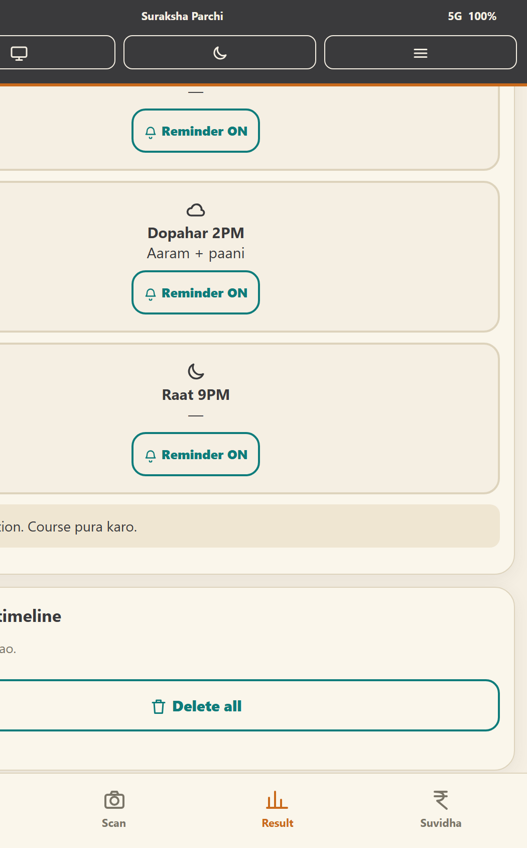
6 PROTOTYPE / LIVE DEMONSTRATION
Working app — try to break it
• Real flow: sample parchi → 87% read → Hindi voice + pictogram timetable
• Crowd moment: add Dolo beside Crocin — RED duplicate-overdose alert fires
• Suvidha tab: Jan Aushadhi prices, Ayushman packages, one-tap helplines
• Backup: 5-minute narrated Hinglish demo video (demo_video_app.mp4)
Team CHANAKYA • Suraksha Parchi — Clear Parchi, Safe Patient • ayush4ru@gmail.com
Notes:
Demo live here: scan the sample, fire the duplicate alert. If WiFi dies, play the narrated video.

Slide 7
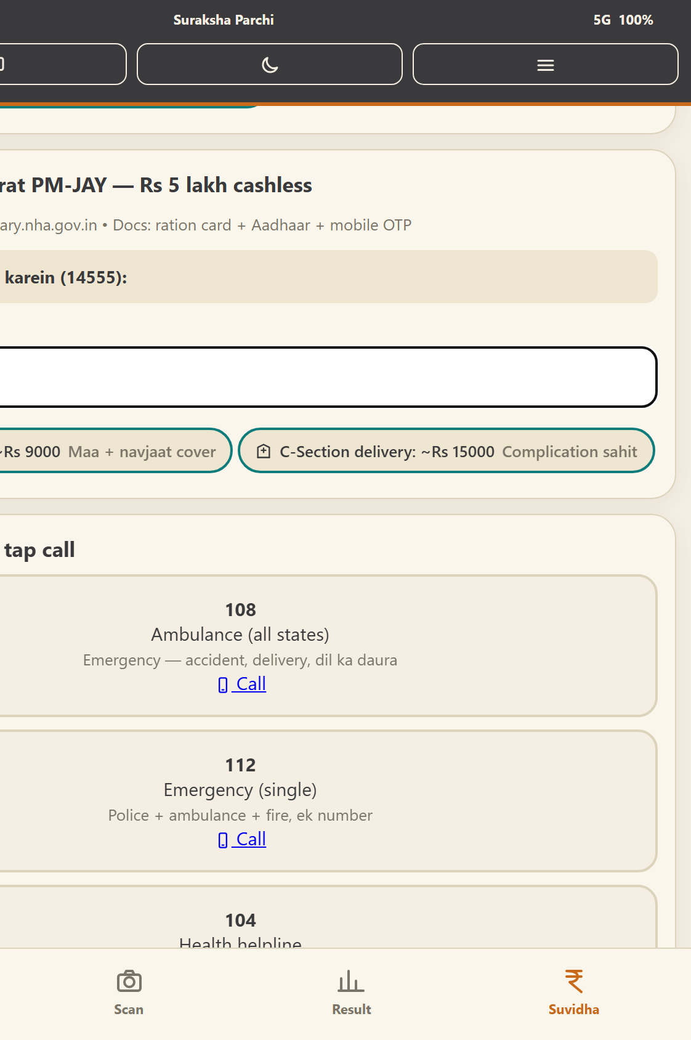
7 TARGET USERS & USE CASES
Built for dadi. Ready for 100Cr.
• Elders and low-literate families — voice + pictures, zero English needed
• Migrants — Bengali and Marathi out of the box, more languages plug in
• 10L+ ASHA workers — doorstep scans, referral slips, adherence ticks
• Jan Aushadhi counters — scan once, print the timetable in 3 languages
Team CHANAKYA • Suraksha Parchi — Clear Parchi, Safe Patient • ayush4ru@gmail.com
Notes:
Name the humans: dadi, the migrant worker, the ASHA didi. Then the scale path.

Slide 8
8 IMPACT & OUTCOMES
Fewer wrong doses, finished courses
• Adherence +40% via voice + reminders — measured per family in the pilot
• Antibiotic course completion +35% — a direct hit on AMR
• Duplicate and overdose alerts catch emergencies before they happen
• Sugar/BP cross-checks catch uncontrolled cases weeks earlier — SDG-3
Pilot: 500 families via 1 health centre. KPIs: scans, adherence %, alerts, referrals.
Team CHANAKYA • Suraksha Parchi — Clear Parchi, Safe Patient • ayush4ru@gmail.com
Notes:
Every claim ties to something the Neon dashboard will actually measure in the pilot.

Slide 9
9 BUSINESS MODEL & IMPLEMENTATION
Free for families. Paid by systems.
• Families: free 10 scans a month, Rs 99 a year for unlimited + Sehat File history
• Pharmacy kiosks at Rs 500 a month — scan, explain, print the timetable
• Health centres and blocks via NHM/CSR pilots — ASHA dashboards included
• Phase 2: Rs 299 beeper pill-box + BP-link hardware, funded by kiosk revenue
Team CHANAKYA • Suraksha Parchi — Clear Parchi, Safe Patient • ayush4ru@gmail.com
Notes:
Free for families forever — systems pay. Investors like that sentence.

Slide 10
10 FEASIBILITY & SCALABILITY
Built in weeks. Scales to Bharat.
• App + verified DBs + tested AI engine — a school team built this in weeks, under Rs 2,000
• New language = one voice + one data column; Postgres scales to lakhs of families
• Messy writing fails → human confirm button; risky drugs → referral only, never a guess
• No internet → cached scans + offline voice; the expo-hall failure mode is designed out
Team CHANAKYA • Suraksha Parchi — Clear Parchi, Safe Patient • ayush4ru@gmail.com
Notes:
School team, real stack, honest risks with fixes. That honesty scores.

Slide 11
11 COMPETITIVE ADVANTAGE
A guardian, not another chatbot
Feature | Suraksha Parchi | Health chatbot | Scanner app
Handwriting + mother-tongue voice | YES, cited + pictograms | NO | Text only
Duplicate + lab cross-check | YES, with red flags | NO | NO
Offline + ASHA workflow | YES, cached + referral | NO | NO
Moat: 500 real Indian parchi scans (consented) + ASHA workflow + offline-first. Dataset + guardrailed prompts = IP.
Team CHANAKYA • Suraksha Parchi — Clear Parchi, Safe Patient • ayush4ru@gmail.com
Notes:
Read the table row by row. End on the dataset moat — 500 real parchis nobody else has.

Slide 12
12 TEAM & VISION
CHANAKYA — Niti se Nirman tak
• Ayush Pandey — Leader: product, app + AI engine, database design
• Kaushal Rawat — CMO: field testing, ASHA interviews, Bengali/Marathi content
• +2 teammates joining: designer + tester • Mentor: [To Fill]
• Ask: one health centre, 500 families, 4 weeks — then scale with you
• ayush4ru@gmail.com • github.com/Sentinal-Corporations/suraksha-sharthi
Team CHANAKYA • Suraksha Parchi — Clear Parchi, Safe Patient • ayush4ru@gmail.com
Notes:
Close warm: names, the ask (a pilot health centre), thank you in three languages.

