Slide 1
Interim Report
Level 4
Dynamic Scenario Generation and Evaluation for VR-Based Military Training
By Team Sentinels
Group Members
Supervisor
214036J Chathuranga S.P.Y.N 214057A Dilshan R.P 214217P Wadumulla G.M.D 214237C Wijesinghe W.N.U
Dr. S.C. Premaratne
Faculty of Information Technology, University of Moratuwa 2026

Slide 2
Overview
Introduction & Background
Research Problem
Aim & Objectives
Proposed Solution
Our Approach — System Architecture
Module 1 — Dynamic Scenario Generation
Module 2 — NPC Behaviour and Coordination
Module 3 — Cognitive Behaviour Analysis
Module 4 — Logging, AAR and Session Replay
Limitations & Future Work
References
Comprehensive Group Project | IN4910

Slide 3
Introduction
Military tactical training (hostage rescue) demands decisions under time pressure, uncertainty and strict safety constraints.
Live exercises are expensive, logistically demanding and hard to repeat under varied conditions.
VR offers a controlled, repeatable alternative — trainees practise mission flow safely while the system captures objective evidence.
Existing VR prototypes suffer from fixed scenarios, repetitive NPC behaviour and shallow post-mission feedback.
This project integrates four cooperating modules into one Unity-based VR training prototype for the Meta Quest 3 platform.
Comprehensive Group Project | IN4910

Slide 4
Background and Motivation
VR training effectiveness depends on meaningful scenario structure, measurable trainee response and informative review mechanisms [Xie et al., 2021].
Most prototypes use fixed or lightly randomised missions — reducing replayability and training value.
Research stresses parameter-driven generation while preserving mission coherence [Luo et al., 2013; Sottilare et al., 2024].
Gap between live runtime NPC behaviour and post-mission review remains largely unaddressed.
Structured AAR with synchronized replay significantly enhances learning efficacy [Kleygrewe et al., 2024].
Comprehensive Group Project | IN4910

Slide 5
Research Problem
Current VR tactical-training prototypes suffer from three simultaneous weaknesses:
1. Scenarios are fixed or only lightly varied.
2. Runtime NPC behaviour is repetitive and lacks coordination.
3. Post-mission review is limited to a final score or short summary.
Result: trainees experience monotonous missions, evaluators receive insufficient evidence, and the training value of repeated sessions degrades quickly.
Comprehensive Group Project | IN4910

Slide 6
Aim & Objectives
Aim: Develop a VR training prototype for dynamic hostage-terrorist scenario generation and evaluation on Meta Quest 3.
Objectives:
• Study VR tactical-training domain and evaluation measures.
• Implement parameter-driven scenario generation with validation.
• Implement event-driven NPC behaviour with coordination.
• Implement cognitive behaviour analysis from runtime evidence.
• Implement structured logging, AAR and synchronized replay.
• Evaluate through module tests, integration tests and user trials.
Comprehensive Group Project | IN4910

Slide 7
Proposed Solution
Unity 2022.3 LTS VR prototype for Meta Quest 3, organised into four cooperating modules:
Module 1 — Dynamic Scenario Generation: evaluator parameters → validated Scenario.json
Module 2 — NPC Behaviour & Coordination: event-driven FSM for terrorists & hostages
Module 3 — Cognitive Behaviour Analysis: reaction time + movement → cognitive indicators
Module 4 — Logging, AAR & Replay: telemetry → score summary + timeline + replay
Shared contract: Scenario.json + common event schema → modules developed & tested in parallel.
Comprehensive Group Project | IN4910

Slide 8
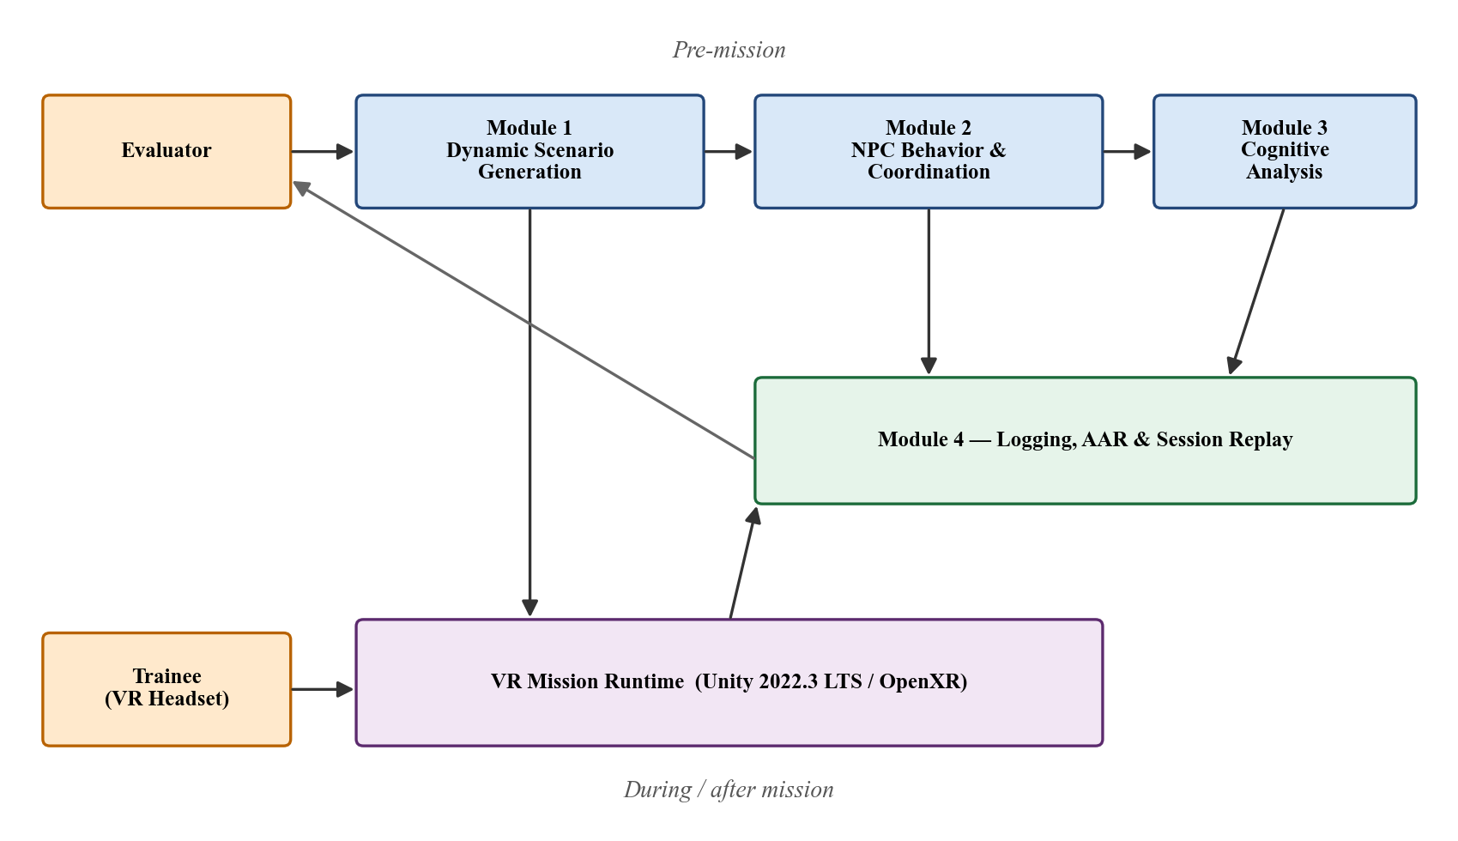
System Architecture
Four modules on top of a Unity VR runtime:
• Module 1 produces Scenario.json before mission.
• Module 2 drives NPC behaviour during mission.
• Module 3 observes trainee in parallel.
• Module 4 transforms session into AAR + replay.
Comprehensive Group Project | IN4910

Slide 9
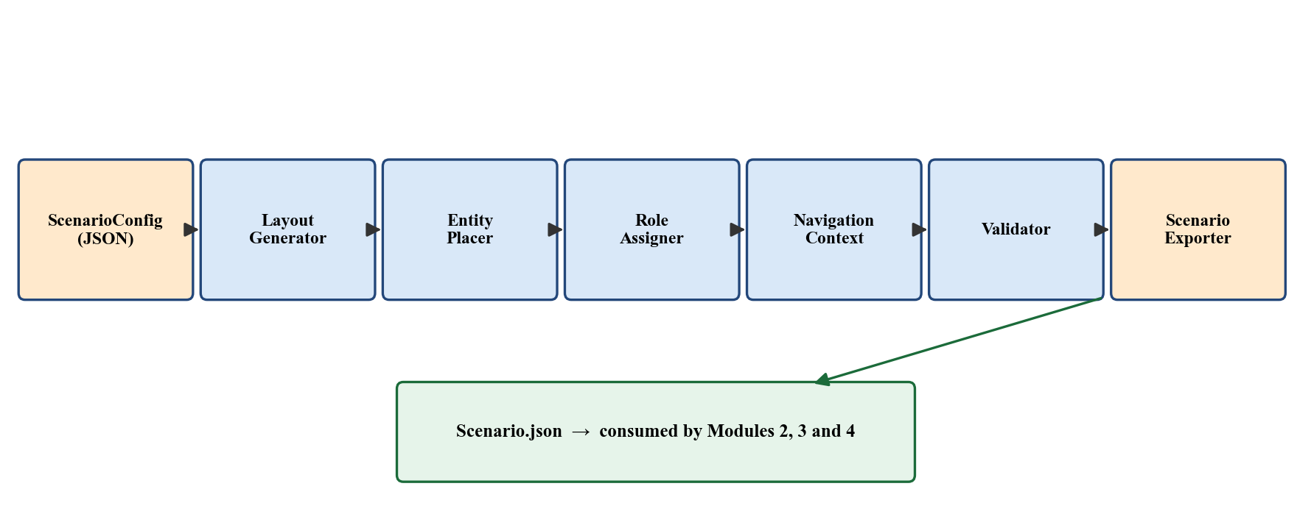
Module 1 — Dynamic Scenario Generation
Converts evaluator-defined parameters into a structured, valid Scenario.json.
Key design properties:
• Determinism — same config + seed = identical scenario every time.
• Traceability — every generated value traces to a config parameter.
• Modular composition — each pipeline stage is a small, testable C# class.
Pipeline: ScenarioConfig → LayoutGenerator → EntityPlacer → RoleAssigner →
NavigationContextBuilder → ScenarioValidator → ScenarioExporter
Comprehensive Group Project | IN4910

Slide 10
Module 1 — Implementation Status
All 8 Stages Complete
Key Integration Points
Stage 1: Data Models & IO — Complete
Stage 2: LayoutGenerator — Complete
Stage 3: EntityPlacer — Complete
Stage 4: RoleAssigner + NavContext — Complete
Stage 5: Orchestrator + Validator + 21 tests — Complete
Stage 6: SceneBuilder (NavMesh bake, NPC spawn) — Complete
Stage 7: EvaluatorConfigPanel (TMP Canvas) — Complete
Stage 8: Editor Tools (menu commands) — Complete
Validation: seed+1 retry on failure, fixed budget.
SceneBuilder maps NpcRole → IdleMode:
Patrol → Patrol (PatrolLine waypoints)
RoamingGuard → Wander (wanderRadius)
StationaryGuard → Static (facingDirection)
HostageGuardian → Static (near hostage)
Hand-off: EventManager.NotifyScenarioReady()
Comprehensive Group Project | IN4910

Slide 11
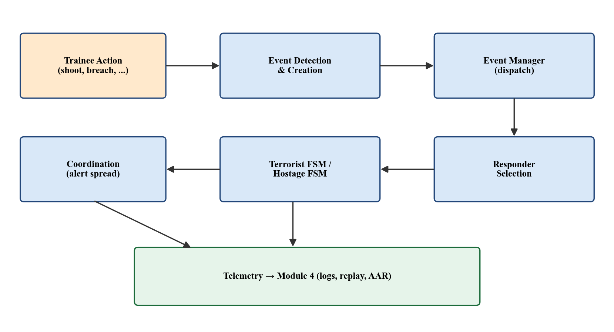
Module 2 — NPC Behaviour and Coordination
Live runtime behaviour engine: turns trainee actions into believable NPC responses.
Core design: event-driven rather than raw input-driven.
• Actions → structured events (ShotFired, GunshotHeard, DoorOpened, PlayerSeen, ...)
• Events routed through central EventManager
• Context-aware responder selection (distance, role, state, perception)
Terrorist FSM: Idle → Suspicious → Alert → Engage
Hostage FSM: Calm → Fearful → Panic → Freeze → Follow
Coordination: alert propagation, leader-issued reaction bias
Comprehensive Group Project | IN4910

Slide 12
Module 2 — Implementation Status
Stage Status
Key Achievements
Stage 1: Runtime data types — Complete
Stage 2: EventManager dispatch — Complete
Stage 3: Terrorist FSM — In progress
Stage 4: Hostage FSM — In progress
Stage 5: Responder-selection scoring — In progress
Stage 6: Coordination logic — Prototype
Stage 7: Telemetry stream to Module 4 — Prototype
Stage 8: Integration testing — Pending
Event types defined in shared JSON schema.
NotifyScenarioReady() wired from Module 1.
Alert propagation prototype: GunshotHeard
escalates nearby terrorists.
IdleMode mapping from Module 1 NpcRole verified.
Next: formalise FSM transitions, complete
responder-selection scoring.
Comprehensive Group Project | IN4910

Slide 13
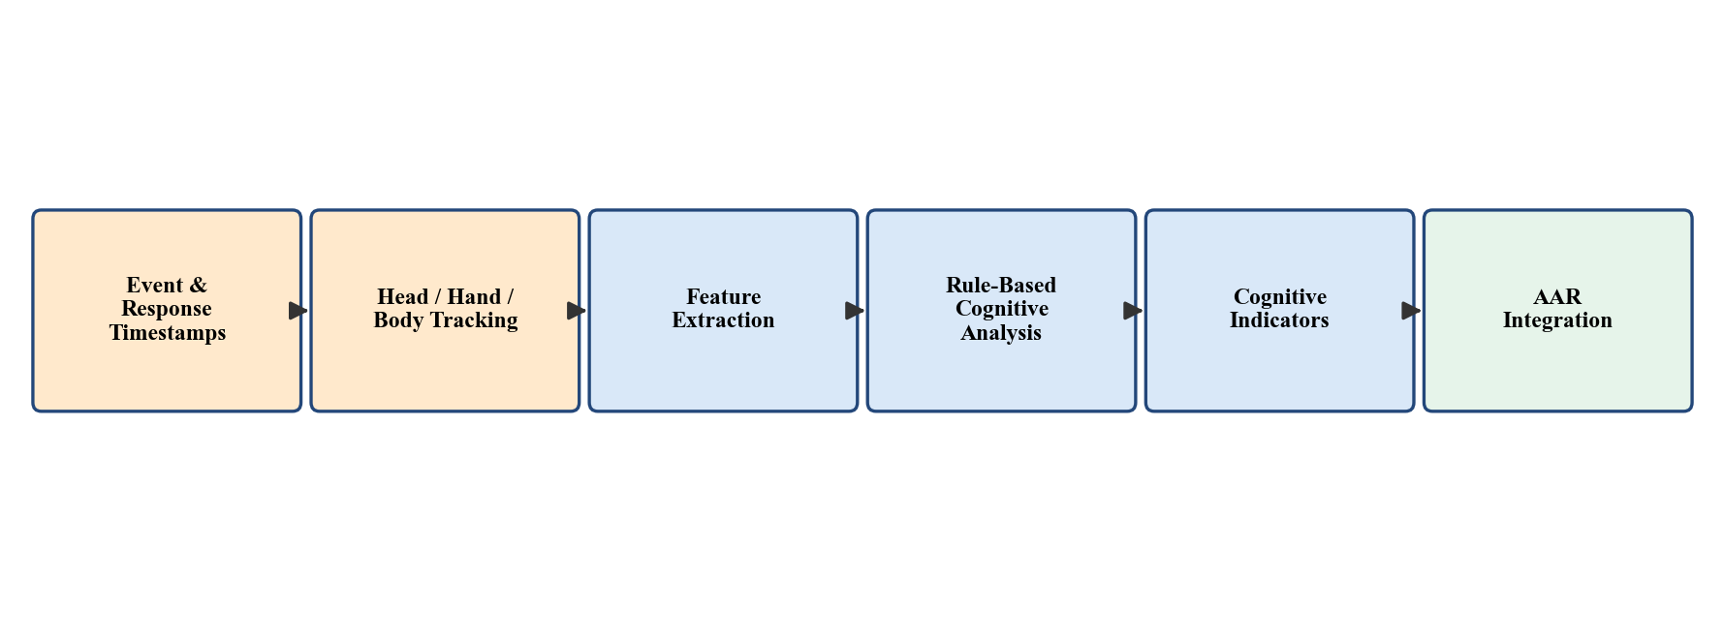
Module 3 — Cognitive Behaviour Analysis
Observes the trainee (does not drive NPC behaviour).
Pipeline:
1. Capture event & response timestamps + head/hand/body transforms
2. Extract features: reaction time, movement initiation, stability, attention
3. Rule-based cognitive analysis → cognitive indicators (load, stress, attention)
4. Present alongside mission telemetry in AAR
Subjective workload: SIM-TLX questionnaire post-mission
(mental demand, frustration, stress, distraction, presence, ...)
Comprehensive Group Project | IN4910

Slide 14
Module 3 — Implementation Status
Stage Status
Key Achievements
Stage 1: VR capture path (OpenXR) — Complete
Stage 2: Timestamp logging schema — Complete
Stage 3: Reaction-time features — In progress
Stage 4: Movement features — In progress
Stage 5: SIM-TLX questionnaire — Drafted
Stage 6: Rule-based cognitive analysis — In progress
Stage 7: Cognitive output schema — Drafted
Stage 8: Pilot data collection — Pending
Capture pipeline subscribes to Module 2
EventManager for event–response pairing.
Feature functions implemented as pure C#
(can run in-engine or off-engine).
SIM-TLX covers 10 dimensions integrated
into post-mission flow.
Next: pilot data from internal play-throughs.
Comprehensive Group Project | IN4910

Slide 15
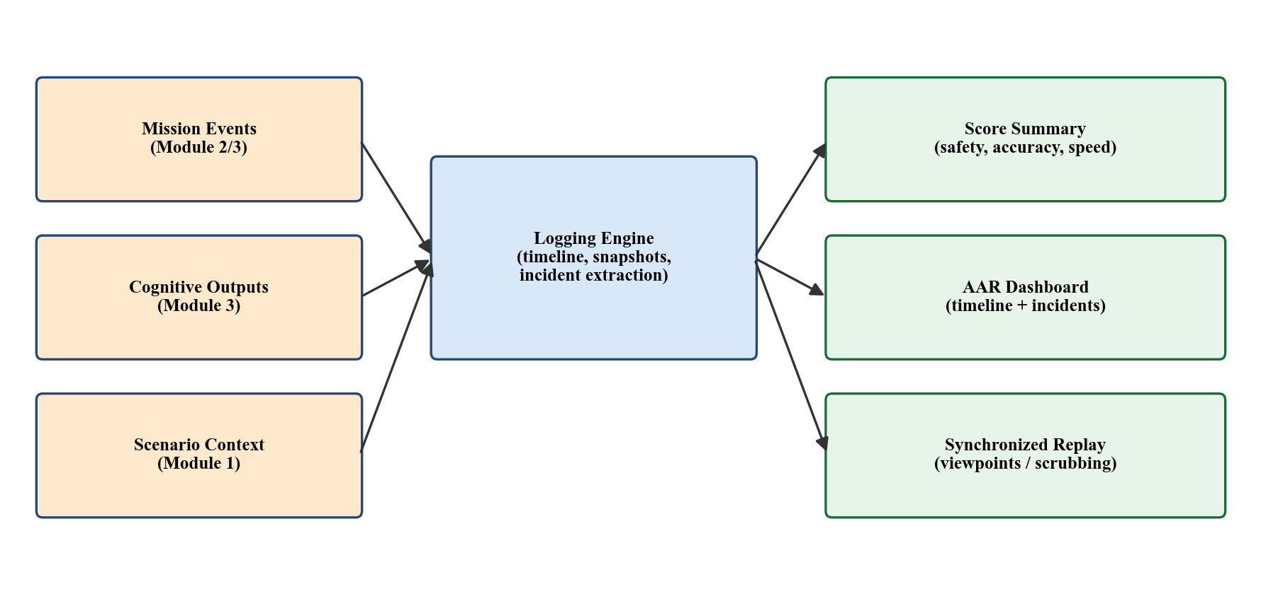
Module 4 — Logging, AAR and Session Replay
Transforms completed mission into structured, inspectable evidence.
Scoped to evidence-based review — no automated tactical recommendations.
Components:
• Session Logging Engine — timestamped events, state snapshots
• Score Summary — safety, accuracy, speed, mission success
• AAR Dashboard — summary cards, key incidents, event timeline
• Synchronized Replay — stored transforms, viewpoint switching, pause/scrub
• Hostage Perspective Panel — state timeline, distress scoring
Comprehensive Group Project | IN4910

Slide 16
Module 4 — Implementation Status
Stage Status
Key Achievements
Stage 1: Data schema — Complete
Stage 2: Logging engine — In progress
Stage 3: Score computation — Complete (v1)
Stage 4: Event timeline + incidents — In progress
Stage 5: AAR dashboard UI — Prototype
Stage 6: Synchronized replay — Pending
Stage 7: Hostage perspective panel — Drafted
Stage 8: Video export + integration — Pending
SessionLogger with ContextMenu-driven
SimulateTestSession for editor testing.
Shared schema: ScenarioEvent, NPCStateChange,
ResponderDecision, BehaviorSnapshot,
SessionSummary.
Replay built on transforms + state snapshots
(not rendered video) → viewpoint switching.
Next: AAR dashboard, replay controls.
Comprehensive Group Project | IN4910

Slide 17
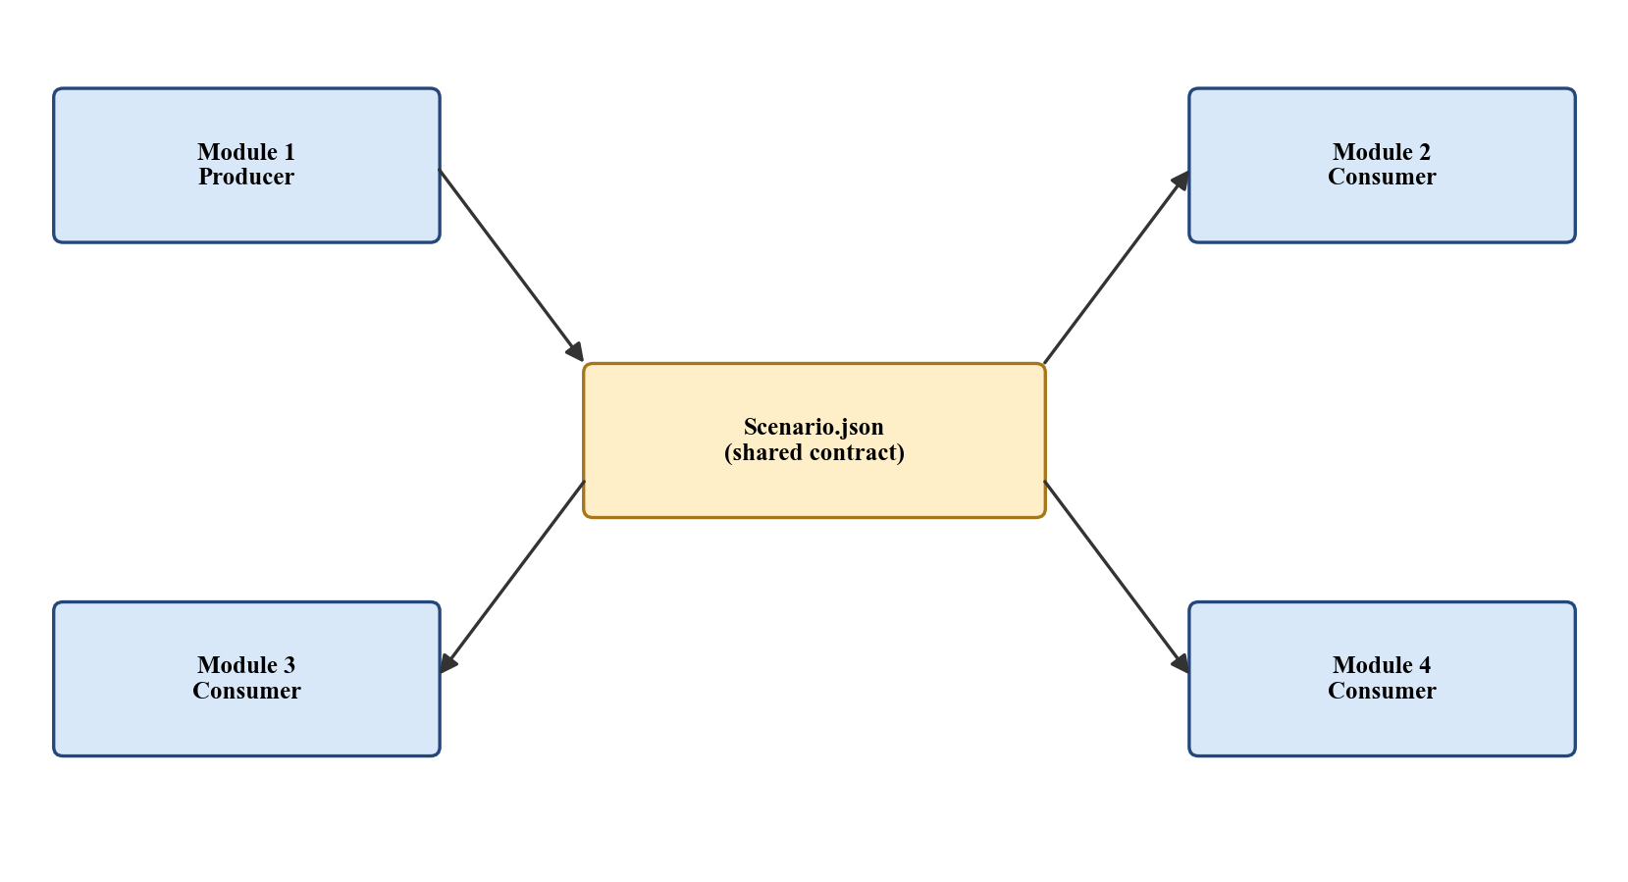
Inter-Module Integration
Centred on Scenario.json — produced by Module 1, consumed by Modules 2, 3 and 4.
Runtime events exchanged through EventManager — observed by Modules 3 and 4.
Post-session artefacts: SessionSummary.json, EventTimeline.json, ReplayData.json
Each module independently testable:
• Module 1: 21 automated generation tests
• Module 2: scripted event sequences → expected NPC states
• Module 3: features verified against pilot recordings
• Module 4: replay synchronisation against recorded sessions
Comprehensive Group Project | IN4910

Slide 18
Limitations
Single floor only — multi-floor layout generation reserved for future work.
hostageCount is always 1 — no multi-hostage logic at this stage.
Consumer-grade headset (Quest 3) — approximate body tracking only.
Small participant pool for cognitive validation (15–30 planned).
No automated tactical recommendations — deliberate scope decision to avoid domain-dependent expert judgment.
Greybox environments only (ProBuilder) — not production-quality assets.
Comprehensive Group Project | IN4910

Slide 19
Future Work
Complete implementation of Modules 2, 3 and 4 to the level of Module 1.
Extend layout generator to multi-floor environments.
Introduce richer NPC coordination patterns and behaviour variety.
Run SIM-TLX-based user study (15–30 participants, low vs. high difficulty).
Expand AAR with comparative views across multiple sessions.
Larger-scale evaluation with trained personnel to assess training transfer.
Comprehensive Group Project | IN4910

Slide 20
References
[1] Xie, B. et al., "A Review on Virtual Reality Skill Training Applications," Frontiers in VR, 2021.
[2] Boyce, M. W. et al., "Enhancing Military Training Using XR," Frontiers in VR, 2022.
[3] Luo, L. et al., "Mission-Based Scenario Modeling and Generation," AIIDE-13, 2013.
[4] Sottilare, R. A. et al., "Using Genetic Algorithms for Scenario Generation," FLAIRS, 2024.
[5] Kleygrewe, L. et al., "AAR in VR Training for Police," Ergonomics, 2024.
[6] Shaker, N. et al., Procedural Content Generation in Games, Springer, 2016.
[7] Cook, M., "Procedural Generation and Information Games," IEEE CoG, 2020.
Comprehensive Group Project | IN4910

Slide 21
Thank You
Comprehensive Group Project | IN4910

