Slide 1
Interim Report
Level 4
Dynamic Scenario Generation and Evaluation for VR-Based Military Training
By Team Sentinels
Group Members
Supervisor
214036J Chathuranga S.P.Y.N 214057A Dilshan R.P 214217P Wadumulla G.M.D 214237C Wijesinghe W.N.U
Dr. S.C. Premaratne
Faculty of Information Technology, University of Moratuwa 2026

Slide 2
Overview
Introduction & Background
Research Problem
Aim & Objectives
Proposed Solution
Our Approach — System Architecture
Module 1 — Dynamic Scenario Generation
Module 2 — NPC Behaviour and Coordination
Module 3 — Cognitive Behaviour Analysis
Module 4 — Logging, AAR and Session Replay
Limitations & Future Work
References
Comprehensive Group Project | IN4910

Slide 3
Introduction
Military tactical training (hostage rescue) demands decisions under time pressure, uncertainty and strict safety constraints.
Live exercises are expensive, logistically demanding and hard to repeat under varied conditions.
VR offers a controlled, repeatable alternative — trainees practise mission flow safely while the system captures objective evidence.
Existing VR prototypes suffer from fixed scenarios, repetitive NPC behaviour and shallow post-mission feedback.
This project integrates four cooperating modules into one Unity-based VR training prototype for the Meta Quest 3 platform.
Comprehensive Group Project | IN4910

Slide 4
Background and Motivation
VR training effectiveness depends on meaningful scenario structure, measurable trainee response and informative review mechanisms [Xie et al., 2021].
Most prototypes use fixed or lightly randomised missions — reducing replayability and training value.
Research stresses parameter-driven generation while preserving mission coherence [Luo et al., 2013; Sottilare et al., 2024].
Gap between live runtime NPC behaviour and post-mission review remains largely unaddressed.
Structured AAR with synchronized replay significantly enhances learning efficacy [Kleygrewe et al., 2024].
Comprehensive Group Project | IN4910

Slide 5
Research Problem
Current VR tactical-training prototypes suffer from three simultaneous weaknesses:
1. Scenarios are fixed or only lightly varied.
2. Runtime NPC behaviour is repetitive and lacks coordination.
3. Post-mission review is limited to a final score or short summary.
Result: trainees experience monotonous missions, evaluators receive insufficient evidence, and the training value of repeated sessions degrades quickly.
Comprehensive Group Project | IN4910

Slide 6
Aim & Objectives
Aim: Develop a VR training prototype for dynamic hostage-terrorist scenario generation and evaluation on Meta Quest 3.
Objectives:
• Study VR tactical-training domain and evaluation measures.
• Implement parameter-driven scenario generation with validation.
• Implement event-driven NPC behaviour with coordination.
• Implement cognitive behaviour analysis from runtime evidence.
• Implement structured logging, AAR and synchronized replay.
• Evaluate through module tests, integration tests and user trials.
Comprehensive Group Project | IN4910

Slide 7
Proposed Solution
Unity 2022.3 LTS VR prototype for Meta Quest 3, organised into four cooperating modules:
Module 1 — Dynamic Scenario Generation: evaluator parameters → validated Scenario.json
Module 2 — NPC Behaviour & Coordination: event-driven FSM for terrorists & hostages
Module 3 — Cognitive Behaviour Analysis: reaction time + movement → cognitive indicators
Module 4 — Logging, AAR & Replay: telemetry → score summary + timeline + replay
Shared contract: Scenario.json + common event schema → modules developed & tested in parallel.
Comprehensive Group Project | IN4910

Slide 8
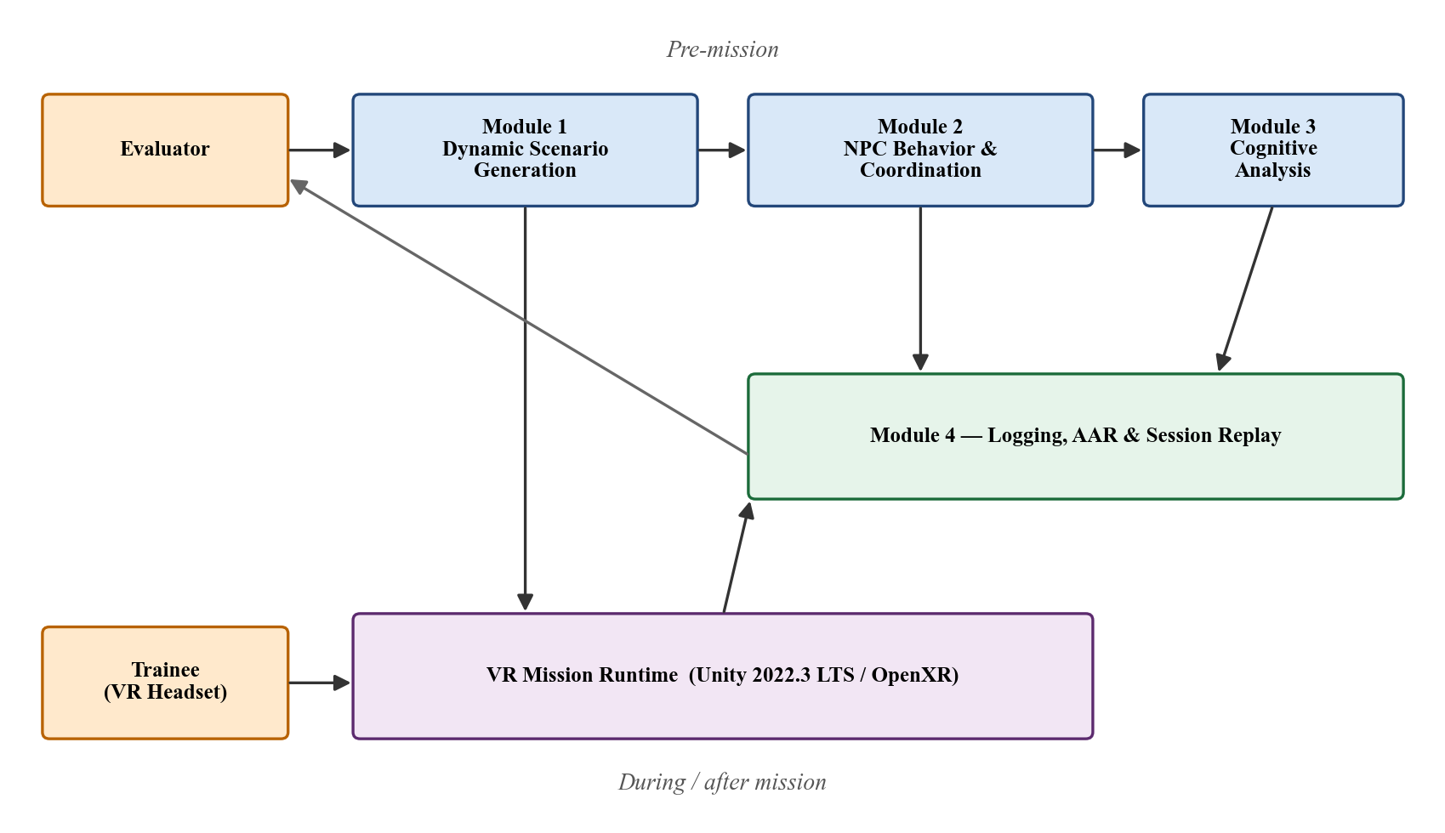
System Architecture
Four modules on top of a Unity VR runtime:
• Module 1 produces Scenario.json before mission.
• Module 2 drives NPC behaviour during mission.
• Module 3 observes trainee in parallel.
• Module 4 transforms session into AAR + replay.
Comprehensive Group Project | IN4910

Slide 9
Module 1 - Dynamic Scenario Generation
1. Input — Evaluator-defined ScenarioConfig.json containing room count,
layout type, entity counts, placement strategy, difficulty and seed.
2. Process —
a) Layout Generation: rooms, doors and entry points from layout type.
b) Entity Placement: trainee, hostages and terrorists by strategy.
c) Role Assignment: Patrol, RoamingGuard, StationaryGuard, HostageGuardian.
d) Navigation Context: waypoints, roam centres, facing directions.
e) Validation: reachability, overlap and constraint checks (seed+1 retry).
3. Output — Validated Scenario.json containing layout, placements, roles
and navigation context, consumed by Modules 2, 3 and 4.
Comprehensive Group Project | IN4910

Slide 10
Module 1 - Dynamic Scenario Generation
Completed so far:
As future work, should complete:
Data Models and IO (Stage 1).
LayoutGenerator — rooms, doors, entries (Stage 2).
EntityPlacer — placement strategies (Stage 3).
RoleAssigner + NavigationContextBuilder (Stage 4).
ScenarioGenerator orchestrator + Validator + 21 tests (Stage 5).
SceneBuilder — NavMesh bake, NPC spawn (Stage 6).
EvaluatorConfigPanel — TMP Canvas UI (Stage 7).
Editor Tools — menu commands (Stage 8).
Multi-floor layout generation.
Additional layout types beyond linear/branching.
More diverse room-size distributions.
Extended evaluator configuration fields.
Integration testing with all four modules.
Comprehensive Group Project | IN4910

Slide 11
Module 2 - NPC Behaviour and Coordination
1. Input — Scenario.json (roles, spawn positions, navigation context)
+ runtime trainee actions (shoot, breach, interact).
2. Process —
a) Event Detection: trainee actions → structured events
(ShotFired, GunshotHeard, DoorOpened, PlayerSeen, ...).
b) Event Dispatch: central EventManager routing and priority.
c) State Transitions: Terrorist FSM (Idle → Suspicious → Alert → Engage)
and Hostage FSM (Calm → Fearful → Panic → Freeze → Follow).
d) Responder Selection: scoring by distance, role, state, perception.
e) Coordination: alert propagation and leader-issued reaction bias.
3. Output — Updated NPC states + behaviour telemetry stream for Module 4.
Comprehensive Group Project | IN4910

Slide 12
Module 2 - NPC Behaviour and Coordination
Completed so far:
As future work, should complete:
Runtime data types (ScenarioEvent, NPCStateChange).
Central EventManager and dispatch path.
NotifyScenarioReady() hand-off from Module 1.
IdleMode mapping (NpcRole → TerroristController).
Alert propagation prototype (GunshotHeard).
Complete Terrorist FSM transition rules.
Complete Hostage FSM transition rules.
Implement responder-selection scoring.
Extend coordination logic (leader bias, support).
Telemetry stream stabilisation for Module 4.
Integration testing against Scenario.json fixtures.
Comprehensive Group Project | IN4910

Slide 13
Module 3 - Cognitive Behaviour Analysis
1. Input — Event timestamps + response timestamps + head / hand / body
transforms captured from the VR runtime (OpenXR).
2. Process —
a) Feature Extraction: reaction time, movement initiation, stability
and attention-related orientation patterns.
b) Rule-Based Cognitive Analysis: threshold-based scoring of extracted
features to estimate cognitive load, stress and attention.
c) SIM-TLX Integration: post-mission subjective workload questionnaire
(mental demand, frustration, stress, distraction, presence, ...).
3. Output — Cognitive indicators (load, stress, attention) presented alongside
mission telemetry in the Module 4 AAR dashboard.
Comprehensive Group Project | IN4910

Slide 14
Module 3 - Cognitive Behaviour Analysis
Completed so far:
As future work, should complete:
VR capture path (head, hand, body-proxy via OpenXR).
Event and response timestamp logging schema.
Reaction-time feature extraction functions.
Movement feature extraction (initiation, stability).
SIM-TLX questionnaire drafted (10 dimensions).
Complete rule-based cognitive scoring.
Finalise cognitive output schema for Module 4.
Collect pilot data from internal play-throughs.
Validate features against SIM-TLX ground truth.
Conduct user study (15–30 participants).
Comprehensive Group Project | IN4910

Slide 15
Module 4 - Logging, AAR and Session Replay
1. Input — Mission events (Module 2) + cognitive outputs (Module 3)
+ scenario context (Module 1).
2. Process —
a) Session Logging: timestamped events, state snapshots to JSON.
b) Score Computation: safety, accuracy, speed, mission success.
c) Incident Extraction: first sighting, first shot, hostage contact,
hostage injury, terrorist neutralised, mission end.
d) AAR Dashboard: summary cards, event timeline, drill-down panels.
e) Synchronized Replay: stored transforms, pause / scrub / viewpoint.
3. Output — SessionSummary.json, EventTimeline.json, ReplayData.json
and an interactive AAR dashboard for evaluator review.
Comprehensive Group Project | IN4910

Slide 16
Module 4 - Logging, AAR and Session Replay
Completed so far:
As future work, should complete:
Data schema (ScenarioEvent, NPCStateChange,
ResponderDecision, BehaviorSnapshot, SessionSummary).
Score-summary computation v1 (safety, accuracy,
speed, mission success).
SessionLogger with SimulateTestSession (ContextMenu).
Event timeline and incident extraction started.
Complete structured-JSON logging engine.
Build AAR dashboard UI (summary cards, timeline).
Implement synchronized replay (viewpoints, scrub).
Add hostage-perspective panel and distress scoring.
Optional player-perspective video export.
Integration testing with full mission sessions.
Comprehensive Group Project | IN4910

Slide 17
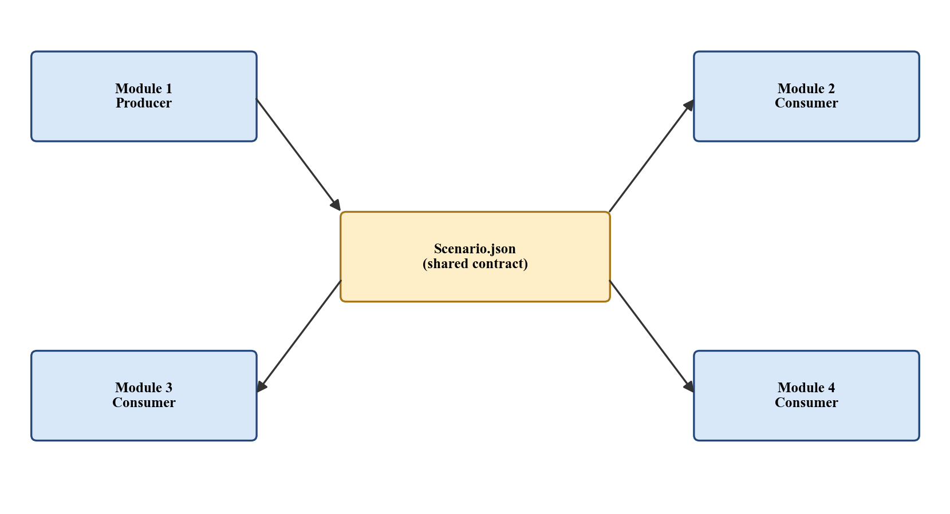
Inter-Module Integration
Centred on Scenario.json — produced by Module 1, consumed by Modules 2, 3 and 4.
Runtime events exchanged through EventManager — observed by Modules 3 and 4.
Post-session artefacts: SessionSummary.json, EventTimeline.json, ReplayData.json
Each module independently testable:
• Module 1: 21 automated generation tests
• Module 2: scripted event sequences → expected NPC states
• Module 3: features verified against pilot recordings
• Module 4: replay synchronisation against recorded sessions
Comprehensive Group Project | IN4910

Slide 18
Limitations
Single floor only — multi-floor layout generation reserved for future work.
hostageCount is always 1 — no multi-hostage logic at this stage.
Consumer-grade headset (Quest 3) — approximate body tracking only.
Small participant pool for cognitive validation (15–30 planned).
No automated tactical recommendations — deliberate scope decision to avoid domain-dependent expert judgment.
Greybox environments only (ProBuilder) — not production-quality assets.
Comprehensive Group Project | IN4910

Slide 19
Future Work
Complete implementation of Modules 2, 3 and 4 to the level of Module 1.
Extend layout generator to multi-floor environments.
Introduce richer NPC coordination patterns and behaviour variety.
Run SIM-TLX-based user study (15–30 participants, low vs. high difficulty).
Expand AAR with comparative views across multiple sessions.
Larger-scale evaluation with trained personnel to assess training transfer.
Comprehensive Group Project | IN4910

Slide 20
References
[1] Xie, B. et al., "A Review on Virtual Reality Skill Training Applications," Frontiers in VR, 2021.
[2] Boyce, M. W. et al., "Enhancing Military Training Using XR," Frontiers in VR, 2022.
[3] Luo, L. et al., "Mission-Based Scenario Modeling and Generation," AIIDE-13, 2013.
[4] Sottilare, R. A. et al., "Using Genetic Algorithms for Scenario Generation," FLAIRS, 2024.
[5] Kleygrewe, L. et al., "AAR in VR Training for Police," Ergonomics, 2024.
[6] Shaker, N. et al., Procedural Content Generation in Games, Springer, 2016.
[7] Cook, M., "Procedural Generation and Information Games," IEEE CoG, 2020.
Comprehensive Group Project | IN4910

Slide 21
Thank You
Comprehensive Group Project | IN4910

