Slide 1
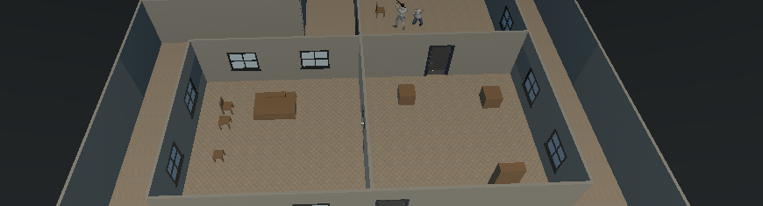

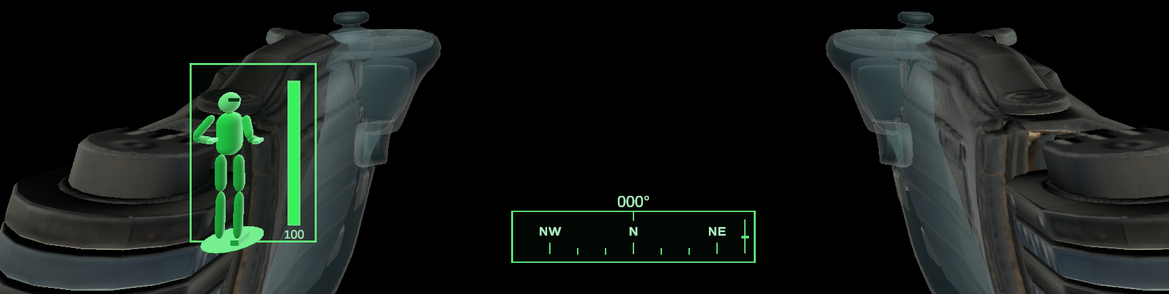
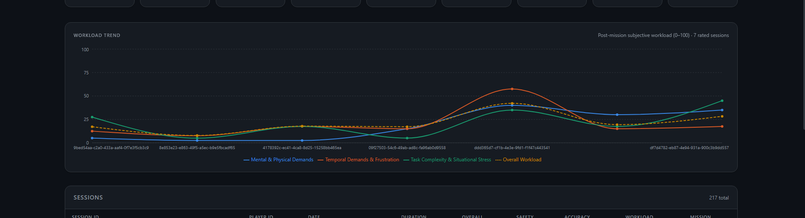
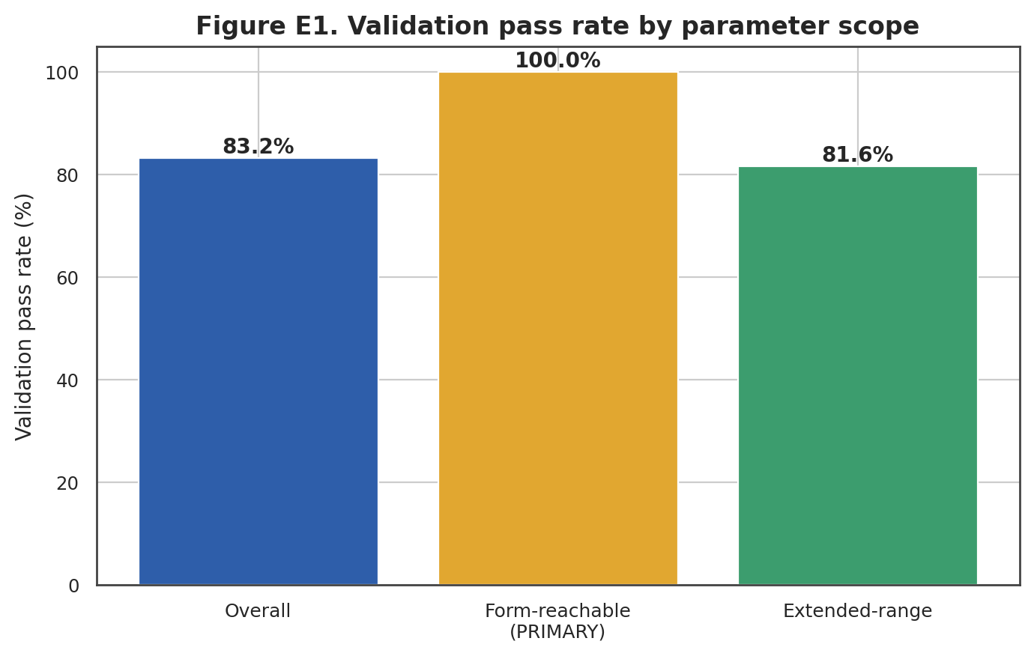
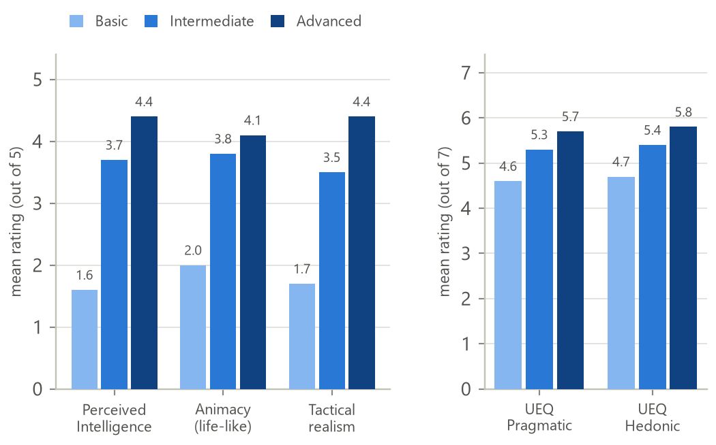
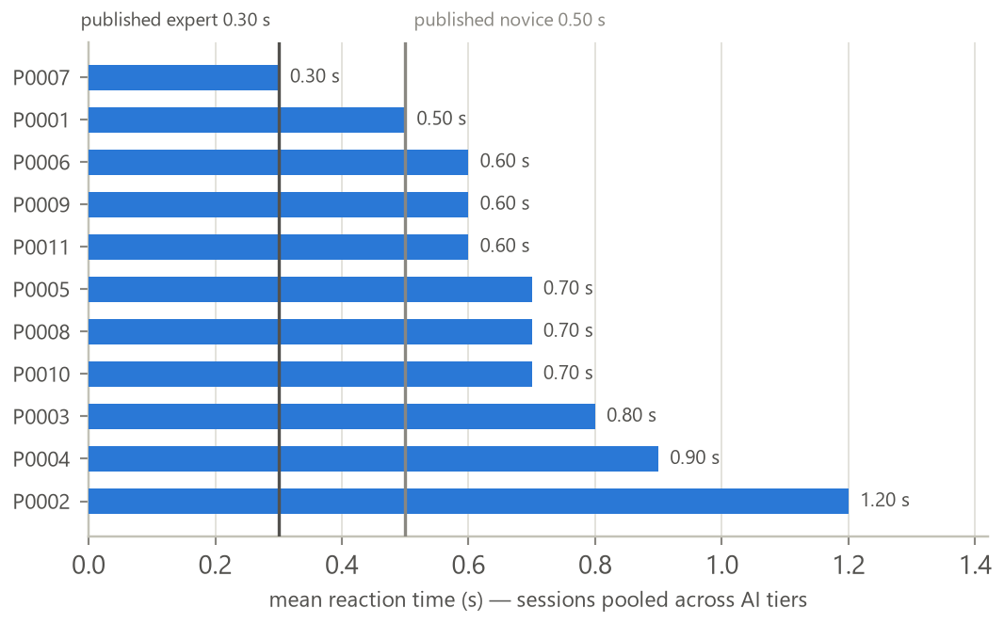
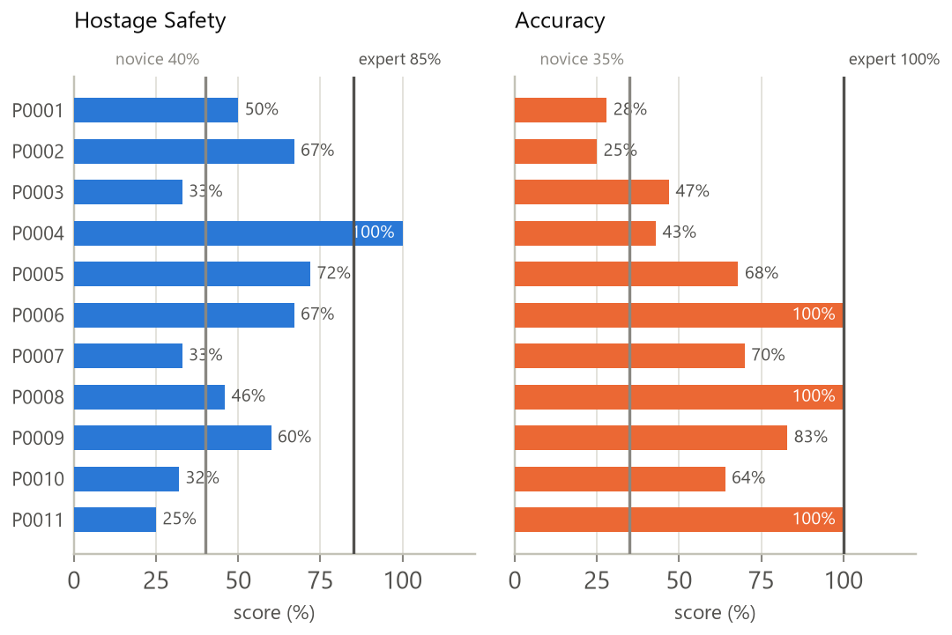

GROUP
56
SENTINELS
Dynamic Scenario Generation and Evaluation for VR-Based Military Training
A four-module Unity VR hostage-rescue trainer for the Meta Quest 3 — parameter-driven scenarios, tactical NPC behaviour, non-invasive cognition analysis, and evidence-linked after-action review — each independently, empirically evaluated.
Problem Statement
Our Approach — System Architecture
Live hostage-rescue training is expensive and hard to repeat under comparable conditions. Existing VR trainers compound this with fixed/lightly-varied scenarios, NPCs that behave predictably, and feedback limited to a single score with no evidence trail.
EVALUATOR
OBJECTIVES
layout · entity counts · AI tier · seed
▪ Generate spatially-valid, varied missions from evaluator parameters.
▪ Drive NPCs through event-driven, doctrinally-grounded, multi-tier behaviour.
▪ Capture trainee cognition/movement non-invasively, honestly against literature.
▪ Demonstrate — not assert — every subsystem works, with a matched evaluation.
ScenarioConfig.json
MODULE 1 — Dynamic Scenario Generation
room graph · placement · roles · nav context · furniture
VR RUNTIME — UNITY MISSION EXECUTION
Scenario.json
Proposed Solution
MODULE 2 — NPC Behaviour
A Unity 2022.3 VR prototype for Meta Quest 3, as four cooperating modules around one shared Scenario.json contract + a common event schema — built and evaluated largely in parallel.
event-driven FSM · squad hunt · 3 AI tiers
Scenario.json context,
for replay/AAR
FOUR COOPERATING MODULES
TRAINEE
▪ M1 Scenario Generation: parameters → validated Scenario.json
▪ M2 NPC Behaviour: event-driven FSM + squad hunt, 3 AI tiers
▪ M3 Cognitive Analysis: reaction time + movement → tiered indicators
▪ M4 Logging & AAR: telemetry → 5 scores + timeline + 2D/3D replay
actions in VR
MODULE 3 — Cognitive Analysis
reaction time · movement · workload
M2 ↔ M3 share one runtime event bus — every action
& NPC state change is a named event, observed by M4
ONE SHARED CONTRACT → FOUR INDEPENDENTLY-TESTABLE MODULES
Runtime telemetry — events · NPC states · cognitive indicators
MODULE 4 — Logging, AAR & Session Replay
M1 → Scenario.json → M2 · M3 · M4
incident extraction · 5 scores · distress index · 2D/3D replay
Room graph, roles & navigation context — produced once by M1, consumed by every module.
→ Evaluator reviews the AAR (post-mission debrief)
M2 → ScenarioEvents → M3 · M4
Runtime event stream — observed live for cognitive features (M3) and logging/AAR (M4).
M4 → SessionSummary → Dashboard
Post-session JSON — scores, timeline & replay data for the evaluation dashboard.
Module 1 produces the mission before play begins; Modules 2 and 3 run live during the mission over a shared event bus; Module 4 transforms the completed session into evidence for the evaluator.
System in Action
MODULE 1
MODULE 2
MODULE 3
MODULE 4
A generated mission realised in Unity — room graph, doors, furniture and NPC roles.
Squad-coordinated terrorists holding a hostage — FSM plus the shared, persistent hunt.
In-headset cognitive mirror HUD — reflecting the trainee's own tracking, non-invasively.
The Sentinels AAR web dashboard — session history, scores and workload trends across the trainee population.
Key Modules & Evaluation Results
01 Dynamic Scenario Generation
02 NPC Behaviour & Coordination
▪ What: Converts evaluator parameters into a valid, playable mission — the contract every other module consumes.
▪ Novelty: No existing system combines layout generation, placement, role assignment, validation and export in one pipeline; hostage room is always the deepest, most-defended dead end (BFS depth), never random.
▪ Method: One seeded System.Random, 4 layout topologies, two-tier validator (local bounds/overlap/doors + global reachability/hostage-path/roles), seed+1 retry (budget 3).
▪ Evaluation: 2,000-scenario statistical study across 6 experiments (Shapiro-Wilk → ANOVA/Kruskal-Wallis, effect sizes).
ScenarioConfig
LayoutGenerator
EntityPlacer
RoleAssigner
▪ What: Drives every terrorist & hostage in-mission via an event-driven FSM plus a squad layer that shares confirmed contact and hunts around the last-seen point.
▪ Novelty: Grounded in real U.S. Army react-to-contact doctrine and the F.E.A.R. squad-AI model, not game convention — trainees rated the Advanced tier most believable yet lost more missions against it (believability ≠ performance).
▪ Method: Shared blackboard (PointLastSeen, hunt state, leader), growing search radius, hostage escalation ladder (warning → shot → execution); 3 switchable AI tiers.
▪ Evaluation: Within-subjects ablation, 11 participants/45 sessions, Godspeed + UEQ-S instruments, Friedman/Wilcoxon.
INDIVIDUAL LAYER
NavigationContext-
Builder
FurniturePlacer
ScenarioValidator
→ Exporter
Scenario.json
Idle
Alert
Investigate
Engage
Cover /
Retreat
Down
SQUAD LAYER
ReportConfirmed-
Contact
BeginHunt
Radius grows
EndHunt
Sighting / gunshot / confirmed-target events drive all transitions; hunt radius grows until re-contact
100%
24 / 26
2,000
1.6→3.7→4.4/5
p ≤ 0.004
11 & 45
valid, every evaluator-reachable config (43/43)
parameter→metric pairs p<0.0001
scenarios across 6 experiments
Validation pass rate — 100% within the evaluator-reachable range
Perceived Intelligence, Basic→Intermediate→Advanced
Friedman, significant on all 3 believability constructs
participants & sessions, within-subjects ablation
Believability ratings rise significantly, Basic → Advanced
03 Cognitive & Movement Behaviour Analysis
04 Logging, AAR & Session Replay
▪ What: Reads the trainee's existing XR head/hand tracking — no extra hardware — to derive movement telemetry and 4-channel reaction time (head, hands, body, trigger).
▪ Novelty: Combines objective movement/reaction evidence with self-reported SIM-TLX workload in one honestly-tiered evaluation; a rule-based reasoning layer explains, not just reports, why a score is high or low.
▪ Method: 3 anti-false-positive rules (already-in-motion, 80 ms noise floor, response window+cooldown); 5 Hz sampling; self-calibrating crouch baseline; A/B/C confidence tiers.
▪ Evaluation: Construct-validity audit of 12 benchmark bands (4 tier A / 5 B / 3 C); one-sample Wilcoxon vs published expert.
INPUT
PROCESS
PROCESS
PROCESS
OUTPUT
▪ What: Subscribes to one shared event bus and turns a completed mission into inspectable evidence — five scores, an incident timeline, a distress index, and a 2D/3D replay.
▪ Novelty: A distinct Operator Safety axis (separate from mission outcome) plus a hostage psychological distress index — dimensions most commercial/academic AAR tools omit entirely.
▪ Method: Scores calibrated to NYPD SOP-9, RAND hostage-rescue outcomes & Hick's Law; Freeze scored above Panic (tonic immobility → worse trauma outcomes); zero-instrumentation logging.
▪ Evaluation: Construct-validity audit vs the Expert Value Table; benchmark + discriminant-validity tests across 11 trainees.
Mission Events
(M2)
Cognitive Outputs
(M3)
Scenario Context
(M1)
XR Tracking
Extract
Interpret
Score
Indicators
Head / hand / body
+ trigger pressure
4-channel reaction time
5 Hz movement sampling
Rule-based scoring vs
A/B/C benchmark bands
+ SIM-TLX self-report
confidence tiering
Cognitive load +
workload profile
LOGGING
ENGINE
Reads existing XR tracking (zero added hardware) at 5 Hz; A/B/C tiers = direct benchmark / literature proxy / exploratory
Score Summary
AAR Dashboard
Synchronised
Replay
4 / 5 / 3
0.65s vs 0.30s
5 Hz
52% vs 85%
68% vs 100%
F=4.22, p=.003
metrics at tier A (direct) / B (proxy) / C (no benchmark)
mean RT vs published expert (p<0.001, r=0.67)
movement sampling, zero added hardware
Mean reaction time per participant vs published expert/novice
Hostage Safety vs published expert (p<0.001)
Accuracy vs distance-normalised expert (p<0.001)
Operator Safety separates trainees most strongly
Hostage Safety & Accuracy — trainees plotted against novice/expert bands
Key Results & Conclusion
LIMITATIONS
Every module was evaluated with a methodology matched to what it produces — a 2,000-scenario statistical study, a controlled ablation with real significance testing, a construct-validity audit, and a benchmark/discriminant-validity audit. M1's generation is valid and traceable to its parameters; M2's AI tiers are perceived as genuinely more intelligent as capability increases; M3 honestly separates trainees from published benchmarks; M4's scoring agrees with every checkable benchmark and discriminates trainees on 3 of 5 scores.
▪ Single floor, single hostage per mission
▪ Quest 3 approximate body tracking; ~20-participant cognitive sample
▪ Greybox (ProBuilder) environments, not production art
FUTURE WORK
Sentinels demonstrates that parameter-driven generation, tactical NPC behaviour, non-invasive cognition measurement, and evidence-linked AAR can be integrated into one coherent, empirically evaluated VR trainer on consumer hardware.
▪ Multi-floor generation; richer NPC coordination
▪ 15–30 participant SIM-TLX study; trained-personnel transfer study
BSc (Hons) in Information Technology
Department of Information Technology
Faculty of Information Technology
University of Moratuwa, Sri Lanka
GROUP MEMBERS
PROJECT SUPERVISOR
214036J Chathuranga S.P.Y.N
214057A Dilshan R.P
214217P Wadumulla G.M.D
214237C Wijesinghe W.N.U
Dr. S. C. Premaratne

