Slide 1
Sentir DATA
Toca, escucha los datos

Slide 2
Team
Francisco Vera
Antonio Moeno
Isaac Aldana
René Tapia
Hugo Velasco
Notes:
“Tell them what you’re going to tell them”
Once I paint them a picture of the success they’ll achieve, using the opening story and slide, I next outline no more than 3 to 5 key “how to’s” for achieving this success, color-coded to each upcoming section of the presentation.
For growing companies I have them focus on four key decisions they must get right: People, Strategy, Execution, and Cash. These four words are placed one per color-coded box. And I’ll share a growth company example for each key point.

Slide 3
Porqué Sentir?
Que sientes al ver estadísticas
SentirDATA
Quién de nosotros no siente?
La tecnología no llega a todos
Mensajes disruptivos
Cazar al usuario desprevenido
Notes:
Going into detail
Each key point is anchored with a question. I find posing a question to the audience relative to each key point engages them to proactively think and apply the ideas to their own situation vs. just listen to what I have to say.
Slide Notes:
Place the title of the first key point where it says “People” and also in the box in the upper right. This may seem redundant, but the repetition is important.
The “subline” in the upper right hand box is for a one or two word anchor to the first key point. In my case, the subline for “People” is “Happiness” – it’s the people you surround yourself with in business who impact your happiness.
I’ll then carry the “box” in the upper right hand corner, color-coded to that section, to additional content slides in that section.

Slide 4
Cómo lograrlo?
Que sientes al ver estadísticas
SentirDATA
Materializar la realidad virtual convirtiéndola en objetos, sonidos e imágenes
Notes:
Going into detail
Each key point is anchored with a question. I find posing a question to the audience relative to each key point engages them to proactively think and apply the ideas to their own situation vs. just listen to what I have to say.
Slide Notes:
Place the title of the first key point where it says “People” and also in the box in the upper right. This may seem redundant, but the repetition is important.
The “subline” in the upper right hand box is for a one or two word anchor to the first key point. In my case, the subline for “People” is “Happiness” – it’s the people you surround yourself with in business who impact your happiness.
I’ll then carry the “box” in the upper right hand corner, color-coded to that section, to additional content slides in that section.

Slide 5
Qué vamos hacer?
Que sientes al ver estadísticas
SentirDATA
Representaciones virtuales de secuencias de datos abiertos que puedan transformarse en objetos tangibles y manipulables
Notes:
Going into detail
Each key point is anchored with a question. I find posing a question to the audience relative to each key point engages them to proactively think and apply the ideas to their own situation vs. just listen to what I have to say.
Slide Notes:
Place the title of the first key point where it says “People” and also in the box in the upper right. This may seem redundant, but the repetition is important.
The “subline” in the upper right hand box is for a one or two word anchor to the first key point. In my case, the subline for “People” is “Happiness” – it’s the people you surround yourself with in business who impact your happiness.
I’ll then carry the “box” in the upper right hand corner, color-coded to that section, to additional content slides in that section.

Slide 6
2 Pilotos
Que sientes al ver estadísticas
SentirDATA
Representación de decesos en tiempo real (H/M)
Transformar la desigualdad de renta por municipio en México DF en un objeto sensorial
Notes:
Going into detail
Each key point is anchored with a question. I find posing a question to the audience relative to each key point engages them to proactively think and apply the ideas to their own situation vs. just listen to what I have to say.
Slide Notes:
Place the title of the first key point where it says “People” and also in the box in the upper right. This may seem redundant, but the repetition is important.
The “subline” in the upper right hand box is for a one or two word anchor to the first key point. In my case, the subline for “People” is “Happiness” – it’s the people you surround yourself with in business who impact your happiness.
I’ll then carry the “box” in the upper right hand corner, color-coded to that section, to additional content slides in that section.

Slide 7
Piloto 1:Análisis de OD Dinámico
Que sientes al ver estadísticas
SentirDATA
Descarga de Base de datos (datamx.io) de forma automática mediante el API usando JSON
Notes:
Going into detail
Each key point is anchored with a question. I find posing a question to the audience relative to each key point engages them to proactively think and apply the ideas to their own situation vs. just listen to what I have to say.
Slide Notes:
Place the title of the first key point where it says “People” and also in the box in the upper right. This may seem redundant, but the repetition is important.
The “subline” in the upper right hand box is for a one or two word anchor to the first key point. In my case, the subline for “People” is “Happiness” – it’s the people you surround yourself with in business who impact your happiness.
I’ll then carry the “box” in the upper right hand corner, color-coded to that section, to additional content slides in that section.

Slide 8
Desarrollo Tecnológico
Que sientes al ver estadísticas
SentirDATA
Accesar al dataset de datosmx.io mediante JSON para su ingesta en Processing. Una vez obtenido el DataSet se introduce a un algoritmo para visualizar mediante vectores lineales la variación de decesos.
Notes:
Going into detail
Each key point is anchored with a question. I find posing a question to the audience relative to each key point engages them to proactively think and apply the ideas to their own situation vs. just listen to what I have to say.
Slide Notes:
Place the title of the first key point where it says “People” and also in the box in the upper right. This may seem redundant, but the repetition is important.
The “subline” in the upper right hand box is for a one or two word anchor to the first key point. In my case, the subline for “People” is “Happiness” – it’s the people you surround yourself with in business who impact your happiness.
I’ll then carry the “box” in the upper right hand corner, color-coded to that section, to additional content slides in that section.

Slide 9
Piloto 2:Análisis de OD Estático
Que sientes al ver estadísticas
SentirDATA
Descarga de Base de datos (datamx.io) de forma manual
Filtro por Entidad: Distrito Federal
Selección de indicadores: Índice GINI 90,2000 y 2010
Notes:
Going into detail
Each key point is anchored with a question. I find posing a question to the audience relative to each key point engages them to proactively think and apply the ideas to their own situation vs. just listen to what I have to say.
Slide Notes:
Place the title of the first key point where it says “People” and also in the box in the upper right. This may seem redundant, but the repetition is important.
The “subline” in the upper right hand box is for a one or two word anchor to the first key point. In my case, the subline for “People” is “Happiness” – it’s the people you surround yourself with in business who impact your happiness.
I’ll then carry the “box” in the upper right hand corner, color-coded to that section, to additional content slides in that section.

Slide 10
Desarrollo Tecnológico
Que sientes al ver estadísticas
SentirDATA
Accesar al dataset de datosmx.io mediante JSON para su ingesta en Processing. Una vez obtenido el DataSet se introduce a un algoritmo para visualizar mediante vectores lineales la variación del índice GINI en OpenGL
Notes:
Going into detail
Each key point is anchored with a question. I find posing a question to the audience relative to each key point engages them to proactively think and apply the ideas to their own situation vs. just listen to what I have to say.
Slide Notes:
Place the title of the first key point where it says “People” and also in the box in the upper right. This may seem redundant, but the repetition is important.
The “subline” in the upper right hand box is for a one or two word anchor to the first key point. In my case, the subline for “People” is “Happiness” – it’s the people you surround yourself with in business who impact your happiness.
I’ll then carry the “box” in the upper right hand corner, color-coded to that section, to additional content slides in that section.

Slide 11

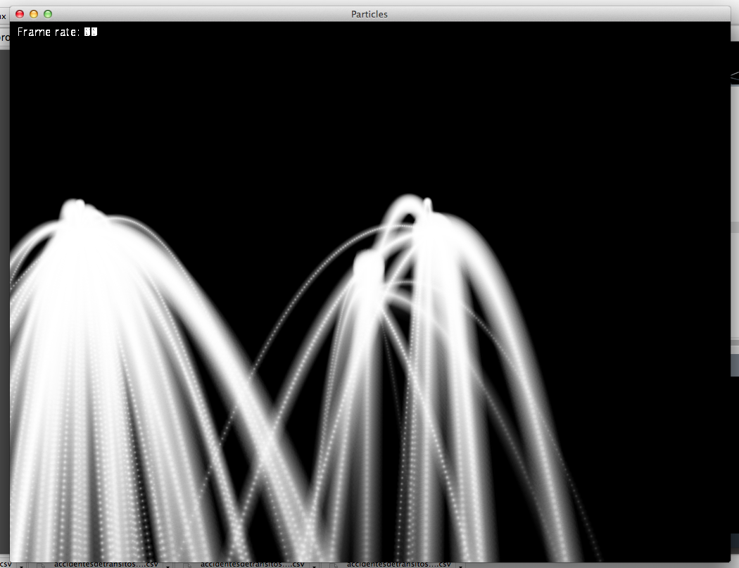
Una imágen dice más que mil palabras
People
Notes:
Image slides
Try to emphasize your concepts with pictures. And I tend to use real pictures – pictures of the companies and executives that are the subjects of my stories. Or I’ll choose a picture that elicits an emotional response to a key point I’m making. It’s important to touch a listener’s heart and head.
Slide Notes:
Note the left bar color aligns with the section color – visual clue that I’m still in Section 1.
To set a picture as a slide background, as on this slide, hold down CONTROL, click the slide and then click Format Background.

Slide 12
Desarrollo Tecnológico
Que sientes al ver estadísticas
SentirDATA
Accesar al dataset de datosmx.io mediante JSON para su ingesta en Processing. Una vez obtenido el DataSet se introduce a un algoritmo para visualizar mediante vectores lineales la variación del índice GINI en OpenGL
Notes:
Going into detail
Each key point is anchored with a question. I find posing a question to the audience relative to each key point engages them to proactively think and apply the ideas to their own situation vs. just listen to what I have to say.
Slide Notes:
Place the title of the first key point where it says “People” and also in the box in the upper right. This may seem redundant, but the repetition is important.
The “subline” in the upper right hand box is for a one or two word anchor to the first key point. In my case, the subline for “People” is “Happiness” – it’s the people you surround yourself with in business who impact your happiness.
I’ll then carry the “box” in the upper right hand corner, color-coded to that section, to additional content slides in that section.

Slide 13
Siguentes Pasos:
Que sientes al ver estadísticas
SentirDATA
Desarrollo de modelo matemático para uso de preguntas específicas (objetivas) que se puedan responder con la interpretaciòn de los datos en tiempo real, como cuantos niños mueren en México cada segundo, y así representarlo de forma visual y dinamica, con una posiblidad a evolucionar a formas tangibles.
Notes:
Going into detail
Each key point is anchored with a question. I find posing a question to the audience relative to each key point engages them to proactively think and apply the ideas to their own situation vs. just listen to what I have to say.
Slide Notes:
Place the title of the first key point where it says “People” and also in the box in the upper right. This may seem redundant, but the repetition is important.
The “subline” in the upper right hand box is for a one or two word anchor to the first key point. In my case, the subline for “People” is “Happiness” – it’s the people you surround yourself with in business who impact your happiness.
I’ll then carry the “box” in the upper right hand corner, color-coded to that section, to additional content slides in that section.

Slide 14
Github
Que sientes al ver estadísticas
SentirDATA
https://github.com/SentirDATA

Slide 15
Gracias
México
Notes:
Key Points
For certain key points, I’ll simply place a few words on a slide without any other visuals, especially when I can’t find an appropriate picture and I want the words to linger in the minds of my audience. Again, I’ll always tell a story that brings the key point alive for the audience while I keep the words on the screen, effectively “burning“ an image in their mind.

