Slide 1


Slide 2
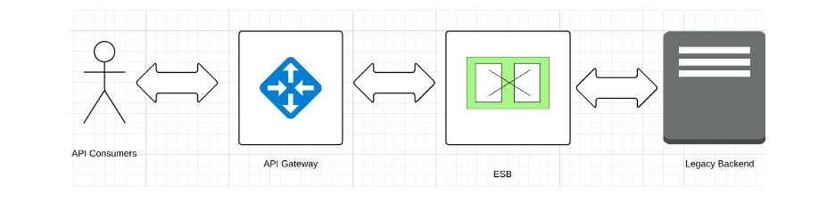
High Level - Scenario

Slide 3
Legacy Back end
Security enable back end
- QOS
        Quality of Service provides security and reliability to a service
- Throttling
        Required to avoid heavy loads that can cause performance issues
WSDL consists below data
- Patient details
- Patient medical details
- Patient personal details

Slide 4
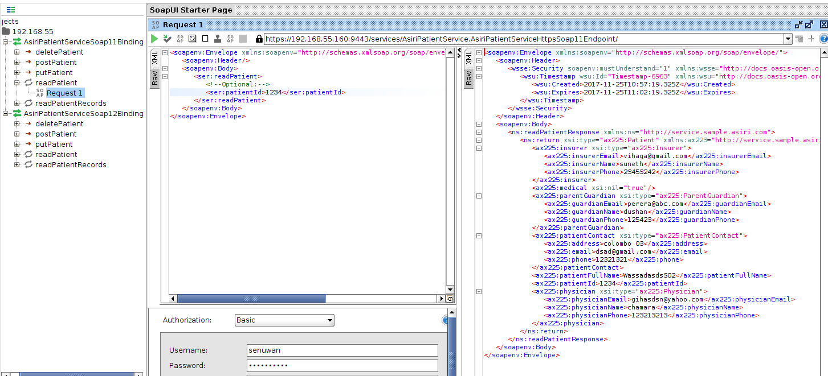
ReadPatient in soap back end

Slide 5
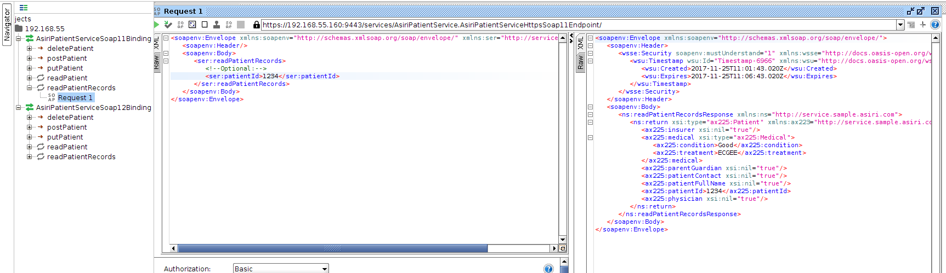
ReadPatientRecords in soap back end

Slide 6
ESB Side Configuration
Create a proxy using below mediators.
switch
property
payload factory
call
class
send
Secured the ESB using a policy
create secured policy and uploaded
Ref :https://docs.wso2.com/display/ESB490/Applying+Security+to+a+Proxy+Service

Slide 7
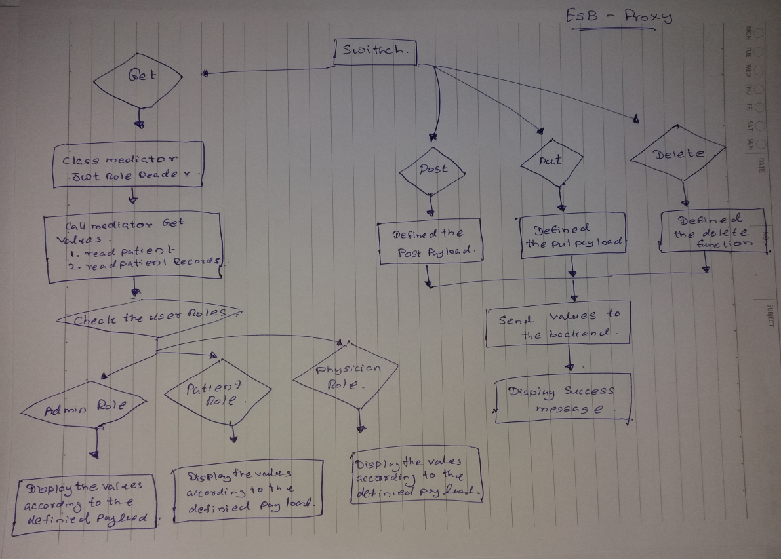
Basic diagram

Slide 8
Switch mediator
To implement crud operations.
Matching case is found, it will be executed, and the remaining switch case mediators are not processed.
Below three method used.
<switch source="$axis2:HTTP_METHOD"> - Connect to back -end
<switch source="get-property('default','Role')"> - get user roles
<switch source="$axis2:HTTP_SC"> - HTTP status code number
Ref : https://docs.wso2.com/display/ESB500/Switch+Mediator

Slide 9
Property mediator
To implement properties. Property mediator is used to store any value temporarily.
Eg:
<property name="SOAPAction" value="urn:readPatient" scope="transport"/>
value – get from the back end
scope - send an HTTP header named 'CustomHeader' with an outgoing request, you
Ref : https://docs.wso2.com/display/ESB500/Property+Mediator

Slide 10
Payload mediator
Payload Mediator transforms or replaces the contents of a message.
Used payload mediator to generate XML and JSON messages.
<payloadFactory media-type="xml">
Ref : https://docs.wso2.com/display/ESB500/PayloadFactory+Mediator

Slide 11
Call mediator
Call mediator is used to specify all the service invocations one after the other in a chain within a single sequence.
<call>
<endpoint>
<address uri="https://192.168.55.160:9443/services/AsiriPatientService" format="soap11"/>
</endpoint>
</call>
Ref: https://docs.wso2.com/display/ESB500/Call+Mediator

Slide 12
Class mediator
Class Mediator creates an instance of a custom-specified class and sets it as a mediator
Call to the JWTReader-1.0.0.jar file
<class name="org.wso2.sample.JWTRoleReader">
<property name="JWT_JSON_Array" value="literal"/></class>
Ref: https://docs.wso2.com/display/ESB500/class+Mediator

Slide 13
Send mediator
Send mediator is used to send messages out of Synapse to some endpoint. Then the response is returned to the OutSequence where you can send it back to the client.
<send> <endpoint>
<address uri="https://192.168.55.160:9443/services/AsiriPatientService"
< format="soap11"/>
</endpoint> </send>
Ref : https://docs.wso2.com/display/ESB500/send+Mediator

Slide 14
Why and How to secured proxy.
Security is an essential element. Without it, anyone can access services and systems. However security a very wide topic that addresses many aspects.
Created security enable project using dev studio.
Uploaded the xml file into the ESB
Called the xml file using below method.
<policy key="gov:/SecuredBackend.xml"/>

Slide 15
How to connect ESB Proxy to secured backend
Encrypted the backend ‘user name’ and ‘password’
Used property mediator and pass the encrypted value.
<property name="Authorization" value="Basic c2VudXdhbjpzZW51d2FuMTIz"
scope="transport"/>

Slide 16
What is service chaining?
Service chaining use to take data from two methods.
Eg :
Lets assume three airlines. ESB can get details from those three airlines, then compare and send on record to out.

Slide 17
API Manager configurations
Created a Pub-Store-TM cluster with IS key manager.
Created an API with using security policies.
Used ESB proxy as the back end.
Defined scopes as per the requirement .

Slide 18
API Manager architecture
Publisher - Enables API providers to easily publish their APIs.
Store -Subscribe to APIs, evaluate them, and interact with API pub
Key Manager – In vole security and key-related operations.
Gateway – securing and protecting scaling API calls.
Traffic Manage - Take decision on throttling.

Slide 19
Why we need clusters
A cluster consists of multiple instances of a product. This way improves performance, because requests are distributed among several servers instead one instance.
High availability - Clustering for high availability results in fewer service interruptions
Simplified administration - Automate workflows for maximum efficiency and scalability.
Increased scalability - Leverage resources more effectively.
Failover and switch over capabilities – Able to redundant backup system , use load-balanced servers to serve the failover functions.

Slide 20
Created a cluster with API Manager and IS as a Key Manager.
Created separate databases in mySQL.
Configured the API Manager node.
Configured the IS as a Key Manager.
Ref: https://docs.wso2.com/display/AM210/Configuring+WSO2+Identity+Server+as+a+Key+Manager

Slide 21
Added IP base throttling.
Applying throttling we can manage the requests.
Throttling also help to increase the performance
Defined IP base throttling for IP 10.100.7.13
Limit to 5 request for minutes.
Ref: https://wso2.com/library/demonstrations/2016/11/screencast-defining-advanced-throttling-policies-in-wso2-api-manager/
https://docs.wso2.com/display/AM210/Adding+New+Throttling+Policies

Slide 22
Caching
When an API call comes to the API gateway, Gateway needs to extract parameters access token, API name, API version, etc.. this verification process needs to be fast an efficient without having any traffic. Caching is used for this purpose.

Slide 23
Type of caching
API Gateway cache -caching is enabled at the Gateway and a request hits the Gateway.
Resource cache – Resource level cache Get Put etc.
Key Manager cache – caching token related data.
Response cache – API level caching.
API Store cache - Reduce the page load time and increase its responsiveness.
Ref: https://docs.wso2.com/display/AM200/Configuring+Caching

Slide 24
Sample payload
{
"patient": {
"medical": {
"condition": "better",
"treatment": "ECG"
},
"parentGuardian": {
"guardianEmail": "perera@abc.om",
"guardianName": "dushan",
"guardianPhone": "125423"
},
"patientContact": {
"address": "colombo 03",
"email": "dsad@gmail.com ",
"phone": "12321321"
},
"physician": {
"physicianEmail": "gihan@fs3df.com",
"physicianName": "chamara",
"physicianPhone": "123213213"
},
"insurer": {
"insurerEmail": "vihaga@gmail.com",
"insurerName": "suneth",
"insurerPhone": "342332423"
},
"patientFullName": "senuwanwithana",
"patientId": "senuwan"
}

Slide 25
Issues.
How to get JWT token according to the user roles.
I have modified, tested in java script code which I found on a blog.
However, could not able to separate the JWT three main parameters, the header, the payload and the signature
Faced issue with configuring the Gateway cluster with load balancer.

Slide 26
Thank You

