Slide 1

EmpowerSA
Empowering Youth for a Brighter Future

Slide 2
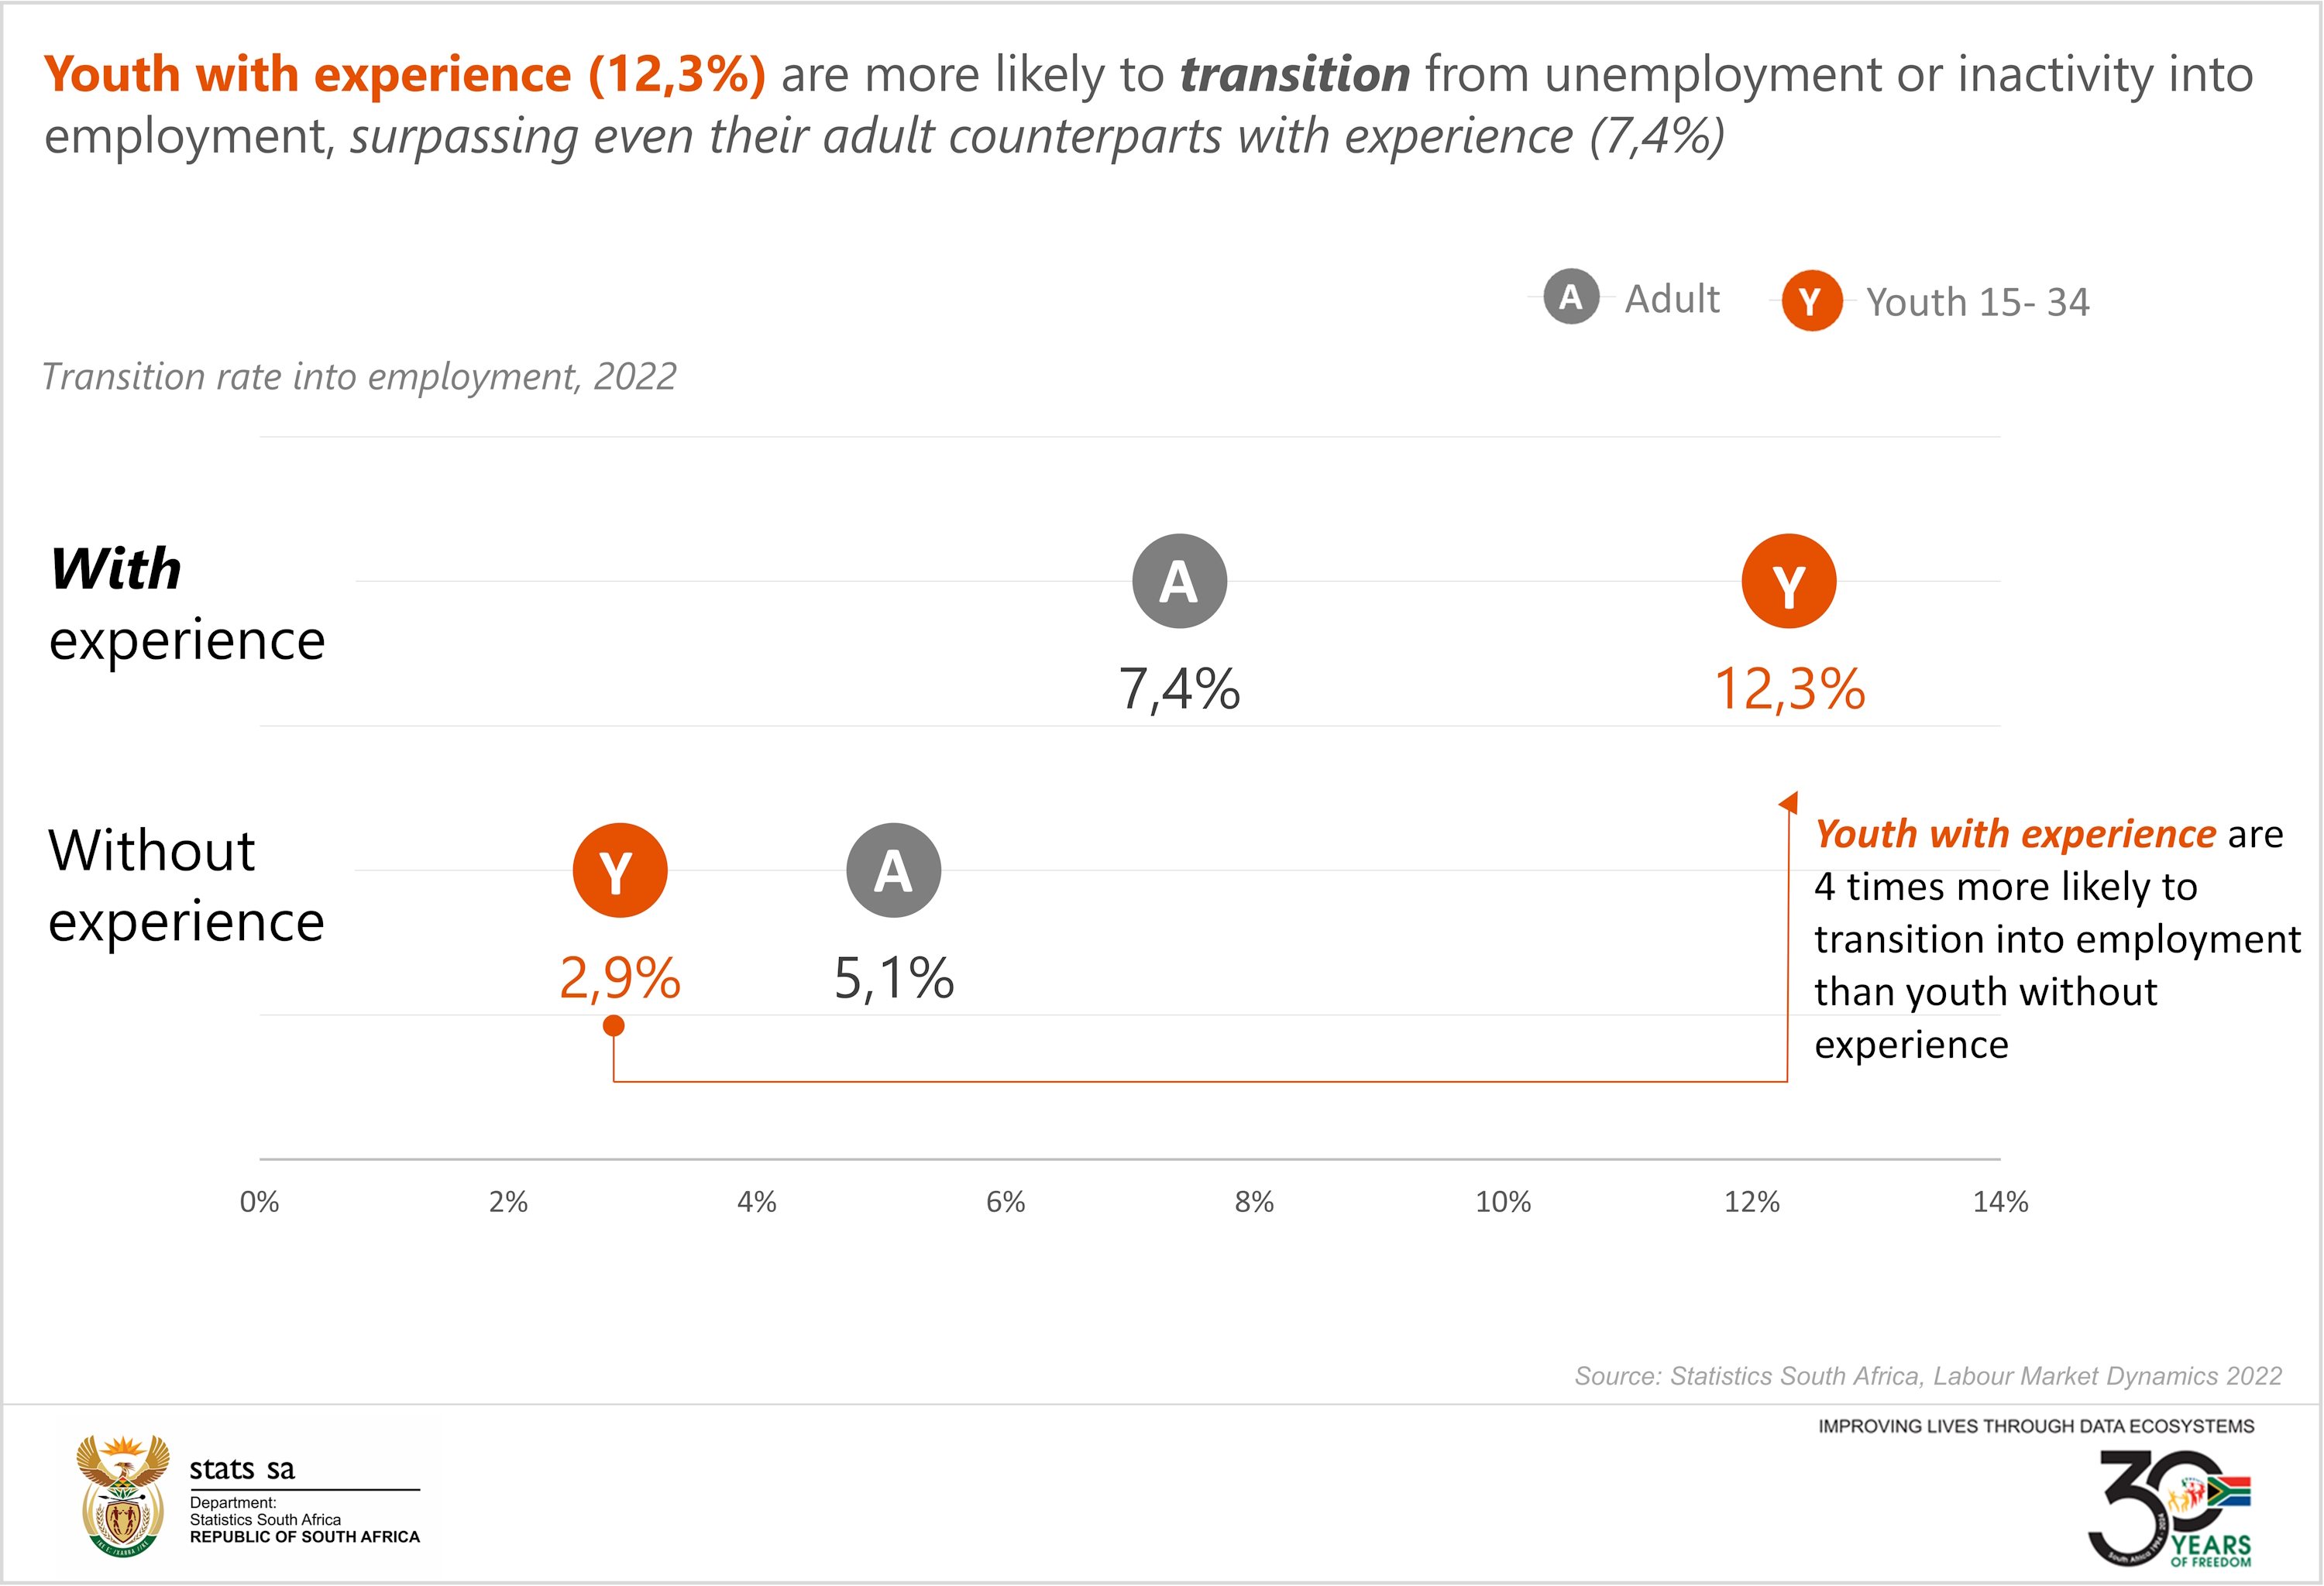
Youth Unemployment Crisis in South Africa
South Africa, like many countries globally, grapples with the challenge of youth unemployment. This is supported by statistics indicating a 45,5% unemployment rate among young individuals (aged 15-34 years), in contrast to the national average of 32,9% in the first quarter of 2024.

Slide 3
Introducing EmpowerSA
EmpowerSA’s mission is to empower youth by providing access to job opportunities, career resources, and skills development programs.
Highlight key features:
Job Listings Aggregation
Resources for Career Development
Skills-Building Resources

Slide 4
Key Features of EmpowerSA
Job Listings: Aggregates relevant, updated job postings tailored to youth in South Africa.
Skill Development Resources: Access to courses and certifications.
Career Guidance: Resume and interview preparation tips

Slide 5
Target Market
Focus youth aged 18-34 in South Africa
According to the mid-year estimates of 2019, the youth (aged 18–34) constitute almost a third of the population (17,84 million) in South Africa, with 9,04 million males and 8,80 million females.

Slide 6
How It Works
Users visit EmpowerSA to browse and apply for job listings.
integrated job APIs (e.g., Adzuna) bring relevant opportunities.
Resources and skills training are easily accessible from the platform.

Slide 7
Market Opportunity
Digital Skills Training: Provide training and resources for in-demand digital skills like coding, data analysis, and digital marketing.
Mentorship and Guidance: Connect young people with experienced professionals for mentorship and guidance to help them achieve their career goals.
Job Listings and Internships: Offer a platform for job listings, internships, and apprenticeships, and partner with companies to offer exclusive opportunities.
Interview Preparation: Provide resources, including video tutorials, mock interviews, and resume-building tools, to help users prepare for interviews and increase their confidence.
Soft Skills Development: Offer courses, webinars, or workshops to help users develop essential soft skills like communication, teamwork, and time management. These opportunities can help address the youth unemployment crisis in South Africa and provide a valuable resource for young people looking to develop their skills and find job opportunities.

Slide 8
Revenue Streams
Job Listing Fees: Charge companies a fee to list their job openings on the platform, with options for featured listings or sponsored content.
Affiliate Marketing: Partner with online course providers or education institutions to offer relevant courses to users, earning a commission for each course sale made through the platform.
Sponsored Content: Partner with brands to create sponsored content, such as webinars, videos, or blog posts, that align with the platform's goals and values.
Data Analytics: Sell anonymized data and insights on youth employment trends and skills development to companies, educational institutions, or government agencies. These revenue models focus on generating revenue from job listings, course sales, and sponsored content, while ensuring that the platform remains free for users to access and upskill.

Slide 9

Join us on our Journey
Join us in empowering South Africa’s youth. Together, we can bridge the gap to employment.”

