Slide 1
Y2018 Research Plan
2018/08/22
Seojin Kim@MDLab., SKKU

Slide 2
Quarterly Plan
학회
 | 1분기 | 2분기 | 3분기 | 4분기
국제저널 | ICML 2019, International Conference on Machine Learning Submission: March 1, 2019 | - | CVPR 2019, International Conference on Machine Learning Submission: Nov 16, 2018
국제학회 | ICCV 2019: International Conference on Computer Vision Submission: March 1,2019 | NIPS 2019, Neural Information Processing Systems Submission: May 18, 2019 |  | -
국내저널 | - | - | - | -
진행
 | 1분기 | 2분기 | 3분기 | 4분기
국제저널 | - | - | - | -
국제학회 | - | - | - | -
국내저널 | - | - | - | -

Slide 3
Papers and Patents
논문
NO | 학회명 | 논문명 | 실적구분
1
2
3
4
5
6
7
8
9
특허
NO | 출원국가 | 특허명 | 실적구분
1
2

Slide 4
연구진행
To Do List
Research
구현
Gradient가 Input 영상에 어떤 영향을 미치는지 (부족)
Paper Reading(1)
Done
Research
Learning rate & decay
Batch size에 따라 어떤 영향이 어떻게 나타나는지
Momentum 이란?

Slide 5
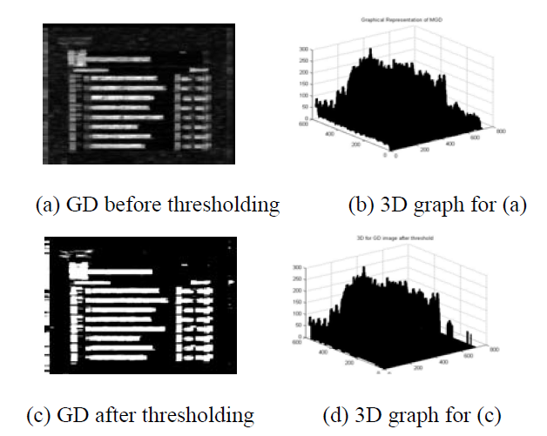
Input & Gradient
High positive and negative gradient values in text regions result from high intensity contrast between the text and background regions
Notes:
A Gradient Difference based Technique for Video Text Detection

Slide 6
Learning Rate Schedule
Annealing the learning rate(학습속도 조정)
How to choose the best learning rate?
Constant Learning Rate
SGD Optimizer, momentum and decay rate are zero.
Step decay
decrease the learning rate by a few epoch, usually a half in 5 epoch or a tenth in 20 epoch.
In real, adaptive methodology is used by validation error.
Exponential decay
α=α0e^−kt. α0,k are hyperparameter, t is the iteration number of epoch.
Time-based decay
α=α0/(1+kt) . α0,k are hyperparameter, t is the iteration number of epoch.
Notes:
http://aikorea.org/cs231n/neural-networks-3/

Slide 7
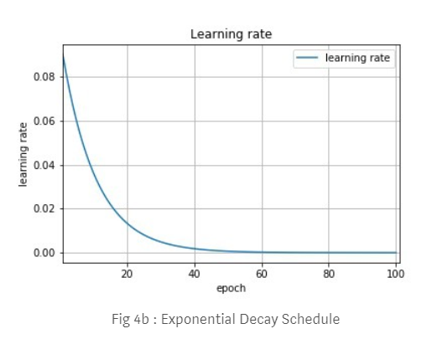
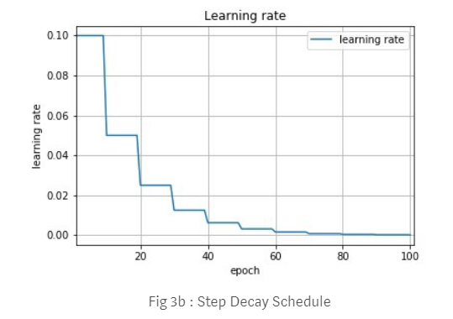
Step based vs Exponential
Step decay: High accuracy
Exponential: More smooth(stable), less time to maximize

Slide 8
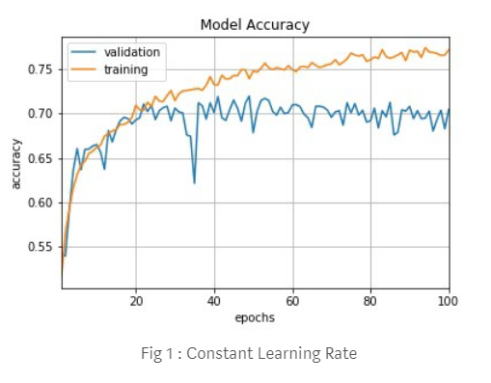
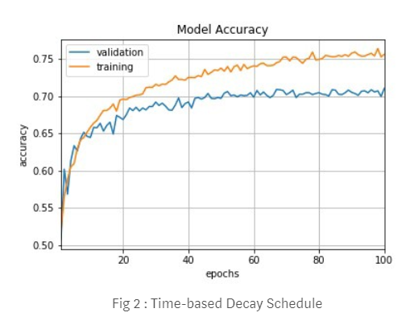
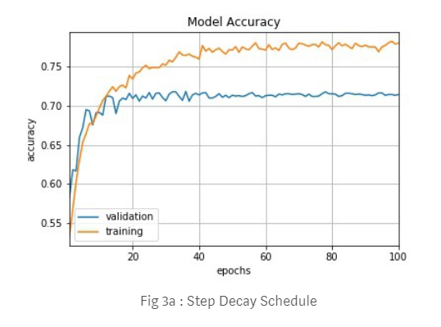
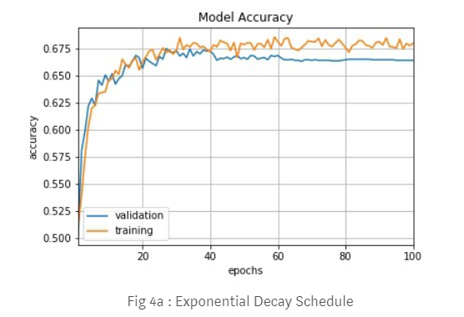
Learning Rate
train a convolutional neural network on CIFAR-10

Slide 9
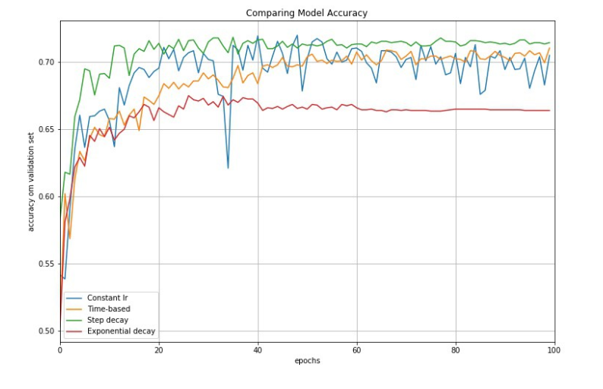
Compare
Hyperparameters have to be defined in advance and they depend heavily on the type of model and problem.
The same learning rate is applied to all parameter updates.
If we have sparse data, we may want to update the parameters in different extent instead.

Slide 10
Momentum
GD Algorithm’s disadvantage
기울기 0인 점을 잘 탈출하지 못한다.
Training Performance가 떨어진다.
Momentum 적용
관성= 기울기가 가던 방향으로 가면서 약간씩 방향을 트는 것
E: 속도 상수(Learning rate)
감마: 관성 상수 (Momentum rate) – 보통 0.5로 시작해서 안정화되면 0.9로 높인다.
수렴하는 점을 보면 관성이 적용되었을 때 대략 어느정도 속도로 움직일 지, (값이 바뀔지)
관성을 사용하는 것, 속도 상수를 보정하는 것. 감마를 0.9로 사용한다는 것, 기존 대비 약 10배 정도의 속도로 움직이도록 한다.

Slide 11
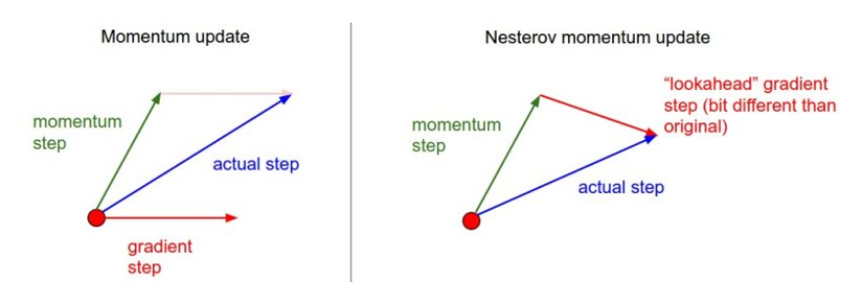

Nesterov Momentum
Momentum Update: x + gradient step
Nesterov Momentum Update: momentum step + “lookahead” gradient step -> slightly better

Slide 12
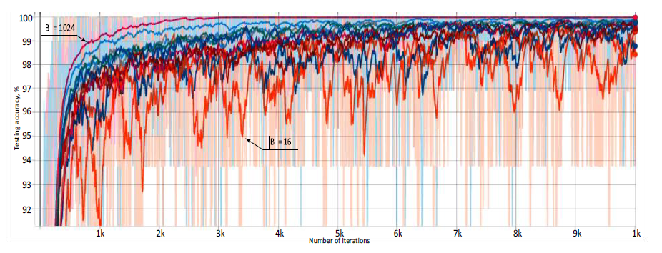
Batch size
Batch size
Used when fitting the model, controls how many predictions must be made at a time.
Impacts the CNN training both in terms of the time to converge and the amount of overfitting.
i.e. smaller batch size yields faster computation but requires visiting more examples in order to reach the same error, since there are less updates per training iteration.
The largest the batch size value, the more smooth the curve and high accuracy.
The lowest and noisiest curve corresponds to the batch size of 16 examples, the highest and the smoothest one – to the batch size of 1024 examples
Impact of Training Set Batch Size on the Performance of Convolutional Neural Networks for Diverse Datasets (ITMS)

Slide 13
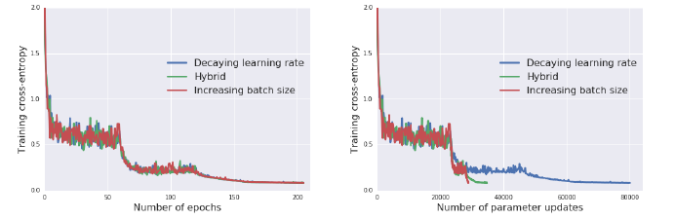
참고: Don’t decay the learning rate
Decay learning rate
Decay the learning rate: enable to converge to the minimum of the cost function
Constant learning rate-> same reduction in noise by increasing the batch size
Wide ResNet of CIFAR10. Identical learning curves but increasing the batch size reduces the number of parameter updates required.
Reduce model training times without hyperparameter tuning.
Directly convert existing hyperparameter choices
Notes:
DON’T DECAY THE LEARNING RATE, INCREASE THE BATCH SIZE(ICLR’18)

Slide 14
Q&A

