Slide 1
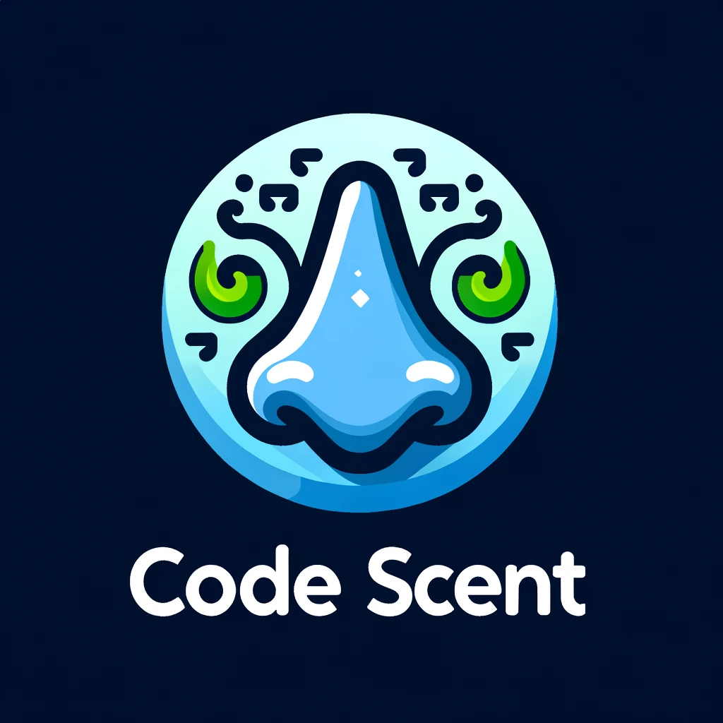

Code Scent
A Customizable IntelliJ IDEA Plugin for Code Smell Detection
CSED 332: Software Design Methods
Project Final Presentation
4nix (Group 4): Jinyoung Kim, Chanho Song, Jinmin Goh, Hyunbin Park, Seokhwan Choi, Gwanho Kim
Notes:
Hello, we are Group 4, 4nix and I am Seokhwan Choi.
We have developed 'A Customizable IntelliJ IDEA Plugin for Code Smell Detection'.

Slide 2
01
Introduction
Table of contents
02
Overview of the project
03
Project Demo
Notes:
Here's our table of contents.

Slide 3
Introduction
01
Main goal of the project
Notes:
First, I will introduce the main goal of our project.

Slide 4
Introduction
Problem 1: Code smells introduce bad design
Code smells can cause problems when fixing bugs, adding new features, or making any changes to the code. Also, they might lead to new bugs.
Problem 2: Each user has different boundaries for what they consider a code smell
For example, some people may think the appropriate number of parameters for a method is three or fewer, while others may think it is six or fewer
Problem 3: Users want to see code smells in their at a glance, categorized by type.
In the traditional plugin, you can only see what a warning is by going to its line.
Notes:
Code smells in a project can lead to bugs when writing additional code.
However, the definition of code smell can vary from person to person.
Existing plugins marked code smells based on fixed criteria.

Slide 5
Introduction
Main goal of our project “Code Scent”
Improve code quality by detecting code smells using automatic code smell detection plugin
Provide locations, explanations of what code smells are found
Unique feature "customization": User can customize the precondition for certain code smells, so that the code smell condition fits to user's convenience (personalized custom plugin)
Can customize "large class due to fields", "large class due to methods", "long method", "message chain", "long parameter list", and "comments" code smells.
Notes:
Therefore, in our project, we aimed to develop an automatic code smell detection plugin.
Users can easily see the locations of code smells identified by our plugin.
A key feature of our project is that users can set their own criteria for code smells.
The types of code smells that users can customize are as follows.
I will show more details in our demo.

Slide 6
Overview of the Project
02
Distribution of user stories across iterations
Explain and evaluate XP practices applied by our team
Notes:
Now, let's talk about the distribution of user stories and XP practices.

Slide 7
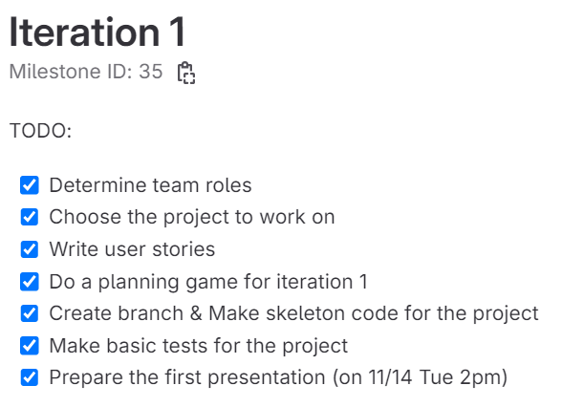
Iteration 1
Make the user story
Find out how to make plugin project
Set up skeleton structure for plugin project
Notes:
In Iteration 1, we set the direction of our project and find out how to build an IntelliJ plugin project.

Slide 8
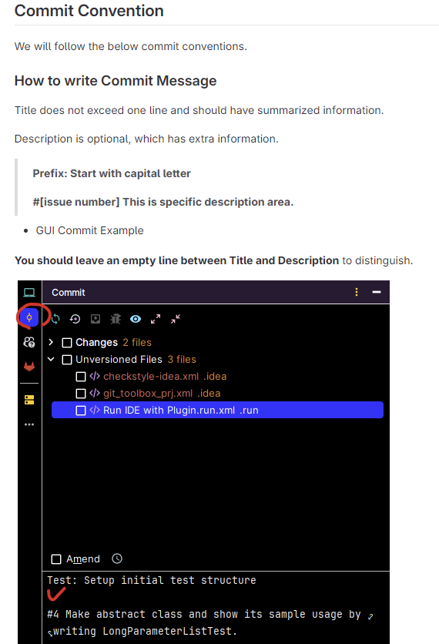
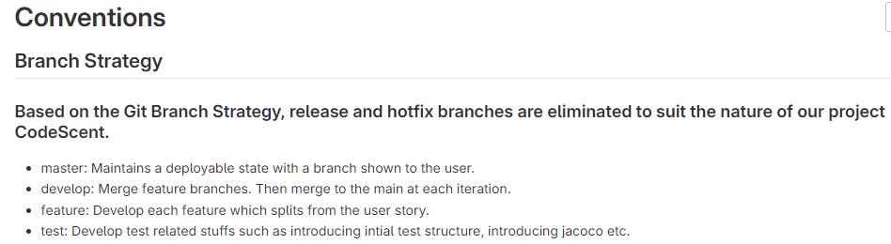
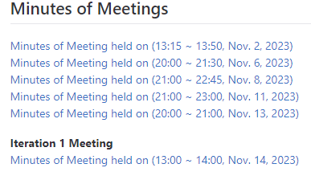
XP Programming in Iteration 1
Assigned priorities and estimated units with planning game by each pair (breakdown user stories into tasks)
Set proper conventions for developing (proper use of codelines and branching)
Branch naming, commit, merge request, etc
Held frequent meetings for iteration 1 period (6 meetings)
Gave continuous feedbacks for every meeting
Notes:
During Iteration 1, we held a total of 6 meetings.
We set proper conventions such as branch naming rules and commit messages to prepare for XP programming starting from Iteration 2.

Slide 9
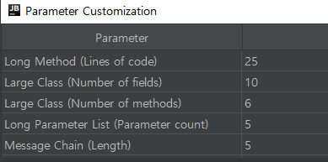
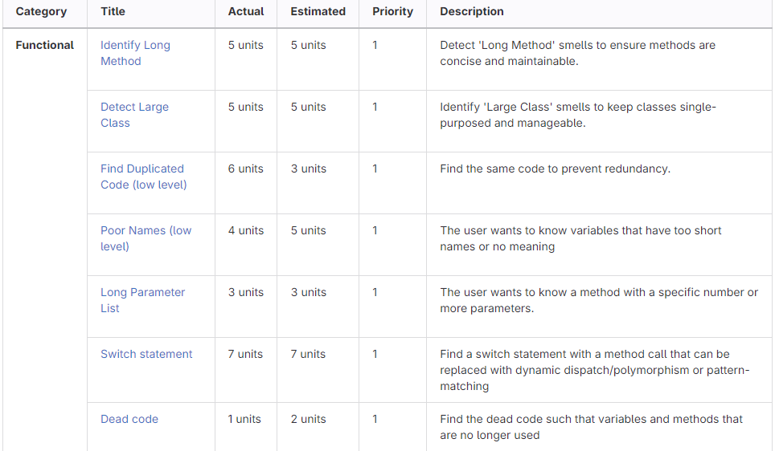
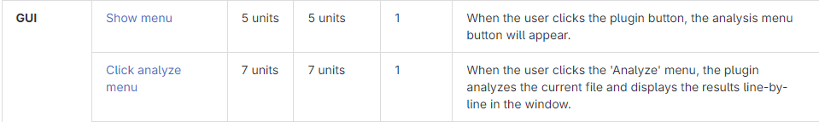
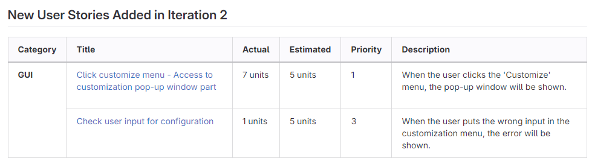
Iteration 2
Actual iteration 2 velocity = 51 units/iteration, Estimated velocity = 52 units/iteration
Usually, priority 1 user stories are implemented in iteration 2.
7 user stories for code smell detection, 4 user stories for GUI
2 new user stories were added in iteration 2
Customization pop-up window, and checking user’s input
Notes:
From Iteration 2, we began the development of the plugin.
During Iteration 2, we carried out development for a total of 51 units, implementing the basic code smell detection logic and GUI, which were set as priority 1.

Slide 10
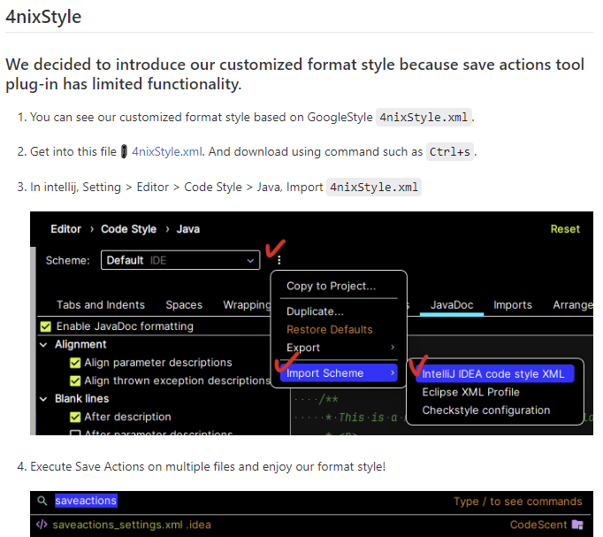
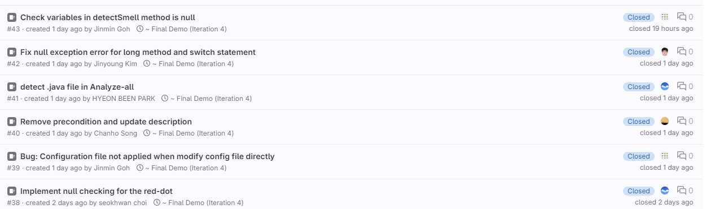



XP Programming in Iteration 2
Pair programming
Worked in each pair for dedicated user stories (breakdown user stories into tasks)
Each pair meets regularly to review the code they are developing and merge requests approved between pairs
Code formatter (coding standards)
Used “Save Actions Tool” plug-in for maintaining consistency of code format structure
Test driven development
Setup initial test structure first (test fails), write code, test pass, refactor
Continuous feedback and communication, continuous integration
Held 5 meetings for iteration 2, merge frequently
Refactor duplicated utilities to utils directory (LoadPsi.java)
Make “issues” when developing for tracking milestone plans
Notes:
We regularly held meetings and shared feedback on each other's work.
From this point, we used the Save Actions Tool to maintain the consistency of code format structure.
Each pair was assigned user stories, and we proceeded with the work through pair programming
We also created issues to keep the entire team know about the current development status.
As the framework of XP programming was established, we carried out it until Iterations 3 and 4.

Slide 11
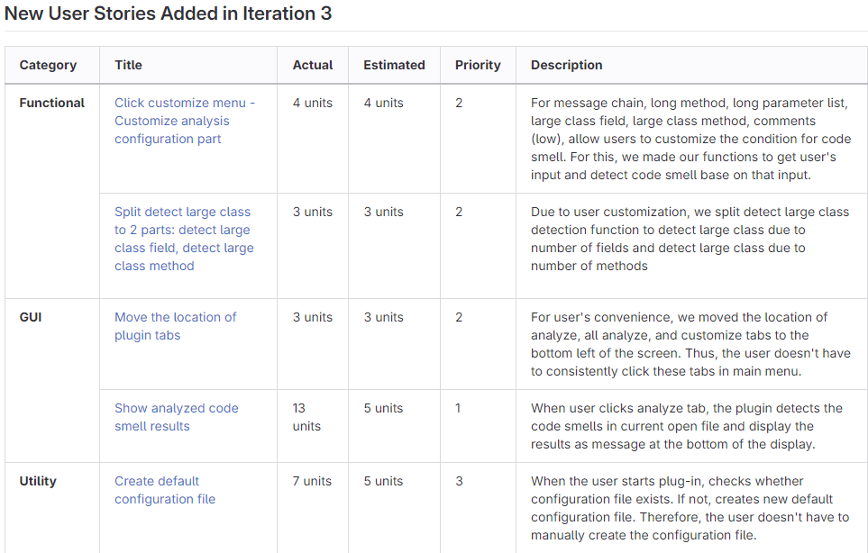
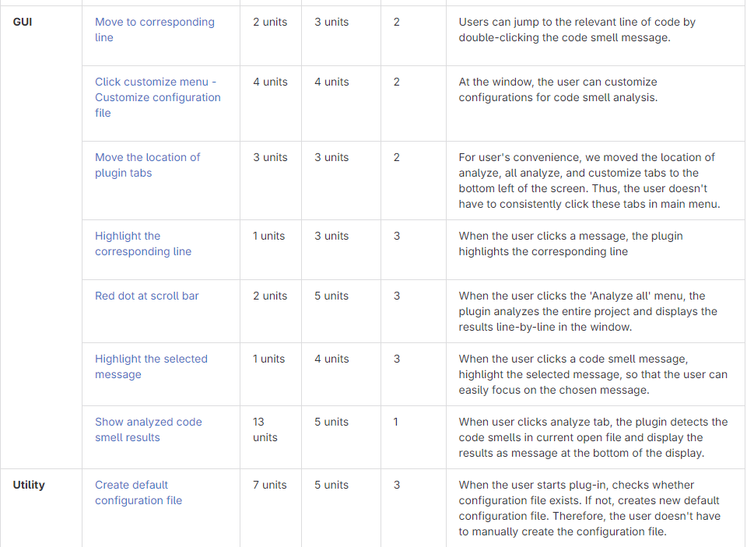
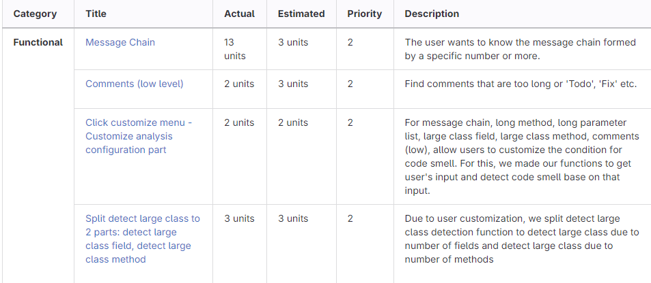
Iteration 3
Actual iteration 2 velocity = 53 units/iteration, Estimated velocity = 43 units/iteration
Usually, priority 2 user stories are implemented in iteration 3.
4 user stories for code smell detection, 7 user stories for GUI, 1 user story for utility
5 new user stories were added in iteration 3
Large user stories (Analyze and Analyze All buttons) were developed by splitting them into small units
Notes:
In Iteration 3, we aimed to maintain the pace of Iteration 2.
We divided too large user stories into smaller units and added new user stories for development.
As a result, we carried out development for a total of 53 units in Iteration 3, implementing additional code smell detection logic and GUI, which were set as priority 2.

Slide 12
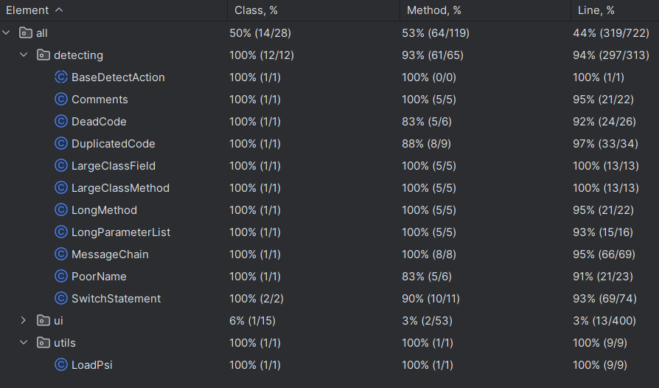
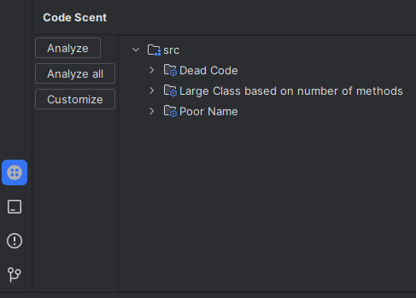
Iteration 3
Improve automatic test coverage by adding more test data
Implement new function ( Message chain, comments, duplicated code, switch statement)
Improve UI (tree structure based on the code smell type)
Notes:
One of the significant achievements of Iteration 3 was improving automatic test coverage by adding more test data.
We also improved the UI based on a tree structure according to the type of code smell.
I will show more details in our demo.

Slide 13
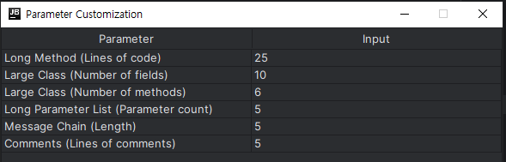
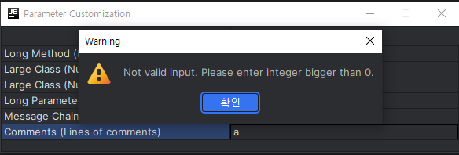
Iteration 3
Implementation of user customization part
Receives user input and detects code smells based on it
It works based on the properties file
Implementation of exception handling for incorrect input
Notes:
Additionally, we completed the user customization part.
There are parameters for detecting code smells based on the data entered by users.
If there is a wrong input, a warning message will be displayed.

Slide 14
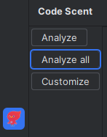
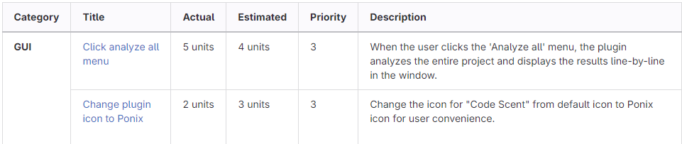
Iteration 4
Actual iteration 4 velocity = 7 units/iteration, Estimated velocity = 7 units/iteration
Priority 3 user story is implemented in iteration 4.
1 new user story is added
More focused on refactoring and quality of the project (Finding and fixing bugs, write clean comments)
Notes:
In Iteration 4, we focused more on refactoring and improving the quality of the project.
While the two pairs focused on finding and fixing bugs and writing clean comments, the other pair implemented 'analyze all', which was set as priority 3.

Slide 15
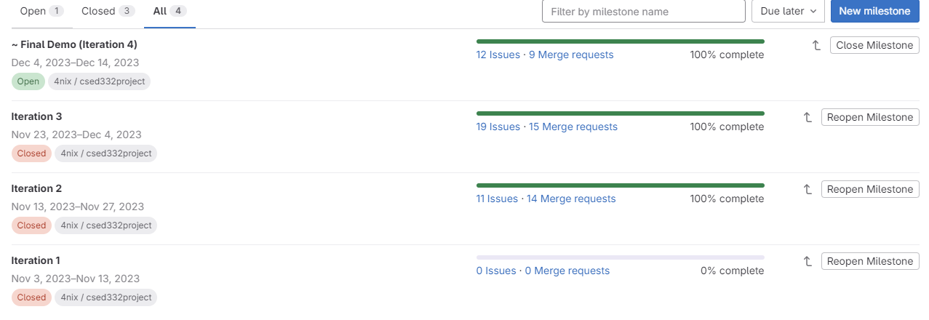
Result
Total number of user stories developed in iteration 1: 24 user stories
Total number of user stories actually implemented: 25 user stories (9 new user stories added)
Total units: 111 units
Total number of user stories not implemented from iteration 1: 8 user stories for functionality
Notes:
We initially set 24 user stories and later added 9.
Out of 33 user stories, we successfully implemented 25 user stories, and did not implement 8 user stories related to functionality.
As a result, we have successfully implemented more user stories than we initially aimed for.

Slide 16
Project Demo
03
Demonstrating our “Code Scent”
Notes:
Now, I will show up with the demo.

