Slide 1


Alert

Slide 2

#ID

Slide 3




Slide 4


isDate?
isDate?

Slide 5

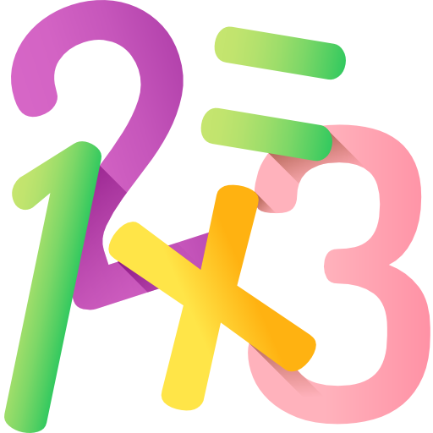
PICK!
isNumber?

Slide 6

reduce

Slide 7

Node JS
Express generator

Slide 8

import
vs
require

