Slide 1
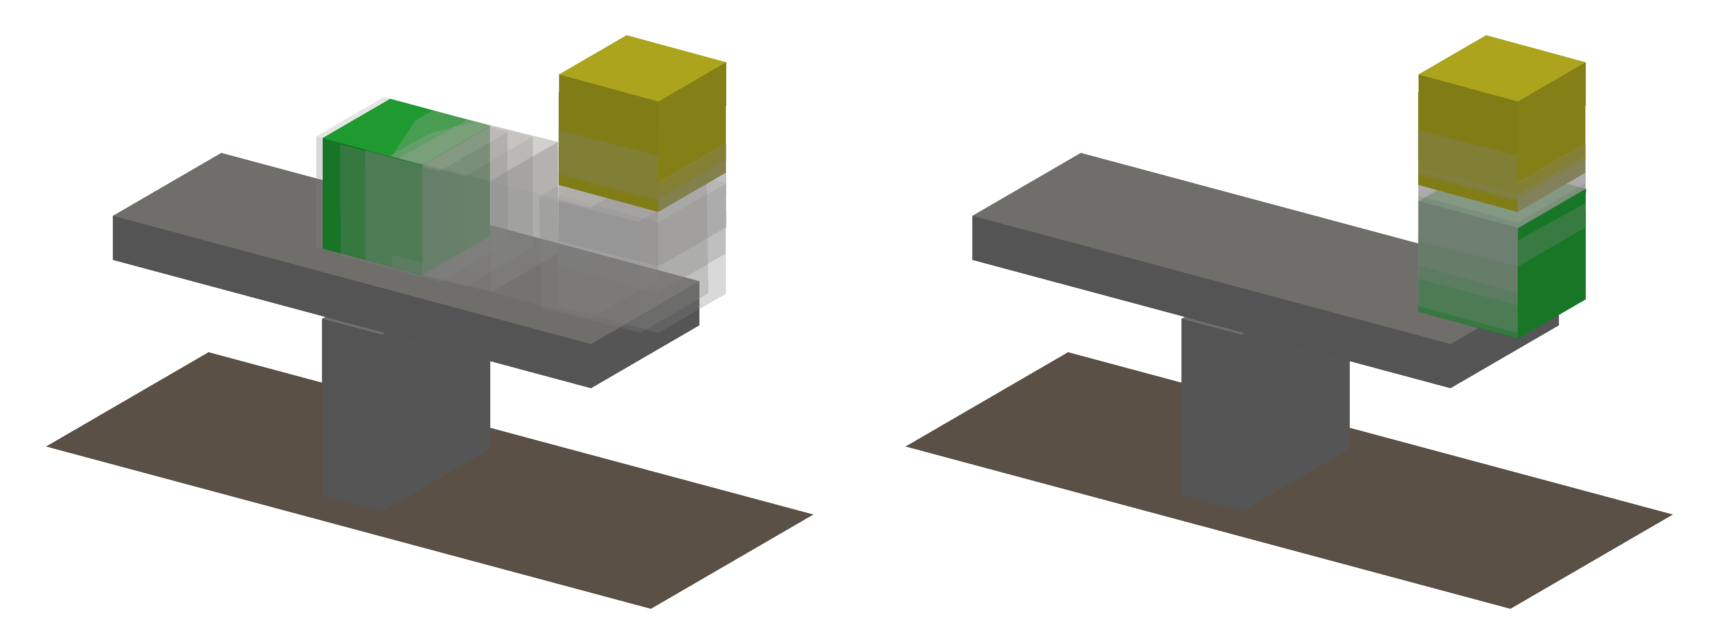


Notes:
Source: benchmarks/posegen-seesaw/seesaw.json and seesaw_trajectories.png. Left: structure-wide equilibrium; right: candidate-only equilibrium. Yellow: initial pose; green: optimized pose; gray: intermediate iterates. Original pixels retained. Labels compiled with pdflatex and dvisvgm; their editable TeX sources are stored in Alternative Text and adjacent .tex files.

Slide 2
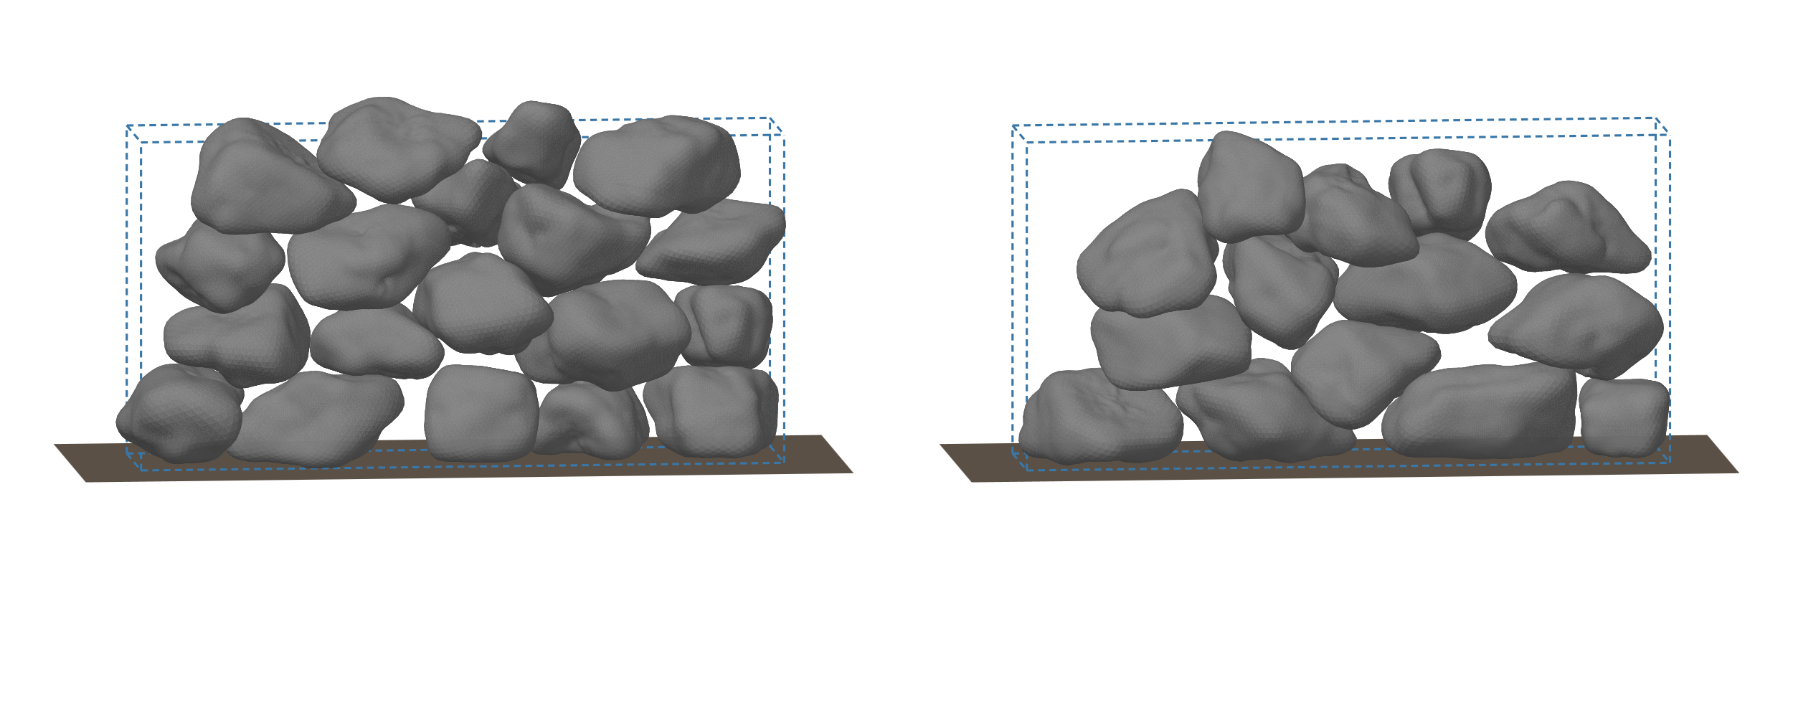


Notes:
Source: benchmarks/wall-comparison/mcts_greedy.svg and numerical_results.json. Seed 6, same 49-stone inventory. MCTS: 19 stones, 43.9542% target filling; greedy: 14 stones, 36.0981%. This is a single recorded comparison, not an aggregate or equal-time benchmark. Dashed blue outlines show the target. Original vector geometry preserved; replacement labels compiled from LaTeX.

Slide 3
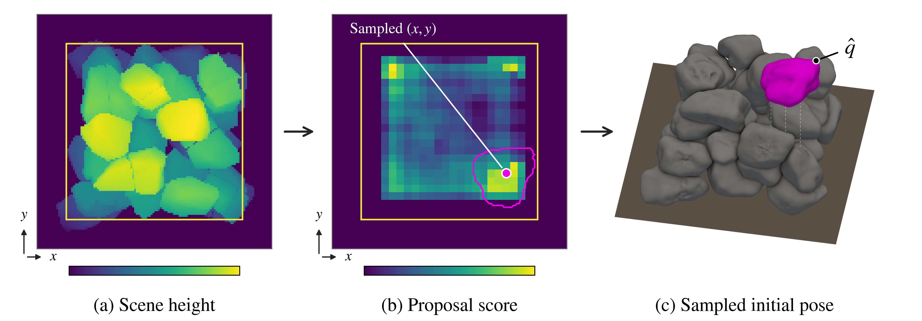
Notes:
Sampling source: project figures/initial-pose-sampling/proposal_pipeline.pdf. Panel labels are separate native IguanaTeX vector displays, regenerated with the installed IguanaTex_v1_58 add-in. Use Edit LaTeX display to change them. The final EPS preserves original PDF geometry instead of the raster preview used here.

