Slide 1
LAB MEETING · 2026.08.21
Robotics Agent Project
SEOKMIN LEE
01

Slide 2
AGENDA
Today’s Discussion
01
Our Research Roadmap
02
Prior Work: CaP-X & VoLo-Agent
03
Code Structure: CaP-X & VoLo-Agent
04
Roadmap Step 1: What Problem Should We Focus On?
05
Until Next Meeting: Benchmark Study & Selection
02

Slide 3
RESEARCH ROADMAP
From Problem Definition to Real-World Deployment
Define the target capability first, then build the evaluation and model around it.
01
02
03
04
05
Problem Definition
Benchmark Selection
Baseline & Limitation Analysis
New Model & SOTA
Real-World Deployment
Long-horizon specialist vs. generalist
Choose benchmarks that expose the target capability
Run prior models and identify failure modes
Design from limitations and push performance
Validate the final system on a real robot
Key decision now → Long-horizon specialized model or broadly stronger generalist?
03

Slide 4
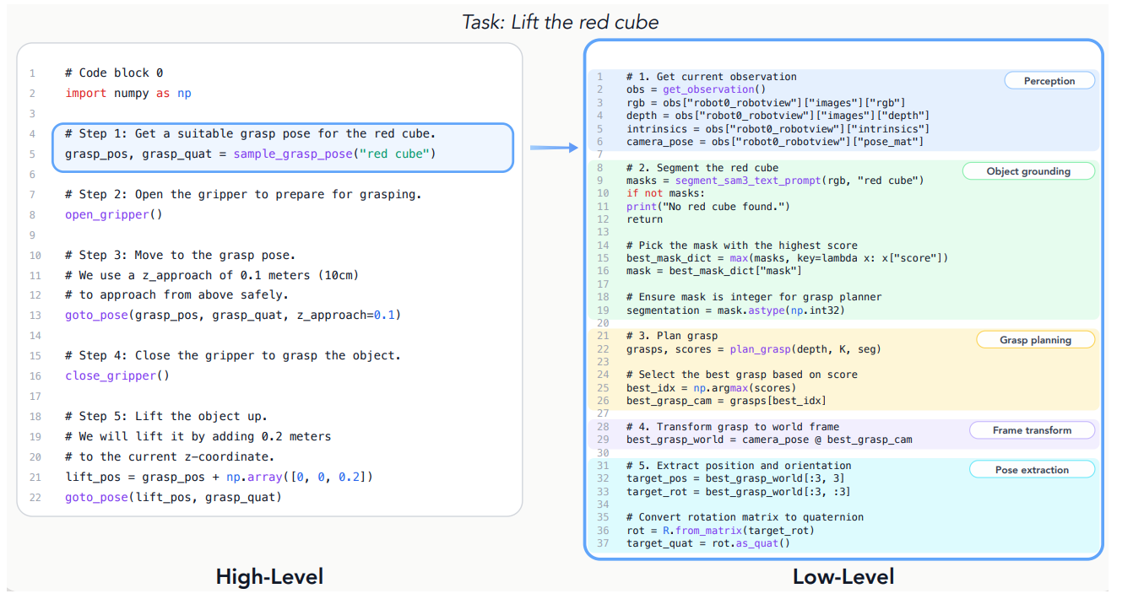
PRIOR WORK · ROBOTICS AGENT
CaP-X: Code as Policy
Core Idea
Task → Generate Code → Execute in Environment
The generated program itself acts as the robot policy.
Policy = Composition of Primitive Functions
Low-Level
segmentation motion / perception basic robot functions
High-Level
e.g. sample_grasp_pose() composition of multiple low-level functions
Design choice: Which primitives should the agent be given?
Example: a high-level grasp primitive internally expands into perception and grasp-planning primitives.
04

Slide 5
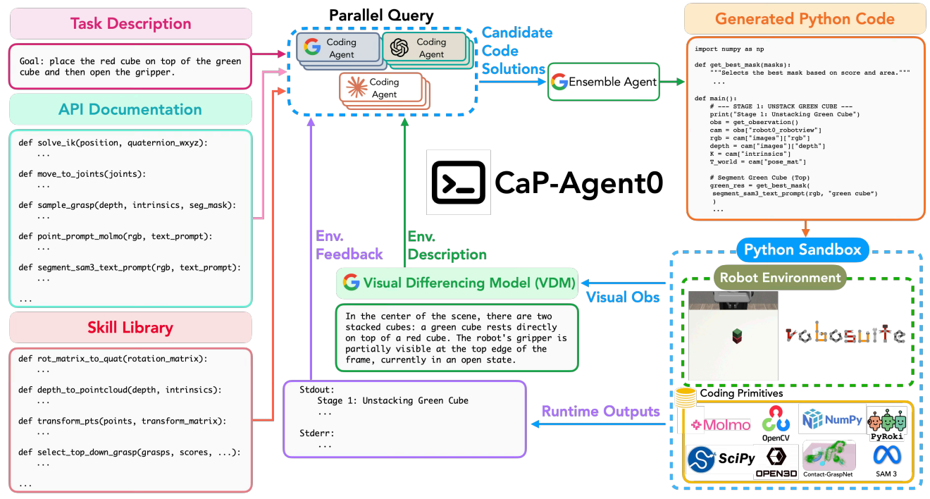
PRIOR WORK · CaP-X
CaP-Agent0: Iterative Code Generation & Reflection
01
Generate
Task description + API / skill documentation → Coding agents generate a Python policy
02
Execute
Run the generated Python code in the environment → One program attempts the entire episode
03
Reflect & Retry
If failed, feed execution feedback back to the agent → Generate a new program and retry the task
Failure feedback = stdout / stderr + Visual Difference Model
VLM compares images before vs. after the episode and describes what changed.
05

Slide 6
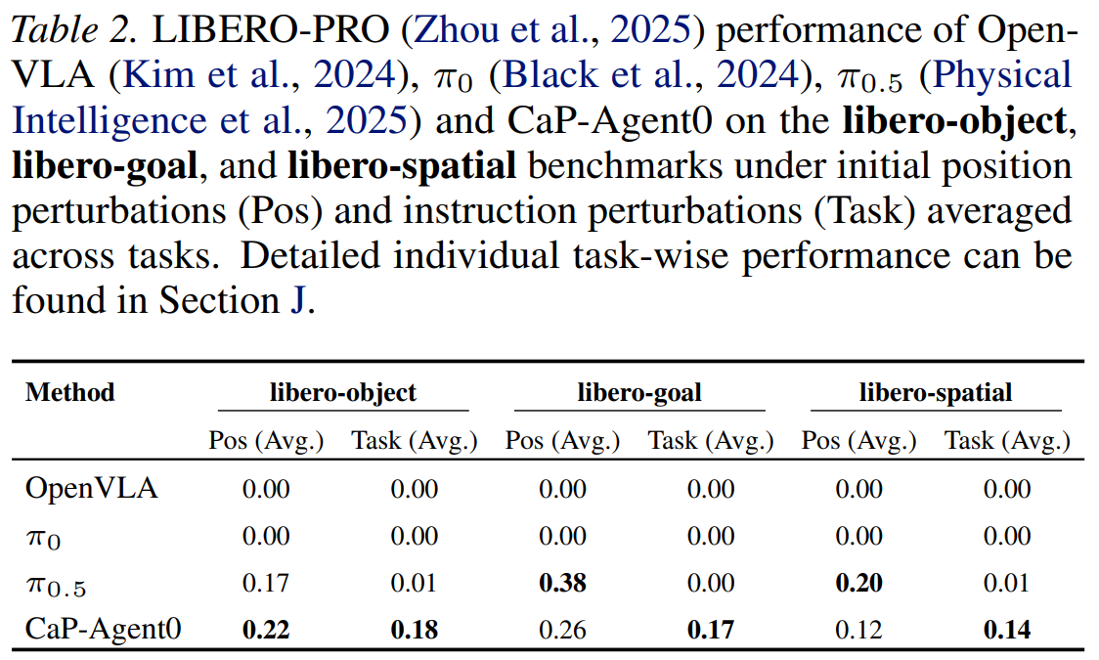
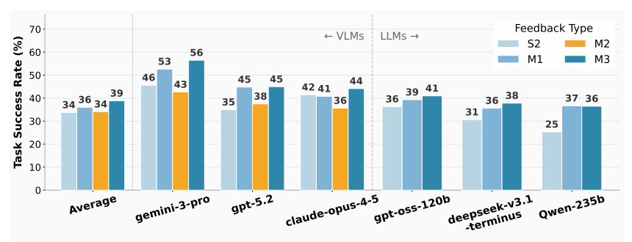
PRIOR WORK · CaP-X
CaP-Agent0: Experimental Results
Agentic feedback improves performance — and CaP-Agent0 is competitive with / stronger than VLA baselines.
01
Ablation Study
02
Comparison with VLA Baselines
Adding richer feedback + multi-turn refinement consistently improves success.
CaP-Agent0 outperforms VLA baselines on most LIBERO-PRO perturbation settings.
06

Slide 7
PRIOR WORK · ROBOTICS AGENT
VoLo-Agent: VLM-Orchestrated Robot Control
Task
Planner VLM
Planning + Monitoring + Re-planning
01
Plan
Planner VLM decomposes the task into an ordered list of subtasks.
[ Subtask 1 , Subtask 2 , Subtask 3 , ... ]
02
Execute
Current subtask is executed with VLA by default; classical control is available as fallback.
VLA
default
Current Subtask: 1
Classical
fallback
03
Monitor
Every ~10 VLA steps, the same Planner VLM outputs Continue / Done / Error.
Planner VLM
Monitor every ~10 VLA steps
When ERROR is detected
① Fall back to classical control
② Re-plan → execute new first subtask
CONTINUE
keep Subtask 1
DONE
→ Subtask 2
ERROR
fallback / re-plan
ERROR + Re-plan → [ New Subtask 1, New Subtask 2, ... ] → execute New Subtask 1
07

Slide 8
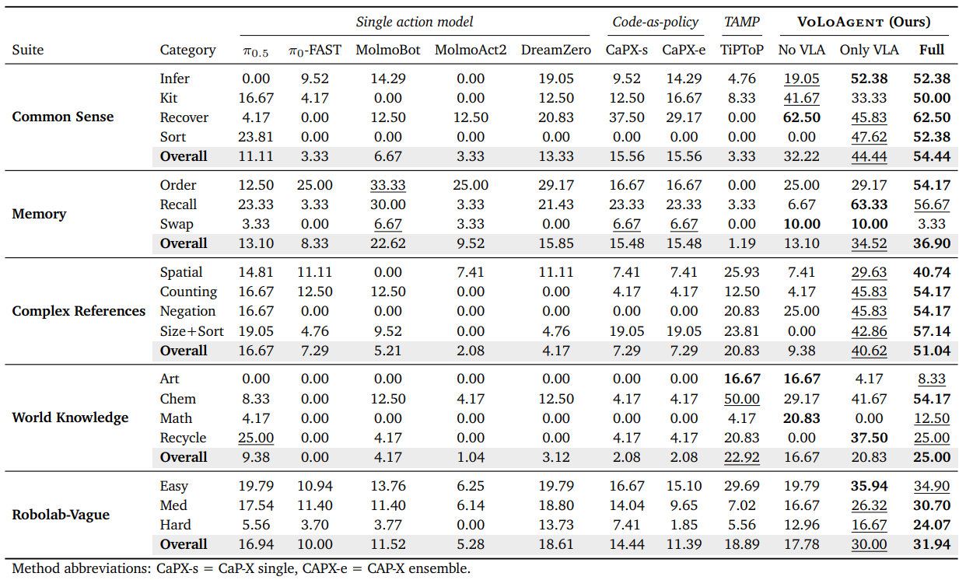
PRIOR WORK · VoLo-Agent
VoLo-Agent: Experimental Results
On their custom benchmark, VoLo-Agent substantially outperforms CaP-X.
08

Slide 9
PRIOR WORK · COMPARISON
CaP-X vs. VoLo-Agent
The key difference is when the agent observes failure and modifies its behavior.
CaP-X
Episode-level Reflection
VoLo-Agent
Intra-episode Reflection
1
Execute the entire episode first
1
Execute the current subtask
2
Observe the result after execution
2
Continuously monitor within the episode
3
Reflect / modify the code
3
Detect Done / Error during execution
4
Retry with a new episode
4
Modify behavior without waiting for episode end
CaP-X: reflect after an episode vs. VoLo-Agent: monitor & reflect inside an episode
09

Slide 10
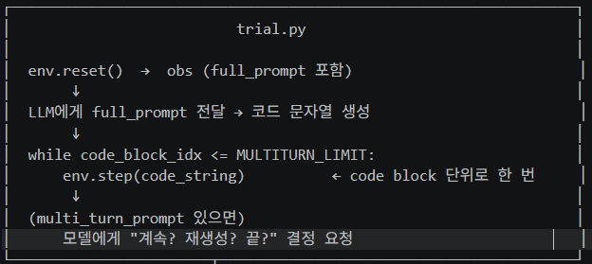
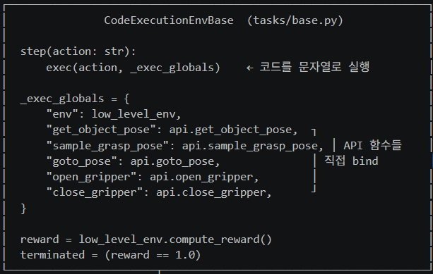
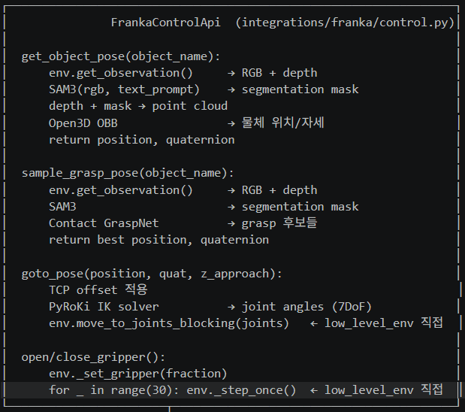
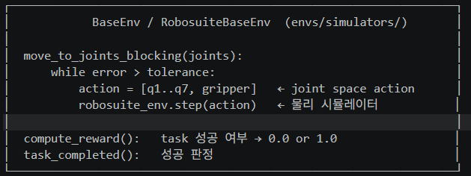
CODE STRUCTURE · CaP-X
CaP-X Code Execution Flow
Code Structure
01
trial.py
env.step(code_string)
Task를 LLM agent에게 넣어 Python code를 만들고, env.step(code_string)을 실행
02
tasks/base.py
생성된 code를 API 함수들과 bind한 뒤, exec(code_string, api functions) 실행
exec() 내부에서 API 함수 호출
03
integrations/franka/control.py
API function들과 code가 실제 Python으로 실행되고, API 내부에서 최종적으로 env.step(joint action)이 호출됨
move_to_joints_blocking / _step_once
10

Slide 11
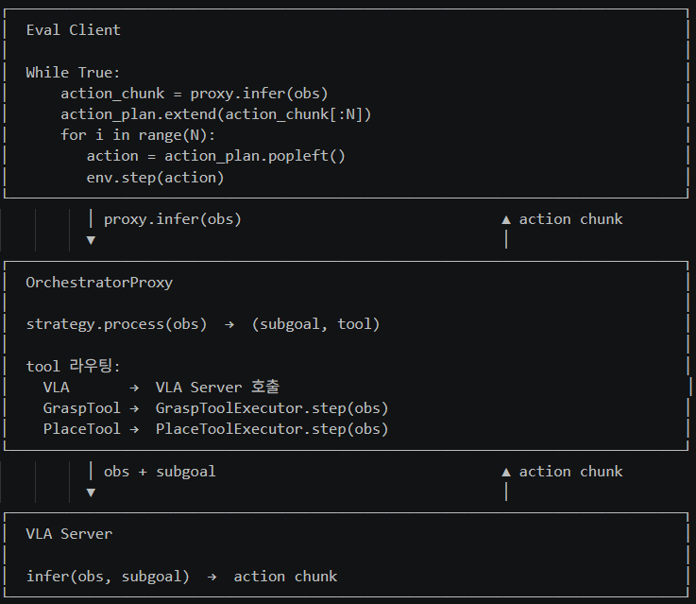
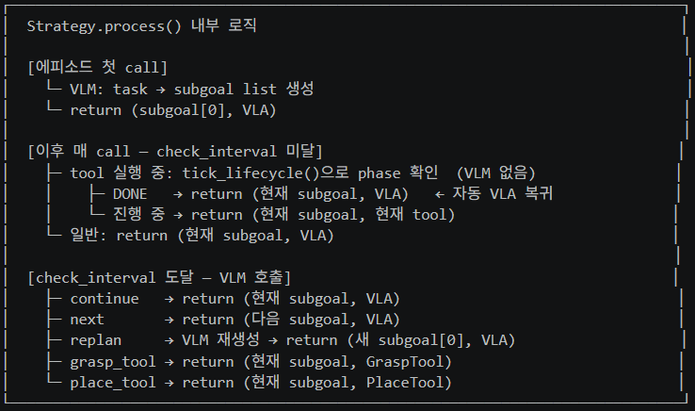
CODE STRUCTURE · VoLo-Agent
Overall Runtime Flow
VoLo-Agent Code Structure
How the system works
01
Core Components
이 시스템에는 크게 4개의 중요한 요소가 있어. Eval Client / OrchestratorProxy / Strategy.process() / VLA Server야
02
Eval Client
기본적으로 Eval Client는 env.step()을 통해서 환경을 rollout할 수 있어. Eval Client는 action을 달라고 Proxy에게 요청하고, Proxy에게 N개의 action chunk를 받아온 다음, 1 action씩 env.step()을 진행해서, N번 실행하고 나면, 다시 Proxy에게 요청하는 구조야
03
OrchestratorProxy
Proxy는 Strategy.process()에게 현재의 (subgoal, tool)을 물어봐서, 현재 써야할 tool에서 observation과 subgoal을 줘서 action을 뽑아서 eval client에게 줘. 여기서 vla tool을 쓰게 되면, vla server에게 요청을 보내서 action을 받아와.
Strategy.process() Internal Logic
04
Strategy.process()
strategy.process()는 에피소드의 첫 call에서는 VLM을 이용해서 subgoal planning을 한 다음에 (첫번째 subgoal, VLA)를 return해 그 다음부터는 계속 똑같이 (첫번째 subgoal, VLA) return하다가 그러다가 checkinterval이 되면 VLM을 이용해서 다음 subgoal로 넘어갈건지 tool로 fallback할건지 replan을 할건지를 결정해서 적절한 action을 취하고 알맞은 (subgoal, tool)을 return해 참고로 tool 실행의 완료는 strategy.process()내에서 VLM을 실행안하고 가볍게 tool에서 검사하는 로직이 있어. tool 실행이 완료되면 VLM실행 없이도 가볍게 (현재 subgoal, VLA)로 바뀌어서 나가게 되는거지
11

Slide 12
CODE STRUCTURE · ENVIRONMENT MANAGEMENT
Repository & Environment Management
Working Rules (for now)
CaP-X
01
Code only is replaceable
연구소 환경에는 전체 구조를 그대로 들고 가고, datasets / docker / checkpoints / assets 등은 유지. 코드 폴더만 GitHub를 이용해 갈아끼우는 방식.
cap-x_main/
├─ cap-x/ — CODE · replace via GitHub
├─ datasets/ — dataset assets
├─ docker/ — environment / images
├─ vlms/ — VLM-related assets
02
Do not change folder structure yet
환경설정이 완전히 끝나기 전까지는 폴더 / 디렉토리 구조를 수정하지 않기. 당분간 현재 구조를 그대로 유지.
VoLo-Agent
03
Leave a diff after modifications
파일을 수정했다면 git diff를 이용해 diff 파일을 만들어 놓고, 어떤 파일을 수정했는지 알려주기.
VoLo workspace/
├─ volo-main/ — CODE · replace via GitHub
├─ checkpoints/ — model checkpoints
├─ vlabench-assets/ — benchmark assets
├─ ... — other large / environment assets
04
Single source of truth
코드, 디렉토리 구조, 환경설정 등 필요한 내용은 모두 maincode/seokmins/add_env_settings.md 참고.
Principle: Keep the environment/assets fixed → swap only the code → record every change with git diff.
12

Slide 13
CURRENT STATUS · ENVIRONMENT SETUP
Current Code & Environment Setup
Home PC
Broad compatibility testing completed
Lab Environment
Migration & serving status
Immediately usable benchmarks
Code / Docker migration
CaP-X
Robosuite · LIBERO-PRO · BEHAVIOR-1K
CaP-X
NOT YET
Docker migration pending — tar file was unexpectedly corrupted.
VoLoAgent
LIBERO (all suites) · VLABench
VoLoAgent
READY
Migration completed; LIBERO run succeeded yesterday.
Test coverage
흰컴에서 가능한 많은 테스트를 진행. 위 benchmark들은 코드만 조금 수정하면 바로 실행 가능할 것으로 예상.
VLMs currently served in the lab
Docker
현재 확인 범위에서는 Docker 자체에는 큰 문제 없을 것으로 예상.
Qwen2.5-VL-3B-Instruct
InternVL2_5-38B
Run commands
실행 command는 seokmins/add_env_settings.md 참고.
Qwen2.5-VL-7B-Instruct
DeepSeek-VL2 (27B MoE)
Qwen2.5-VL-32B-Instruct
Phi-4-multimodal-instruct (14B)
Current VLM
현재는 Qwen2.5-VL-7B-Instruct만 지원.
InternVL2_5-8B
Home: benchmark compatibility largely verified | Lab: VoLo ready, CaP-X Docker migration remains
13

Slide 14
ROAD MAP · PROBLEM SETTING
What Problem Should We Focus On?
First decision: specialize in long-horizon manipulation, or target broad generalist improvement?
MY PICK
Long-Horizon Manipulation
Specialized strength
Generalist
Broad improvement
Be substantially better on long-horizon tasks while remaining comparable on other tasks.
Achieve meaningful gains across many different task types and capabilities.
Clear target failure modes across long execution sequences
Broader and potentially stronger final claim
Easier to isolate where current agents fail: planning, monitoring, recovery, memory
Requires improvements that transfer across heterogeneous tasks
Benchmark selection can directly emphasize long-horizon capability
Harder to identify one shared limitation that explains performance gaps
Current Direction: Long-Horizon Manipulation
Long-horizon tasks seem like a better starting point because the limitations of existing agents are relatively easier to expose and analyze.
14

Slide 15
NEXT STEP · BEFORE THE NEXT MEETING
Next Meeting
Study the benchmark landscape first → then decide together what we should evaluate on.
01
02
03
Benchmark Study
Benchmark Selection
Environment Setup
각 benchmark가 무엇을 측정하는지 공부
다음 미팅에서 같이 논의해서 최종 benchmark 선정
Benchmark가 정해지면 환경설정은 내가 책임지고 마무리
Long-horizon capability
Long-horizon 성능을 잘 보여줄 수 있는가?
Selected benchmarks ready to run
Task difficulty / diversity
기존 agent들의 limitation을 분석하기 좋은가?
CaP-X / VoLo-Agent execution environment
Generalization / robustness
실험 규모가 현실적으로 가능한가?
Reproducible commands & setup documentation
Suitability for our problem setting
Benchmark selection first. Environment setup comes immediately after.
Once we decide the benchmarks together, I will take responsibility for completing the environment setup.
15

Slide 16
THE END

