Slide 1
Robotics Agent Project
Meeting Presentation
August 28, 2026

Slide 2
Agenda
From benchmark exploration to a reflection-based agent idea
01
Benchmark Overview
Representative benchmarks for robotic manipulation agents
02
What We Learned from Benchmarks
Even with an oracle planner, task success remains low — is the VLA the bottleneck?
03
Naive Idea: Reflection with Working Memory
Can task-progress-aware working memory enable better reflection and recovery?
04
Benchmark Selection
Choose benchmarks that expose the bottleneck and evaluate the proposed idea

Slide 3
01
CHAPTER 01
Benchmark Overview
Exploring robotic manipulation benchmarks
from simple manipulation to long-horizon tasks
LIBERO · RoboCasa · VLABench · BEHAVIOR-1K · and more

Slide 4
Table-top
Markovian
MuJoCo-based
LIBERO
Five commonly used task suites
10 Tasks
10 Tasks
10 Tasks
LIBERO-SPATIAL
LIBERO-OBJECT
LIBERO-GOAL
Spatial relationships
Object understanding
Goal understanding
90 Tasks
10 Tasks
LIBERO-90
LIBERO-10
Broad task diversity
Longer & diverse tasks
LIBERO spans controlled generalization suites and broader multi-task manipulation suites.

Slide 5
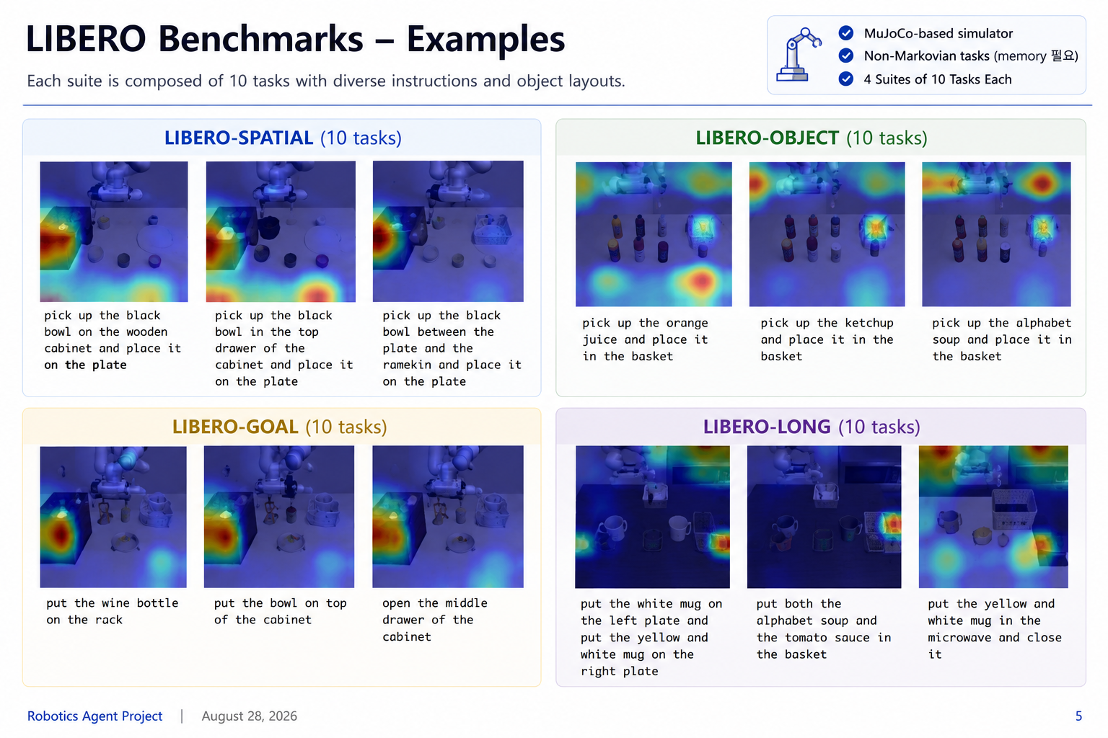
MuJoCo-based simulator
Markovian tasks
4 Suites of 10 Tasks Each

Slide 6
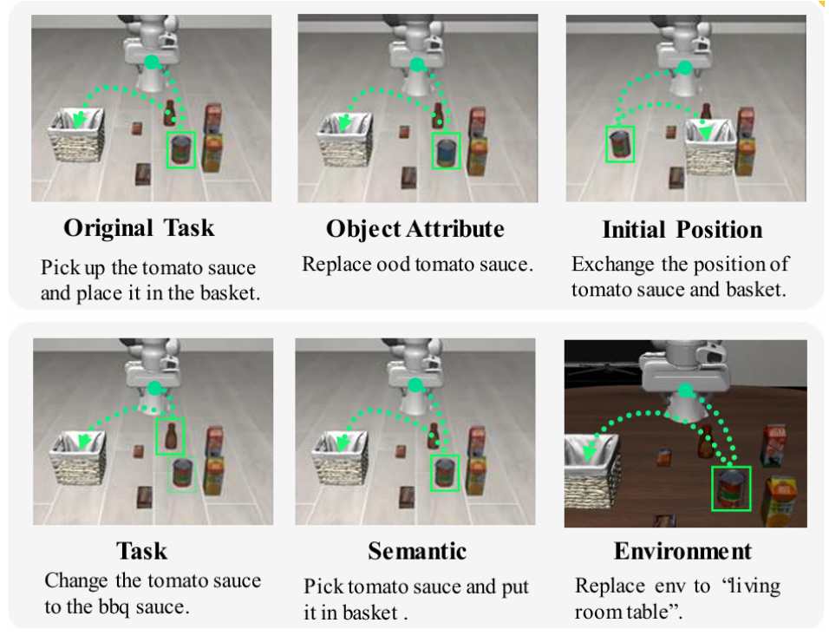
LIBERO-PRO
Table-top
Markovian
MuJoCo-based
5 perturbations
LIBERO + controlled perturbations for robustness evaluation
Perturbation Types
1
Object Attribute
replace target object attributes
2
Initial Position
swap or move object positions
3
Task
change the requested goal
4
Semantic
rephrase the instruction
5
Environment
change table / background scene
Goal: measure whether VLAs survive realistic distribution shifts.

Slide 7
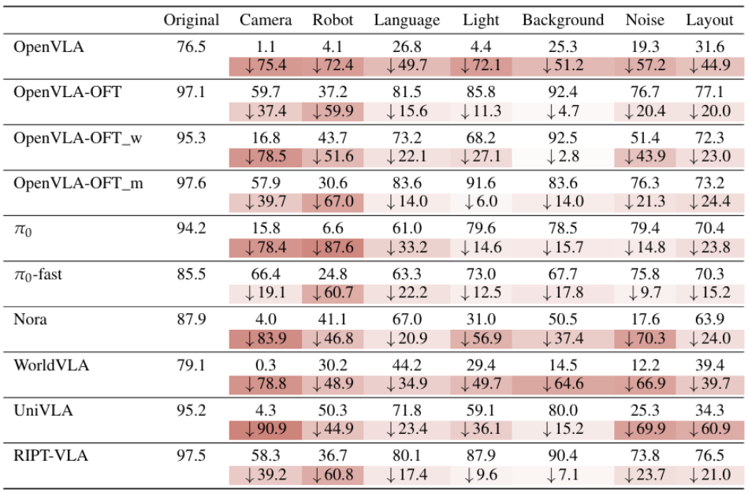
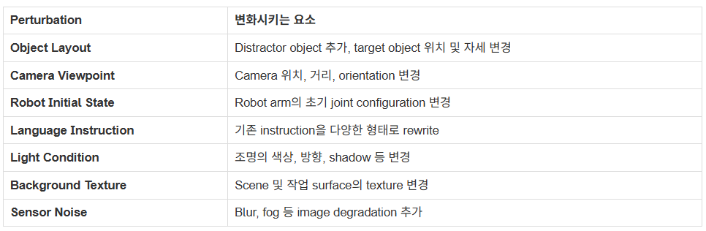
LIBERO-Plus
Table-top
Markovian
MuJoCo-based
LIBERO extension
7 perturbations
Robustness benchmark with diverse perturbation dimensions
Performance drops under perturbations
Perturbation dimensions
Key point: current VLAs are highly brittle to camera, robot state, layout, and noise shifts.
Robotics Agent Project | August 28, 2026

Slide 8
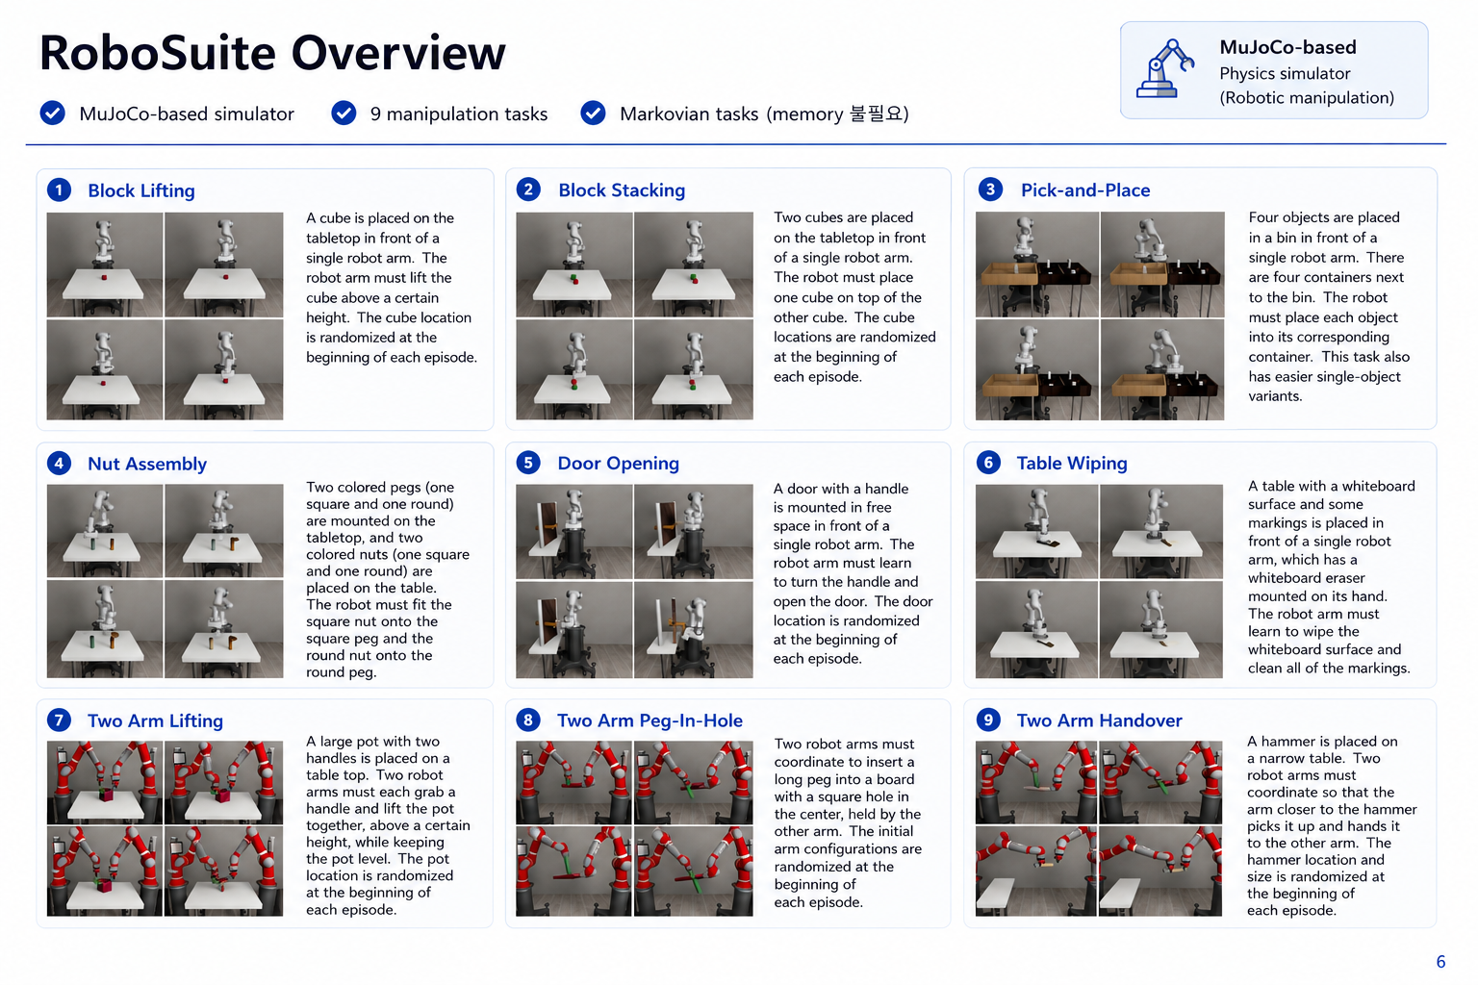

Slide 9
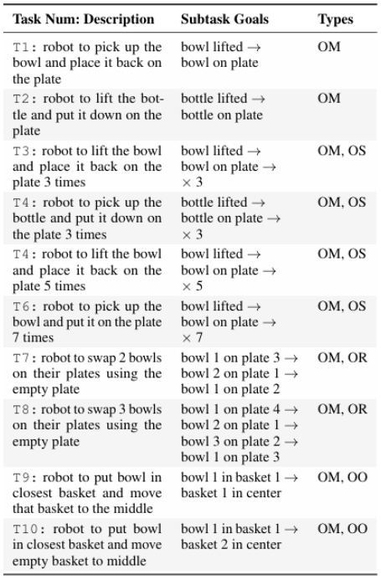
LIBERO-Mem
Table-top
MuJoCo-based
10 Tasks
Non-Markovian
Object-level memory benchmark built on LIBERO
Why memory is required
Current observation alone is intentionally ambiguous. The agent must remember which object was interacted with, how many times, where it moved, and whether it became occluded.
OM
Object Motion
OS
Object Sequence
track recent object state / motion
remember interaction count
OR
Object Relations
OO
Object Occlusion
track identity, order, relations
maintain hidden object state
Object Motion → Sequence → Relations → Occlusion
Robotics Agent Project | August 28, 2026

Slide 10
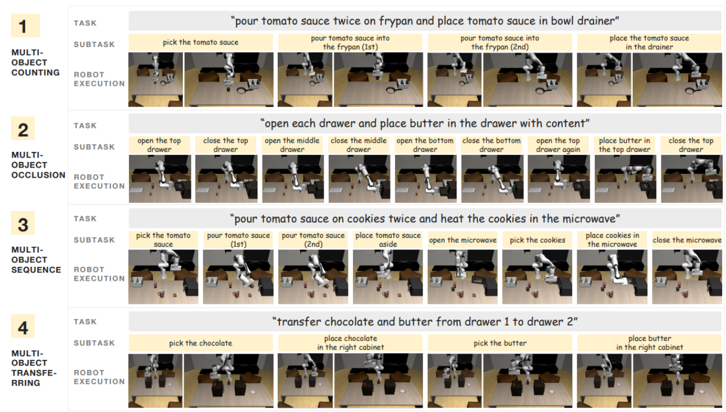
RoboMemArena
Table-top
Non-Markovian
Non-Markovian tabletop manipulation benchmark

Slide 11
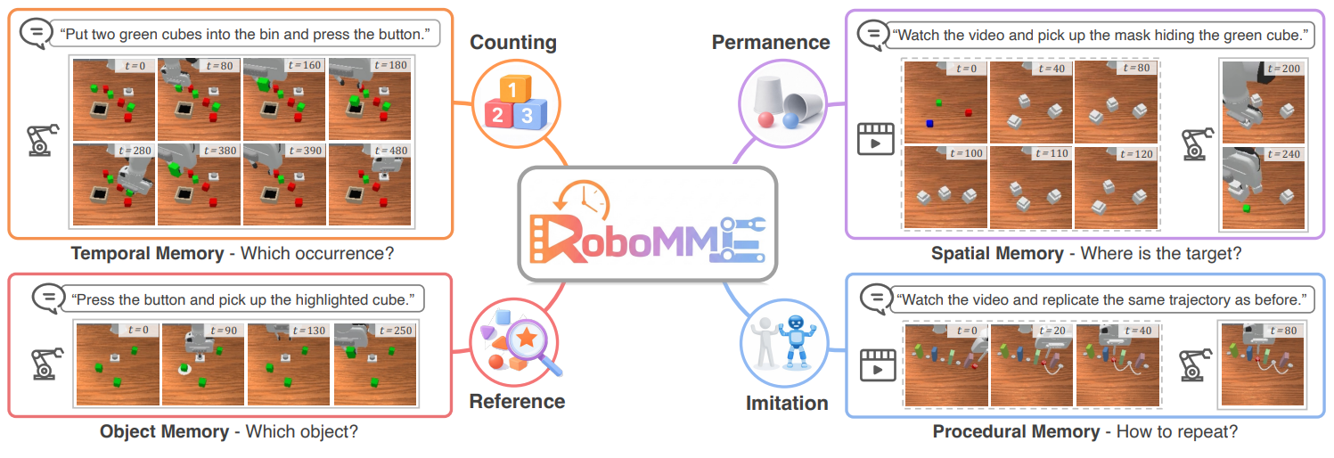
RoboMME
Non-Markovian
Table-top
Memory
Table-top memory benchmark for multi-step manipulation

Slide 12
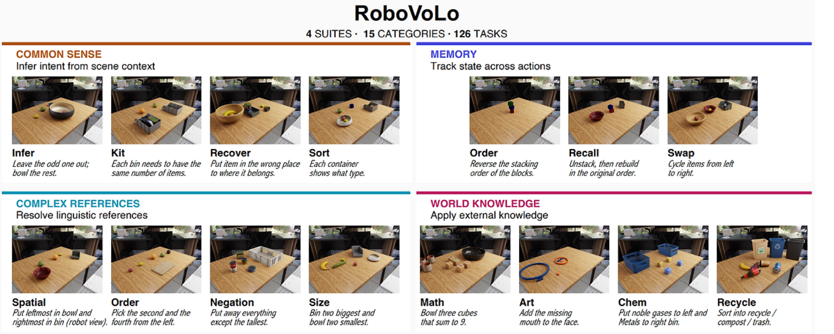
RoboVoLo
4 Suites
15 Categories
126 Tasks
Table-top
Table-top benchmark covering both Markovian and non-Markovian manipulation tasks
Task Character
Markovian Table-top Tasks
LIBERO-like tasks current observation is mostly enough
Non-Markovian Table-top Tasks
LIBERO-Mem-like tasks need state / interaction history
Useful bridge between simple LIBERO tasks and explicit memory benchmarks.
Robotics Agent Project | August 28, 2026

Slide 13
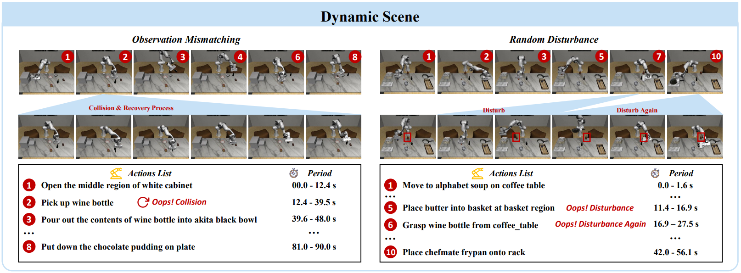
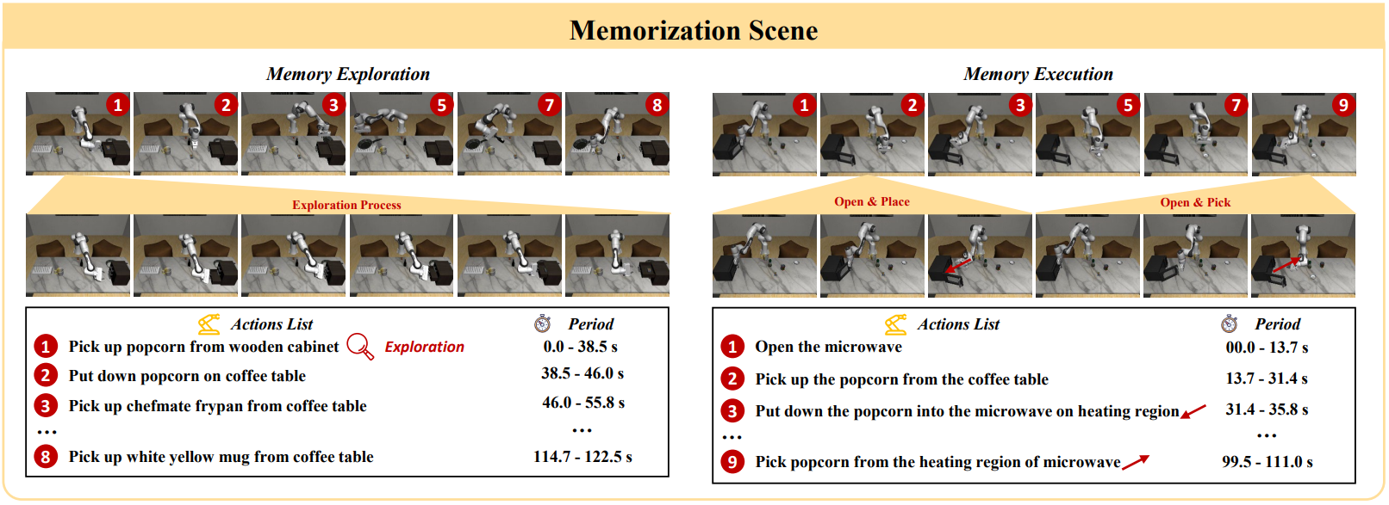
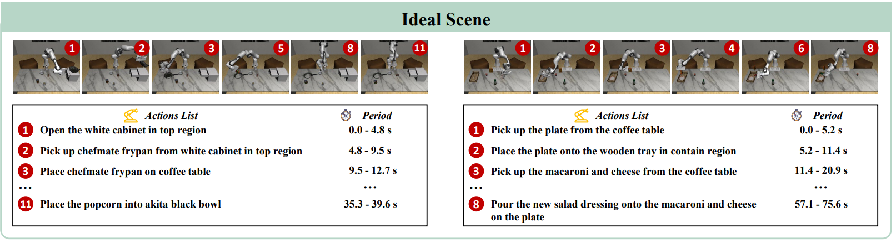
RoboCerebra
Table-top
Ideal: Markovian
Dynamic / Memorization: Non-Markovian
Non-Markovian
Non-Markovian
Markovian
Robotics Agent Project | August 28, 2026

Slide 14
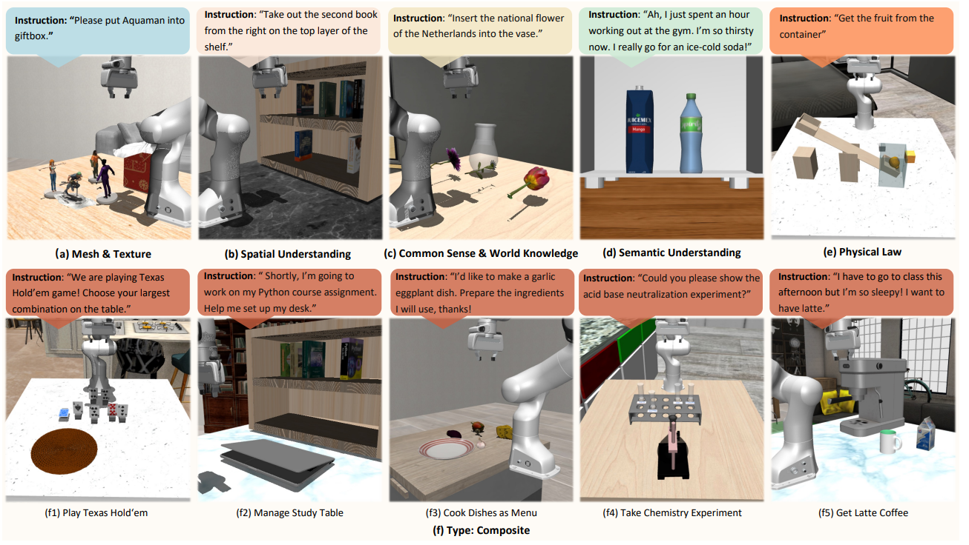
VLABench
Non table-top
Markovian (partially non-Markovian)
Benchmark covering diverse instructions, physical scenes, and reasoning-heavy tasks
Robotics Agent Project | August 28, 2026

Slide 15
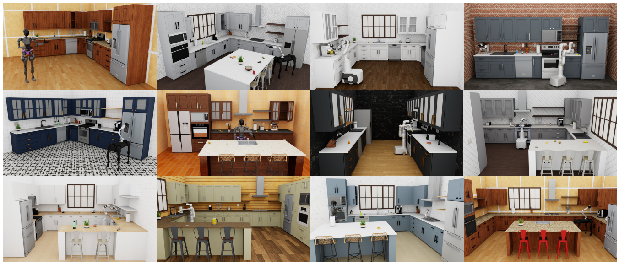
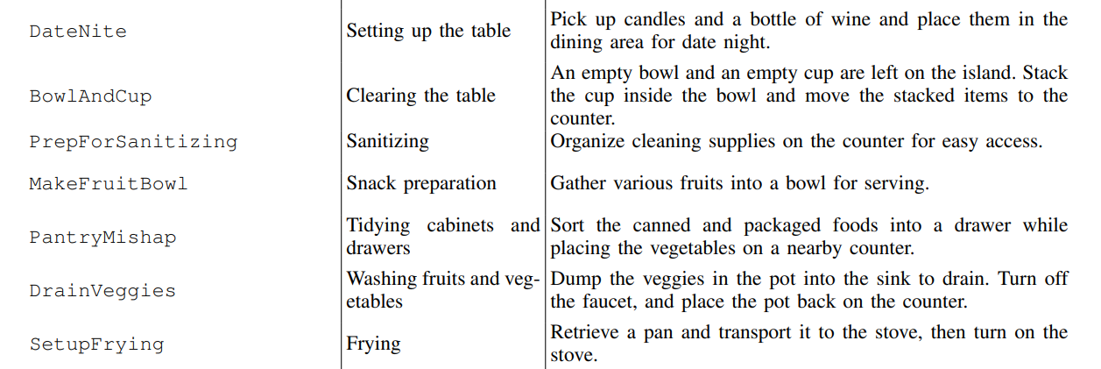
RoboCasa
MuJoCo-based
Kitchen scenes
Non table-top
Markovian (partially non-Markovian)
Kitchen manipulation benchmark with diverse layouts and household tasks
Diverse kitchen layouts
Representative tasks
Robotics Agent Project | August 28, 2026

Slide 16
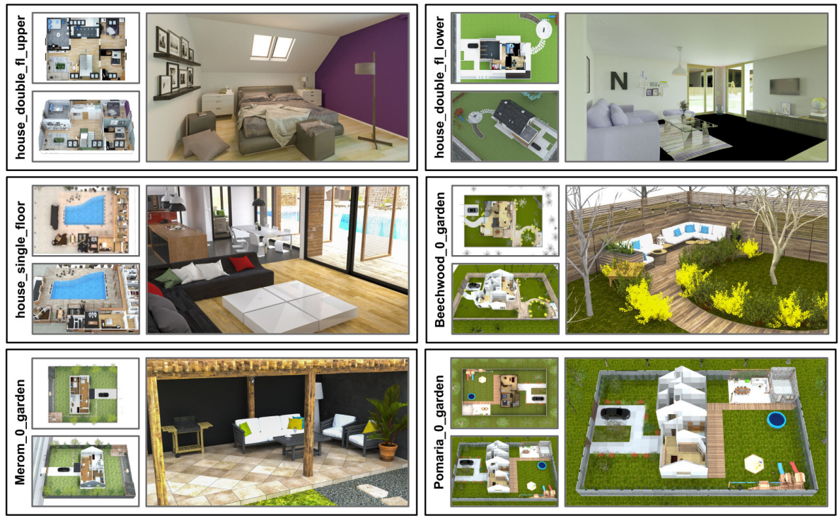
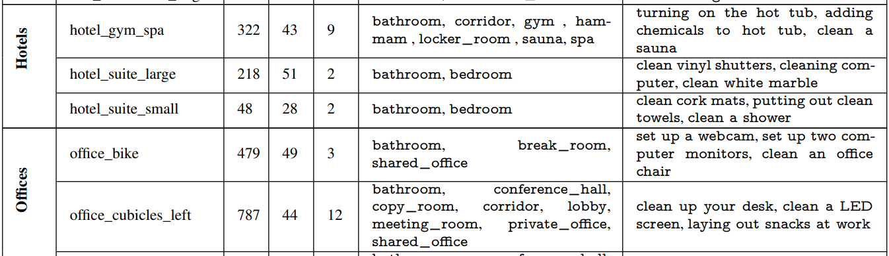
BEHAVIOR-1K
1,000 Tasks
Household scenes
Non table-top
Markovian (partially non-Markovian)
Large-scale household activity benchmark with diverse indoor and outdoor scenes
Representative environments
Scene / activity examples
Robotics Agent Project | August 28, 2026

Slide 17
What We Learned from Benchmarks
Oracle planner alone is not enough
Planner가 oracle이어도, 실제 task success는 여전히 낮은 경우가 많았다.
1
Planning은 맞아도 execution이 깨짐
2
따라서 bottleneck은 VLA일 가능성이 큼
3
단, RoboMME는 예외적으로 보임
subgoal 자체는 올바르지만 grasp, place, collision recovery, local adjustment에서 실패하는 경우가 많음
high-level reasoning보다 low-level action generation / state tracking / recovery 능력이 부족한 모습
RoboMME에서는 이 경향이 뚜렷하게 보이지 않았고, memory/reasoning 자체가 더 큰 요인일 수 있음
Takeaway: planning보다 VLA execution / recovery 능력을 올리는 방향이 더 직접적인 개선 포인트일 수 있다.

Slide 18
Naive Idea: Reflection with Memory
Goal: episode 간 reflection을 잘 하자
Episode 간 reflection을 잘 하기 위해서는, 실패 과정과 교훈을 둘 다 기억해야 한다.
Step 1
Step 2
Step 3
Intra-episode Memory
Reflection
Inter-episode Memory
한 episode 동안 무슨 일이 있었는지 기록 성공/실패뿐 아니라 왜 실패했는지 알기 위한 과정 정보 저장
저장된 과정을 바탕으로 실패 원인을 분석 다음 episode에서 쓸 수 있는 교훈을 추출
Reflection 결과를 저장 이후 episode에서 활용해 성공률을 높이는 방향으로 policy / strategy 보정
Intra-episode memory → Reflection → Inter-episode memory

Slide 19
Benchmark Selection
Practical path for testing reflection-based agents
Final target은 BEHAVIOR-1K처럼 복잡한 benchmark에서 잘하는 것.
1
Final Target: BEHAVIOR-1K
2
First Step: RoboVoLo
3
Baseline Quality Check
복잡한 household task에서 잘하면 가장 좋음. 하지만 environment와 task가 너무 복잡해서 reflection이 바로 잘 작동하기는 쉽지 않을 수 있음.
조금 더 쉬운 tabletop setting에서 시작. reflection으로 agent가 실제로 더 잘해지는지 먼저 확인하기 좋은 후보.
agent baseline이 reflection 자체가 불가능할 정도로 구리면, 먼저 baseline을 어느 정도 쓸 수 있는 수준까지 개선해야 함.
Selection: RoboVoLo로 reflection 효과를 먼저 검증하고, 이후 BEHAVIOR-1K로 확장.

Slide 20
The End
Thank you

